Slide 1
Period 7:
UNIT 2: CLOTHING
Lesson 1: Getting started
Listen and read
Teacher: Nguyen Thuy Dung

Slide 2
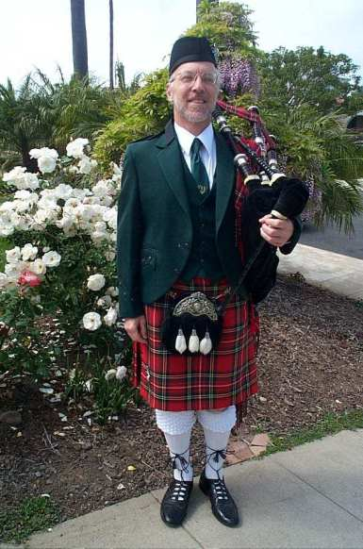
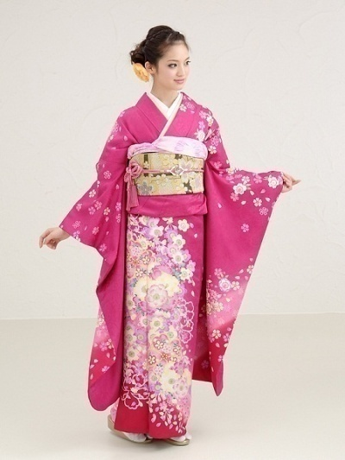
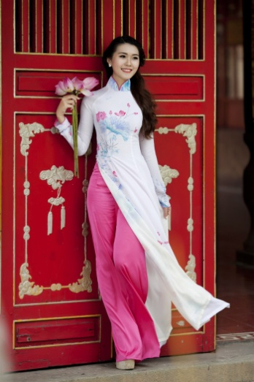
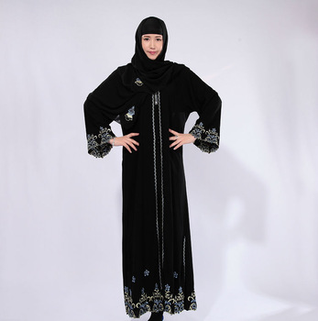
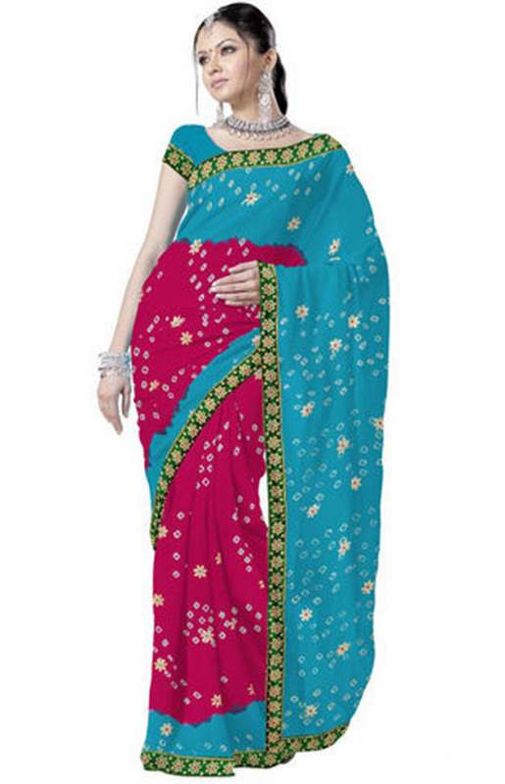
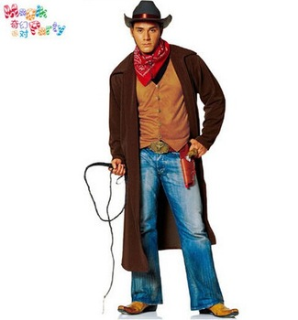
Where does she/ he from ?
a
b
c
d
e
f

Slide 3
27
25
23
30
29
28
26
24
22
21
20
19
18
17
16
15
14
13
12
11
10
09
08
07
06
05
04
03
02
01
00
Hết
giờ
Start

Slide 4
Where does she/ he from ?
c)Scotland
a)Japan
b)Viet Nam
e)The USA
f)Aribia
d) India

Slide 5
Getting started
Scotland/
kilt
a)Japan
/ kimono
b)Viet Nam/ Ao dai
The USA/
cowboy
Aribia/
veil
India/ sari

Slide 6
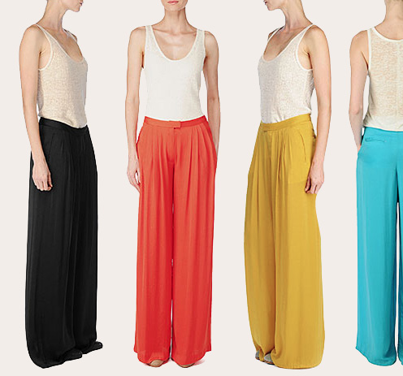
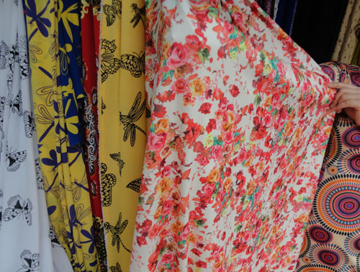
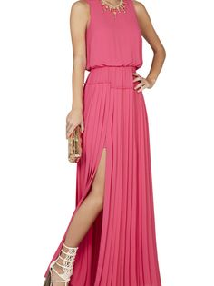
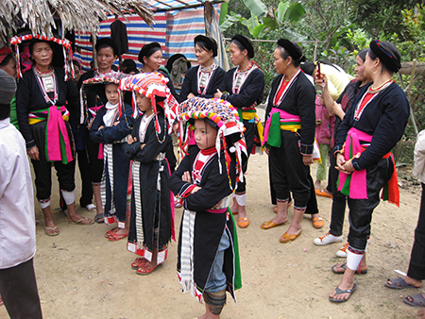
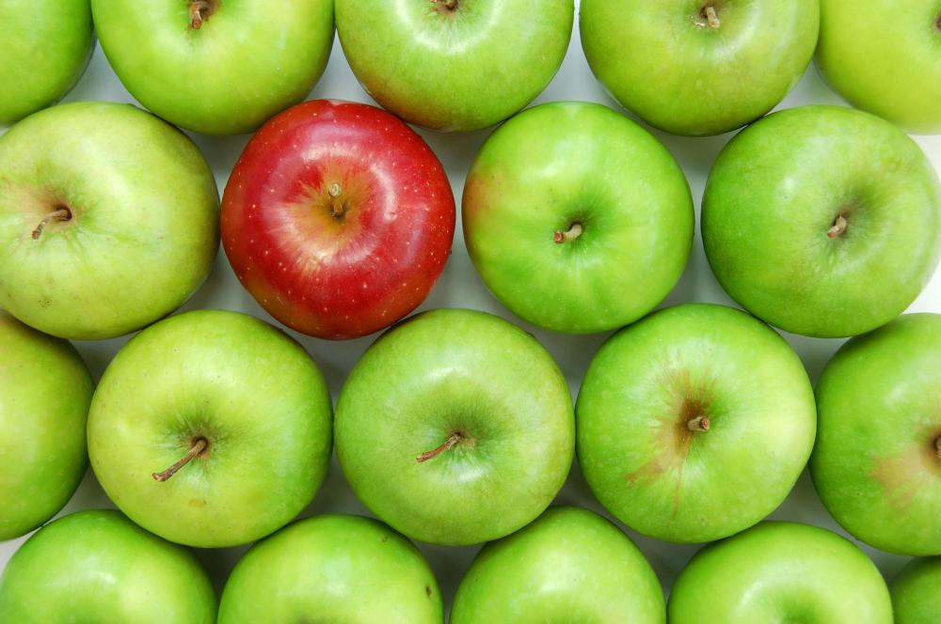
New words
- Poet (n):
Nhà thơ
- Poetry (n):
Thơ ca
- Silk tunic (n):
Vải lụa dài, rộng
- Loose pants (n):
Quần ống rộng
- Slit (v):
Xẻ, cắt
- Inspiration (n):
Cảm hứng
- Unique (adj):
Duy nhất, độc đáo
- Ethnic minority (n):
Dân tộc thiểu số

Slide 7
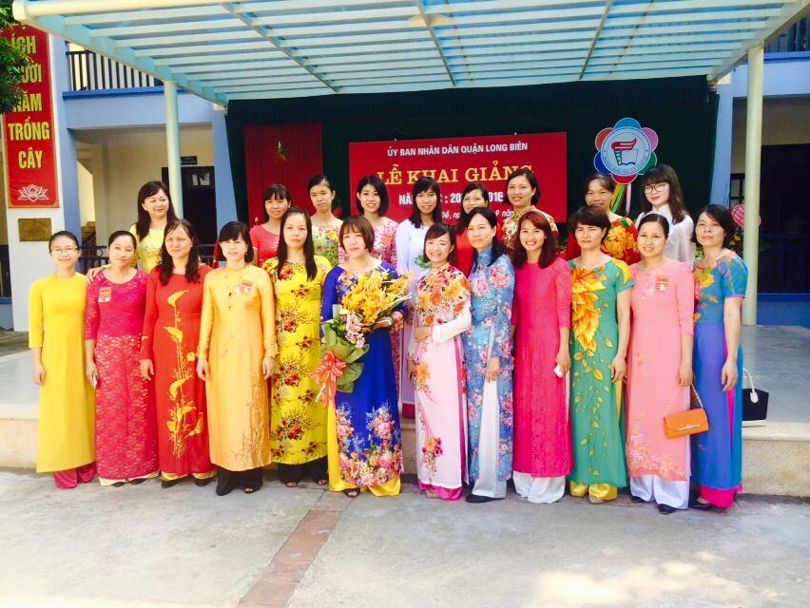

Slide 8
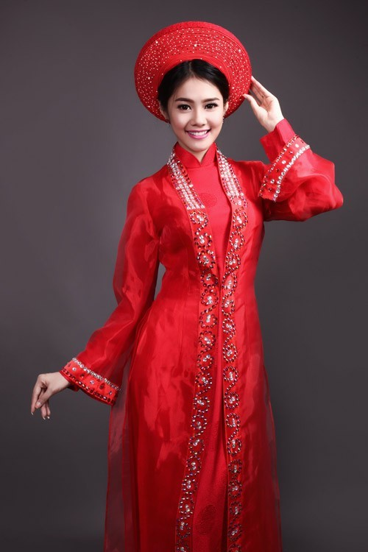
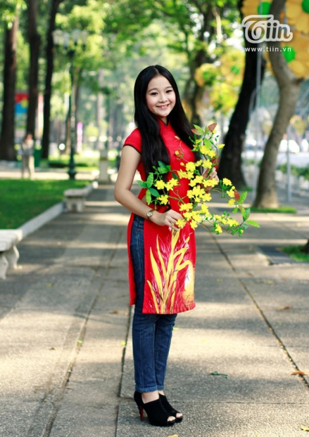
Listen and read
The 1st paragraph:
Introduction about tranditional Ao dai: material and design.
The 2nd paragraph:
Modernization of Ao dai

Slide 9
comprehension
A. Complete the sentences (p 14).
poems, novels and songs.
long silk tunic with slits up the sides worn over loose pants.
to wear modern clothing at work.
lines of poetry on it.
symbols such as suns, stars, crosses and stripes.

Slide 10
comprehension
B. Answer the question (p 14).
1.Traditionally, men and women used to wear Aodai.
2. Because it is more convenient.
3. They've printed lines of poetry on it or have added symbols such as suns , stars, crosses and stripes to the Aodai.

Slide 11
Review grammar
* THE PRESENT PERFECT TENSE
They have visited villages.
They have added these patterns to the Ao dai.
=> Form:
S + have/ has + V(3)+…..
* Note: already, just, yet, ever …..

Slide 12
CHOOSE A, B, C or D TO COMPLETE THE SENTENCES
1.Why ______ so much rice today ?
A. have you eaten
B. has you eaten
C. has you ate
D. have you ate
2.They ______ the meeting time.
A . haven't forgot
B. hasn't forgot
C. haven't forgotten
D. hasn't forgotten
3.Mum ________ to Spain before.
A. has never driven
B. has never drove
C. have never driven
D. have never drove
4.You _________ the train tickets.
A. haven't bought
B. hasn't bought
C. haven't buyed
D. hasn't buyed
5.She ________ a horse before.
A. have not ridden
B. has not ridden
C. have not rode
D. has not rode
6. _____ the letter ?
A. Has your dad wrote
B. Have your dad wrote
C. Have your dad written
D. Has your dad written
7. The woman ______ her book.
A. haven't read
B. hasn't readen
C. haven't readen
D. hasn't read
8. The movie _____ . Please be quiet !
A. have began
B. has began
C. has begun
D. have begun

Slide 13
HOMEWORK
Write vocabulary
Do exercise 1, 2 (WB/ p.15)
Prepare Unit 2: Read

