Slide 1
She’s
American.

Slide 2
He’s
British.

Slide 3
She’s
Polish.

Slide 4
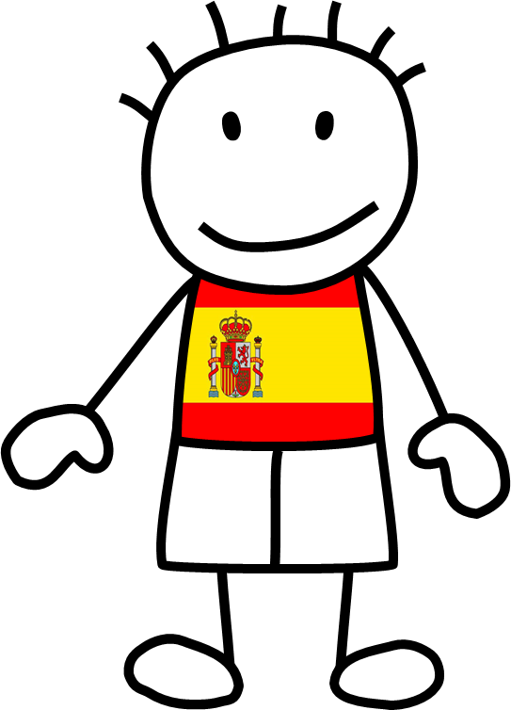
He’s
Spanish.

Slide 5
She’s
French.

Slide 6
He’s
German.

Slide 7
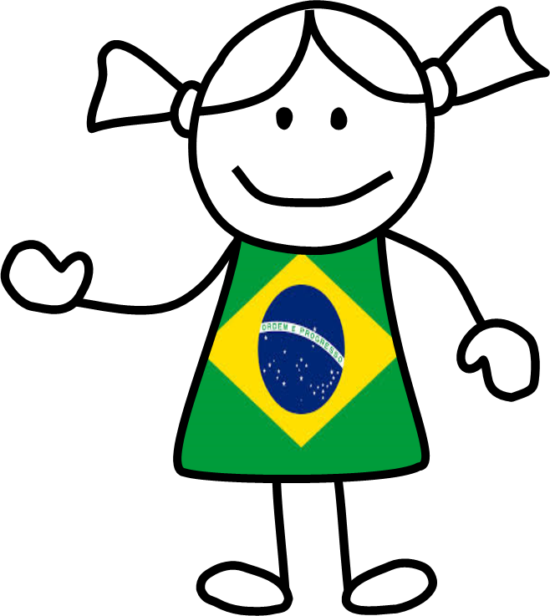
She’s
Brazilian.

Slide 8
He’s
Canadian.

Slide 9
She’s
Greek.

Slide 10
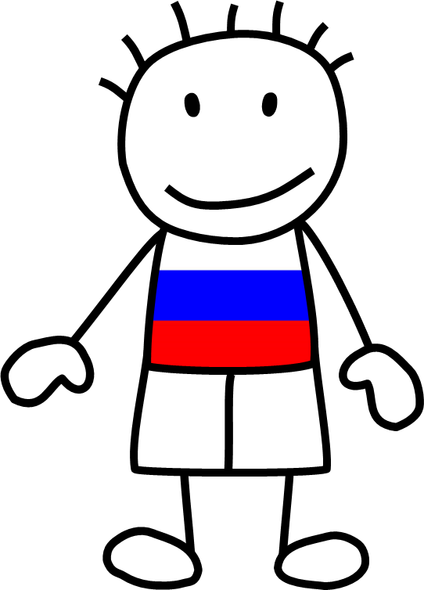
He’s
Russian.

Slide 11
She’s
Czech.

Slide 12
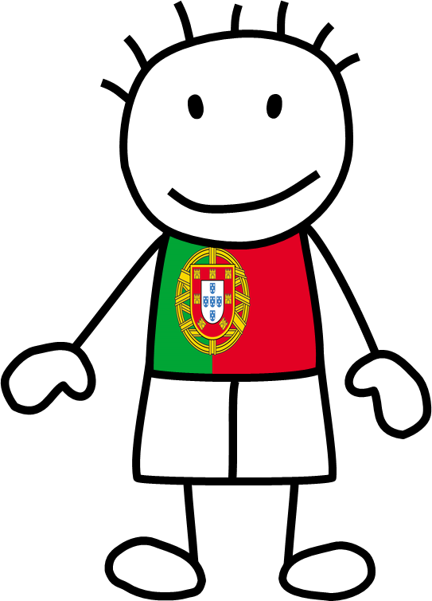
He’s
Portuguese.

Slide 13
She’s
Australian.

Slide 14
He’s
Italian.

Slide 15
She’s
Mexican.

Slide 16
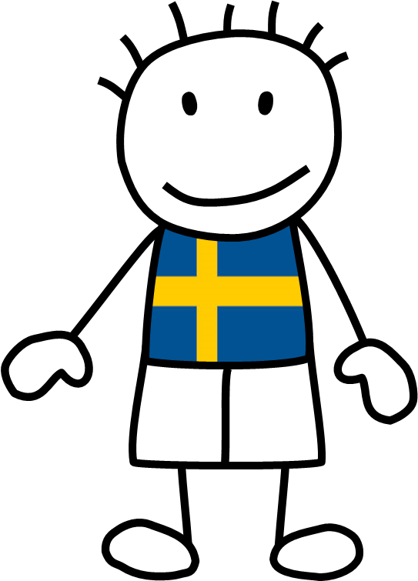
He’s
Swedish.

Slide 17
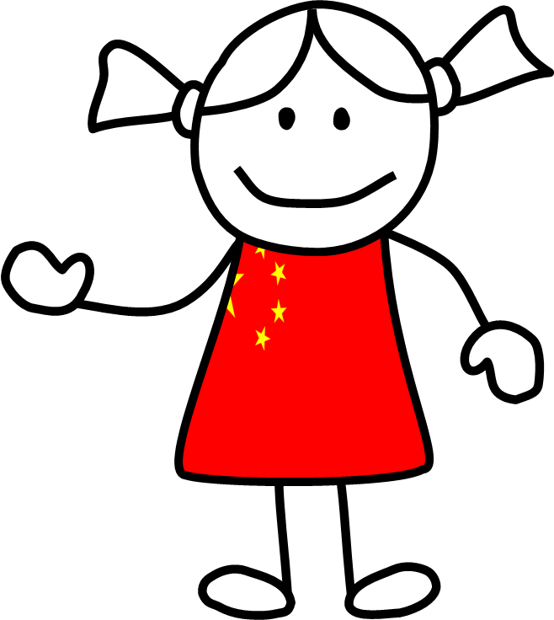
She’s
Chinese.

Slide 18
He’s
Egyptian.

Slide 19
She’s
Dutch.

Slide 20
He’s
Japanese.

