Slide 1
WELCOME TO OUR CLASS

Slide 2
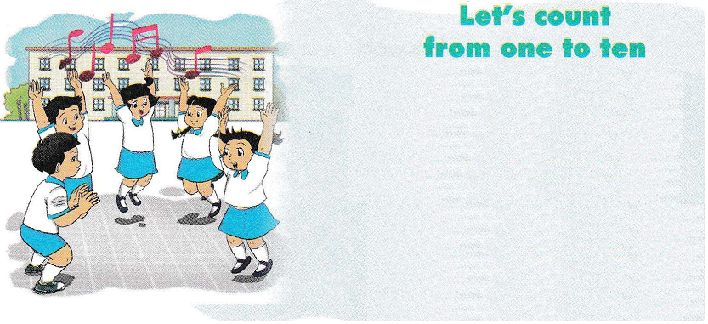

Slide 3
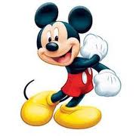
Let’s play
“Roll The Dice”

Slide 4
Unit 4: How Old Are You?
Period 24. Lesson 3

Slide 5
f
s

Slide 6
five
six

Slide 7
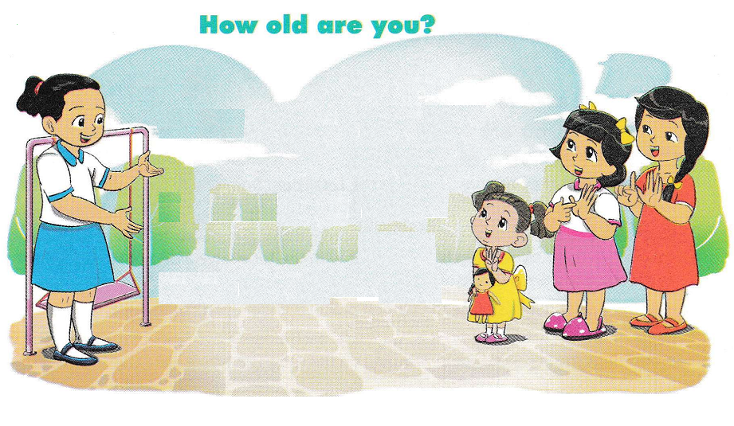

Slide 8
Good bye!
See you later!

