Slide 1


Welcome to our class 3B
Subject: English
Teacher : Luong Ngoc Oanh

Slide 2

Warm - up

Slide 3
S
T
A
N
D
U
P
__ __ __ __ __ __ __

Slide 4

THURSDAY, NOVEMBER 2nd 2017
Unit 6: Stand up!
Lesson 1: 1, 2, 3,4

Slide 5
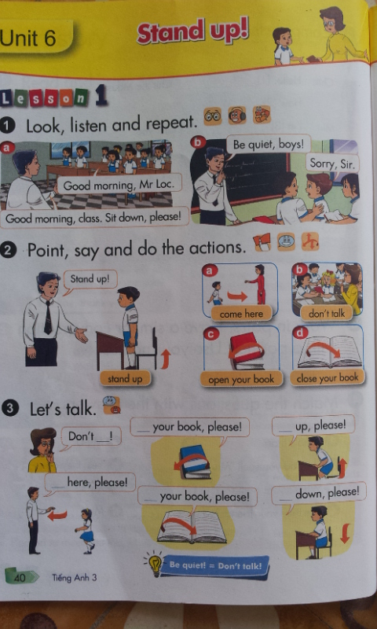


Slide 6
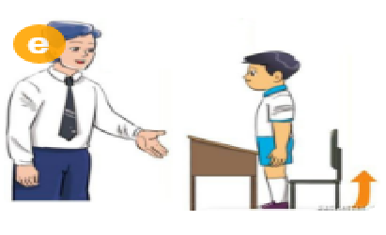
Stand up!

Slide 7
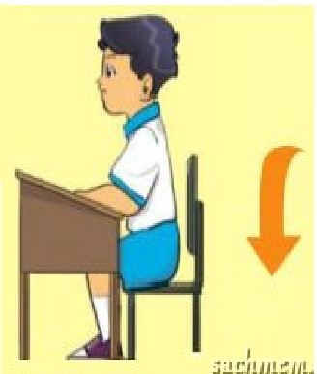
Sit down

Slide 8
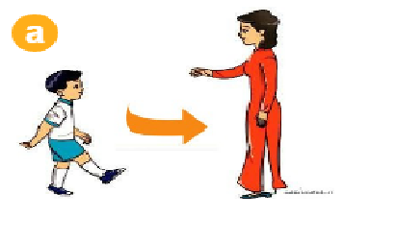
Come here!

Slide 9
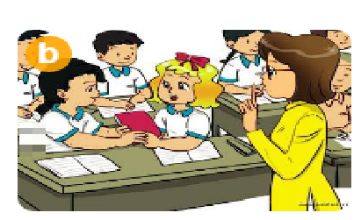
Don’t talk!

Slide 10

Open your book!

Slide 11

Close your book!

Slide 12


Matching

Slide 13

Let's play
Hot seat

Slide 15
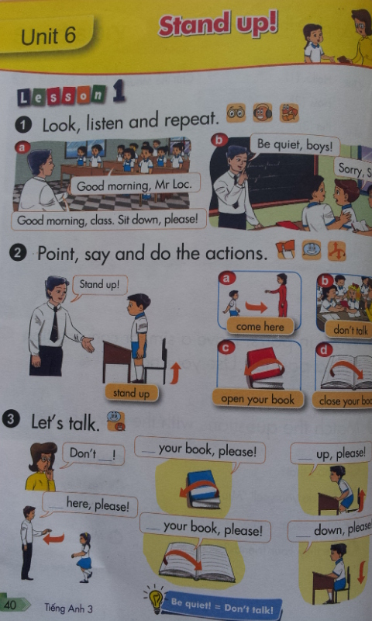

Don’t talk

Slide 16
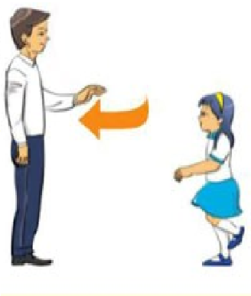
Come here, please!

Slide 17

Open your book, please!

Slide 18
Close your book, please!

Slide 19
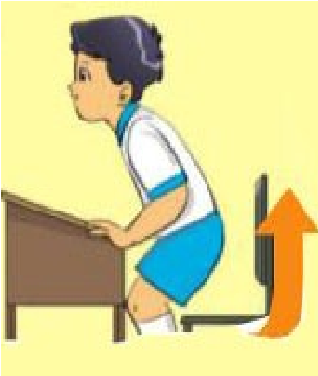
Stand up, please!

Slide 20
Sit down, please!

Slide 21
Work in pairs

Slide 22
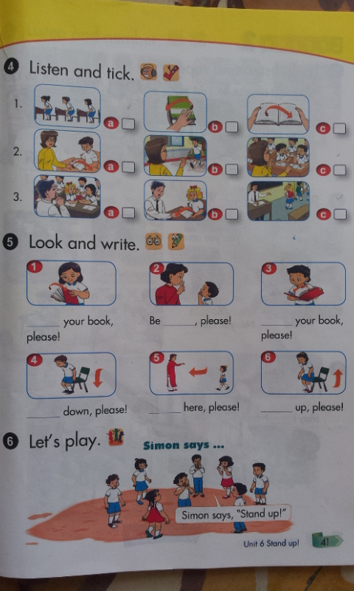
V
V
V

Slide 23



Let's play
Who's a millionaire?

Slide 24

Reorder the words to make the sentence.
Your/ book! / open
Open your book!

Slide 25

SsSt_ nd
50:50
A. o
B. e
C. a
D. u.
C. a.

Slide 26
Sit……….
50:50
A. you.
B. down
B. down
C. up
D. nice

Slide 27
………...your book!
50:50
A. open
A. open
B. yours
C. your.
D. A and C

Slide 28
Don’t……….
50:50
A. say
B. Talk.
B. talk
C. look.
D. repeat.

Slide 29
You are a millionaire.
L
F

Slide 30
Summary
Stand up, please!
Sit down, please!

