Slide 2
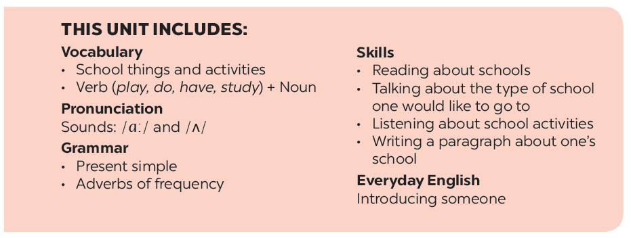

Slide 3
Everyday English
New friends at school
Introducing someone
Read and tick the questions you think are suitable to ask a new friend at school.
Listen and read the dialogue. Pay attention to the highlighted parts.
There is a quiz for students in the new school newsletter. Answer the questions.
Work in groups. Practise introducing a friend to someone else.
Work in groups. Take turn to interview the others. Use the questions above.

Slide 4
Everyday English
Introducing someone

Slide 5
Listen and read the dialogue. Pay attention to the highlighted parts.
Vy: Phong, this is Duy, my new friend.
Phong: Hi, Duy. Nice to meet you.
Duy: Hi, Phong. Nice to meet you, too.

Slide 6
Work in groups. Practise introducing a friend to someone else.

Slide 7
New friends at school

Slide 8
Read and tick the questions you think are suitable to ask a new friend at school.
1.
Are you from around here?

2.
Do you like music?

3.
How much money do you get?
4.
What is your favourite subject at school?

5.
Are you hungry now?
6.
Do you play football?

7.
How do you go to school avery day?

8.
Where do you often go shopping?
Notes:
City landmarks phải ở trên mục 3

Slide 9
Write one or two more questions on a piece of paper. Then share them with the class.

Slide 10
There is a quiz for students in the new school newsletter. Answer the questions.

Slide 11
1.
Do you remember all your new classmate’s names?
Yes

No

2.
Do you often listen to your friend’s advice?
Yes

No


Slide 12
3.
Do you share things with your classmates?
Yes

No

4.
Do you keep your friend’s secret?
Yes

No


Slide 13
5.
Do you play with your classmates at break time?
Yes

No

6.
Do you help your classmates with their homework?
Yes

No


Slide 14
7.
Do you go to school with your friends?
Yes

No

8.
Do you listen when your classmates are talking?
Yes

No


Slide 15
Work in groups. Take turn to interview the others. Use the questions above.

