Slide 1
Unit 9: NATURAL DISASTERS
LESSON 3: A CLOSER LOOK 2

Slide 2
OBJECTIVES
Knowledge
Core competence
Grammar:
“The past continuous”
Develop teamwork skills,
communication skills and
Creativity.

Slide 3
01
Let’s warm up
Watch the video and answer the questions!

Slide 5
Let’s answer some questions
01
03
What is the film about?
It’s about natural disaster
What happened to the building when the people were praying?
It collapsed/broke down

Slide 6
Let’s answer some questions
03
04
What was happening while the father was driving?
The volcano was erupting
What was happening when the plane was taking off?
The land was sliding.
What tense was used in these answers?

Slide 7
Let’s answer some questions
The volcano was erupting
The land was sliding.
What tense was used in these answers?
The past continuous tense

Slide 8
The past continuous tense
FORM
The volcano was erupting.
(+) S + was/ were + V-ing…
(-) S + was/ were not + V-ing…
(?) Was/ were + S + V-ing…?
She wasn’t talking in class.
Was the land sliding?

Slide 9
The past continuous tense
Usage:
We use the past continuous to describe:
1. An action that was happening at a particular time in the past.
Example:
I was having dinner at 6 p.m. yesterday.
Were you having dinner at 6 p.m. yesterday?
– Yes, I was.

Slide 10
The past continuous tense
Usage:
- A past action that was happening when another action interrupted it. We use the past simple for the action that interrupted it.
Example:
When / While we were watching TV, we felt the earthquake.
What were they doing when they felt the
earthquake?
– They were watching TV.

Slide 11
The past continuous tense
Usage:
Notes:
- We can use when or while before the past continuous.
- We can only use when before the past simple.

Slide 12
Let’s practice!
The past continuous!

Slide 13
Task 1: complete the sentences by putting the verbs in brackets into the past continuous.
1. They (help) ______________ the flood victims at 10 o’clock last night.
2. It (not snow) ________________ when I left home this afternoon.
3. While she (work) ____________ in the field, the tornado
came.
were helping
wasn’t snowing
was working

Slide 14
Task 1: complete the sentences by putting the verbs in brackets into the past continuous.
4. – What you ______ (do) ______ at 9 o’clock yesterday morning? – I (watch) ________________ the news about a volcanic eruption.
5. – ______ you (cry) ______ when I saw you two days ago? – No, I wasn’t.
Were
doing
was watching
were
crying

Slide 15
Task 2: Circle the correct answer to complete each sentence.
1. We donated / were donating money to help the earthquake victims last month.
2. – What did you do / were you doing when the
volcano erupted? – I slept / was sleeping in my bed.
3. While they camped / were camping near the river, the flood was coming / came suddenly.

Slide 16
Task 2: Circle the correct answer to complete each sentence.
4. After Tom ran / was running out of his house, he moved / was moving quickly to a safer place.
5. I didn’t read / wasn’t reading a newspaper at 9 a.m. yesterday, but I watched / was watching the news about the tornado.

Slide 17
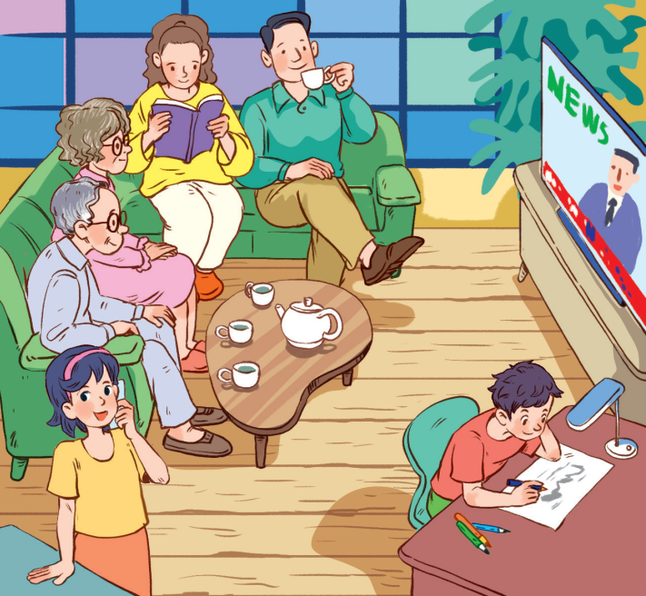
Task 3: Look at the picture and write what each person in Lan’s family was doing when the earthquake happened. Use the given word and phrases from the box.
watch TV read a book
talk on the phone
draw drink tea

Slide 18
Task 3:
watch TV read a book draw
drink tea talk on the phone
1. Lan’s grandparents were watching TV.
2. Lan’s/ Her mother was reading a book.
3. Lan’s/ Her father was drinking tea.
4. Lan was talking on the phone.
5. Lan’s/ Her brother was drawing.

Slide 19
Task 4: Form questions using the past continuous. Then in pairs, ask and answer the questions.
Example:
you / play / football / 5 o’clock yesterday afternoon?
Were you playing football at 5 o’clock yesterday afternoon?
Yes, I was. / No, I wasn’t. I was doing my homework

Slide 20
Task 4: Form questions using the past continuous. Then in pairs, ask and answer the questions.
1. you / have dinner / 7 o’clock yesterday evening?
Were you having dinner at 7 o’clock yesterday evening?
2. you / do / homework / 8 o’clock yesterday evening?
Were you doing your homework at 8 o’clock yesterday evening?

Slide 21
Task 4: Form questions using the past continuous. Then in pairs, ask and answer the questions.
3. you / watch / film / 9 o’clock yesterday evening?
Were you watching a film at 9 o’clock yesterday evening?
Notes:
Call 1 student in each pair randomly to ask and answer the question

Slide 22
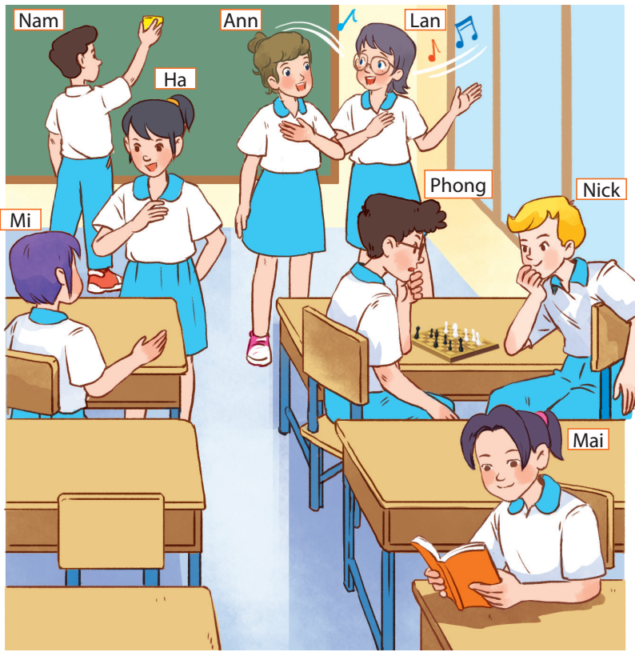
Task 5: Work in groups. Take turns to say a sentence that describes what each person in the picture was doing
- Mai was reading.
- Phong and Nick were playing chess.
- Lan and Ann were singing.
- Nam was cleaning the board.
- Mi and Ha were talking.

Slide 23
Chain game!
GAME
TIME!!!

Slide 24
GAME TIME: Chain game!
Work in groups of 6
The first student say what he/she was doing at a particular time yesterday.
The next student repeat and continue with what he /she was doing at that time using when/while

Slide 25
GAME TIME: Chain game!
Example:
Student 1:
I was playing game at 9 PM yesterday.
Student 2:
While you were playing game, I was doing my homework.
Student 3:
While she was playing game and you were doing your homework. I was listening to BTS music…..

Slide 26
Let’s recap! Write complete sentences using the given words:
1. We/ donate / money / help / landslide / victims / last month./
=> We donated money to help the landslide victims last month.

Slide 27
Let’s recap! Write complete sentences using the given words:
2. What / you / do / when / volcano / erupt? / I / sleep / my bed./
=> What were you doing when the
volcano erupted? – I was sleeping in my bed.

Slide 28
Let’s recap! Write complete sentences using the given words:
3. While / she / pull / some carrots / in / garden,/ tornado / come./
=> While she was pulling up some carrots in the garden, the tornado came.

Slide 29
Homework
- Remember the structures and the use of the past continuous.
- Do exercises in the workbook.
- Prepare for Lesson 4 - Communication

Slide 30
THANKS FOR LISTNING

