Slide 1


NGUYEN BINH KHIEM SECONDARY SCHOOL
Hello every one !!!
love

Slide 2

* Game: Sentence racing.
- the tallest
- the shortest
- the biggest
- the smallest
Ex: Minh is the tallest in my class.

Slide 3


UNIT 12. ROBOTS
LESSON 3:

Slide 4

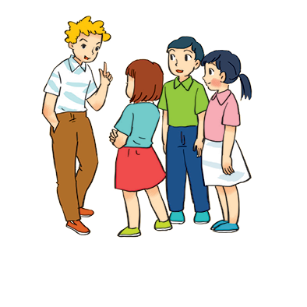

* Grammar
Superlative adjectives: short adjectives
We use superlative adjectives to compare three or more people or things.
* Form:
Example:
- Tom is the tallest in his class.
The + short adj + est
- This is the biggest of the three bags.

Slide 5
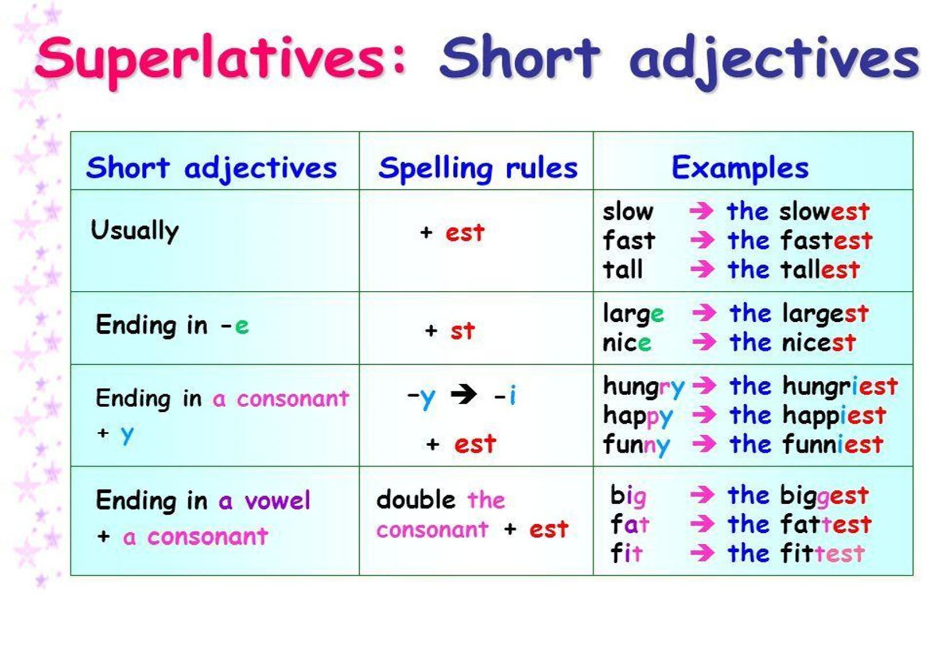

Slide 6

Write the superlative form of the adjectives in the table below.
Adjectives | Superlative form
fats
tall
noisy
nice
hot
light
quiet
heavy
large
fastest
tallest
noisiest
nicest
hottest
lightest
quietest
heaviest
largest

Slide 7

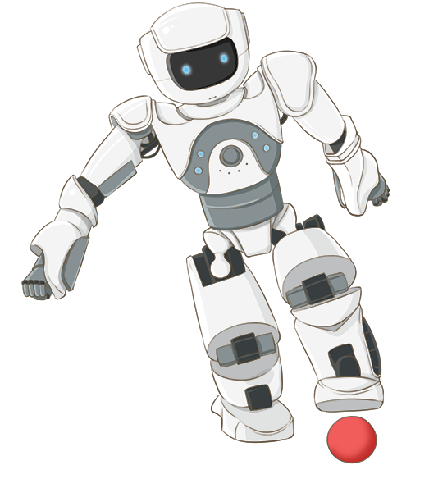
Complete the following sentences with superlative form of the adjectives in brackets. 1 is an example.
1.
Bonbon can move 10 tons; it’s the strongest of all. (strong)
2.
This robot can understand all of what we say. It’s the
_______ in the robot show. (smart)
smartest in the robot show. (smart)
He is the
he is about 1.8 m tall. (tall)
_______ in our class;
3.
tallest in our class;
4.
This is the
we can put it in our bag. (small)
_______ of all home robots;
smallest of all home robots;
5.
This robot is only 200 dollars.
It’s the
cheapest in our shop. (cheap)
_______ in our shop. (cheap)

Slide 8

Complete the following sentences with comparative or superlative form of the adjectives in brackets.
1. My brother has a ............ room than me. (tidy)
2. The ........... desert of all is Sahara and it’s in Afnca. (hot)
3. Travelling by plane is ......... than going by car. (fast)
4. Who is the .................. in your family? (tall)
5. I think dogs are ........... than cats. (smart)
6. The Nile is the ……………river in the world. (long)
Game:
The big Wheel.

Slide 9
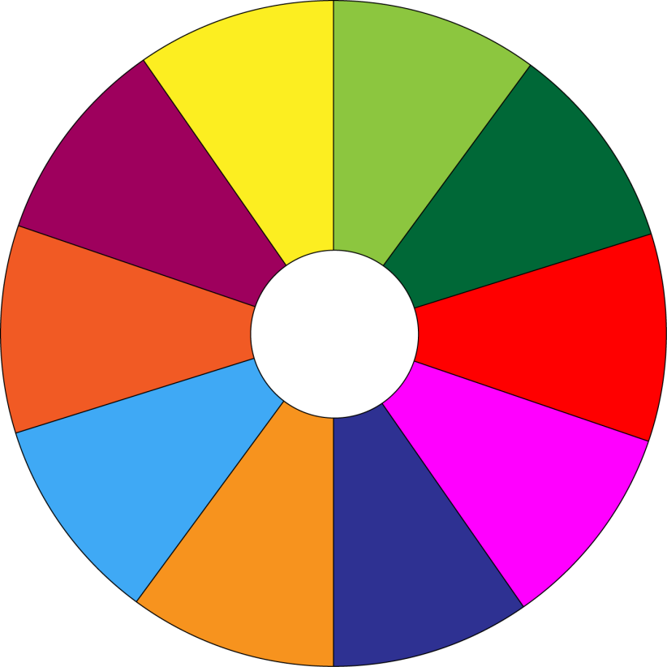
THE BIG WHEEL GAME
QUESTIONS
10
40
1
4
30
50
SPIN
2
5
20
10
-15
-20
3
6
05
60

Slide 10
Complete the following sentences with comparative or superlative form of the adjectives in brackets.
1. My brother has a ............... room than me. (tidy)
tidier

Slide 11
Complete the following sentences with comparative or superlative form of the adjectives in brackets.
2. The ................. desert of all is Sahara and it’s in Afnca. (hot)
hottest

Slide 12
Complete the following sentences with comparative or superlative form of the adjectives in brackets.
3. Travelling by plane is ............... than going by car. (fast)
faster

Slide 13
Complete the following sentences with comparative or superlative form of the adjectives in brackets.
4. Who is the .................. in your family? (tall)
tallest

Slide 14
Complete the following sentences with comparative or superlative form of the adjectives in brackets.
5. I think dogs are …............ than cats. (smart)
smarter

Slide 15
Complete the following sentences with comparative or superlative form of the adjectives in brackets.
6. The Nile is the ..……………river in the world. (long)
longest

Slide 16
Complete the following sentences with comparative or superlative form of the adjectives in brackets.
1. My brother has a ............ room than me. (tidy)
2. The ........... desert of all is Sahara and it’s in Afnca. (hot)
3. Travelling by plane is ......... than going by car. (fast)
4. Who is the .................. in your family? (tall)
5. I think dogs are ........... than cats. (smart)
6. The Nile is the ……………river in the world. (long)
1. Tidier 2. hottest 3. faster 4. tallest 5. smarter

Slide 17
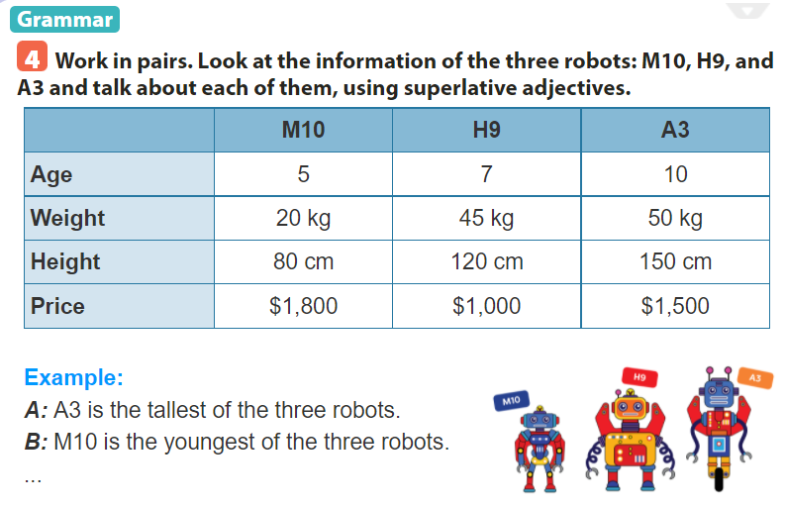

Slide 18
* Suggested adjectives
Tallest
shortest
Youngest
Oldest
Cheapest
Heaviest
Lightest
A3 is the heaviest of 3 robots.
A3 is the tallest of 3 robots.
H9 is the cheapest of 3 robots.
M10 is the shortest of 3 robots.
M10 is the lightest of 3 robots.

Slide 19



Find someone who…
Work in pairs. Ask your partner to find in your class someone who is
the tallest
the oldest
the smartest
the shortest
the biggest
the smallest
Minh
* MODELLING
A: Who is the tallest in our class?
B: Minh is the tallest in our class.

Slide 20
* Production
Calls some pairs to report their findings.
In our class, Khoi is the tallest…

Slide 21


Homework
- Do exercises in the workbook.
- Prepare lesson 4 ( communication)

Slide 22

Thank you!
Have a nice day!

