Slide 1



Toán 1
Trang 26-27

Slide 2
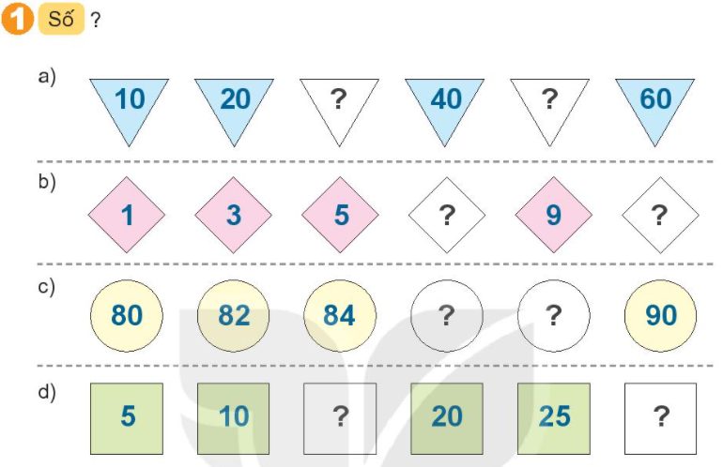
30
50
7
11
86
88
15
30

Slide 3
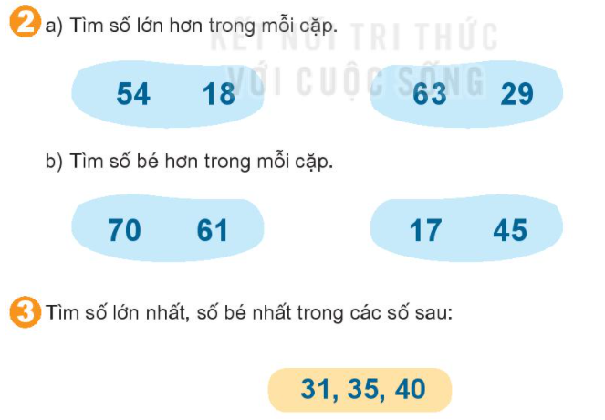

Slide 4

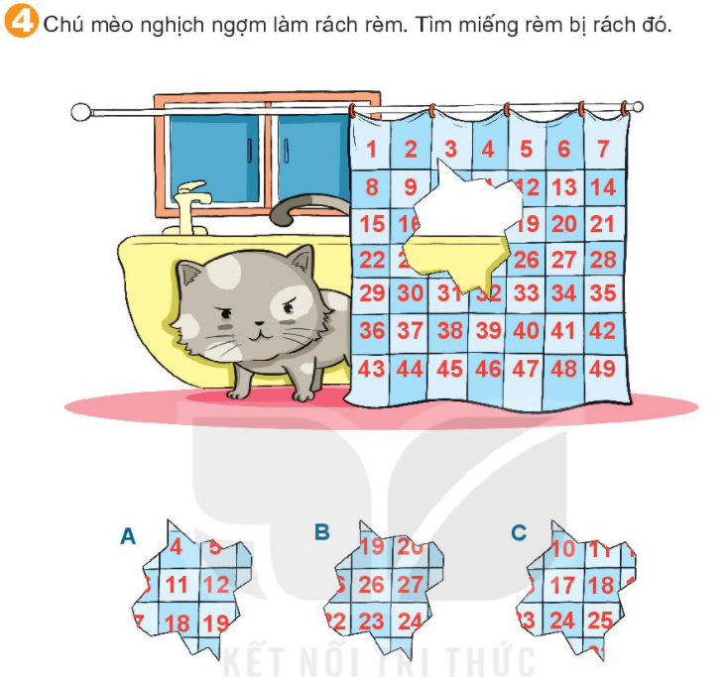

Slide 5
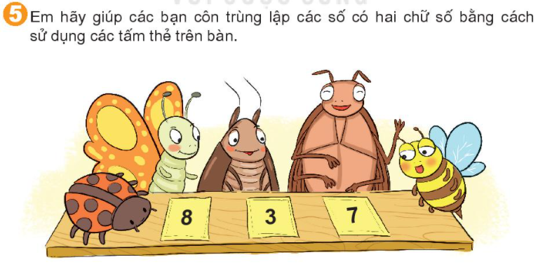
83
87
38
37
78
73

