Slide 1

Unit 5: Sports and hobbies
Lesson 2.3
Page 73

Slide 2
Vocabulary Review

Slide 3
gickikn
k | i | c | k | i | n | g

Slide 4
actcginh
c | a | t | c | h | i | n | g

Slide 5
nitihtg
h | i | t | t | i | n | g

Slide 6
rhtoginw
t | h | r | o | w | i | n | g

Slide 7

It’s time to learn …

Slide 8


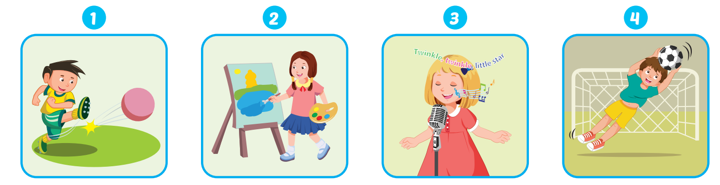
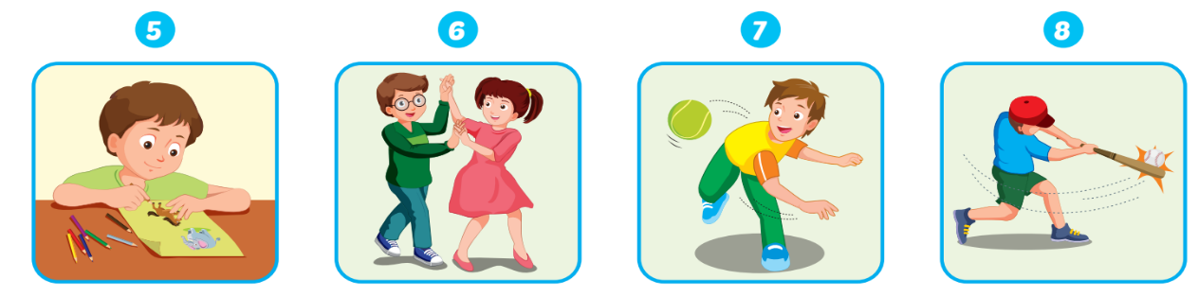

Slide 9
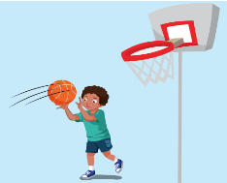
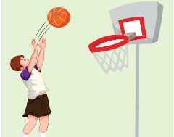
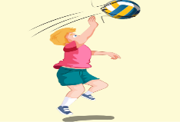

Extra Structure:
What is she/he good at?
She/He’s good at ____.

Slide 10


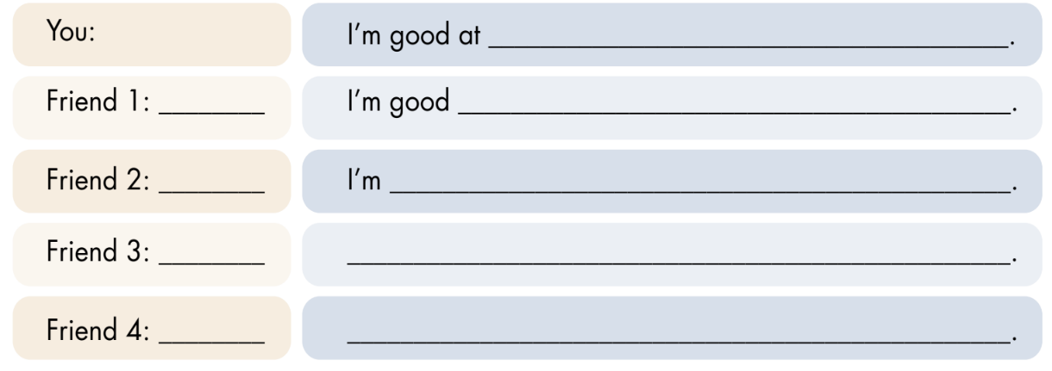

Slide 11
Talk about you and your partner:
I’m good at ________.
He’s good at ________.
I’m good at ________.
She’s good at ______.

Slide 12
Today’s lesson
Vocabularies
hitting
kicking
catching
throwing
Structures/ Sentence patterns
What are you good at?
- I'm good at kicking.

