Slide 1
Unit 6: Clothes
Lesson 3.1
Page 88

Slide 2
It’s time to learn …

Slide 3
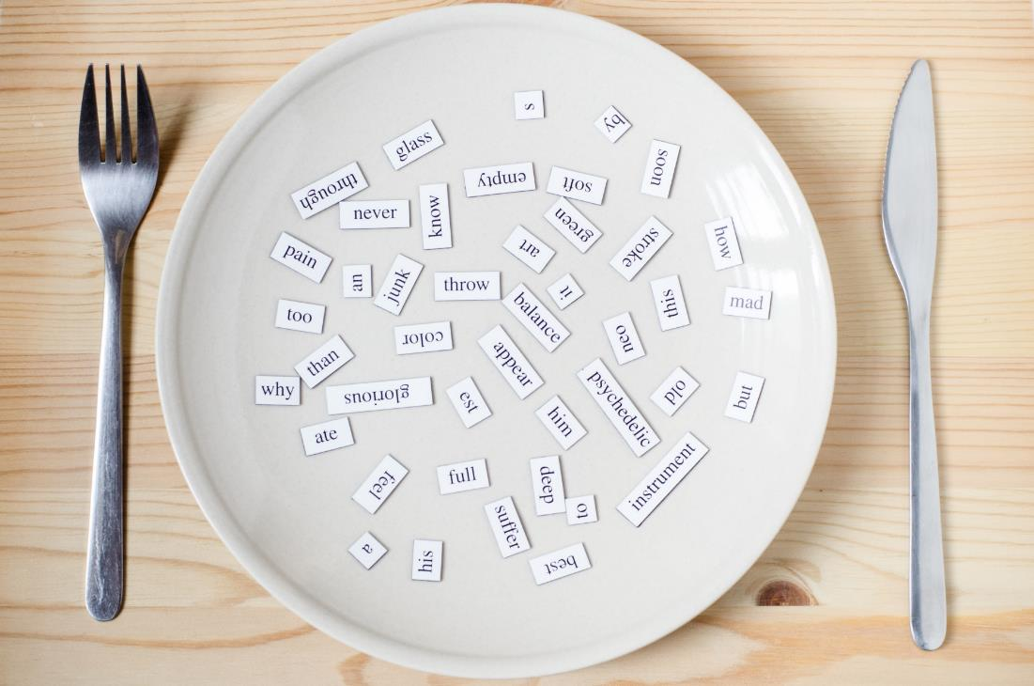
New words
belt,
scarf,
sweater,
pajamas,
skiing.

Slide 4
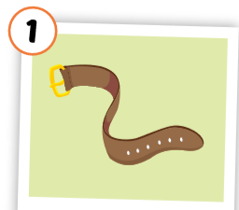
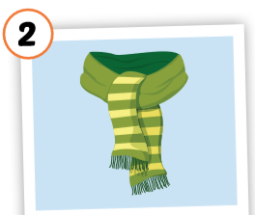
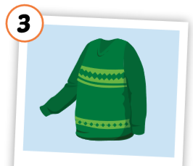
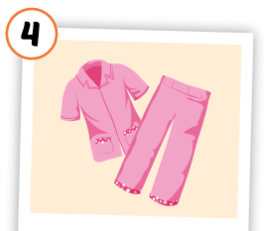
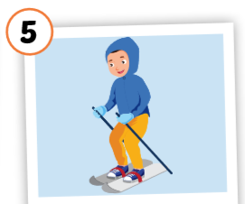
Click each English word to hear the sound.
belt
scarf
sweater
pajamas
skiing
/belt/
thắt lưng
/ skɑːrf / khăn choàng
/ ˈswetər /
áo len
/ pəˈdʒæməz / quần áo ngủ
/skiːɪŋ/
trượt tuyết
Notes:
GV giới thiệu từ vựng, CCQ

Slide 7
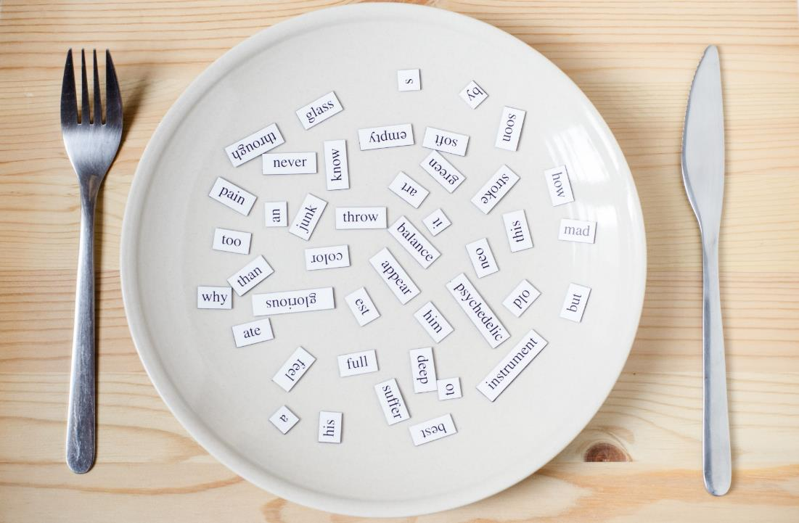
Structures

Slide 8
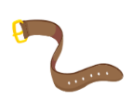
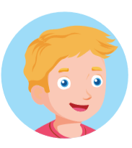
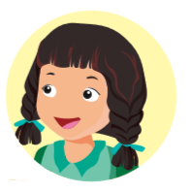
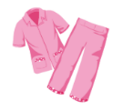
Is that your belt?
Yes, it is. /No, it isn’t.
Are those your pajamas?
Yes, they are./No, they aren’t.

Slide 9
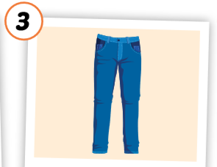
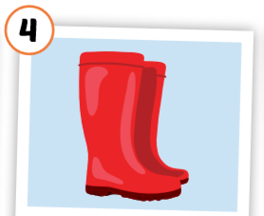
Put the pictures in the right group.
◆
❖
Is that …?
Are those…?

Slide 10
2
1
SPIN
5
3
6
4
5
6

Slide 11
sweater
Yes
those
aren’t

Slide 12
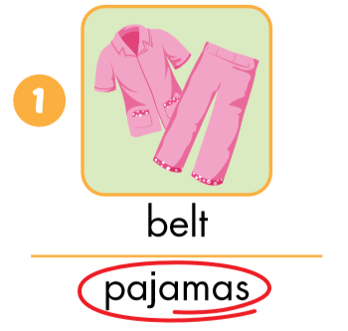
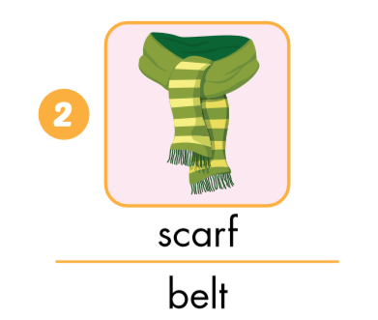
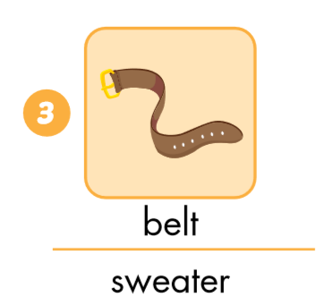
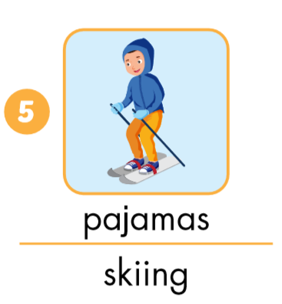
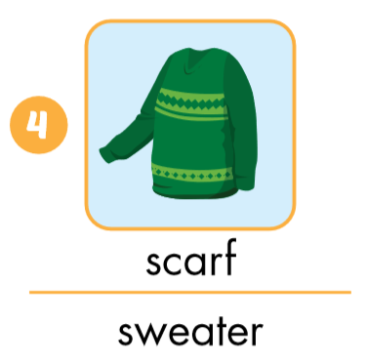
A. Look and circle.

Slide 13
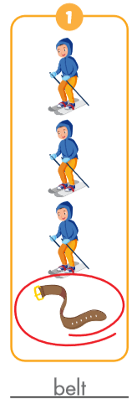
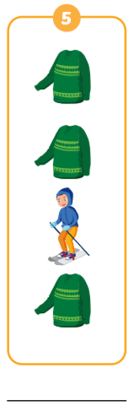
v
belt
pajamas
scarf
sweater
skiing

Slide 14
Let’s draw!
Work in pairs.
Draw your clothes thing.
Tell your friend about your picture.
Notes:
134722862

Slide 15
Today’s lesson
Vocabularies
belt,
scarf,
Sweater,
pajamas,
skiing.
Structures/ Sentence patterns
Is that your belt?
Yes, it is./No, it isn’t
Are those your pajamas?
Yes, they are./No, they aren’t.

