Slide 1
Unit 13
WHAT DO YOU DO
IN YOUR FREE TIME?
Lesson 2

Slide 2
Vocabulary

Slide 3
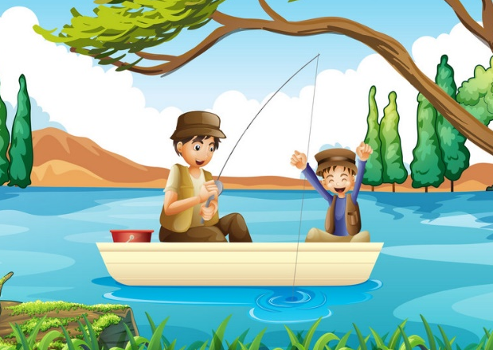
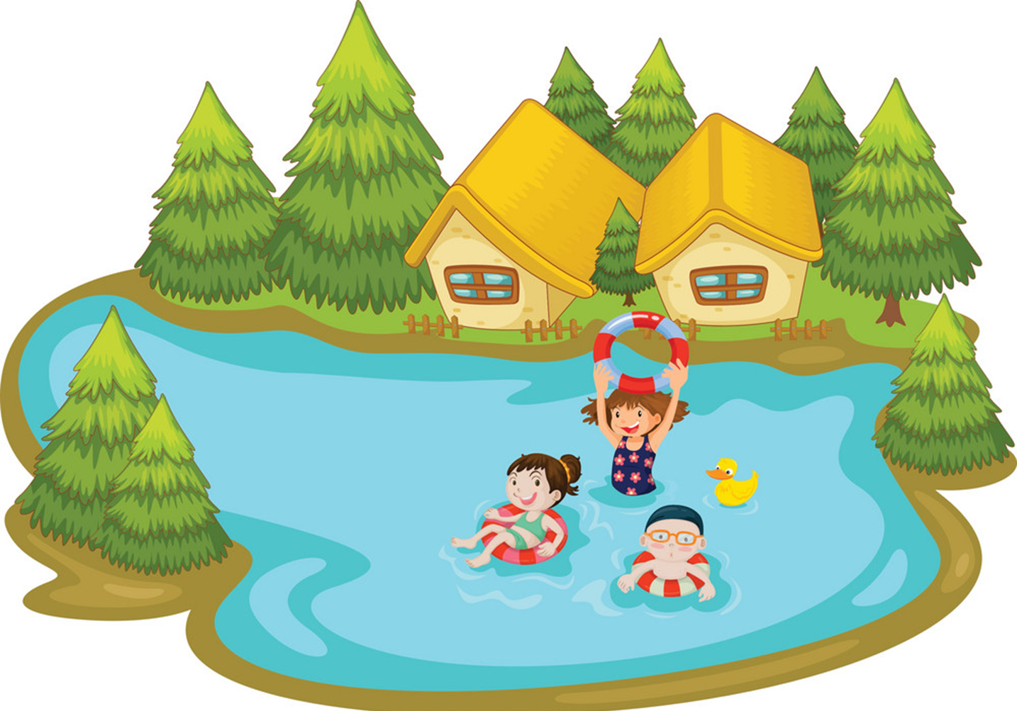
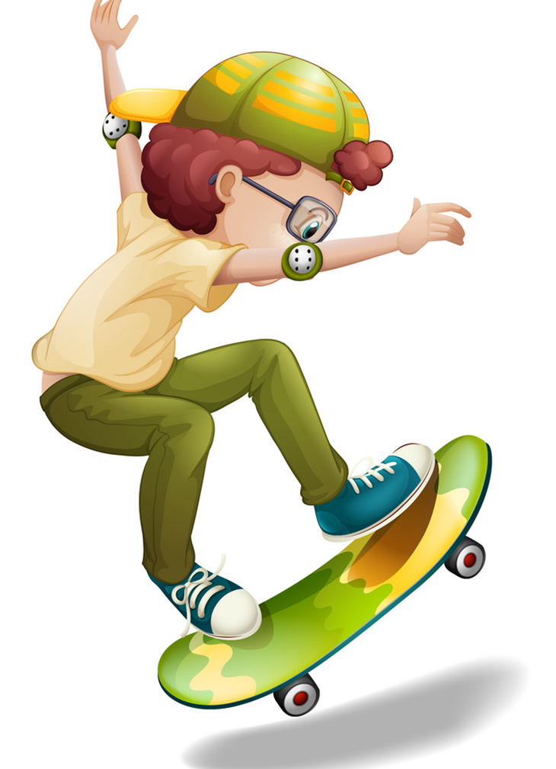
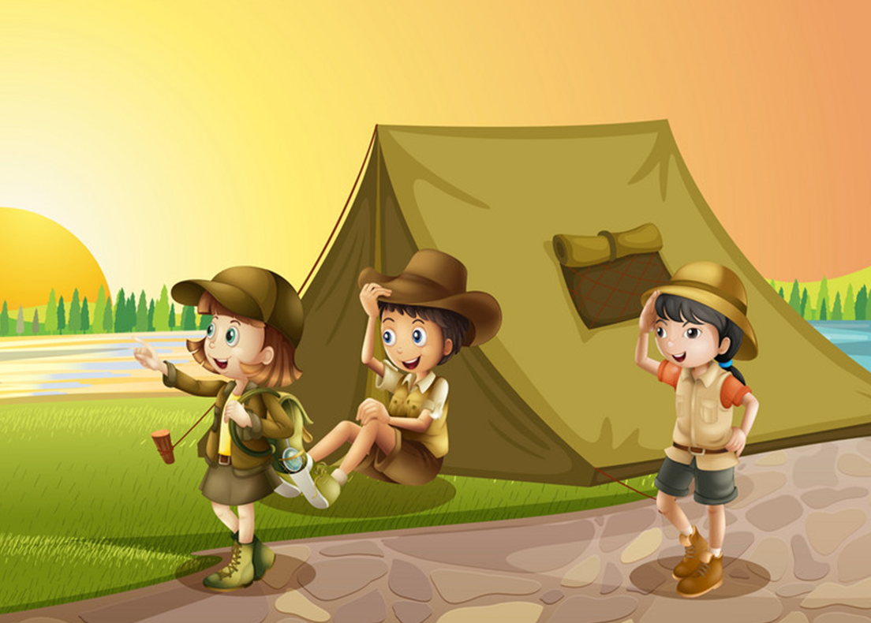
Vocabulary
go fishing
go swimming
go skating
go camping

Slide 4
Grammar

Slide 5
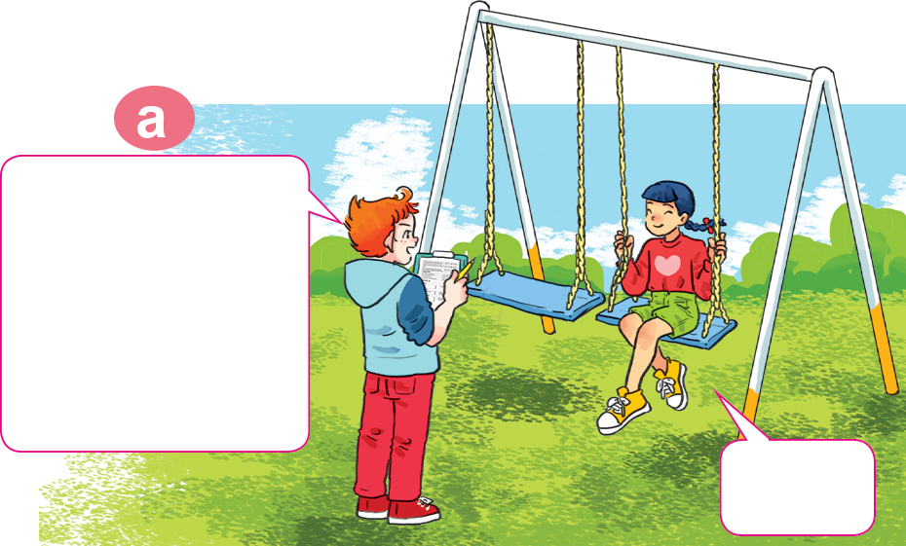
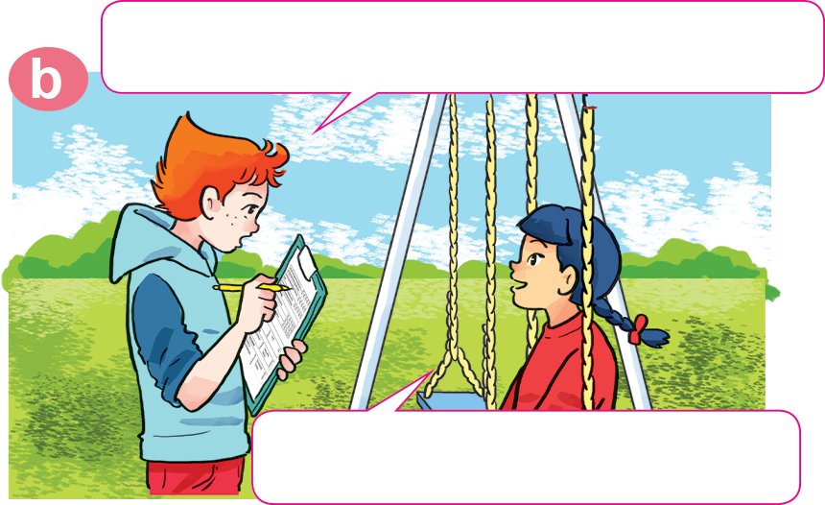
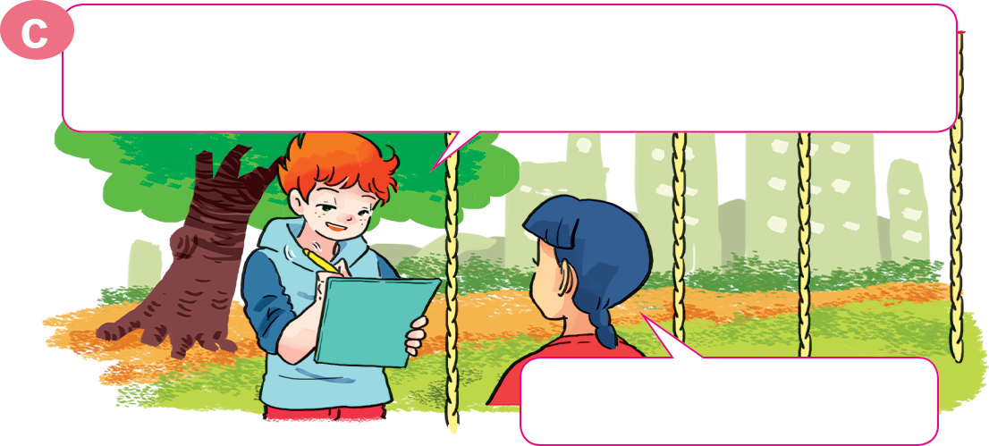
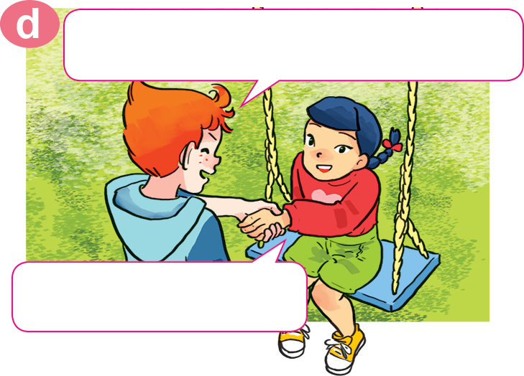
1. Look, listen and repeat
What do you do in your free time?
Hello, Akiko.
May I ask you some questions for my survey?
Sure.
I watch cartoons on TV.
OK, watching cartoons. How about your mother? What does she do in her free time?
OK. Thank you very much.
She goes shopping.
You're welcome.

Slide 6
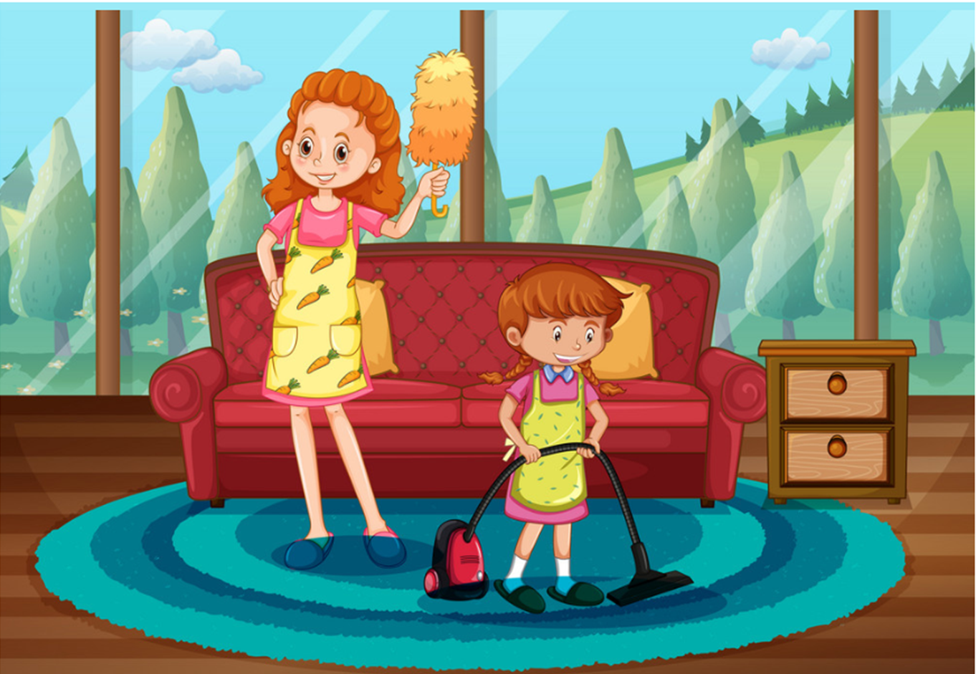
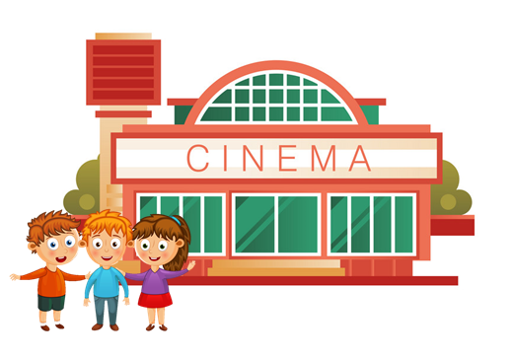
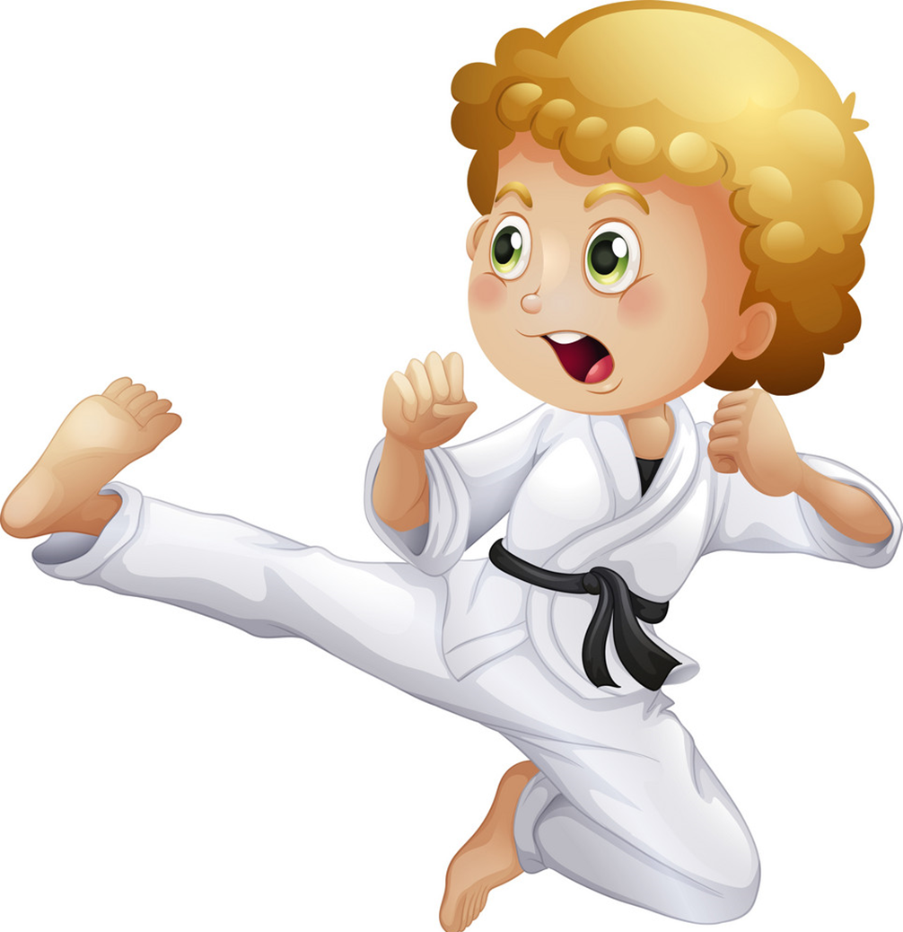
Model sentence
What does your ________ do in ____ free time?
She / He ______________________.
surfs the Internet
goes fishing
goes swimming
cleans the house
goes to the cinema
goes camping
does karate
goes skating

Slide 7
4. Listen and circle a, b or c.
1. Phong often goes ___________ in his free time.
a. fishing b. camping c. skating
2. His father ___________ twice a week.
a. does karate b. plays football c. works in the garden
3. His mother goes ___________ at weekends.
a. swimming b. Shopping c. camping
4. His sister ___________ in her free time.
a. surfs the Internet b. does homework
c. cleans the house

Slide 8
5. Write about what your family members do in their free time.
1. What do you do in your free time?
2. How often do you do it?
3. What does your father do in his free time?
4. What does your mother do in her free time?

Slide 9
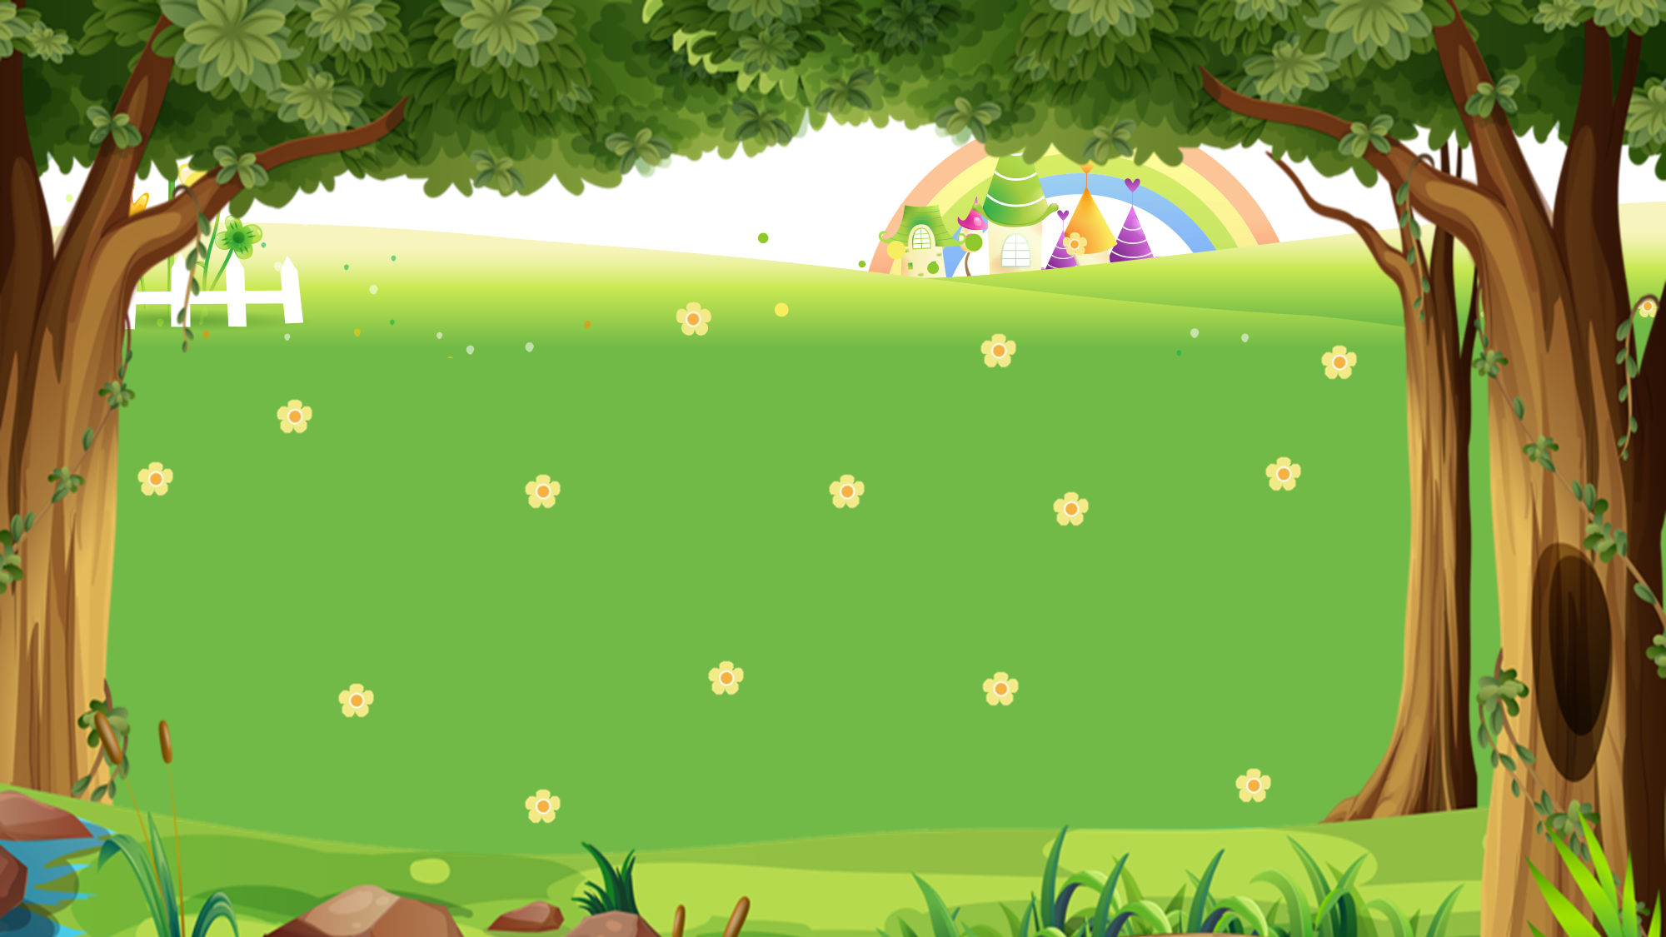
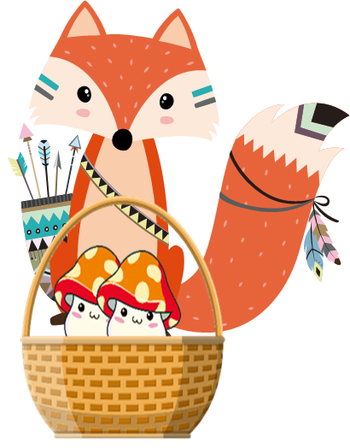
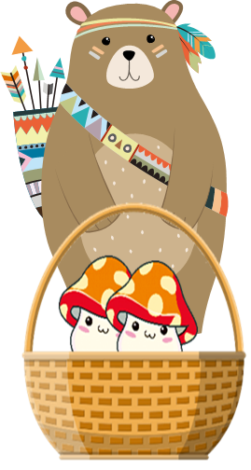
PICKING MUSHROOMS
1
2
3
Các đội CHỌN lần lượt các Ô SỐ để trả lời câu hỏi.
Đội nào trả lời NHANH HƠN và ĐÚNG thì được CỘNG 1 điểm.
CLICK hình hoặc hình để cộng điểm.
4
5
6
7
8
9
10

Slide 10
Time’s up
1
2
3
4
5
6
7
8
9
10
What does _____ do in her free time?
Back
A. your mother
B. your father
C. you

Slide 11
Time’s up
1
2
3
4
5
6
7
8
9
10
What does _____ do
in his free time?
Back
A. you
B. your brother
C. your sister

Slide 12
Time’s up
1
2
3
4
5
6
7
8
9
10
What does your grandma do in _____ free time?
Back
A. your
B. his
C. her

Slide 13
Time’s up
1
2
3
4
5
6
7
8
9
10
What _____ you do
in your free time?
A. do
Back
B. does

Slide 14
Time’s up
1
2
3
4
5
6
7
8
9
10
What _____ your grandpa do
in his free time?
B. does
Back
A. do

Slide 15
Time’s up
1
2
3
4
5
6
7
8
9
10
What does Tony do in his free time?
He ______ camping.
Back
A. goes
B. go

Slide 16
Time’s up
1
2
3
4
5
6
7
8
9
10
What does your mother
do in her free time?
She _______ swimming.
B. goes
Back
A. go

Slide 17
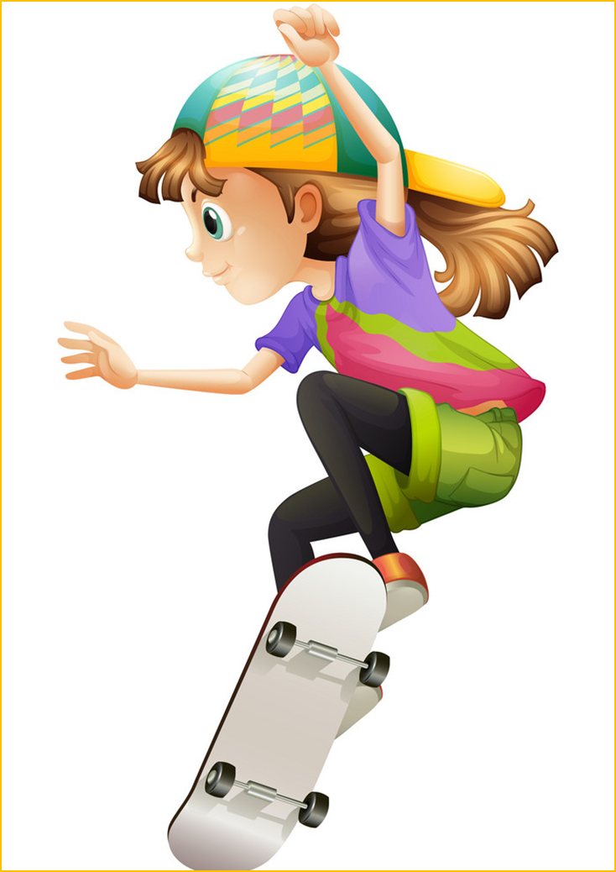
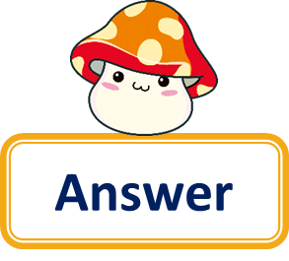
Time’s up
1
2
3
4
5
6
7
8
9
10
Question
What does your teacher do in her free time?
She goes skating.
Back
Answer

Slide 18
Time’s up
1
2
3
4
5
6
7
8
9
10
What does your friend do in his free time?
Question
He does karate.
Back
Answer

Slide 19
Time’s up
1
2
3
4
5
6
7
8
9
10
What do you do
in your free time?
Question
I go fishing.
Back
Answer

Slide 20
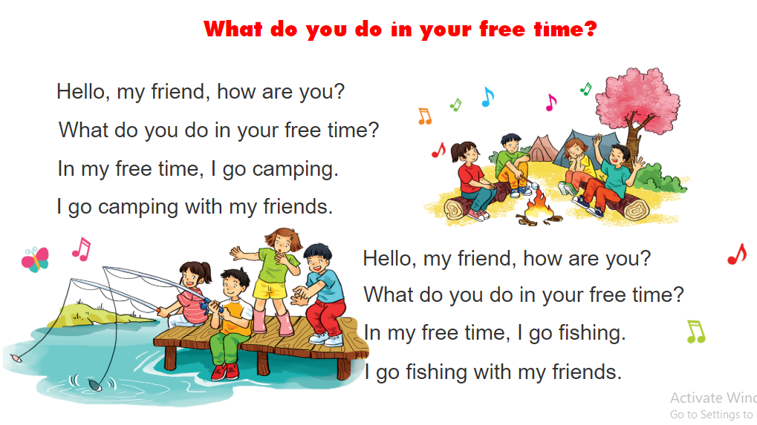
6. Let’s sing.

