Slide 1
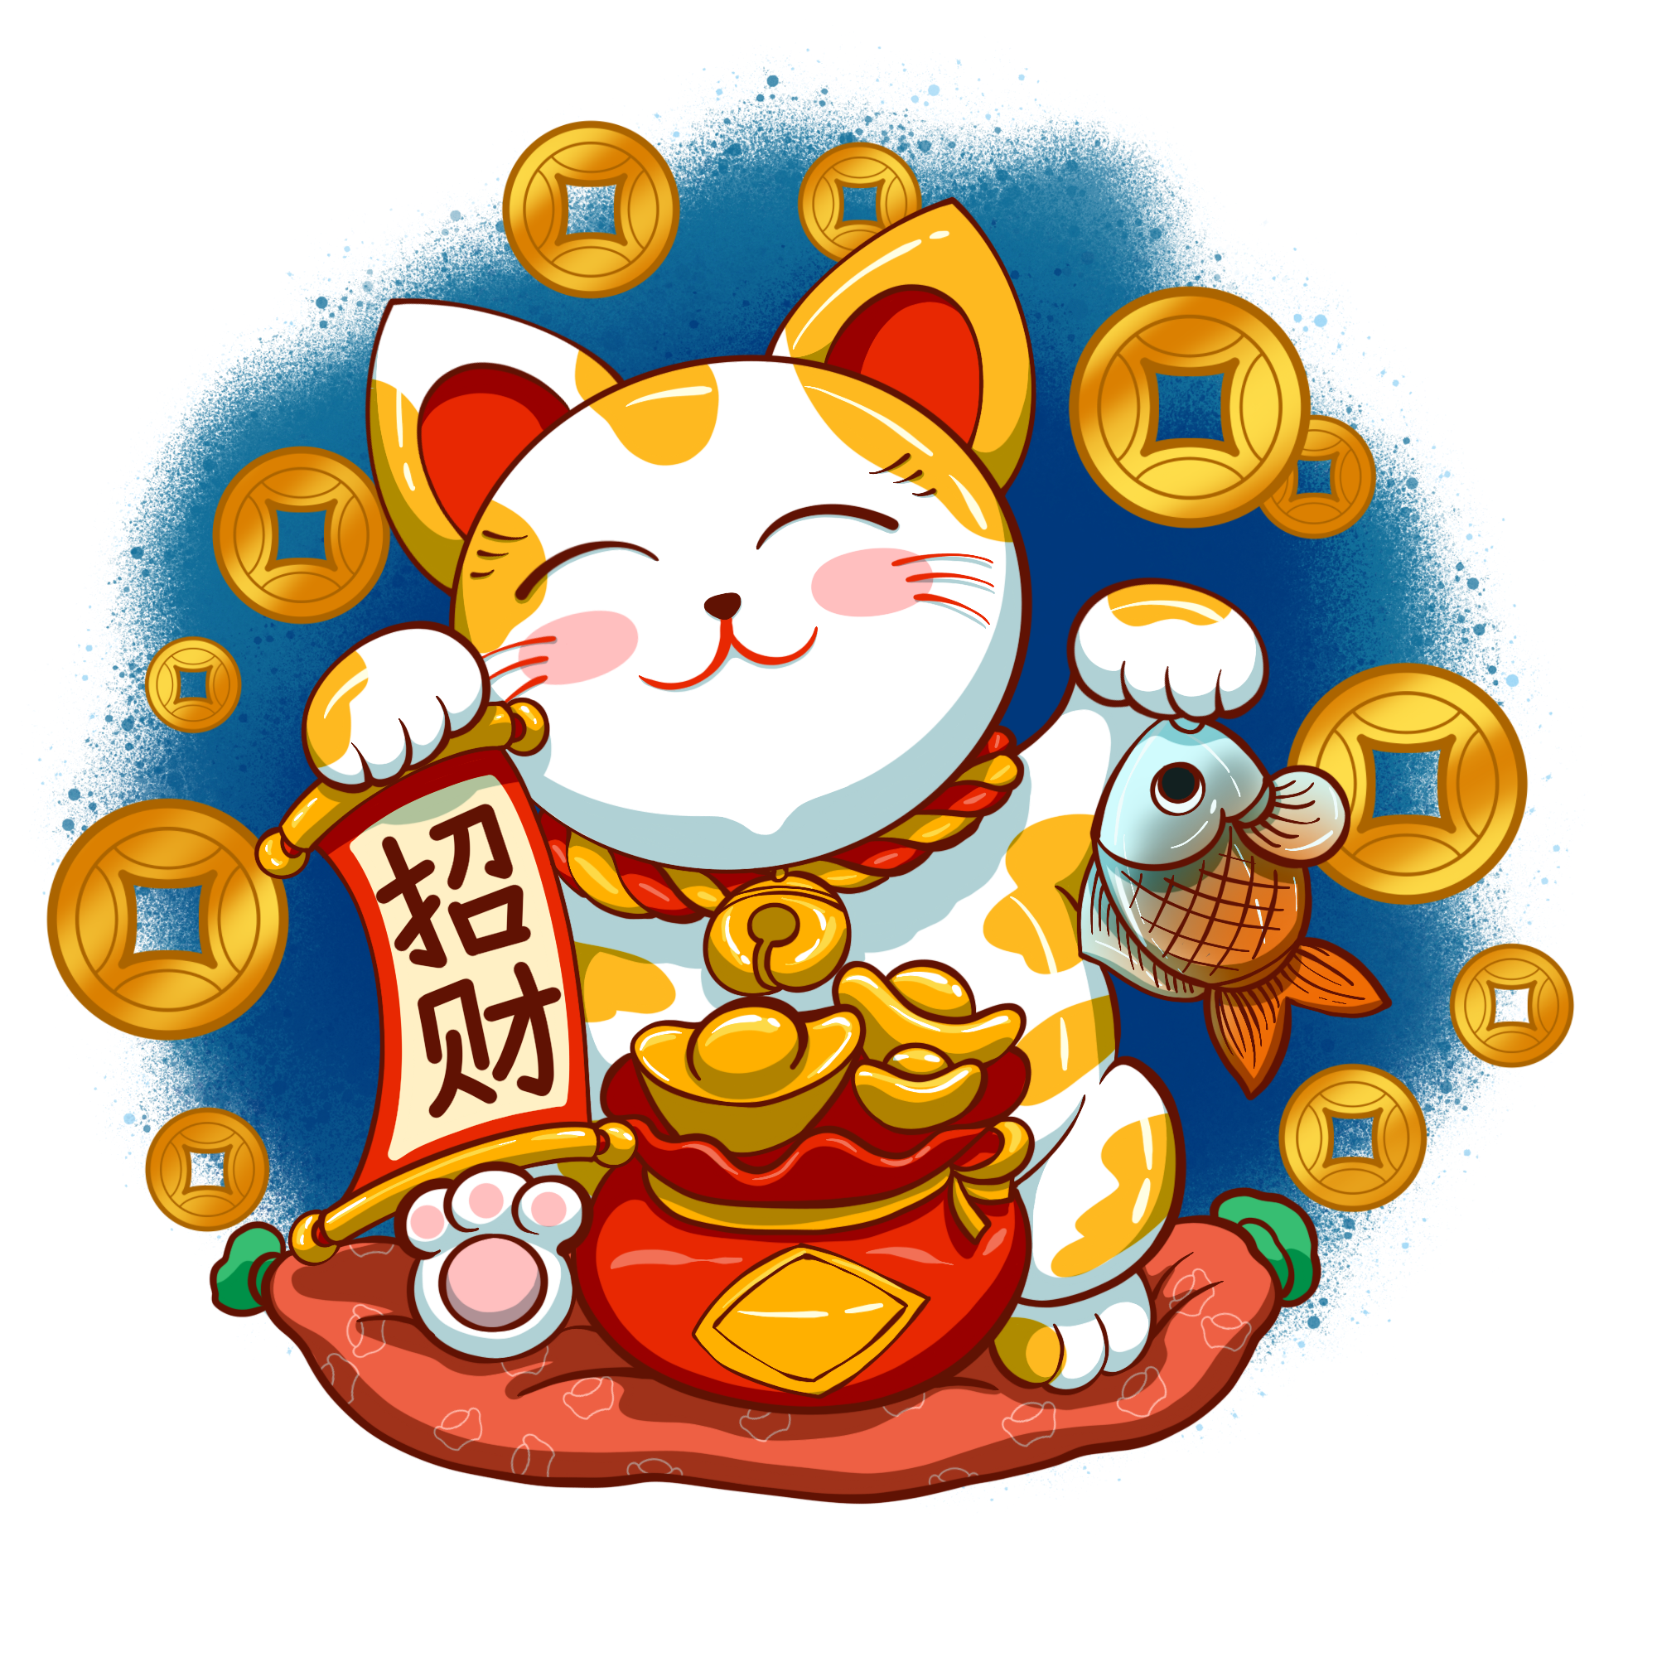
Tết

Slide 2
Tet
New Words
Từ vựng

Slide 3
Water melon
Banh Chung/ Chung cake
Happy Lunar Year

Slide 4
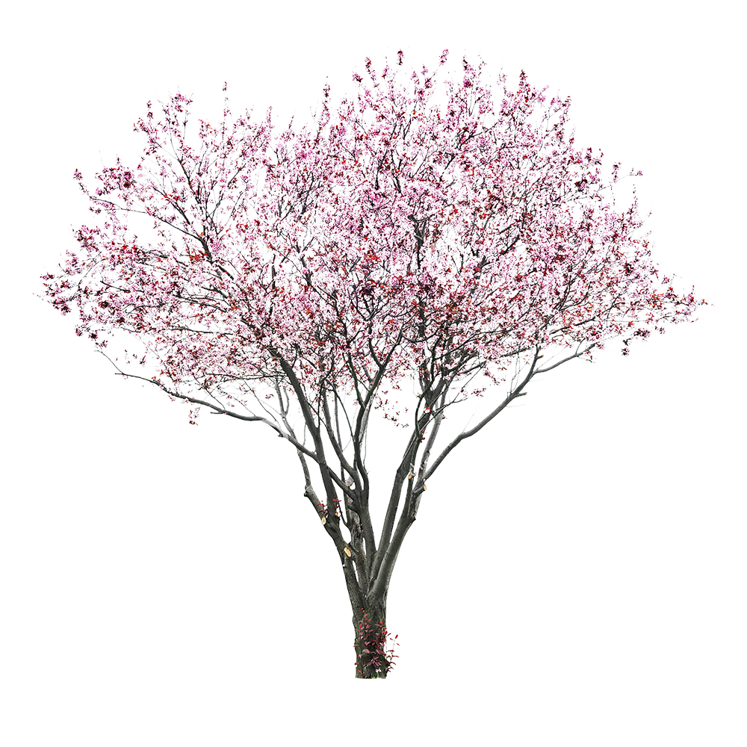
Lucky money
Peach blossom

Slide 5
Let watch a video What do you see?
https://www.youtube.com/watch?v=1seYuaWehxY

Slide 6
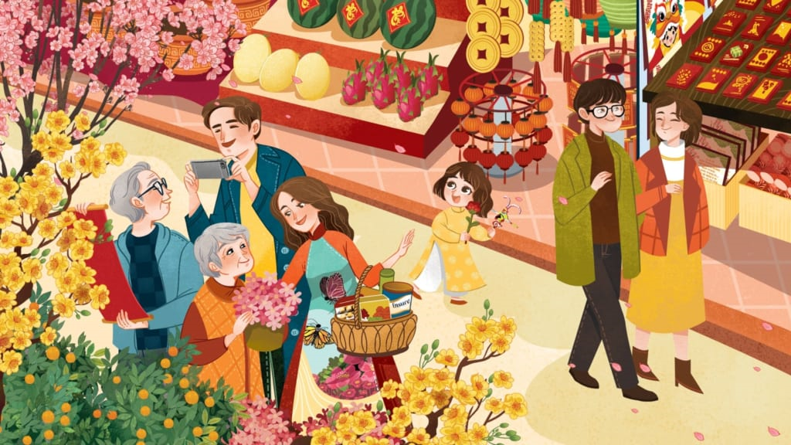
Go shopping

Slide 7
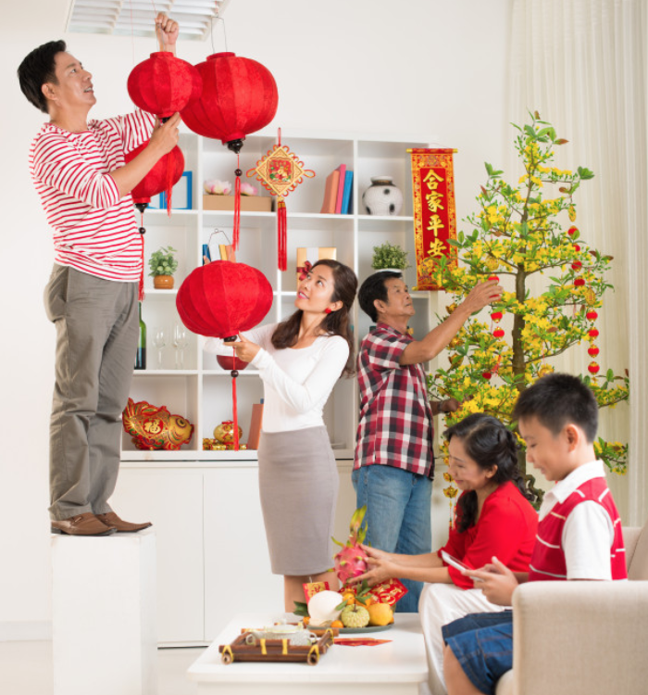
Clean the house

Slide 8
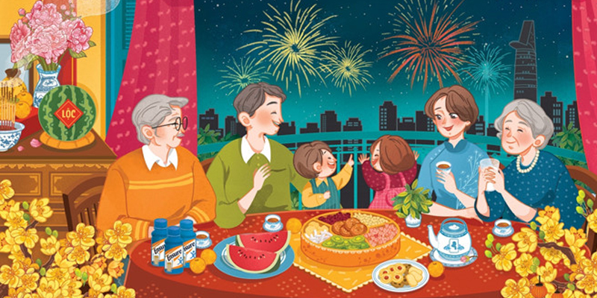
Watch firework

Slide 9
PLAY

Slide 11
HẾT GIỜ
What do you do on Tet holiday?
A
Clean the house
B
Cook Banh Chung
C
Go shopping

Slide 12
HẾT GIỜ
What do you do on Tet holiday?
A
Go shopping
B
Clean the house
C
Get lucky money
D
Watch fireworks

Slide 13
HẾT GIỜ
What do you do on Tet holiday?
A
Go home
B
Go shopping
C
Watch fireworks

Slide 14
HẾT GIỜ
What is it?
A
Pineapple
B
Peal
C
Watermelon

Slide 15
HẾT GIỜ
What is it?
A
Watermelon
B
fireworks
C
Lucky money
D
Peach blossom

Slide 16
HẾT GIỜ
What do you do on Tet?
A
Cook Banh Chung
B
Get Lucky money
C
Watch fireworks

Slide 17
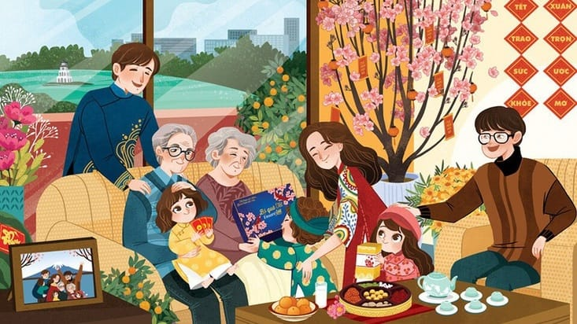
Visit relatives

Slide 18
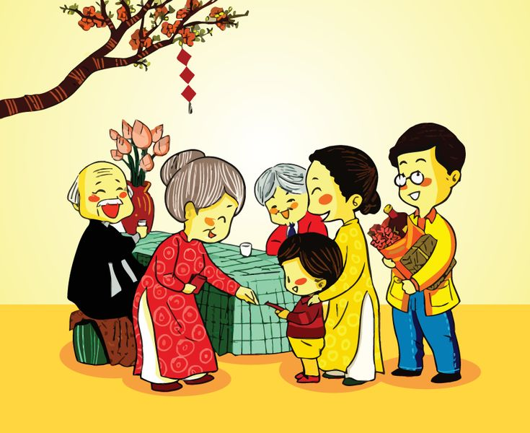
Get lucky money

Slide 19
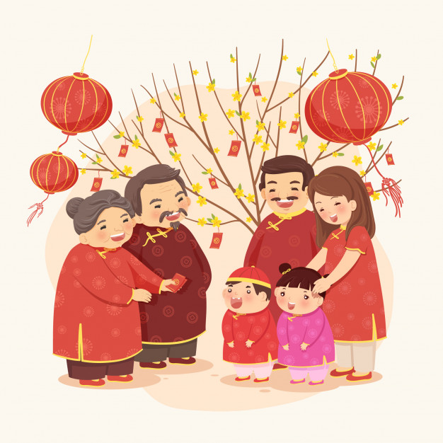
Tell a wish

Slide 20
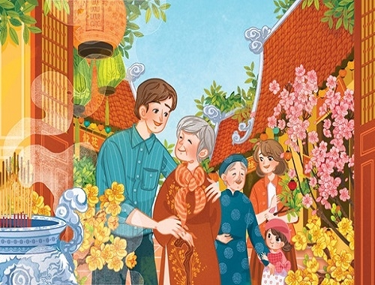
Go pagoda

Slide 21
Matching
tell
go
a wish
pagoda

Slide 22
Matching
visit
get
relatives
Lucky money

Slide 23
Matching
see
go
shopping
fireworks

Slide 24
Matching
tell
go
a wish
pagoda

Slide 25
Visit
get
go
relatives
Lucky money
pagoda

Slide 26
Fill in the blank
the house
pagoda
fireworks
shopping
Tet is coming. We clean _____________, and go ______________. On Tet, we watch ______________. We visit relatives and get Lucky money. We go ____________ and make a wish.

