Slide 1




English 7
Unit 1
Hobbies
Lesson 1: Getting started

Slide 2
English 7
Objectives
lexical items related to ‘Hobbies’

Slide 3


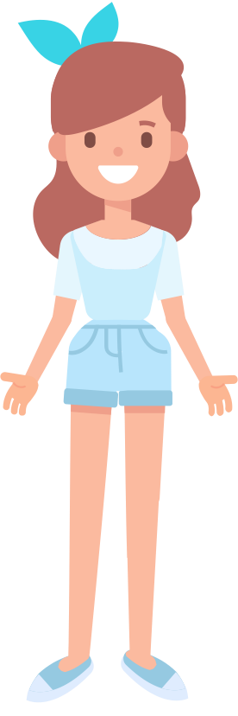



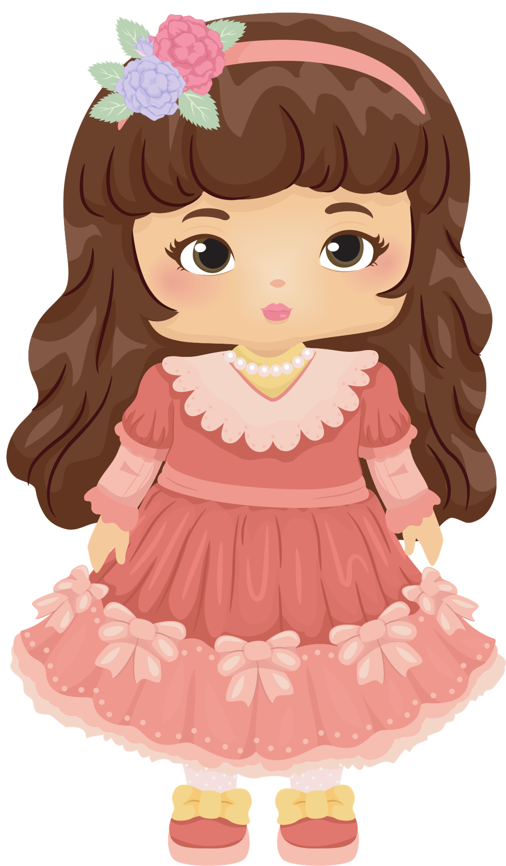
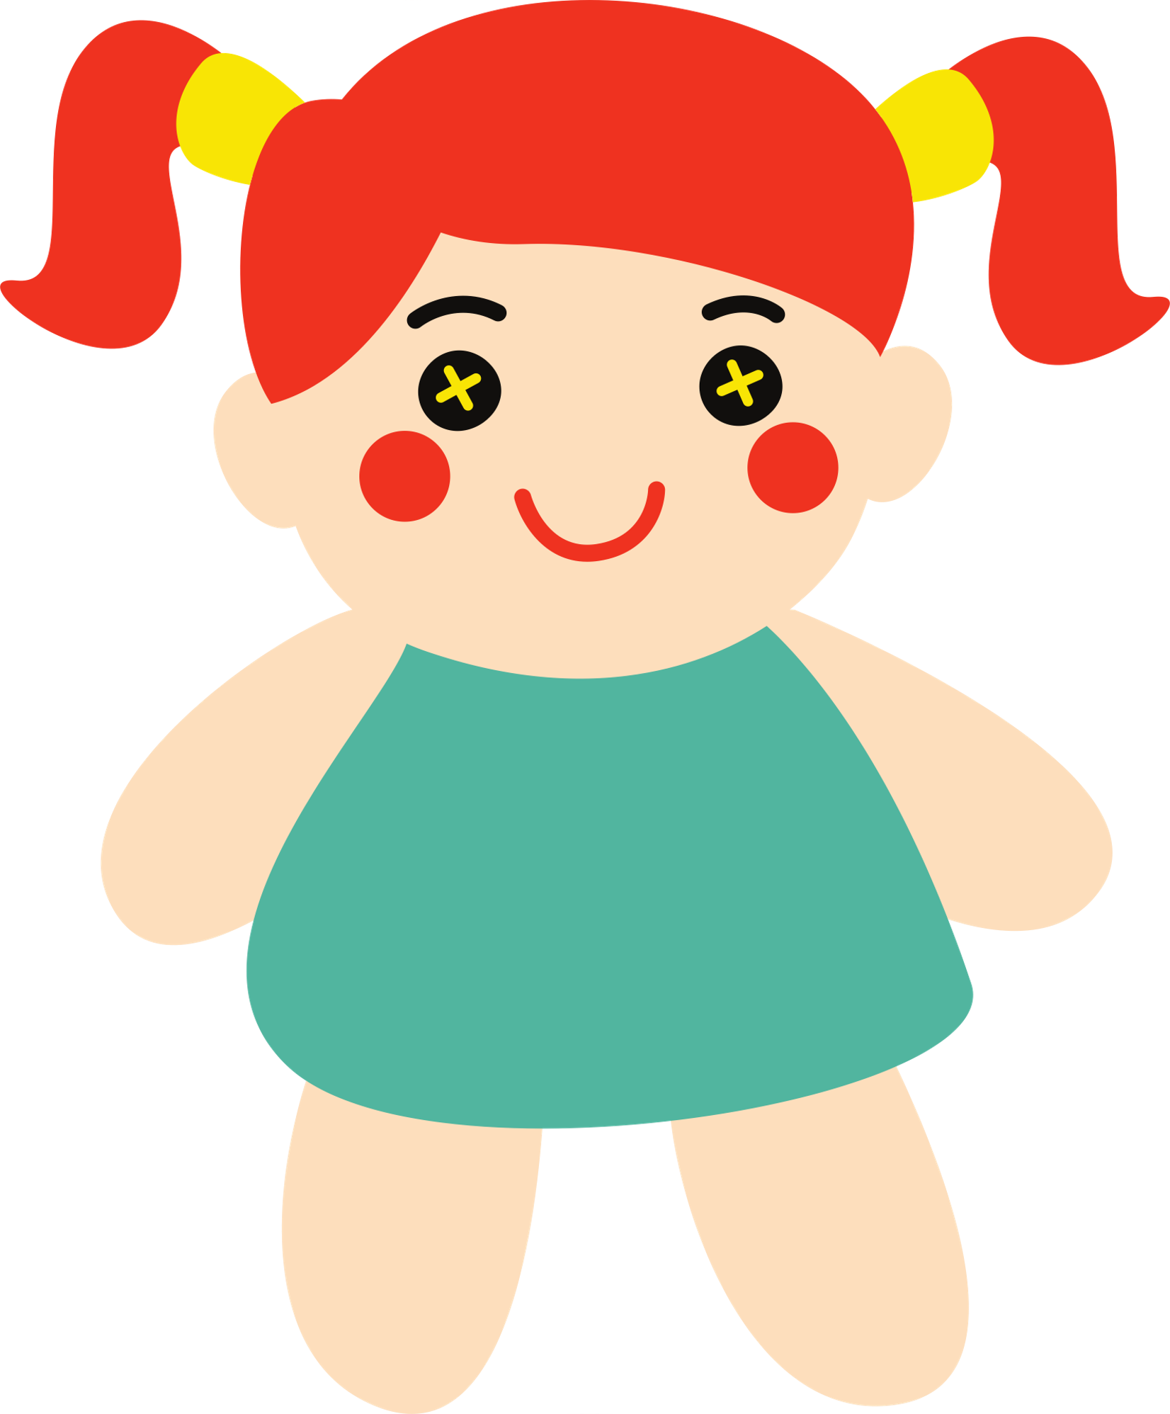

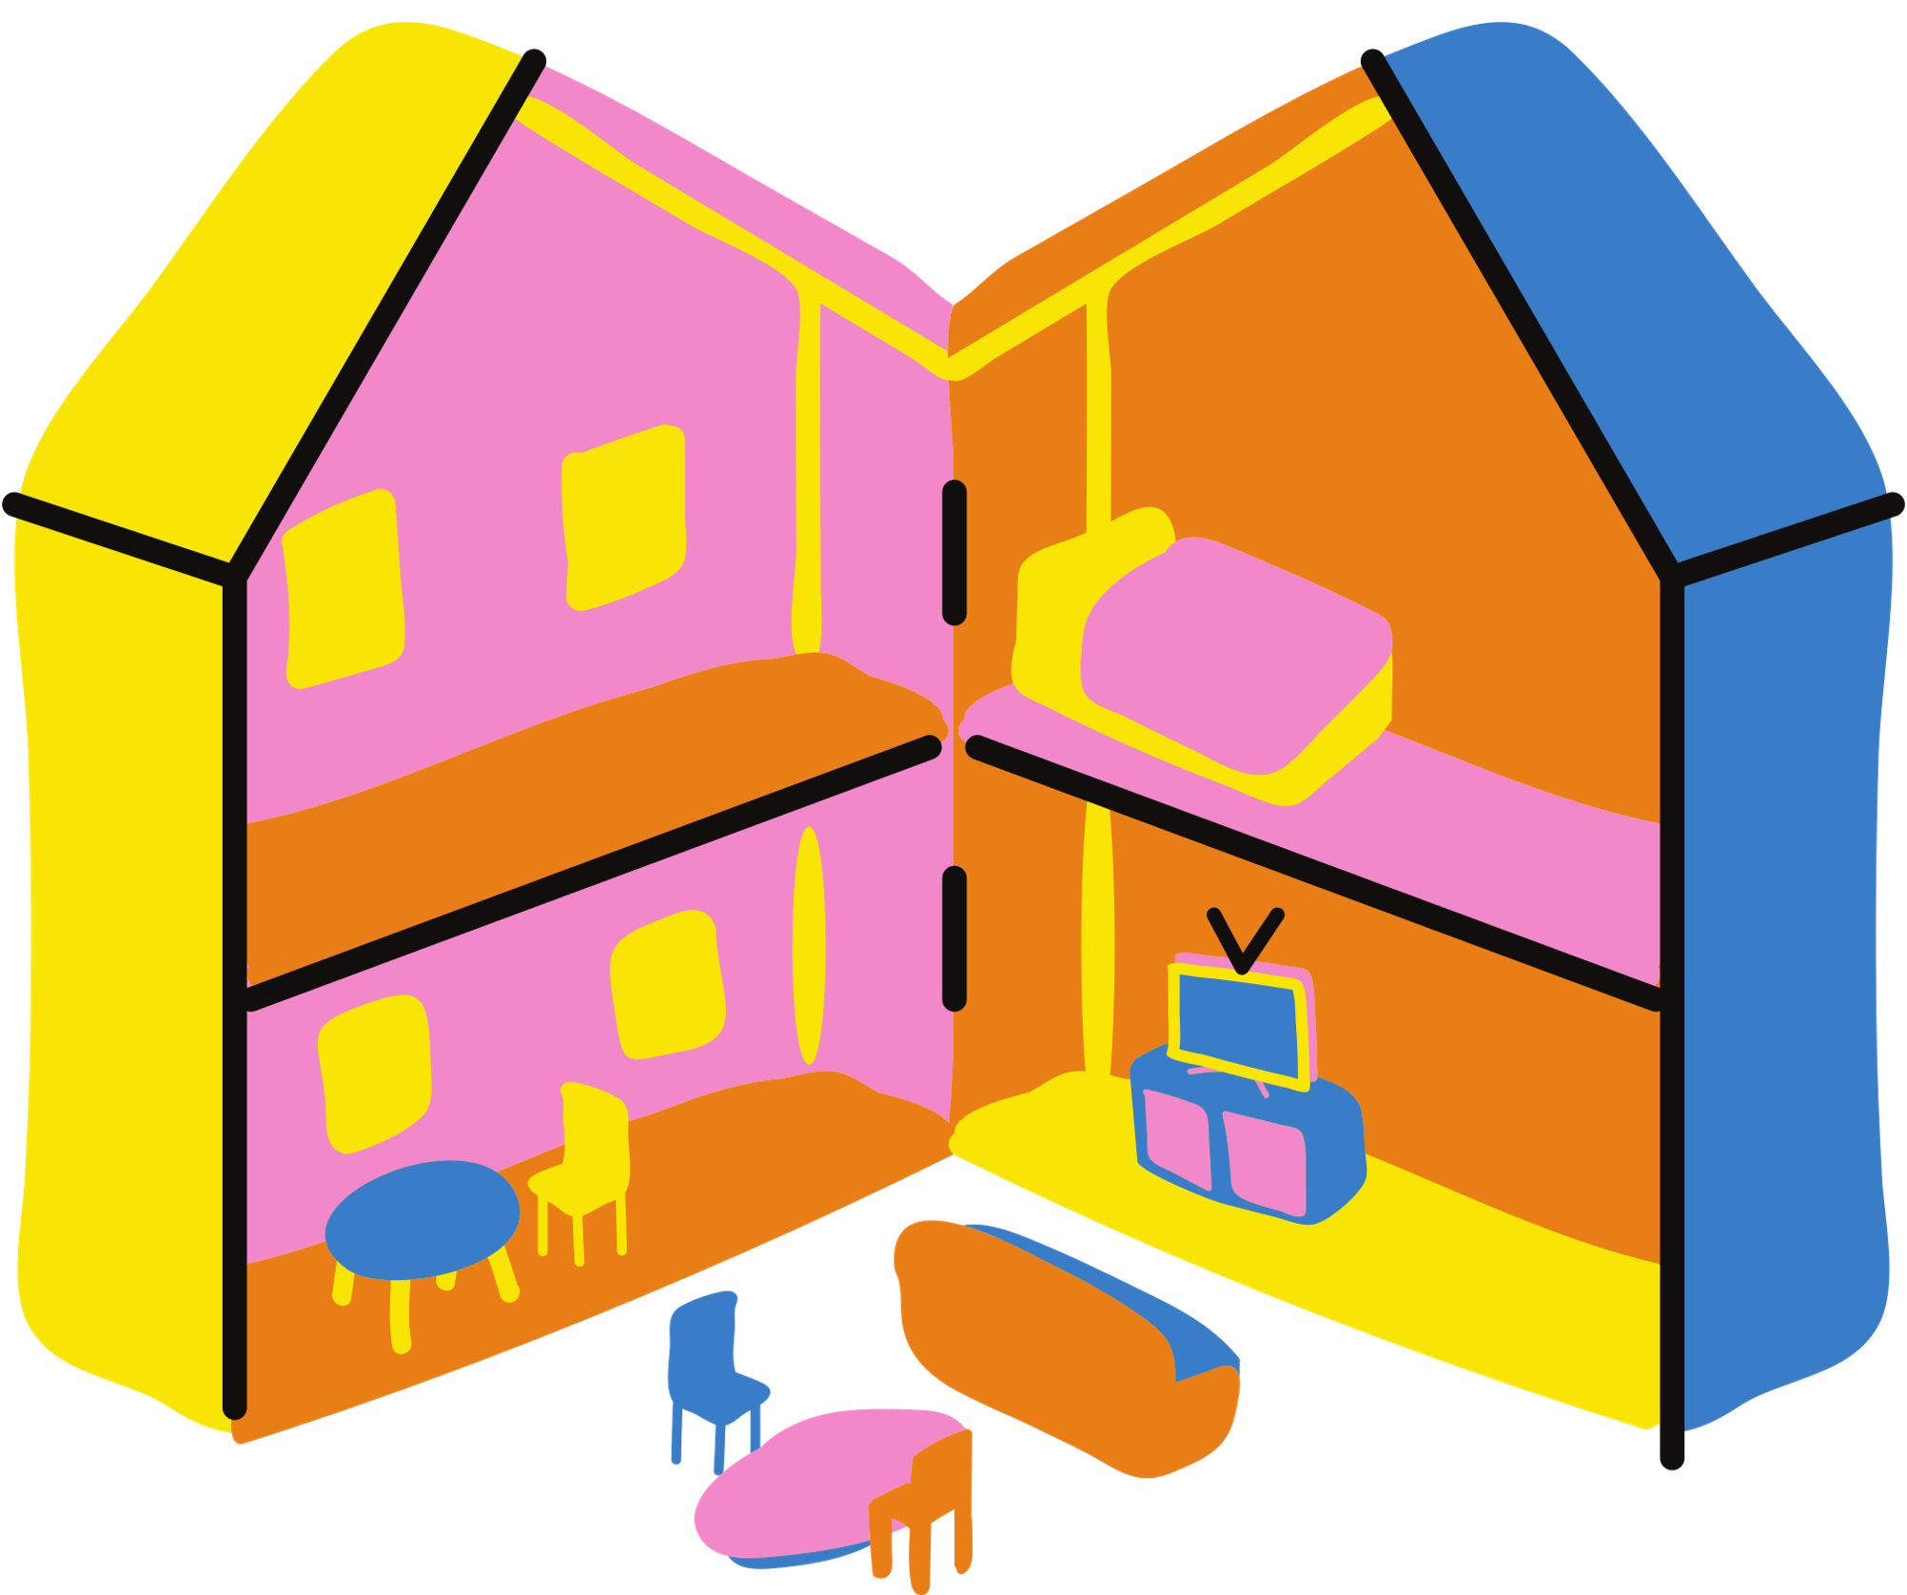
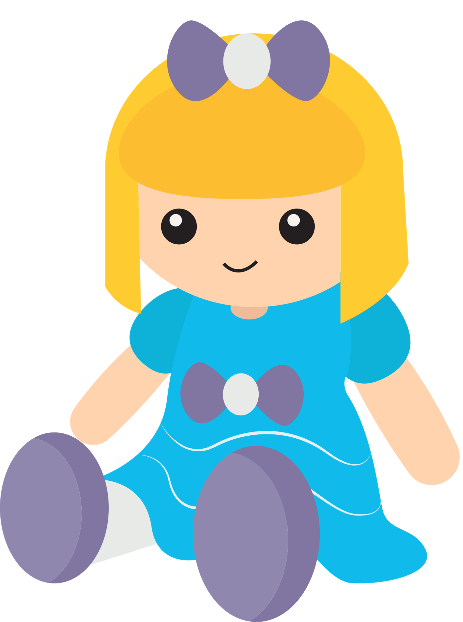

English 7
1. Who are they?
→ Ann and Trang
Trang
Trang
2. Where are they?
Ann
→ Trang’s house
3. What are they talking about?

Slide 4

English 7
Exercise 1 (p.8) Listen and read
Ann: Your house is very nice, Trang.
Trang: Thanks! Let's go upstairs. I'll show you my room.
Ann: I love your dollhouse. It's amazing. Did you make it yourself?
Trang: Yes. My hobby is building dollhouses.
Ann: Really? Is it hard to build one?
Trang: Not really. All you need is some cardboard and glue. Then just use a bit of creativity. What do you do in your free time?
Ann: I like horse riding.
Trang: That's rather unusual. Not many people do that.
Ann: Actually, it's more common than you think. There are some horse riding clubs in Ha Noi now. I go to the Riders' Club every Sunday.
Trang: I'd love to go to your club this Sunday. I want to learn how to ride.
Ann: Sure. My lesson starts at 8 a.m.
Ann: Your house is very nice, Trang.
Trang: Thanks! Let's go upstairs. I'll show you my room.
Ann: I love your dollhouse. It's amazing. Did you make it yourself?
Trang: Yes. My hobby is building dollhouses.
Ann: Really? Is it hard to build one?
Trang: Not really. All you need is some cardboard and glue. Then just use a bit of creativity. What do you do in your free time?
Ann: I like horse riding.
Trang: That's rather unusual. Not many people do that.
Ann: Actually, it's more common than you think. There are some horse riding clubs in Ha Noi now. I go to the Riders' Club every Sunday.
Trang: I'd love to go to your club this Sunday. I want to learn how to ride.
Ann: Sure. My lesson starts at 8 a.m.

Slide 5

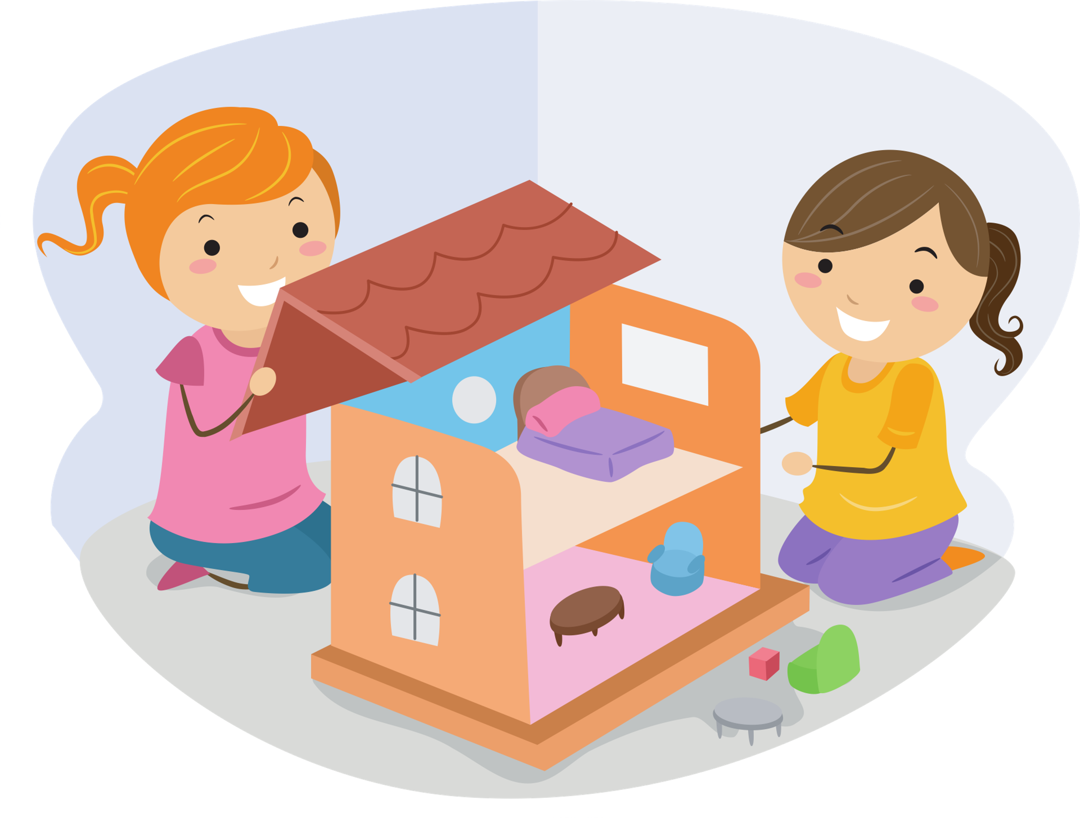
English 7
Exercise 1 (p.8) Listen and read
building dollhouses
horse riding

Slide 6
English 7
Exercise 2 (p.9) Read and underline key words.
1. Trang needs help with building dollhouses.
2. Trang uses glue and cardboard to build her dollhouse.
3. To build a dollhouse, you need to use your creativity.
4. Ann goes to a horse riding club every Sunday.
5. Ann’s lesson starts at 8 p.m.

Slide 7
English 7
Exercise 2 (p.9) Check and write T (True) and F (False).
1. Trang needs help with building dollhouses.
F
Ann: I love your dollhouse. It's amazing. Did you make it yourself?
Trang: Yes. My hobby is building dollhouses.
T
2. Trang uses glue and cardboard to build her dollhouse.
Ann: Really? Is it hard to build one?
Trang: Not really. All you need is some cardboard and glue. Then just use a bit of creativity.

Slide 8
English 7
Exercise 2 (p.9) Check and write T (True) and F (False).
T
3. To build a dollhouse, you need to use your creativity.
Ann: Really? Is it hard to build one?
Trang: Not really. All you need is some cardboard and glue. Then just use a bit of creativity.
4. Ann goes to a horse riding club every Sunday.
T
Ann: Actually, it's more common than you think. There are some horse riding clubs in Ha Noi now. I go to the Riders' Club every Sunday.
5. Ann’s lesson starts at 8 p.m.
F
Trang: I'd love to go to your club this Sunday. I want to learn how to ride.
Ann: Sure. My lesson starts at 8 a.m.

Slide 9
English 7
Exercise 2 (p.9) Check and write T (True) and F (False).
1. Trang needs help with building dollhouses.
2. Trang uses glue and cardboard to build her dollhouse.
3. To build a dollhouse, you need to use your creativity.
4. Ann goes to a horse riding club every Sunday.
5. Ann’s lesson starts at 8 p.m.
F
T
T
T
F

Slide 10
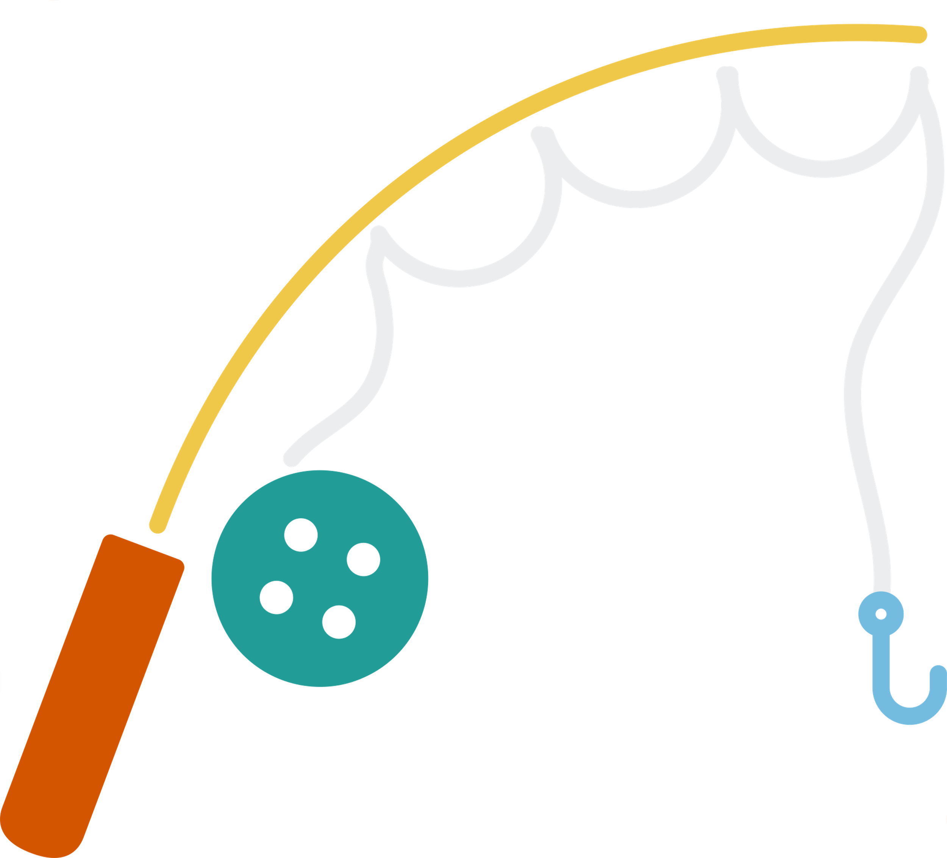



English 7
GAME: TYPHOON
Student picks a number
Answer the question to open the box
your points
steal points
blow points

Slide 11







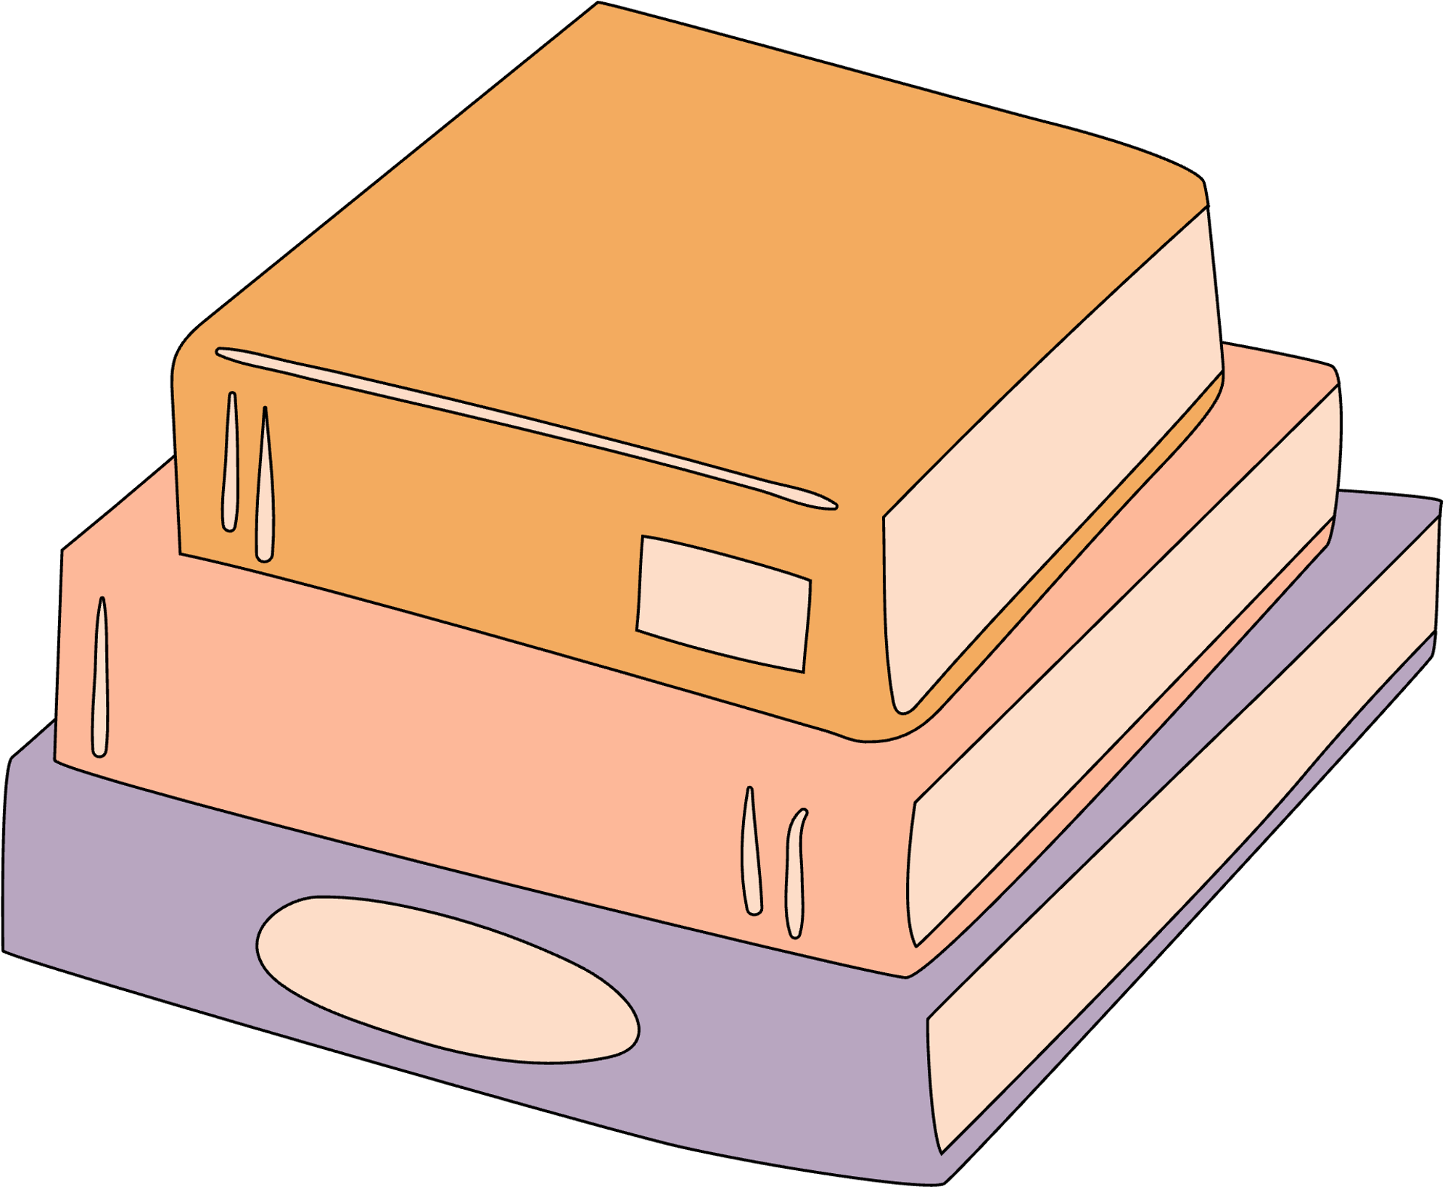
ENGLISH 7

Slide 12


building dollhouses

Slide 13
horse riding

Slide 14
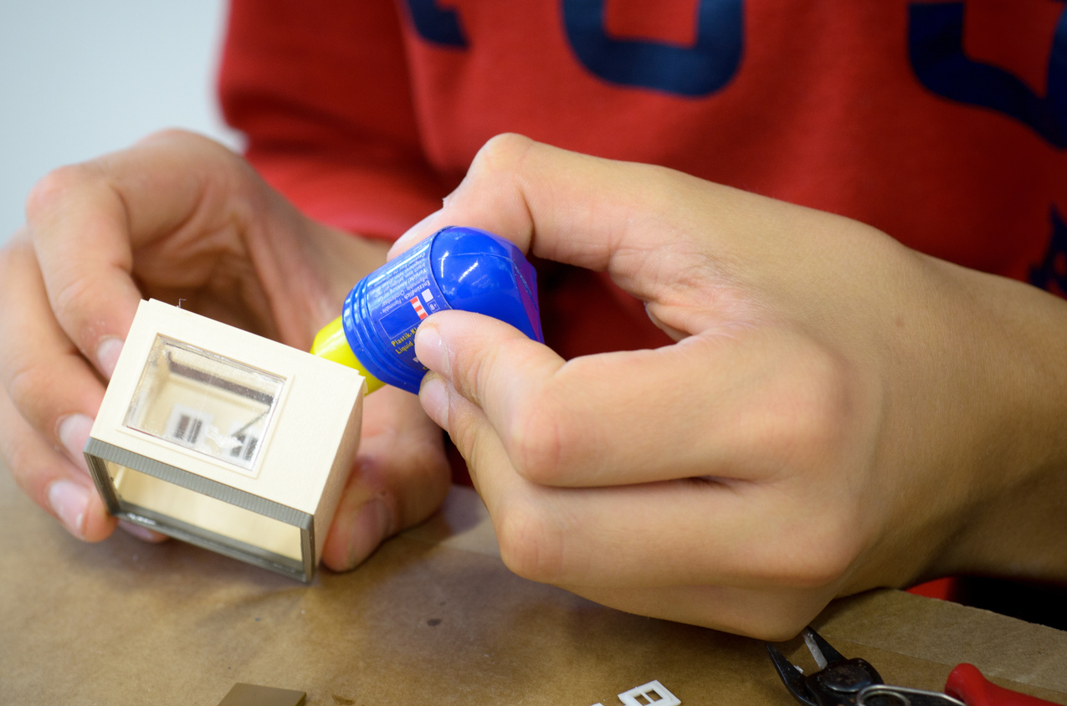
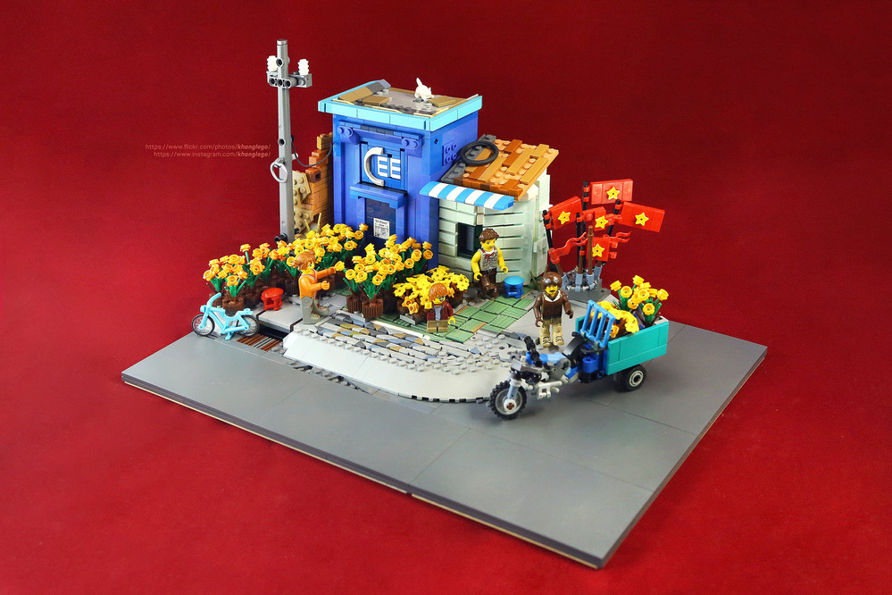
making models

Slide 15
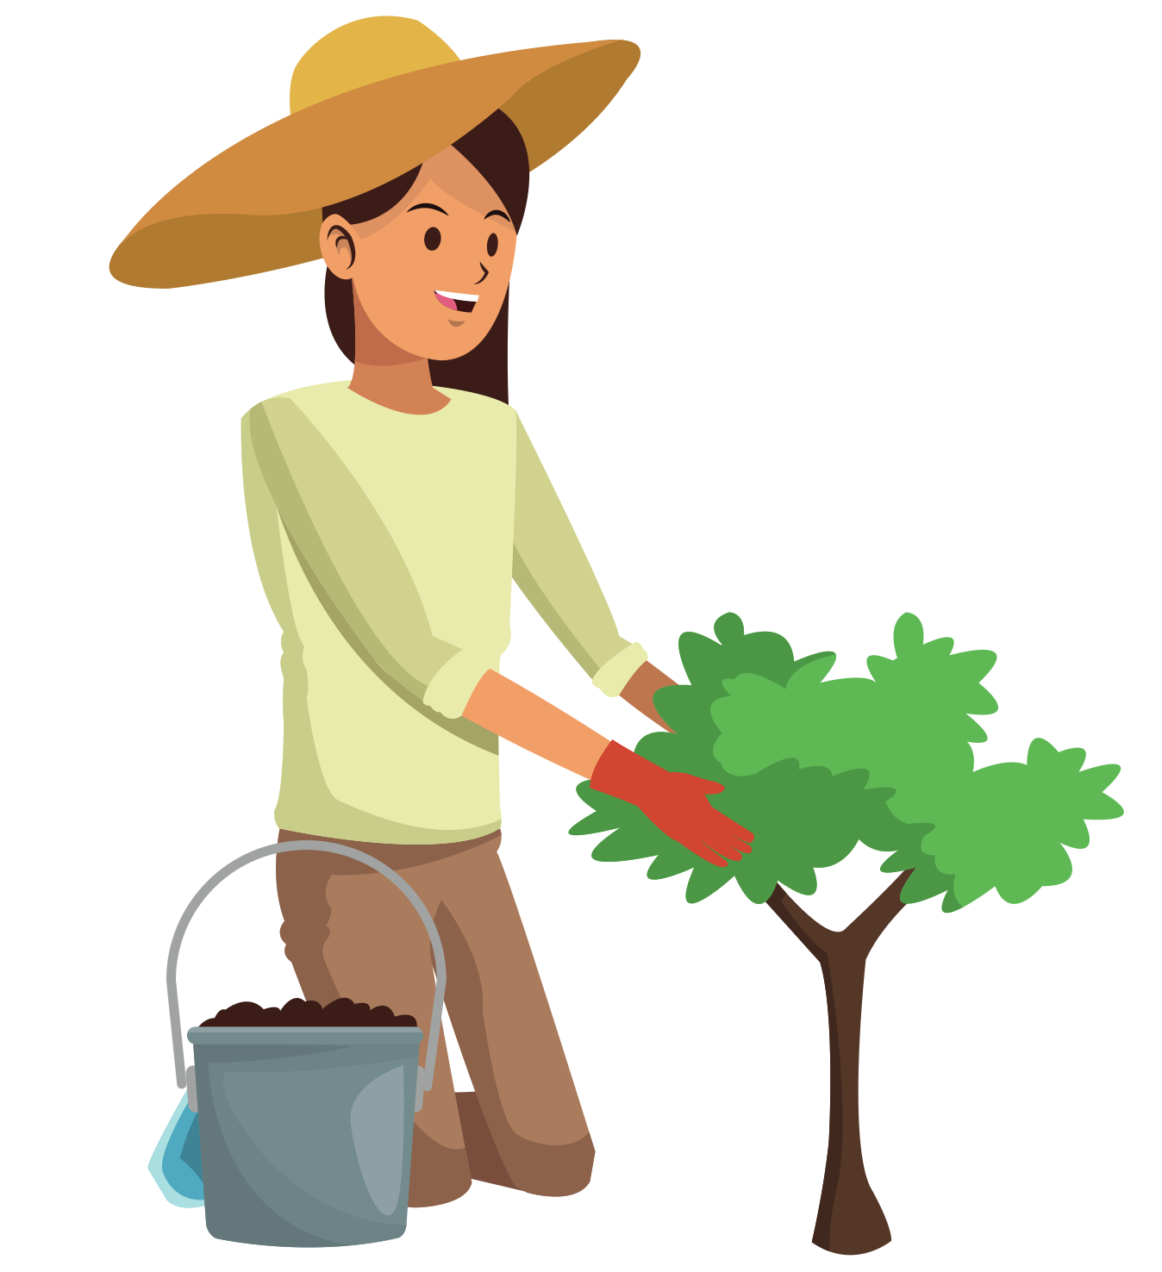
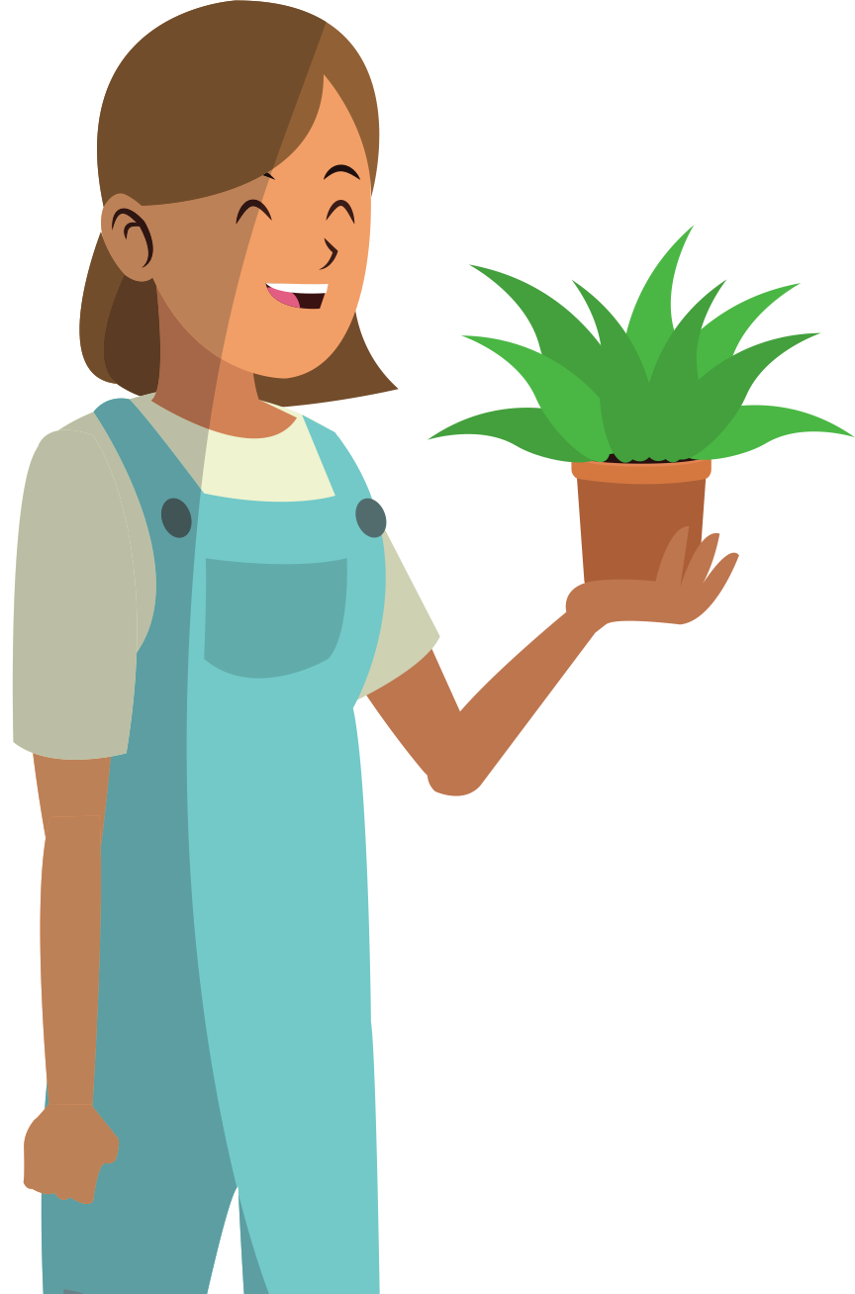
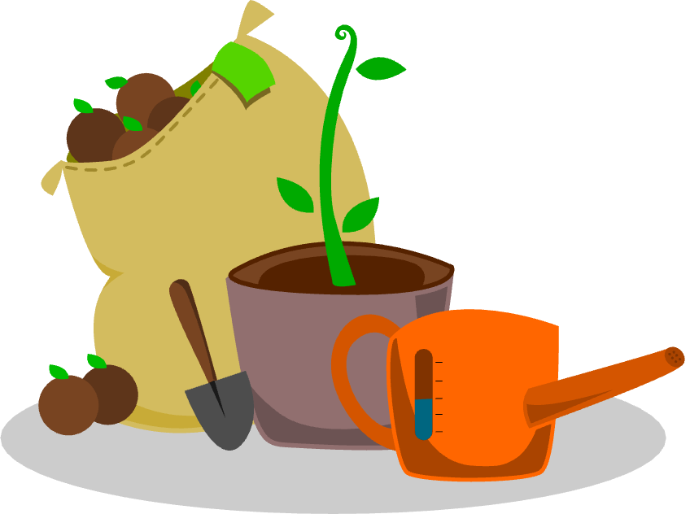
gardening

Slide 16
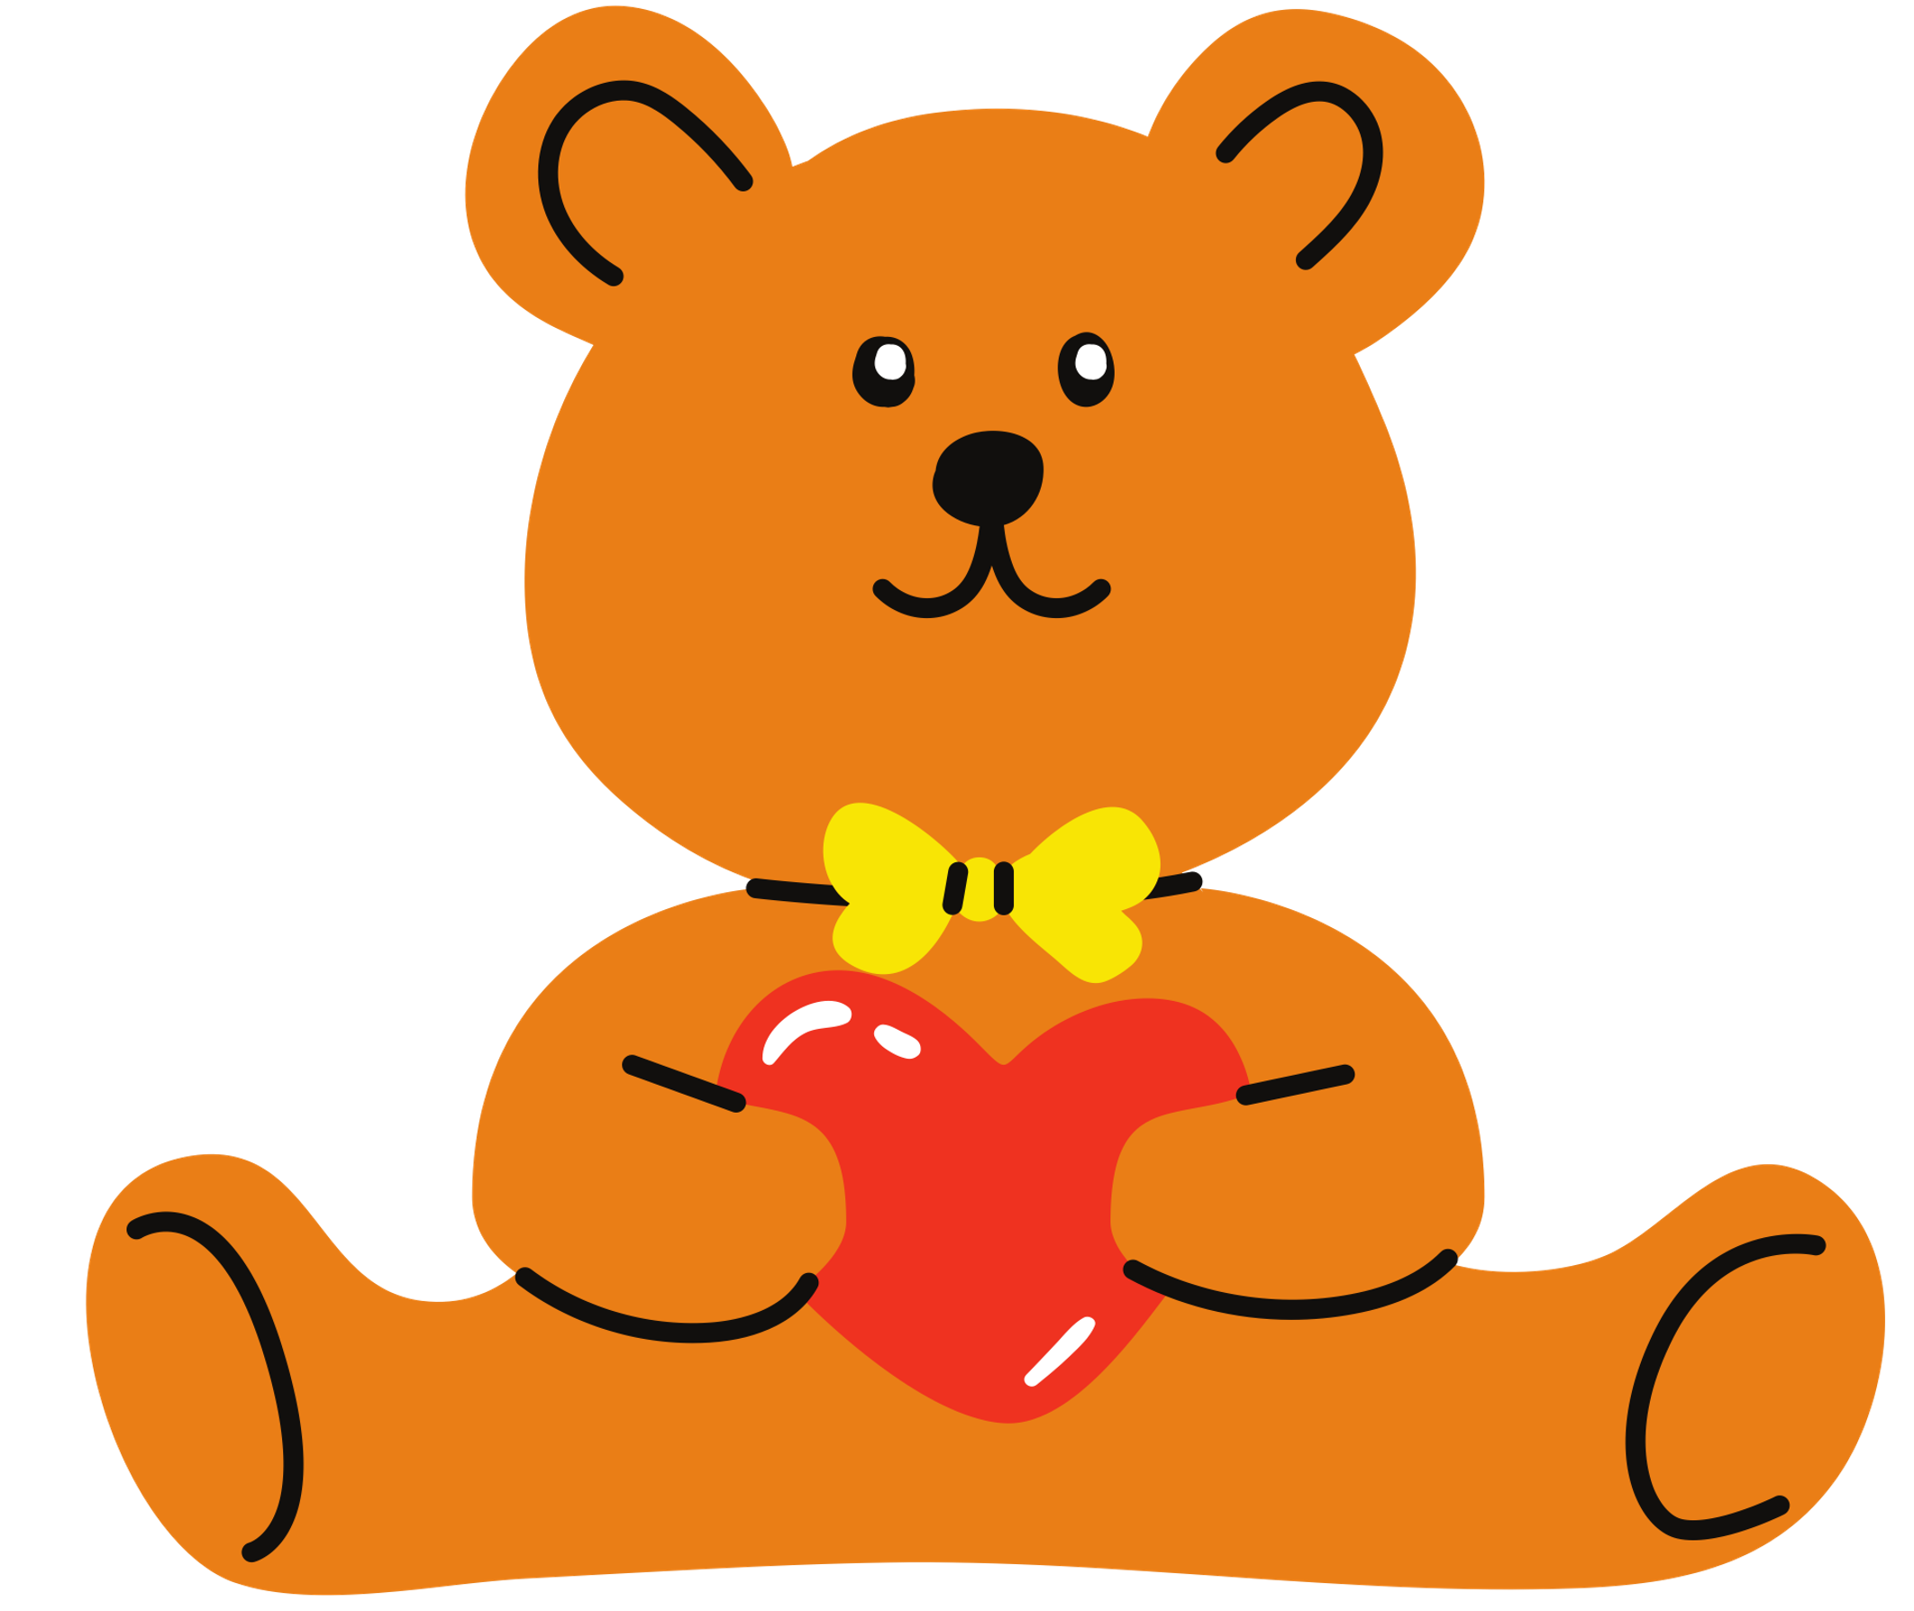
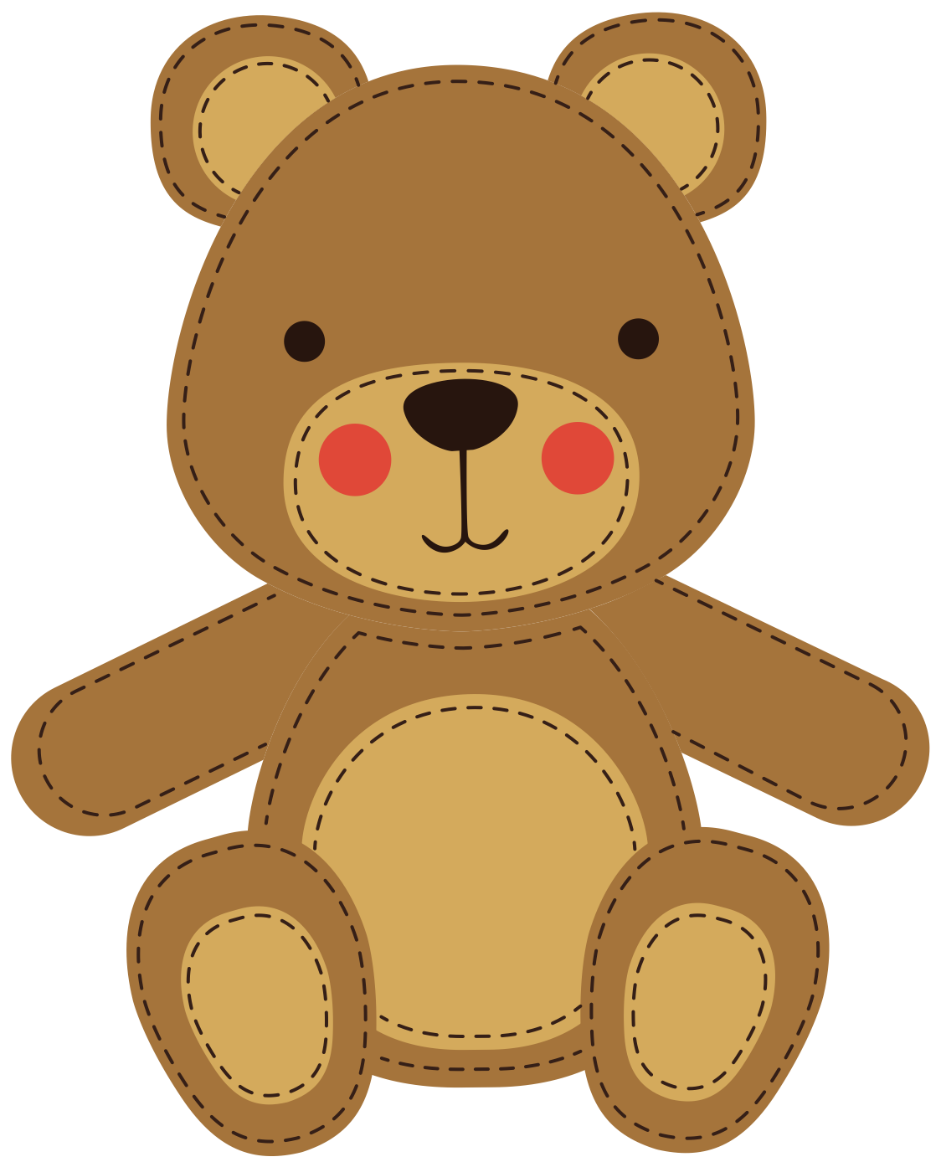
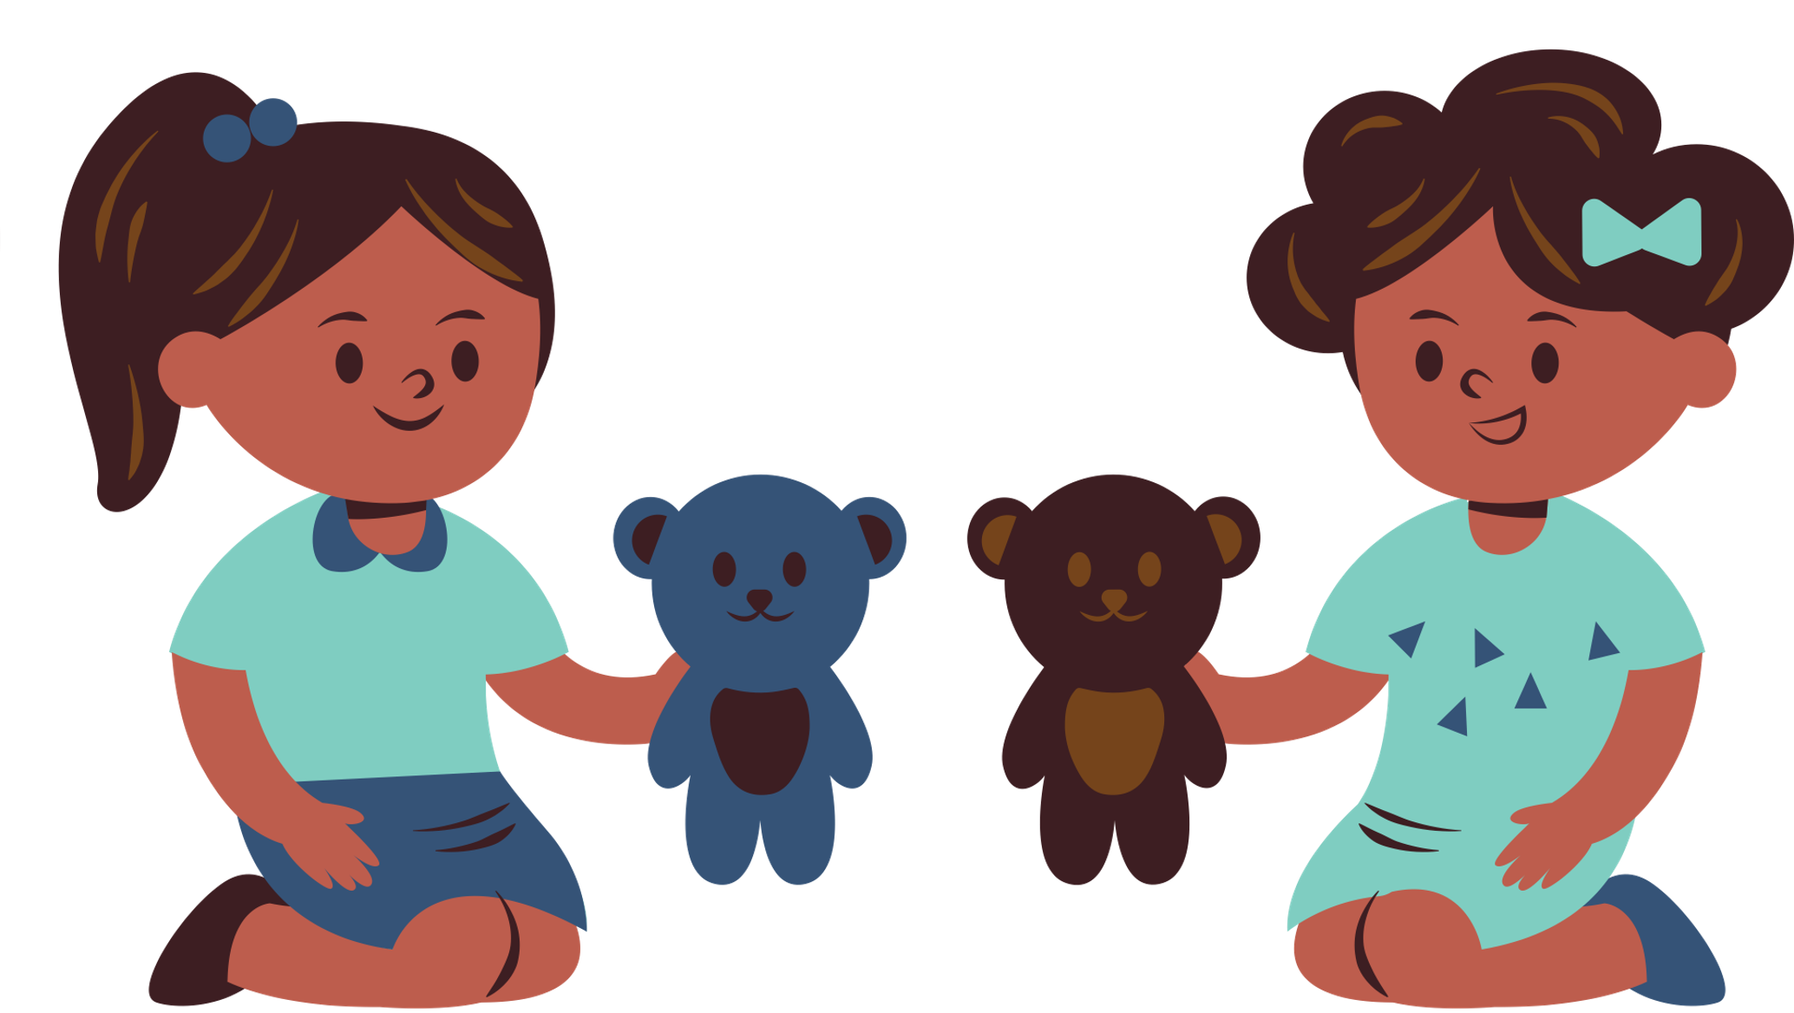
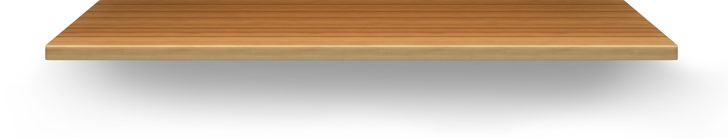

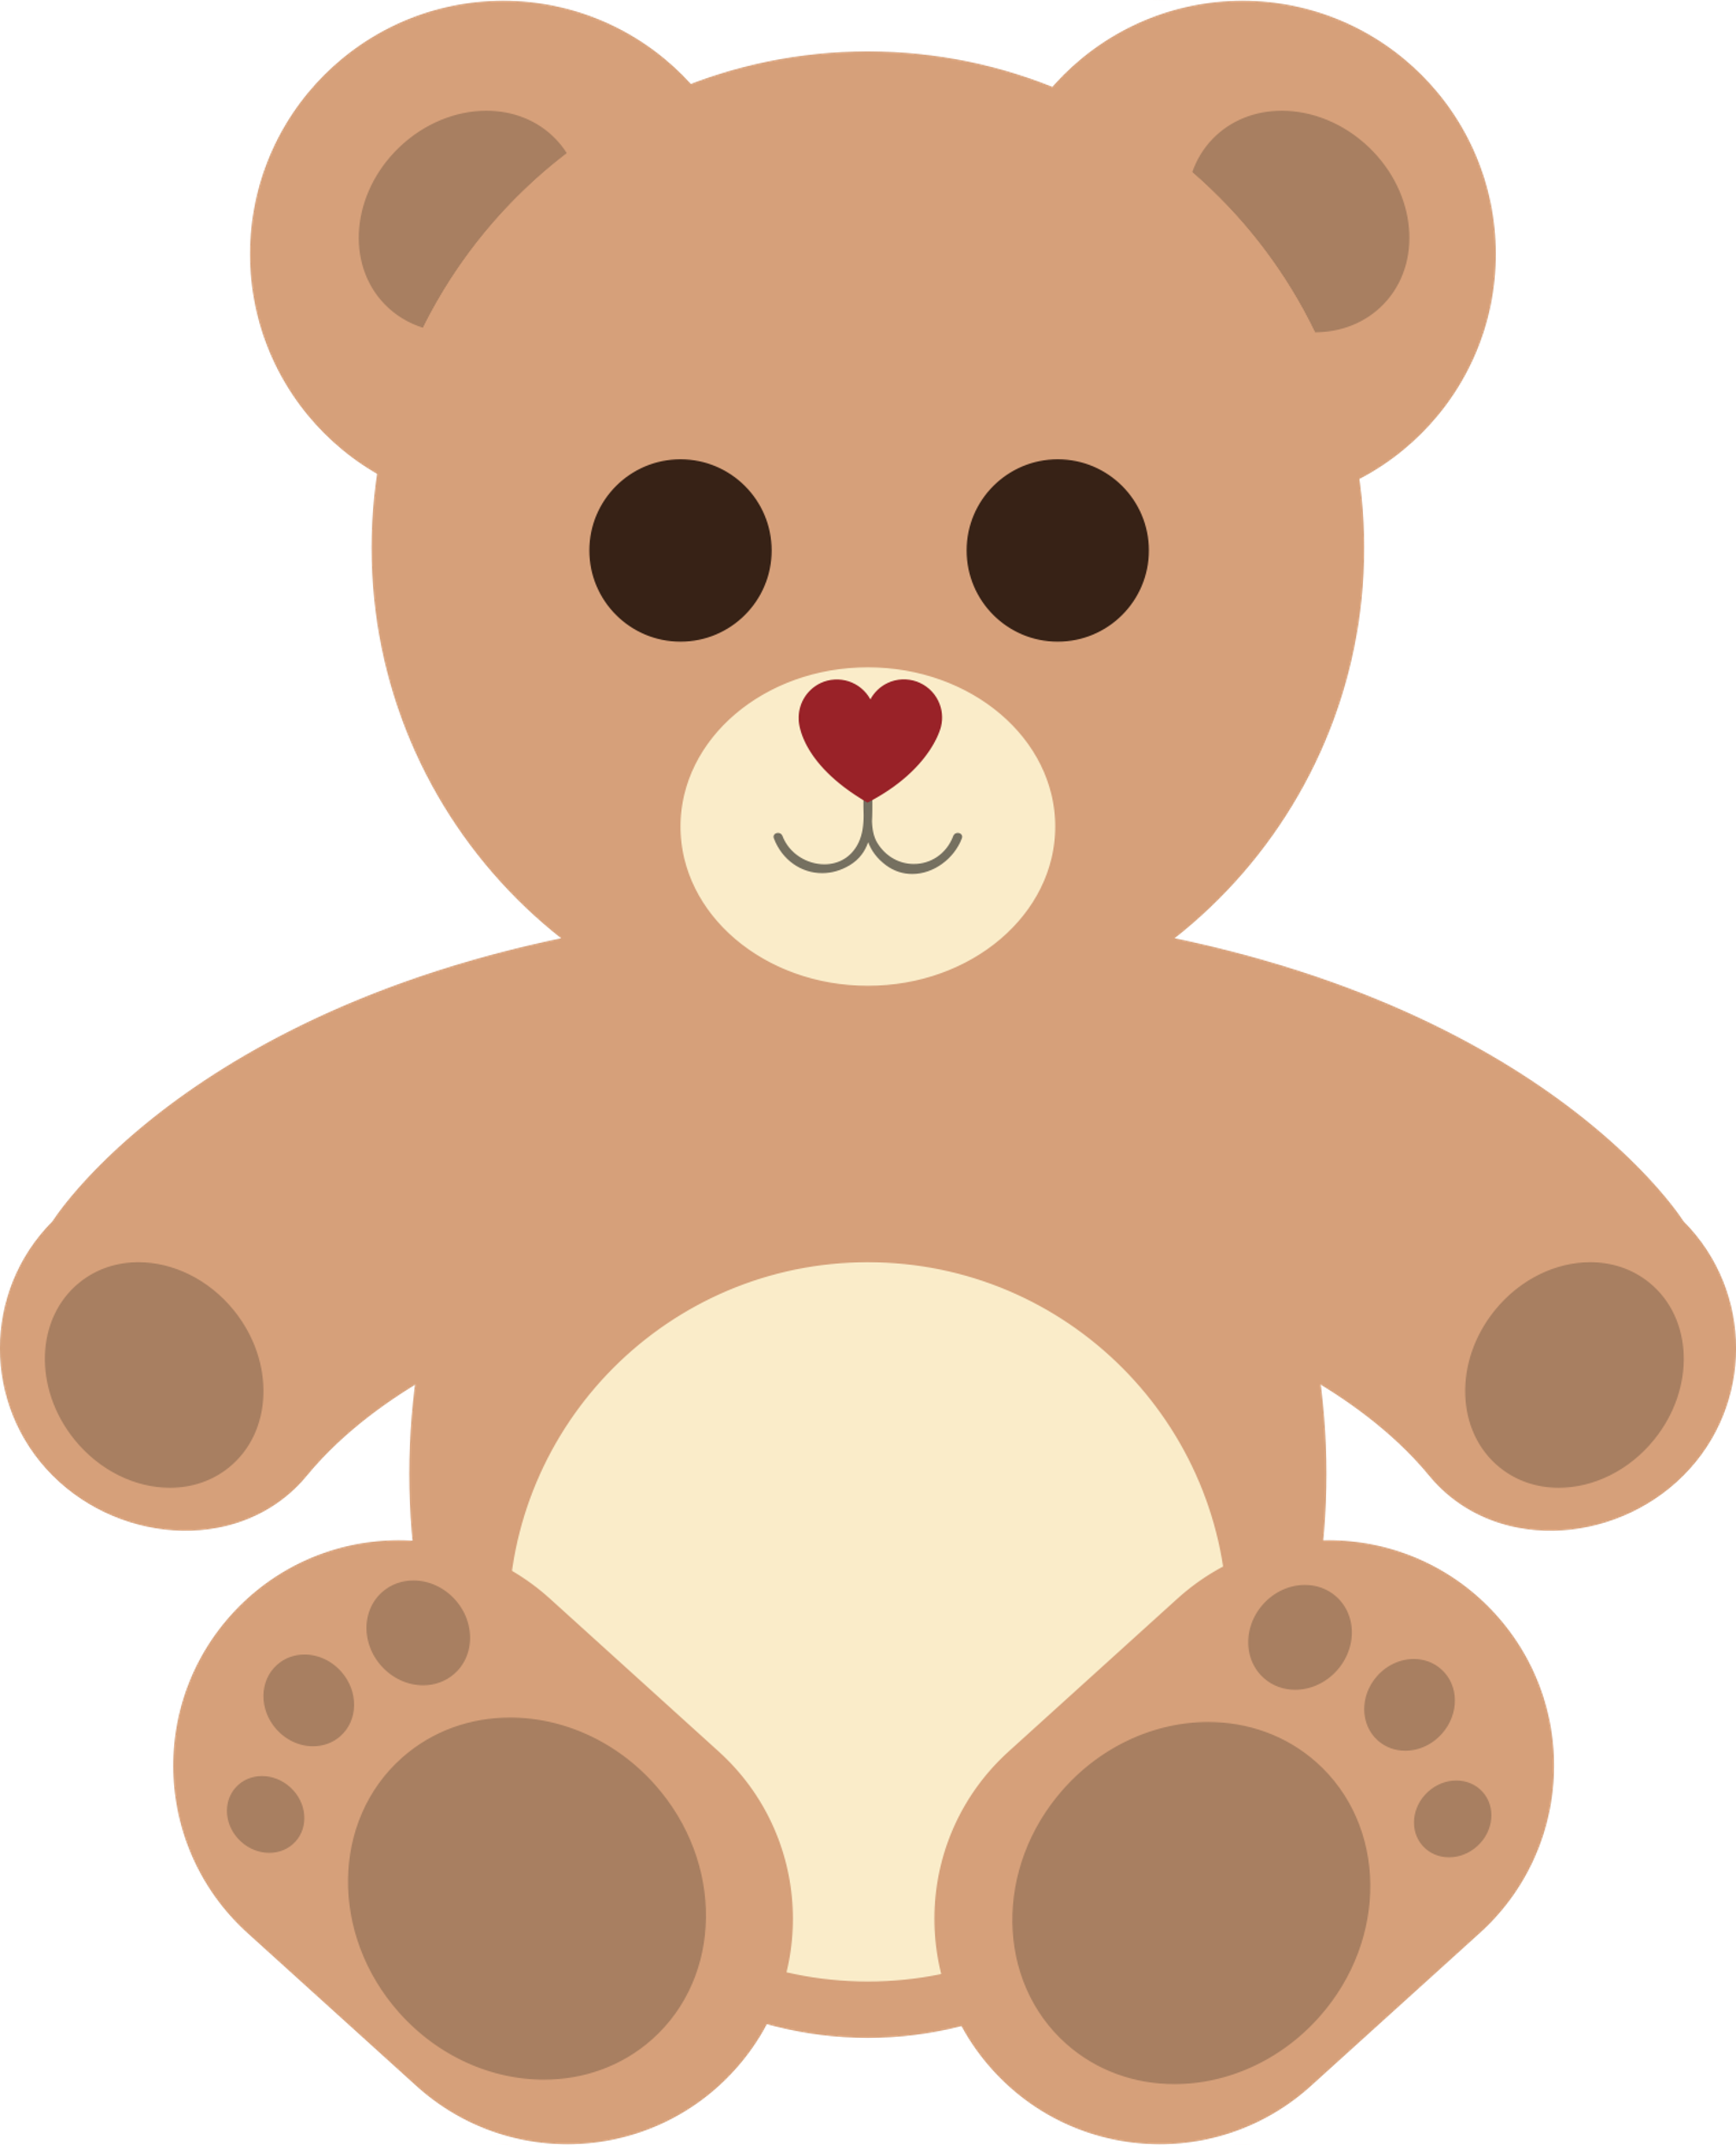
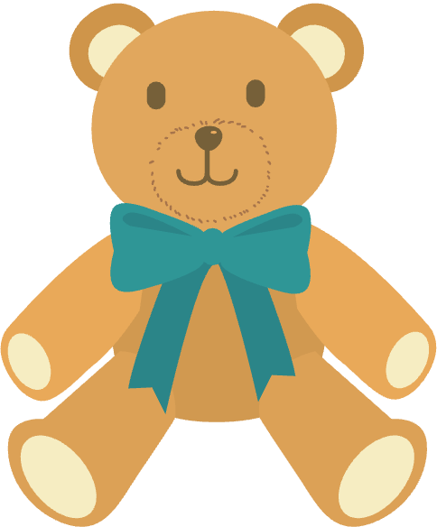
collecting teddy bears

Slide 17
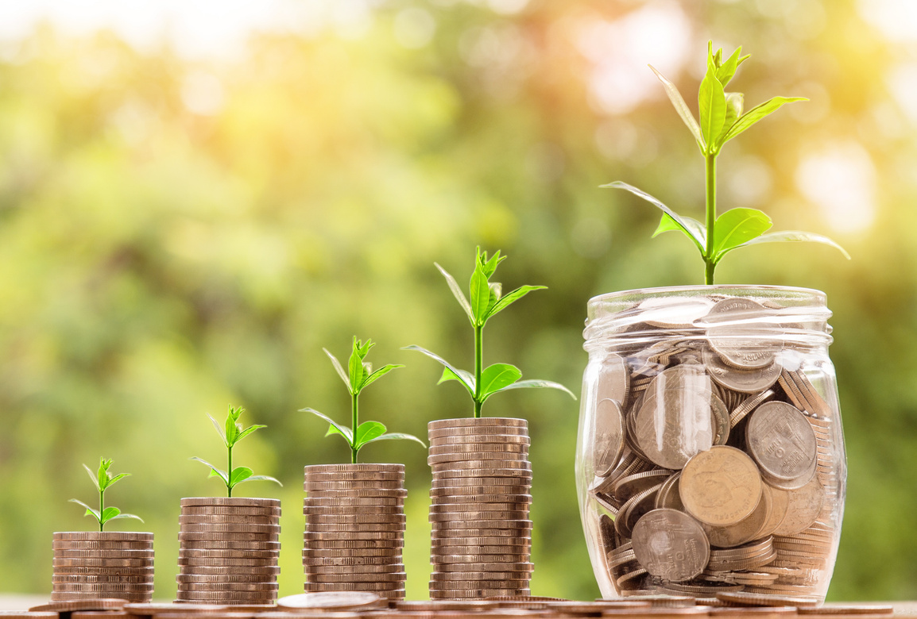
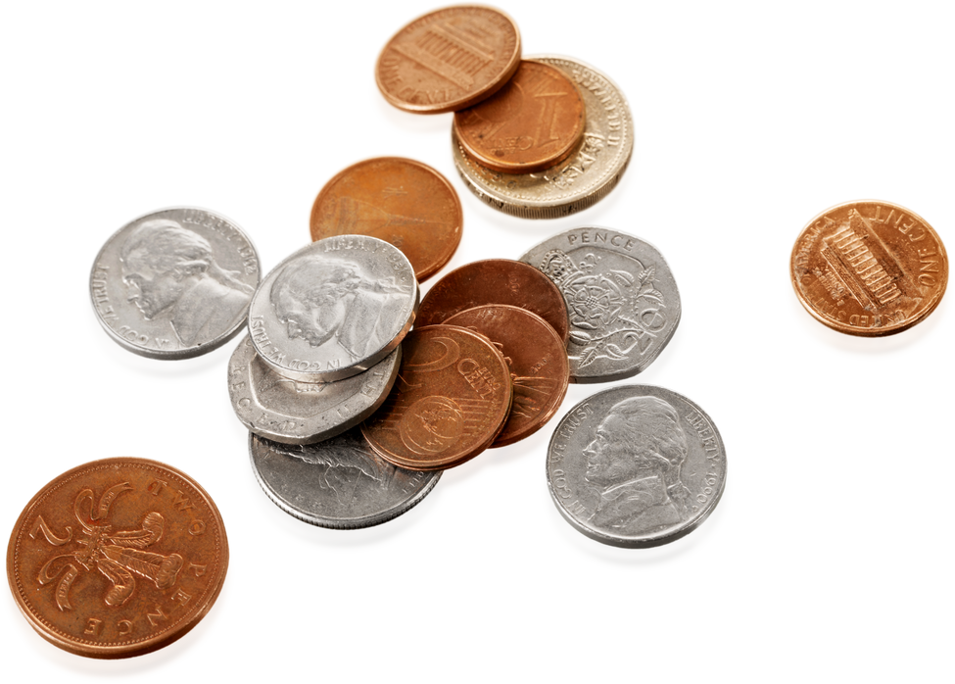
collecting coins

Slide 18

horse riding /ˈhɔːs raɪdɪŋ/
making models /ˈmeɪkɪŋ ˈmɒdlz /
gardening /ˈɡɑːdnɪŋ/
collecting teddy bears
/kəlektɪŋ ˈtedi beə(r)z/
collecting coins /kəlektɪŋ kɔɪnz/
building dollhouses /ˈˈbɪldɪŋˈdɒlhaʊsiz/
cưỡi ngựa
làm mô hình
làm vườn
sưu tập gấu bông
sưu tập tiền xu
làm nhà búp bê

Slide 19

File
Edit
View
Exercise 4 (p.9)
Work in pairs. Write the hobbies from 3 in the suitable column.
doing things
making things
collecting things
horse riding
making dollhouses
collecting teddy bears
gardening
making models
collecting coins
making dollhouse
collecting coins
collecting teddy bears
gardening
horse riding
making models

Slide 20
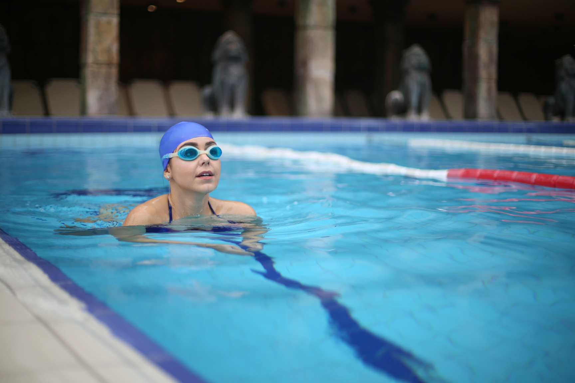

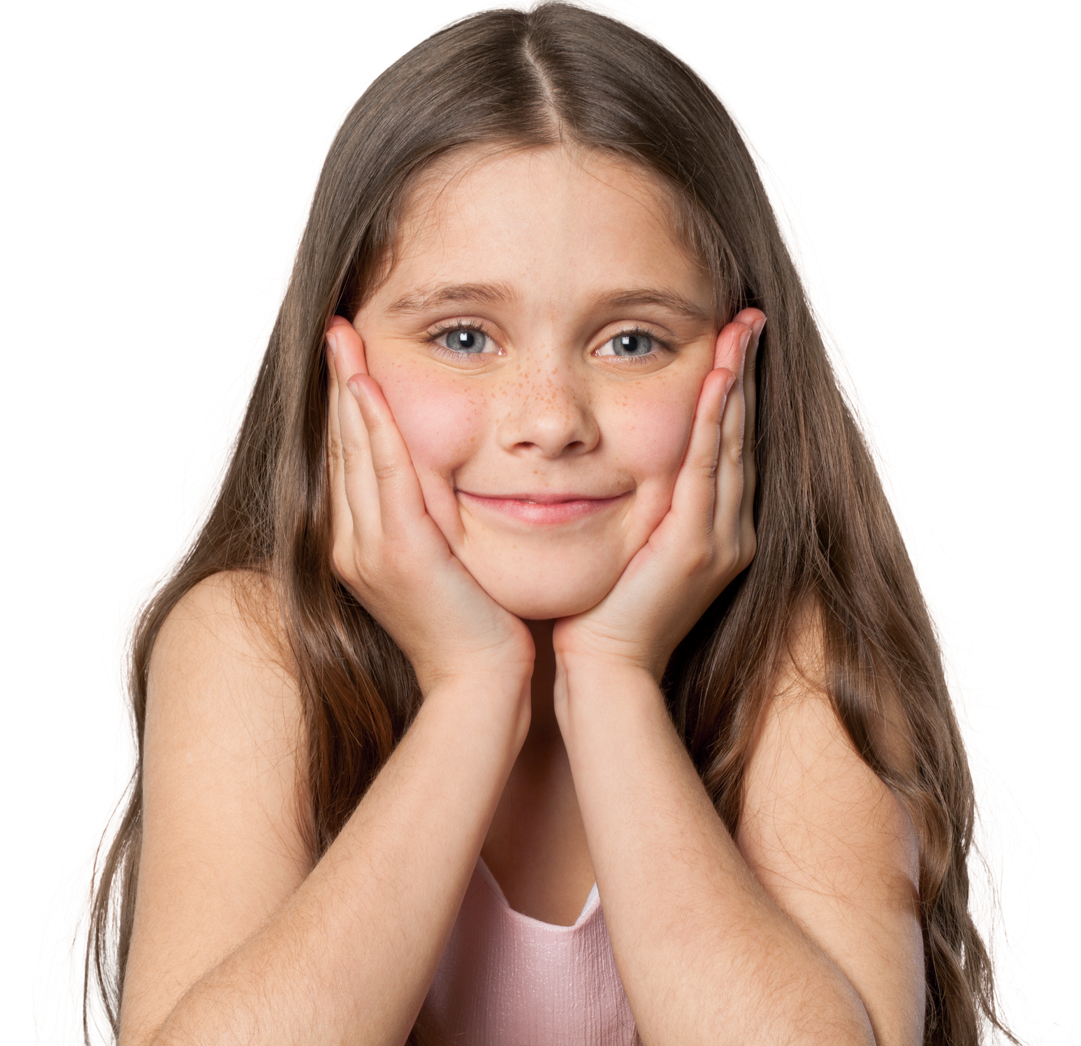
ENGLISH 7
GAME:
Find someone who
Work in groups
In 3 minutes
Ask your classmates which hobbies they like.
Use structure “Do you like …?”
Write their names in your worksheet

Slide 21

Find someone who likes:
 | Names
horse riding
building dollhouses
collecting teddy bears
collecting coins
gardening
making models
…

Slide 22
English 7
RECAP
1. What did we learn today?
A. My school B. Hobbies C. Sports
2. Odd one out.
A. horse riding B. making models
C. gardening D. hobbies

Slide 23





File
Edit
View
THANK YOU
See You Next Time

