Slide 2
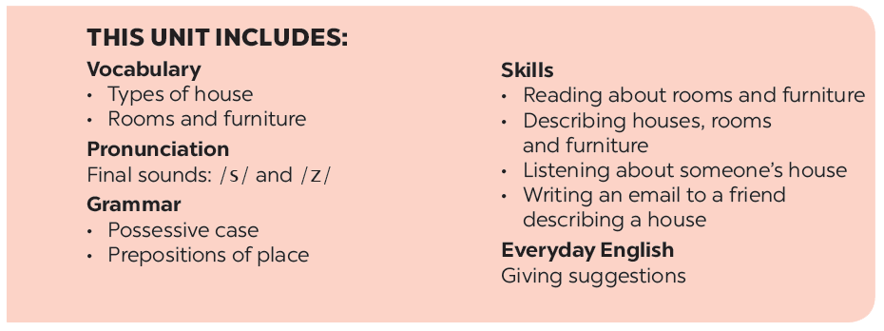

Slide 3
Listening
Writing
Look at the pictures. Name each of them. Guess if they are mentioned in the listening text.
Answer the questions.
Write an email to Mira, your pen friend. Tell her about your house. Use the answers to the questions in 3.
Listen to Mai talking about her house. Tick () T (True) or F (False).

Slide 4
Listening

Slide 5
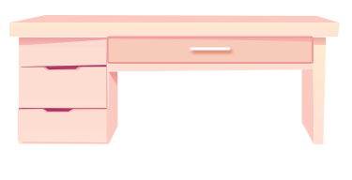
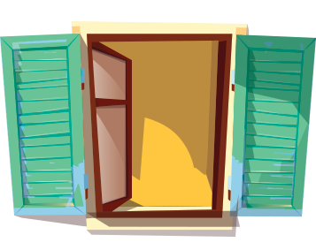
Look at the pictures. Name each of them. Guess if they are mentioned in the listening text.
1
2
3
bookself
sofa
desk
4
5
clock
window
Now listen and check your guesses.

Slide 6
Listen to Mai talking about her house. Tick () T (True) or F (False).
 |  | T | F
1. | There are four people in Mai’s family.
2. | Mai’s house has seven rooms.
3. | The living room is next to the kitchen.
4. | In her bedroom, there’s a clock on the wall.
5. | She often listens to music in her bedroom.

There are three people in Mai’s family.

Mai’s house has six rooms.



She often reads books in her bedroom.
Audio script

Slide 7
AUDIO SCRIPT
My name's Mai. I live in a town house in Ha Noi. I live with my parents. There are six rooms in our house: a living room, a kitchen, two bedrooms, and two bathrooms. I love our living room the best because it's bright. It's next to the kitchen. I have my own bedroom. It's small but beautiful. There's a bed, a desk, a chair, and a bookshelf. It also has a big window and a clock on the wall. I often read books in my bedroom.

Slide 8
Writing

Slide 9
Answer the questions.
1.
Where do you live?
2.
How many rooms are there in your house? What are they
3.
Which room do you like the best in your house? Why?

Slide 10
Write an email to Mira, your pen friend. Tell her about your house. Use the answers to the questions in 3.
To: mira@webmail.com
Subject: My house
Hi Mira,
Thanks for you email. Now I’ll tell you about my house.
What about you? Where do you live? Tell me in your next email.
All the best,

