Slide 2
Unit
1
HOBBIES
LESSON 2: A CLOSER LOOK 1
VOCABULARY
PRONUNCIATION
Unit
HOBBIES

Slide 3
OBJECTIVES
By the end of the lesson, students will be able to:
Use the lexical items related to hobbies
Know how to use verbs of liking
Pronounce the sounds /ə/ and /ɜ:/ correctly in isolation and in context

Slide 4
LESSON 2: A CLOSER LOOK 1
WARM-UP
Asking questions
Task 1: Complete the word webs with the words from the box.
Task 2: Complete the sentences, using the –ing form.
Task 3: Look at the pictures and say the sentences. Use suitable verb of the –ing form.
VOCABULARY
Task 4: Listen and repeat. Pay attention to the sounds /ə/ and /ɜ:/.
Task 5: Listen to the sentences and pay attention to the underlined parts. Tick (✓) the appropriate sounds. Practise the sentences.
PRONUNCIATION
PRODUCTION
Game: Who is faster?
CONSOLIDATION
Wrap-up
Homework

Slide 5
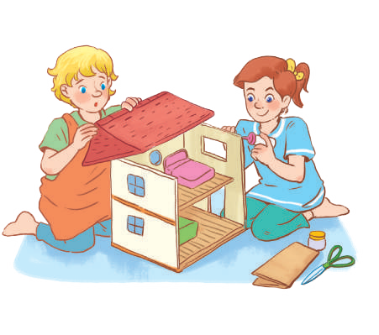
LESSON 2: A CLOSER LOOK 1
WARM-UP
Asking questions
Aims of the stage:
to create an active atmosphere in the class before the lesson
to lead into the new lesson

Slide 6
WARM-UP
1. What is your favourite hobby?
2. When did you start your hobby?

Slide 7
LESSON 2: A CLOSER LOOK 1
WARM-UP
Asking questions
Task 1: Complete the word webs with the words from the box.
Task 2: Complete the sentences, using the –ing form.
Task 3: Look at the pictures and say the sentences. Use suitable verb of the –ing form.
VOCABULARY
Aims of the stage:
to introduce the new words

Slide 8
VOCABULARY
jogging (n)
/ˈdʒɒɡɪŋ /
đi/ chạy bộ thư giãn

Slide 9
VOCABULARY
coin (n)
/kɔɪn/
đồng xu

Slide 10
VOCABULARY
New words | Pronunciation | Meaning
1. jogging (n) | / ˈdʒɒɡɪŋ / | đi, chạy bộ thư giãn
2. coin (n) | / kɔɪn / | đồng xu

Slide 11
VOCABULARY

Slide 12
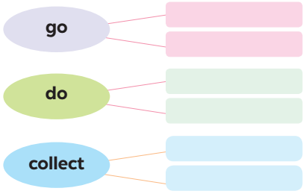
VOCABULARY
1
Complete the word webs below with the words from the box.
dolls
jogging
coins
judo
swimming
yoga

Slide 13
VOCABULARY
2
Complete the sentences, using the –ing form of the verbs from the box.
1. My dad has a big bookshelf because he loves _________ old books. 2. My sister likes _________ camping at the weekend. 3. My best friend hates _________ computer games. 4. Does your brother like _________ models? 5. My mum enjoys _________ yoga every day to keep fit.
collecting
going
playing
making
doing

Slide 14
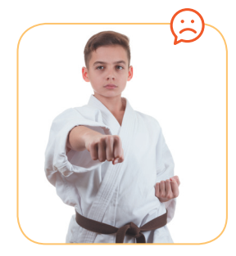
VOCABULARY
3
Look at the pictures and say the sentences. Use suitable verb of liking or disliking and the –ing form.
He hates / doesn’t like doing judo.

Slide 15
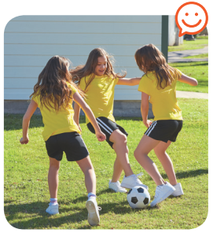
VOCABULARY
3
Look at the pictures and say the sentences. Use suitable verb of liking or disliking and the –ing form.
They like / love / enjoy playing football.

Slide 16
VOCABULARY
3
Look at the pictures and say the sentences. Use suitable verb of liking or disliking and the –ing form.
They love / like / enjoy gardening.

Slide 17
VOCABULARY
3
Look at the pictures and say the sentences. Use suitable verb of liking or disliking and the –ing form.
They enjoy / like / love collecting stamps.

Slide 18
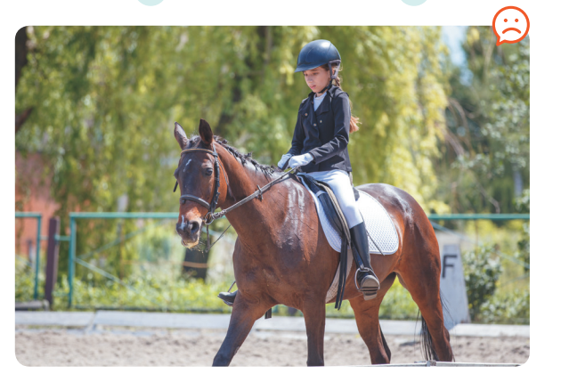
VOCABULARY
3
Look at the pictures and say the sentences. Use suitable verb of liking or disliking and the –ing form.
She hates / doesn’t like riding a horse / horse riding.

Slide 19
LESSON 2: A CLOSER LOOK 1
WARM-UP
Asking questions
Task 1: Complete the word webs with the words from the box.
Task 2: Complete the sentences, using the –ing form.
Task 3: Look at the pictures and say the sentences. Use suitable verb of the –ing form.
VOCABULARY
Task 4: Listen and repeat. Pay attention to the sounds /ə/ and /ɜ:/.
Task 5: Listen to the sentences and pay attention to the underlined parts. Tick (✓) the appropriate sounds. Practise the sentences.
PRONUNCIATION

Slide 20
PRONUNCIATION
/ə/ and /ɜ:/
Aims of the stage:
to help Ss identify how to pronounce the sounds /ə/ and /ɜ:/
to help Ss practise pronouncing these sounds in words & sentences

Slide 21
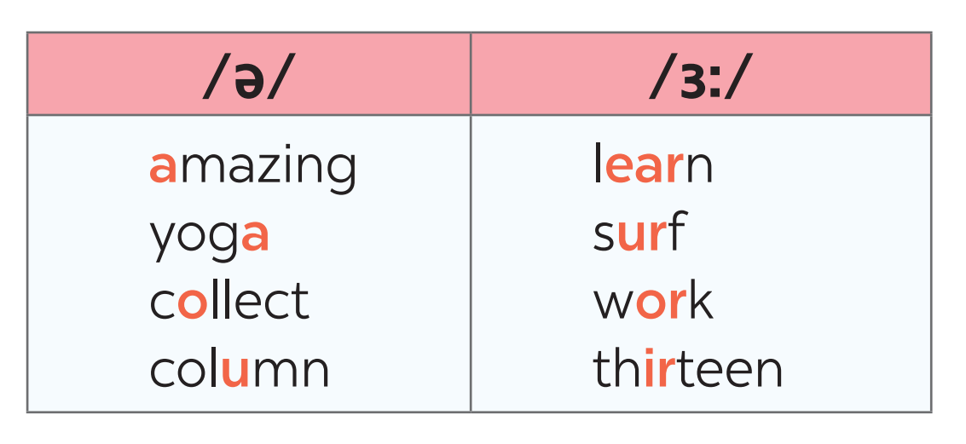
PRONUNCIATION
4
Listen and repeat. Pay attention to the sounds /ə/ and /ɜ:/.

Slide 22
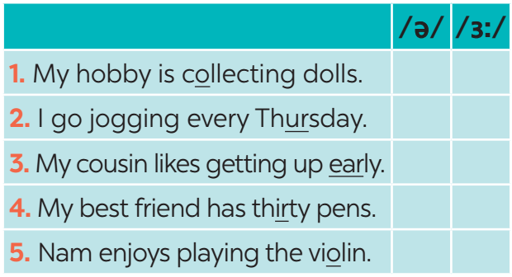
PRONUNCIATION
5
Listen to the sentences and pay attention to the underlined parts. Tick (✓) the appropriate sounds. Practise the sentences.
/ə/ and /ɜ:/
✔
✔
✔
✔
✔

Slide 23
LESSON 2: A CLOSER LOOK 1
WARM-UP
Asking questions
Task 1: Complete the word webs with the words from the box.
Task 2: Complete the sentences, using the –ing form.
Task 3: Look at the pictures and say the sentences. Use suitable verb of the –ing form.
VOCABULARY
Task 4: Listen and repeat. Pay attention to the sounds /ə/ and /ɜ:/.
Task 5: Listen to the sentences and pay attention to the underlined parts. Tick (✓) the appropriate sounds. Practise the sentences.
PRONUNCIATION
PRODUCTION
Game: Who is faster?
CONSOLIDATION
Wrap-up
Homework

Slide 24
PRODUCTION
Game: Who is faster?
Aims of the stage:
to give students a chance to apply what they have learnt

Slide 25
PRODUCTION
Game: Who is faster?
Work in groups of four
Write sentences including: hobbies and one of the sounds /ə/ and /ɜ:/
(e.g: Listening to music is a very common hobby.)
The group with the most correct sentences is the winner.

Slide 26
CONSOLIDATION
1
WRAP-UP
VOCABULARY
PRONUNCIATION

Slide 27
CONSOLIDATION
2
HOMEWORK
Find 3 more words relating to hobbies that have the sound /ə/ or /ɜ:/.

Slide 28
Website: sachmem.vn
Fanpage: facebook.com/sachmem.vn/

