Slide 1
Listen and read (p.26)
SHOCKING NEWS
Duong: Did you watch the news last night?
Nick: No, I didn’t. What’s happened?
Duong: There was a typhoon in Nam Dinh Province.
Nick: What exactly is a typhoon? We don’t get them in England.
Duong: It’s a severe tropical storm.
Nick: Oh no! That’s terrible! What time did it hit the area?
Duong: They said at about 10 a.m.
Nick: Was anyone injured?
Duong: Only a few minor injuries were reported. Most people had moved to safe areas when the storm broke.
Nick: That’s a relief. Did it cause any damage to property?
Duong: It seems many houses and public buildings were destroyed or flooded, and thousands of people were left homeless.
Nick: That’s awful! Despite all the modern technology available to us, we’re still helpless against natural disasters. How is the government helping the people there?
Duong: They’ve sent rescue workers to free people who were trapped in flooded homes. Once the heavy rain stops, they’ll start clearing up the debris. Medical supplies, food and rescue equipment have also been sent.
Nick: That’s great! How about the people left without homes?
Duong: They’ve been taken to a safe place where temporary accommodation will be provided for them.
Read the conversation in GETTING STARTED and underline any sentences in the passive voice that you can find. Check your findings with a partner.

Slide 2
GRAMMAR QUIZ
1. This house was built in 1935. “was built” is
A. Passive B. Active
2. Somebody built this house in 1935.
A. Passive B. Active
3. When we use an active verb, we say
A. what the subject does B. what happens to the subject
4. When we use a passive verb, we say
A. what the subject does B. what happens to the subject
5. When we use the passive, who or what causes the action is
A. often unknown or unimportant B. very important and it must be clear
6. If we want to say who does or what causes the action, we use
A. with B. by

Slide 3
Active voice
Present simple
This company
employs
eighty people.
Eighty people
are employed
by this company.
Passive voice
am/is/are + PII

Slide 4
Active voice
Present perfect
We
have removed
all the furniture
from the living room.
All the furniture
has been removed
from the living room.
Passive voice
Have/has been + PII

Slide 5
Active voice
Present progressive
They
are renovating
the hotel.
The hotel
is being renovated
(by them)
Passive voice
am/is/are + being PII

Slide 6
Active voice
present simple
They
always serve
tea
with cakes.
Tea
is always served
with cakes
(by them)
Passive voice
adverb

Slide 7
Active voice
Past simple
I
repaired
the roof
last year.
The roof
was repaired
(by me)
last year.
Passive voice
was/ were + PII

Slide 8
Active voice
Future: will do
Mary
will pay
the bill
tomorrow.
The bill
will be paid
(by Mary)
tomorrow.
Passive voice
will be + PII

Slide 9
Ex3. Rewrite the following sentences using the correct passive voice.
1. Volunteers have given out food and blankets to homeless people.
__________________________________________________________________
2. So far, rescue workers have freed ten people trapped in collapsed buildings.
__________________________________________________________________
3. Did the storm destroy the whole village?
__________________________________________________________________
4. If the storm hits the area, it will cause a lot of damage.
__________________________________________________________________
5. They are going to organise a garden party to raise money for the victims of the flood.
__________________________________________________________________
Food and blankets have been given out to homeless people.
Ten people trapped in collapsed buildings have been freed (by the rescue workers) so far.
Was the whole village destroyed (by the storm)?
If the area is hit by the storm, a lot of damage will be caused.
A garden party is going to be organised to raise money for the victims of the flood.

Slide 10
Ex2. Complete the sentences using the correct passive form of the verbs in brackets.
was scattered
1. Debris (scatter) ____________ across the countryside by the strong winds last night.
2. Ten new houses (build) ____________ in the town every year.
3. Residents of ﬂooded villages (take) __________ to a safe place last night.
4. In the future, natural disasters
(predict) _______________ accurately with the help of technology.
5. Food and medical supplies (deliver)
___________________________________ later this afternoon
are built
were taken
will be predicted
will be delivered/are going to be delivered

Slide 11


Paul went to the party. Sarah went to a parry last week too, but they didn't see each other.
Paul left the party at 10.30 and Sarah arrived at 11 o'clock. So: When Sarah arrived at the party, Paul wasn't there.
By 11 o’clock, Paul had gone home.
When Sarah arrived at the party, Paul had gone home.
Past perfect

Slide 12
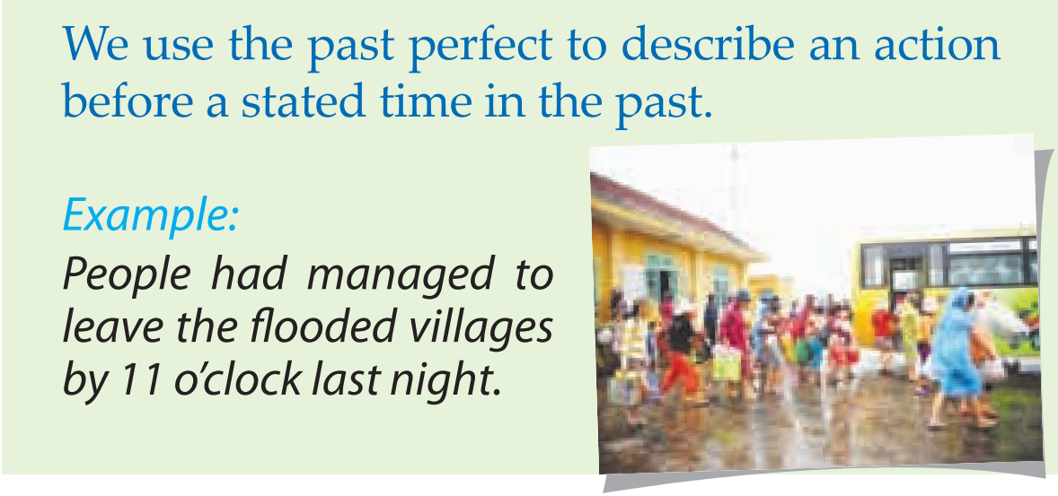
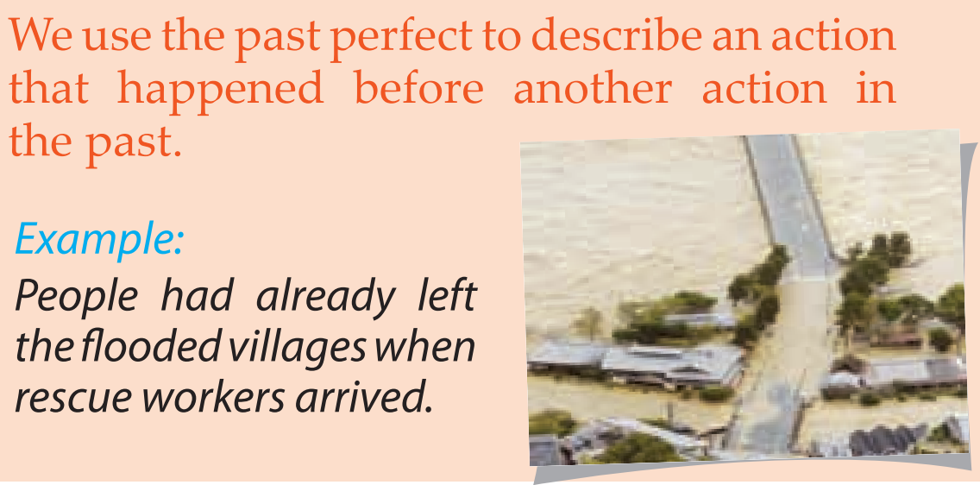
Past perfect
By 11 o’clock, Paul had gone home.
When Sarah arrived at the party, Paul had gone home.

Slide 13
By 11 o’clock,
Paul
had
gone
home.
S
had
PII
By 11 o’clock,
Paul
hadn’t
gone
home.
S
hadn’t
PII
Had
Paul
gone
home
by 11 o’clock
?
PII
?
Had
S

Slide 14
Ex5. Complete the sentences by putting the verbs in brackets into the simple past or past perfect.
had left
erupted
1. Most people (leave) __________ before the volcano (erupt) ________.
2. By the time we (arrive) ________ at the canyon, it (stop) ___________ snowing.
3. They (spend) _____________ the night in the flooded area before help (arrive) __________.
4. Simon (get) __________ lost because he (not take) ______________ a map with him.
5. I (find) __________ my pen after I (buy) _____________ a new one.
arrived
had stopped
had spent
arrived
got
hadn’t taken
found
had bought

