Slide 2
TRƯỜNG THCS LONG BIÊN
BÀI GIẢNG ĐIỆN TỬ MÔN TIẾNG ANH 9
UNIT 6: LIFESTYLE
Period 46 : Skills 1
GV: Nguyễn Thị Hiền
Tổ Ngoại Ngữ - Năng khiếu

Slide 3
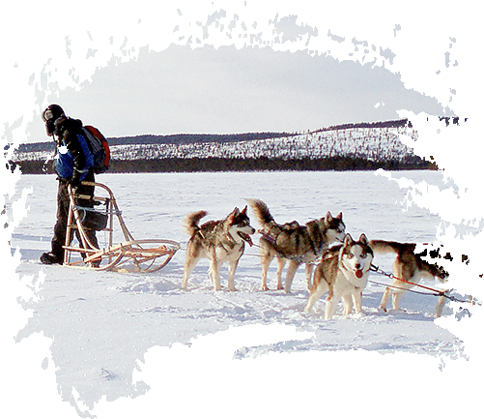
Unit
6
LIFESTYLES
LESSON 5: SKILLS 1
1

Slide 4
LESSON 5: SKILLS 1
WARM-UP
﻿Discuss the picture.
Task 1: Read the text and check your answers.
Task 2: ﻿Match the highlighted words in the text with their meanings.
* Vocabulary
Task 3: ﻿Read the text again and answer the questions.
READING
Task 4: ﻿Work in pairs. Look at the pictures and use the cues to talk about what people in some places do to maintain their traditional lifestyle.
Task 5: ﻿Work in pairs. Ask and answer about how people in your area maintain their traditional lifestyle. You can use the ideas in 4 and the reading text in 1.
SPEAKING
CONSOLIDATION
Wrap-up
Homework

Slide 5
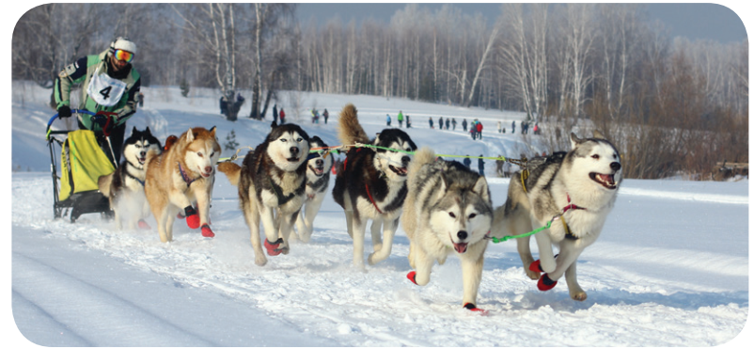
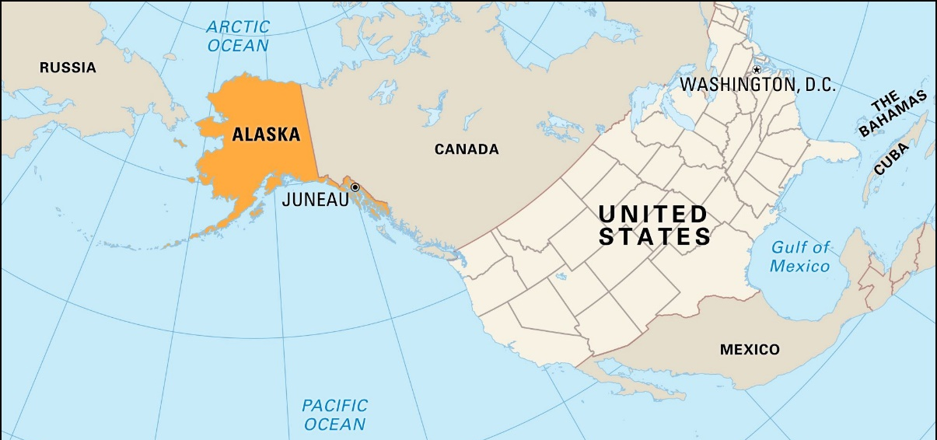
WARM-UP
1
Work in groups. Look at the picture, and discuss what you know about Alaska.
Location?
Climate?
Native people?
Language?
Cuisine?
Culture?

Slide 6
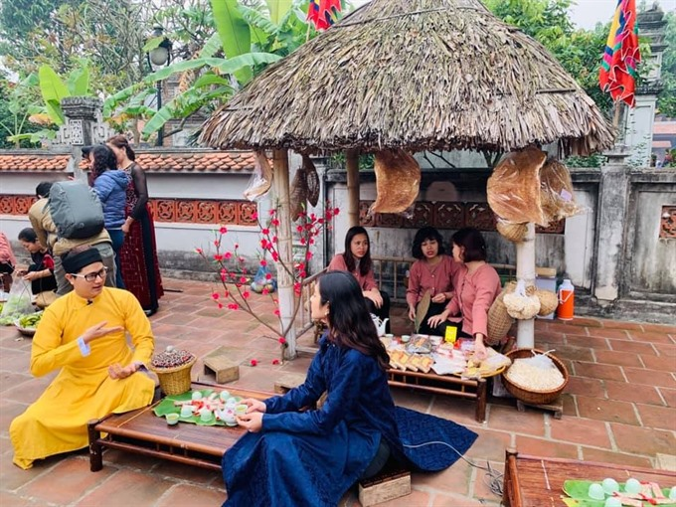
READING
maintain (v)
﻿/meɪnˈteɪn/
duy trì, gìn giữ

Slide 7
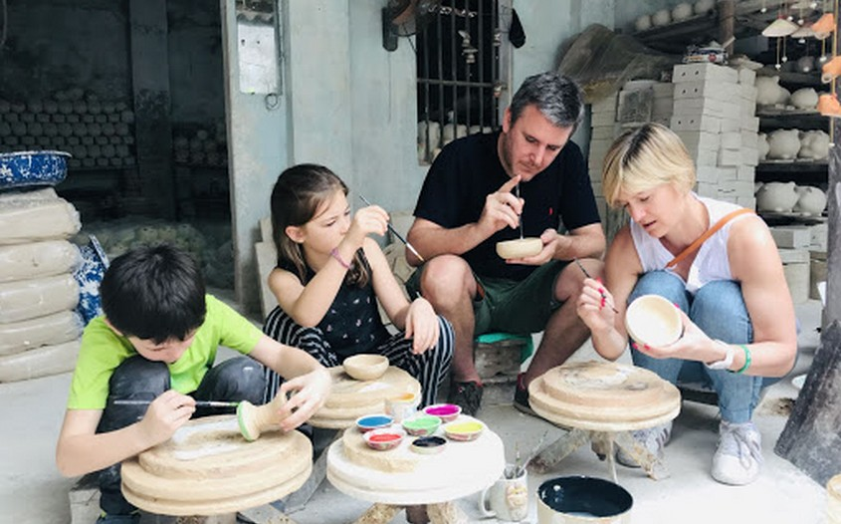
READING
experience (v)
﻿/ɪkˈspɪəriəns/
trải nghiệm

Slide 8
READING
style (n)
﻿/﻿staɪl/
phong cách

Slide 9
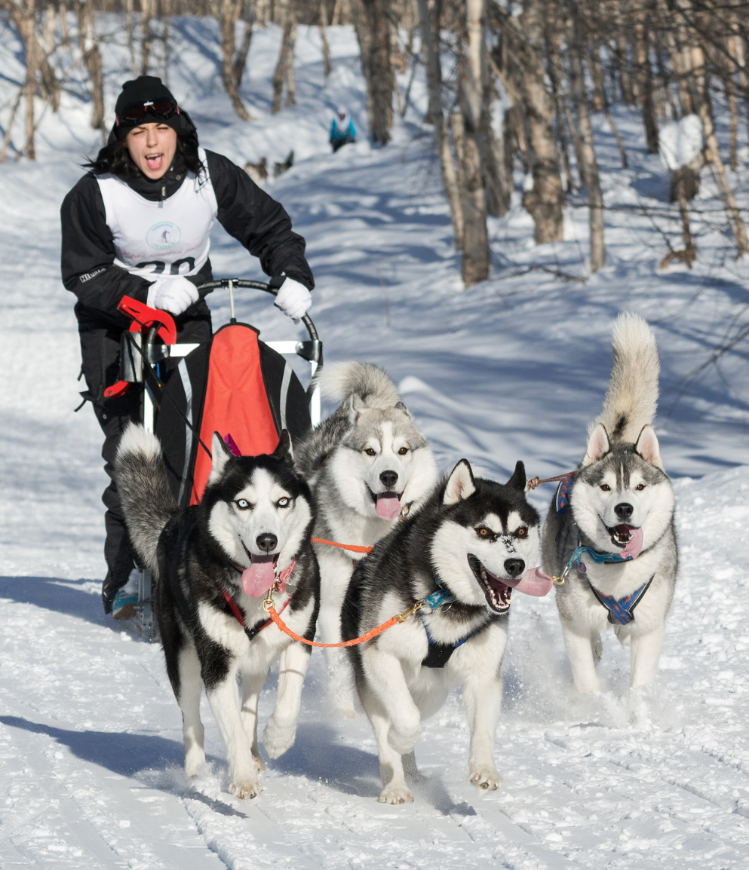
READING
musher (n)
﻿/﻿﻿ˈmʌʃə/
người điều khiển xe trượt tuyết chó kéo

Slide 10
READING
New words | Pronunciation | Meaning
1. maintain (v) | ﻿/meɪnˈteɪn/ | ﻿duy trì, gìn giữ
2. experience (v) | ﻿/ɪkˈspɪəriəns/ | ﻿trải nghiệm
3. style (n) | /﻿staɪl/ | phong cách
4. musher (n) | ﻿/ˈmʌʃə/ | ﻿người điều khiển xe trượt tuyết chó kéo

Slide 11
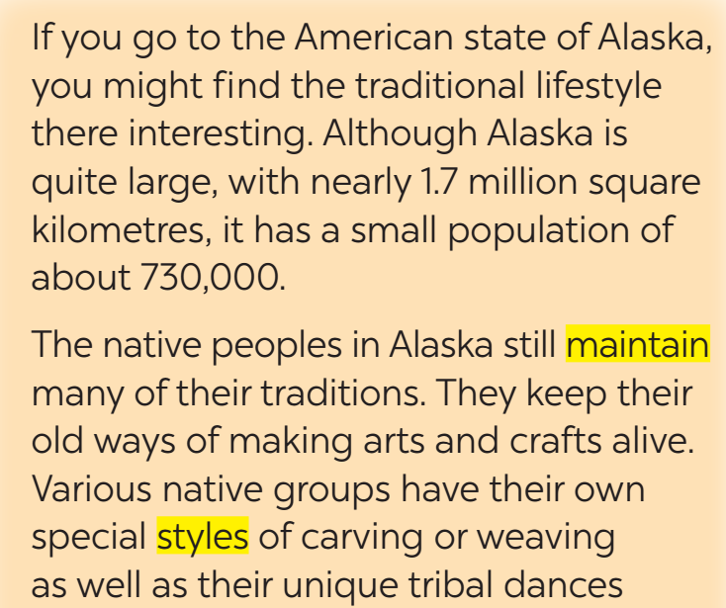
READING
2
Match the highlighted words in the text with their meanings.

Slide 12
READING
2
Match the highlighted words in the text with their meanings.

Slide 13
READING
3
Read the text again and answer the questions.
﻿1. What is the population of Alaska?
﻿→ It is about 730,000 / 730 thousand.
2. Who have special styles of carving or weaving?
→ ﻿Various native groups have their own special styles of carving or weaving
3. Where can we find the culture of the native peoples in Alaska?
→ ﻿We can fnd it in their villages.

Slide 14
READING
3
Read the text again and answer the questions.
﻿4. How long is the Iditarod Trail Sled Dog Race?
﻿→ It is 1,510 km (long).
5. Is the Iditarod Trail Sled Dog Race an international competition?
→ ﻿Yes, it is.

Slide 15
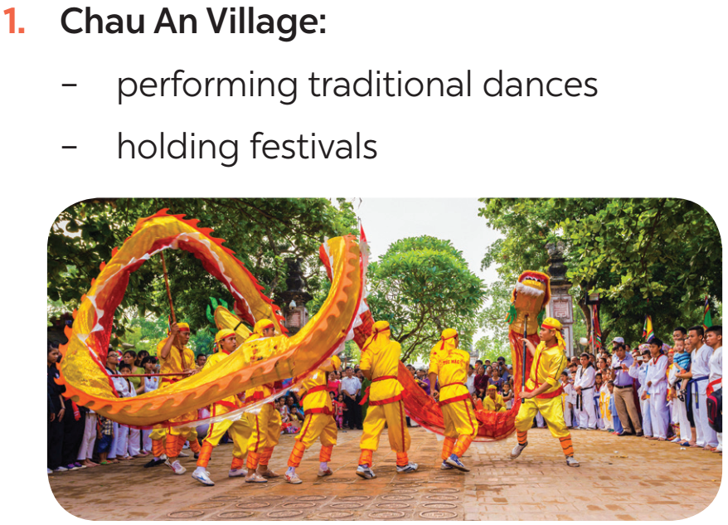
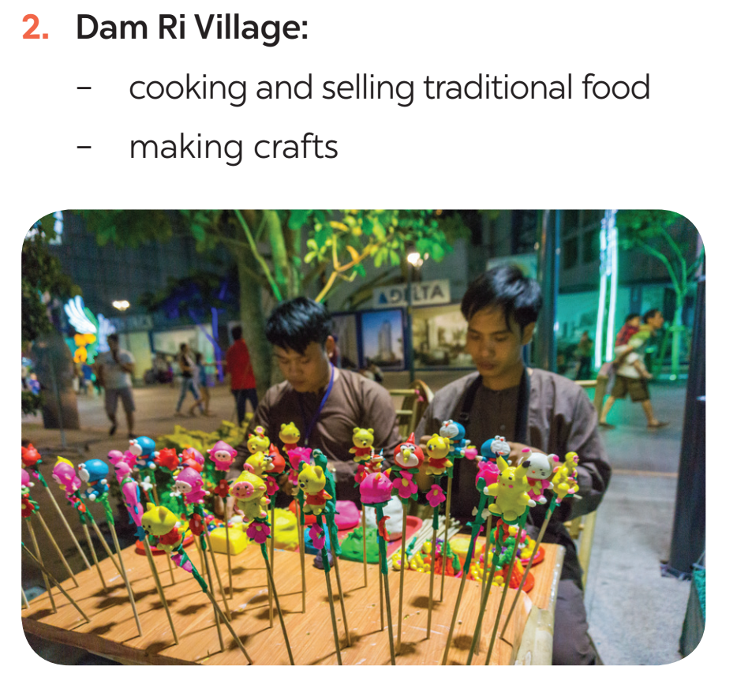
SPEAKING
4
Work in pairs. Look at the pictures and use the cues to talk about what people in some places do to maintain their traditional lifestyle.

Slide 16
SPEAKING
5
Work in pairs. Ask and answer about how people in your area maintain their traditional lifestyle. You can use the ideas in 4 and the reading text in 1.
Example:
I live in Bat Trang, which is a pottery village not far from Ha Noi centre. To maintain the traditional lifestyle, local people will make pottery and paint on the ceramic statues. Then they will sell those pottery products to tourists.

Slide 17
CONSOLIDATION
1
Wrap-up
What have we learnt in this lesson?
Read about Alaska
Talk about ﻿how people in their area maintain traditional lifestyles

Slide 18
CONSOLIDATION
2
Homework
Students’ workbook.

Slide 19
Website: hoclieu.vn
Fanpage: facebook.com/www.tienganhglobalsuccess.vn/

