Slide 1
UNIT 6: OUT TET HOLIDAY
LESSON 4: COMMUNICATION
English 6

Slide 2
Everyday English
Saying New Year’s wishes
1
Listen and read the New Year’s wish.
2
Practise saying New Year’s wishes to your friends, using the suggestions below or creating your own.
New Year practices in the world
3
Match the sentences with the pictures. Them match them with the countries
4
Read how people in different countries celebrate their New Year. Then match the countries with the activities.
5
Work in groups. Each student chooses one activity from 4. Take turns to say them aloud. The group says which country he / she is talking about.

Slide 3
COUNTRY FLAGS

Slide 4
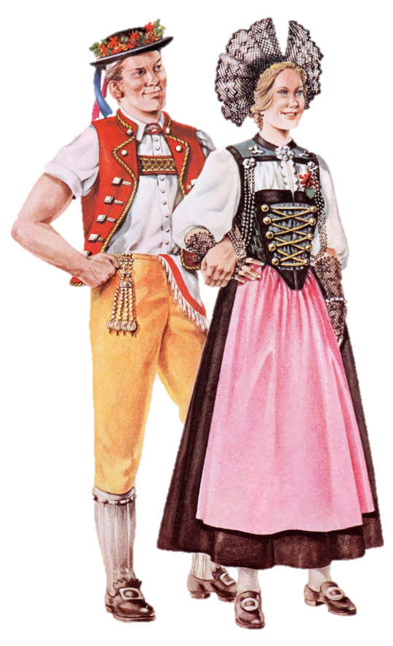
A. Romania
B. Switzerland
C. Japan
D. Thailand
E. Spain

Slide 5
A. Romania
B. Switzerland
C. Japan
D. Thailand
E. Spain

Slide 6
A. Romania
B. Switzerland
C. Japan
D. Thailand
E. Spain

Slide 7
A. Romania
B. Switzerland
C. Japan
D. Thailand
E. Spain

Slide 8
A. Romania
B. Switzerland
C. Japan
D. Thailand
E. Spain

Slide 9
Everyday English
Saying New Year’s wishes

Slide 10
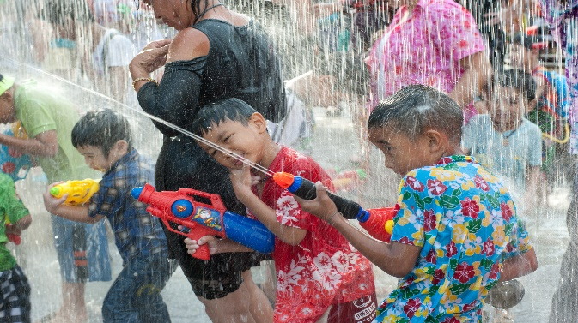
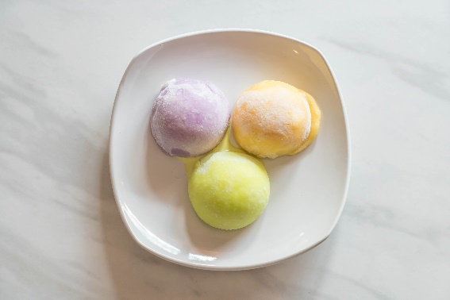
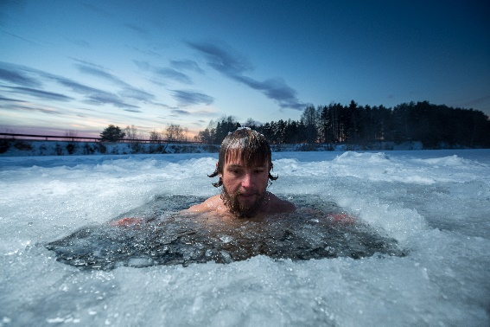
U6 L4
Vocabulary
Ja‘pan (n)
Nhật
Spain (n)
Tây Ban Nha
‘Switzerland (n)
Thụy Sĩ
rice cake (n)
bánh gạo
bathe (v)
tắm
ice hole (n)
hố băng.
throw water ( phrv)
ném nước, tạt nước

Slide 11
Rub out and remember
Japan (n)
Nhật
Spain (n)
Tây Ban Nha
Switzerland (n)
Thụy Sĩ
rice cakes (n)
bánh gạo
bathe (v)
tắm
ice hole (n)
hố băng.
throw water ( phrv)
ném nước, tạt nước

Slide 12
Happy New Year
Some common wishes on New Year holiday
Wish you healthy and successful
Best wishes for the new year.
Best wishes for a happy and successful new year!

Slide 13
1
Listen and read the New Year’s wish.
Notes:
Slide này không đúng.

Slide 14
2
Practise saying New Year’s wishes to your friends, using the suggestions below or creating your own.
happy days from january to december
a year full of fun
happiness and cheers
a life full of happy moments
success in your studies
Wishing you
I wish you
+ noun/ noun phrase.
I wish you happy days from january to december
Notes:
Slide này không đúng.

Slide 15
Suggested answers:
I wish / Wishing you happy days all the year round.
I wish / Wishing you good health and happiness.
I wish / Wishing you success in your work and a happy New Year.
I wish / Wishing you success in your study and laughter all the year round.
I wish / Wishing you a year full of joy and success.
I wish / Wishing you love and care from everybody around you.

Slide 16
New Year practices in the world

Slide 17
3
Match the sentences with the picture. Then match them with the countries
1.
They go to Times Square to watch the New Year’s Eve Ball drop.
3.
They eat mochi rice cakes.
2.
They bathe in an ice hole.
4.
They throw water on other people.
a
b
c
d

Slide 18
b
a
1.
They go to Times Square to watch the New Year’s Eve Ball drop.
Thailand
The USA
b
c
2.
They bathe in an ice hole.
Japan
Russia
a
c
3.
They eat mochi rice cakes.
Japan
The USA
d
4.
They throw water on other people.
Thailand
Russia

Slide 19
4
Read how people in different countries celebrate their New Year. Then match the countries with the activities.
In Japan, temples ring their bells 108 times at midnight on December 31. By doing so, people believe the bad things of the past year will leave.
In Spain, people try to put 12 grapes in their mouth at midnight for good luck.
In Switzerland, they drop ice cream on the floor to celebrate the New Year.
In Romania, they throw coins into a river for good luck.
In Thailand, they throw water on other people to wash away bad luck.
Notes:
City landmarks phải ở trên mục 3

Slide 20
MATCHING
Countries
Activities
1. Japan
a. put 12 grapes in the mouth
b. ring bells 108 times
2. Spain
a. put 12 grapes in the mouth
b. ring bells 108 times
3. Switzerland
e. drop ice cream on the floor
c. throw coins into a river
c. throw coins into a river
5. Thailand
d. Throw water on other people
4. Romania
e. drop ice cream on the floor
d. throw water on other people
=> Answer: 1- b 2- a 3- e 4- c 5- d

Slide 21
5
Work in groups. Each student chooses one activity from 4. Take turns to say them aloud. The group says which country he / she is talking about.
Example:
They throw water on other people.
It’s in Thailand.

Slide 22
Homework
Learn vocabulary and the structure by heart.
Do exercise in your work book
Prepare the next lesson: Skills 1

