Slide 2
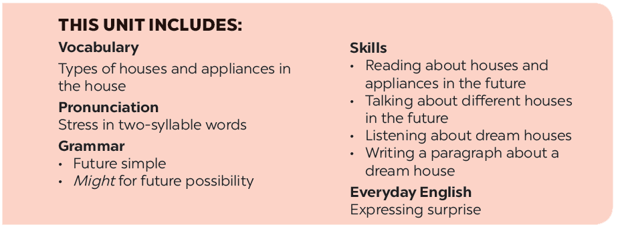

Slide 3
Grammar
Future simple
Might for future possibility
Fill the blanks with will ('ll) or won’t to make the sentences true for you.
Read the two poems. Tick () T (True) or F (False).
Complete the conversation with will ('ll) or won’t.
Work in groups. Think about what you might do or have in the future. Share your ideas with your classmates.
Write sentences, using will ('ll) or won't and the words given.

Slide 4
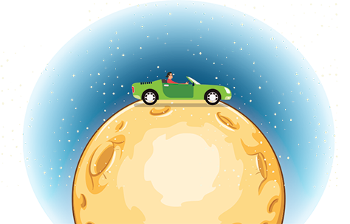
Grammar
Future simple
We use the future simple to talk about an action that happens in the future.
Example:
My father will travel on the Moon in a super car in the future.
We’ll live in that cottage next year. (’ll is the short form of will)
We won’t live in that cottage anytime soon. (won’t is the short form of will not)
Will they live on the Moon?
Yes, they will.
No, they won’t.

Slide 5
Fill the blanks with will ('ll) or won’t to make the sentences true for you.
Example:
I think I’ll listen to music in the afternoon.
1.
I think I _______ stay at home tonight.
2.
My friends _______ go to the library this afternoon.
3.
My mum _______ make a cake today.
4.
I _______ have an English test tomorrow.
5.
Our family _______ move to the new house next week.

Slide 6
Complete the conversation with will ('ll) or won’t.
A: Oh, no. The dog ran away again!
B: Don’t worry – he (1)
A: Are you sure he (2)
B: OK, he might not come back today. But I’m sure he (3)
come back tomorrow.
A: I don’t believe you! He (4)
never see him again. I’m sure.
B: Oh, look ... Here he is!
_______ come back.
will / ‘ll come back.
will?
_______?
_______
will / ‘ll
won’t come back. We (5)
_______ come back. We (5) _______
_______
will / ‘ll

Slide 7
Write sentences, using will ('ll) or won't and the words given.
1.
computer / do / housework
A computer will / won’t help me to do my housework.
2.
robot / water / ﬂowers
A robot will help me to water the flowers.
3.
smart TV / cook / meal
A smart TV won’t help me to cook meals.
4.
washing machine / iron / clothes
A washing machine will / won’t help me to iron the clothes.
5.
smartphone / take care / children
A smartphone won’t help me to take care of the children.

Slide 8
Grammar
Might for future possibility
We use might + V to talk about actions that are possible in the future (We are not sure if they will happen or not).
Example:
We might live in a UFO.
They might not travel in cars.

Slide 9
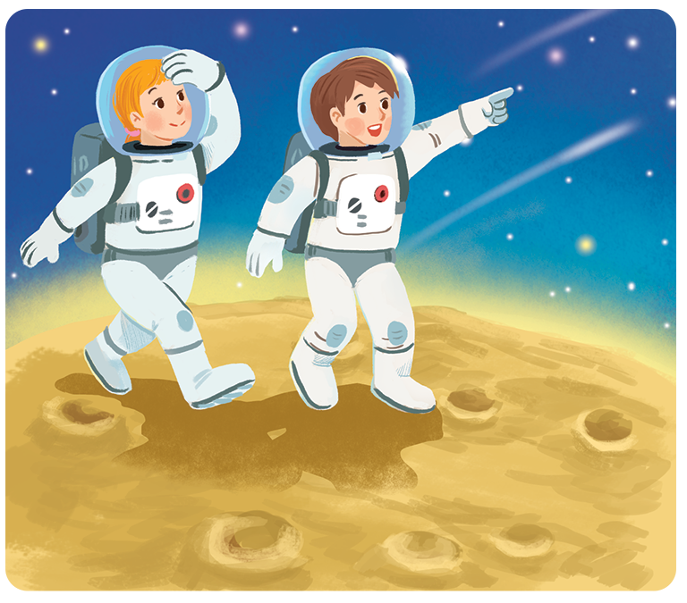
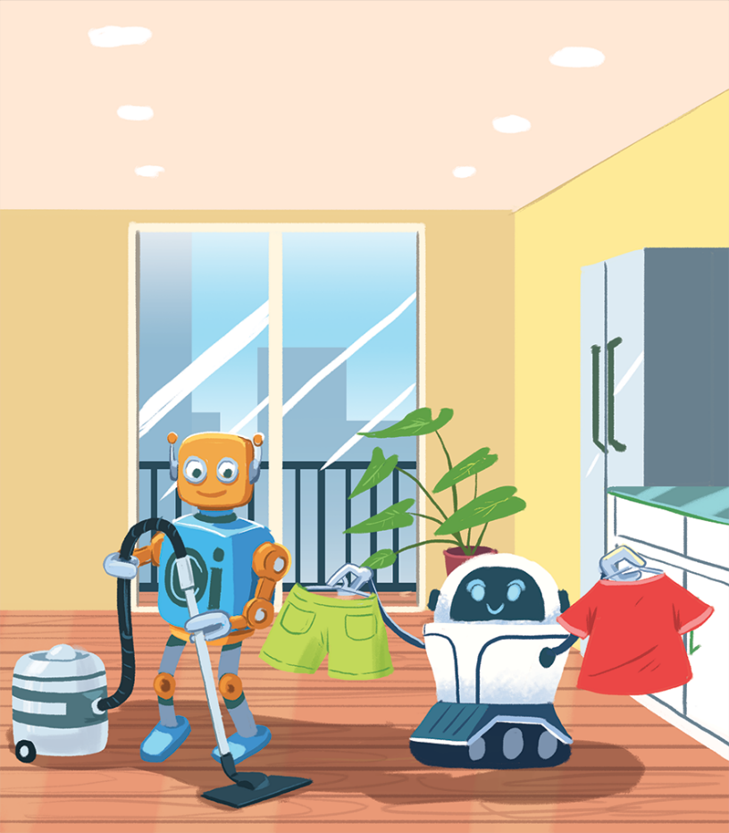
Read the two poems. Tick () T (True) or F (False).
In the future
We might live with robots.
They might clean our houses.
They might wash our clothes.
They might not talk to us.
Jenny, aged 12
In the future
We might go on holiday to the Moon.
We might stay there for a long time.
We might have a great time.
We might come home soon.
Henry, aged 11

Slide 10
 | T | F
1. Jenny thinks we might live with robots.
2. Henry thinks we might travel to the Moon.
3. Jenny thinks robots might not clean our houses.
4. Henry thinks we will stay on the Moon for a short time.
5. Jenny thinks robots might help us to do the housework.
6. Henry thinks we might not have a great time on the Moon.







Slide 11
Work in groups. Think about what you might do or have in the future. Share your ideas with your classmates.
Example:
I might have a smartphone to surf the internet.

