Slide 1


GOOD MORNING
EVERYONE !!!

Slide 2

Unit 5: Festivals in Viet Nam
Lesson 3: A closer look 2

Slide 3
Grammar
Simple and compound sentences: review
1. Write S for simple sentences and C for compound sentences.
S
________ | 1. I enjoy playing tennis with my friends every weekend.
________ | 2. I like spring, but I don’t like the spring rain.
________ | 3. I’ve been to Ha Long twice, and I joined the carnival there once.
________ | 4. My family and I went to the Nha Trang Sea Festival in 2011.
________ | 5. I like the Mid-Autumn Festival and look forward to it every year.
C
C
S
S

Slide 4
2. Connect each pair of sentences with an appropriate conjunction in the box to make compound sentences.
and but or so yet
At the Mid-Autumn Festival children carry beautiful lanterns. It’s a memorable childhood experience.
=>
During Tet, Vietnamese people buy all kinds of sweets. They make chung cakes as well.
=>
The Hung King’s sons offered him many special foods. Lang Lieu just brought him a chung cake and a day cake.
=>
To welcome Tet, we decorate our house with peach blossoms. We can buy a mandarin tree for a longer lasting display.
=>
The Huong Pagoda Festival is always crowded. We like to go there to pray for good fortune and happiness.
=>
At the Mid-Autumn Festival children carry beautiful lanterns, so it’s a memorable childhood experience.
During Tet, Vietnamese people buy all kinds of sweets, and they make chung cakes as well.
The Hung King’s sons offered him many special foods, but Lang Lieu just brought him a chung cake and a day cake.
To welcome Tet, we decorate our house with peach blossoms, or we can buy a mandarin tree for a longer lasting display.
The Huong Pagoda festival is always crowded, yet we like to go there to pray for good fortune and happiness.

Slide 5
3. Connect each pair of sentences with an appropriate conjunctive adverb in the box to make compound sentences.
however nevertheless moreover therefore otherwise
Chu Dong Tu and Giong are both legendary saints. They are worshipped for different things.
=>
Tet is the most important festival in Viet Nam. Most Vietnamese return home for Tet.
=>
Tet is a time for us to worship our ancestors. It’s also a time for family reunion.
=>
The Khmer believe they have to float lanterns. They may not get good luck.
=>
The Hung King Temple Festival was a local festival. It has become a public holiday in Viet Nam since 2007.
=>
Chu Dong Tu and Giong are both legendary saints; however (nevertheless), they are worshipped for different things.
Tet is the most important festival in Viet Nam; therefore, most Vietnamese return home for Tet.
Tet is a time for us to worship our ancestors; moreover, it is also a time for family reunion.
The Khmer believe they have to float lanterns; otherwise, they may not get good luck.
The Hung King Temple Festival was a local festival; nevertheless (however), it has become a public holiday in Viet Nam since 2007.

Slide 6
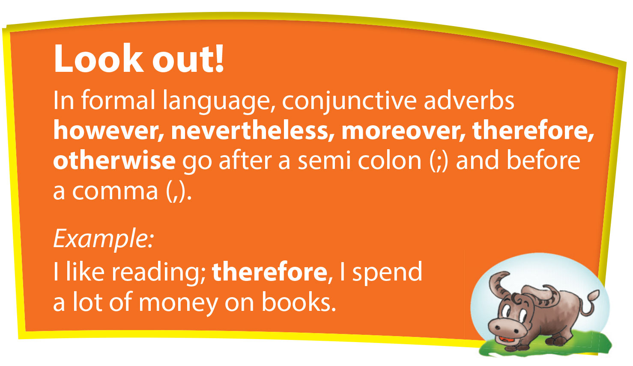

Slide 7
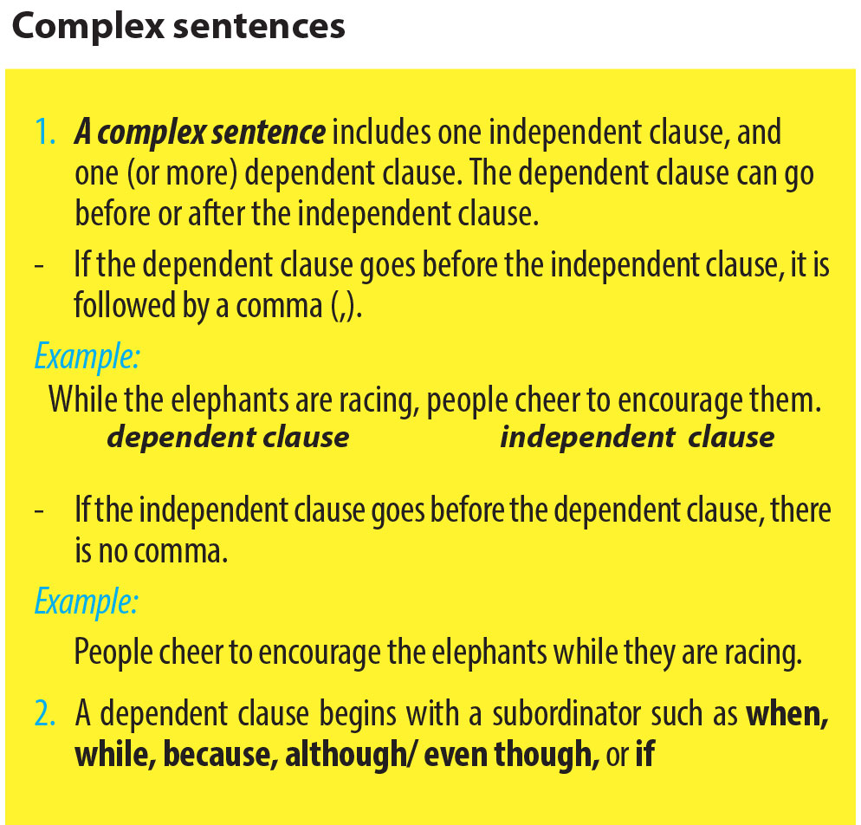

Slide 8
4. Match the dependent clauses with the independent ones to make complex sentences.
Dependent clause | Independent clause
1. When the An invaders came to Viet Nam, | A. it is an essential part of the ceremony to worship the Water God.
2. Because quan ho is the traditional folk song of Bac Ninh, | B. the three-year-old boy grew up very fast and defeated them, legend says.
3. Even though Tien Dung was a daughter of the 18th Hung King, | C. the crowds encourage them with drums and gongs.
4. If a pair of cows in the Cow Racing Festival go outside the line, | D. only this kind of singing is allowed at the Lim Festival.
5. Although the Buffalo-fighting Festival sounds frightening, | E. she married a poor man, Chu Dong Tu.
6. While the dragon boats at Ghe Ngo are racing, | F. they cannot continue the race.
B
D
E
F
A
C

Slide 9
5. Fill each blank with one suitable subordinator when, while, even though/ although, because or if.
The Elephant Race Festival is held by the Mnong people in spring in Don Village or in the forests near Srepok River, Dak Lak Province. (1) __________ the space must be wide enough for around 10 elephants to race, villagers often choose a large, flat area. (2) __________ the race is held in the forests, the area must be without too many big trees.
The elephants are led to the starting line, and (3) __________ the horn command is given, the race begins. The elephants are encouraged by the sounds of drums, gongs and the cheering crowds (4) __________ they are racing.
(5) __________ an elephant wins the race, it lifts its trunk above its head and waits for its prize. (6) ____________________ the prize is small, every rider is proud to be the race winner.
Because
If
when
while
When
Athough / Even though

Slide 10
6. Use your own words/ ideas to complete the sentences below. Compare your sentences with a partner.
I have never been there
Although I Iike the Giong Festival, _______________________________________.
Because it’s one of the most famous festivals, ______________________________.
If you go to Soc Son, __________________________________________________.
When people go to Huong Pagoda, ______________________________________.
While people are travelling along Yen Stream, ________________________
_________________
we shouldn’t miss it
you should visit Giong Temple
they take a lot of photos
they can enjoy the beautiful scenery of the area

Slide 11


