Slide 1

Song Ve secondary school.
Good morning class!!!

Slide 2

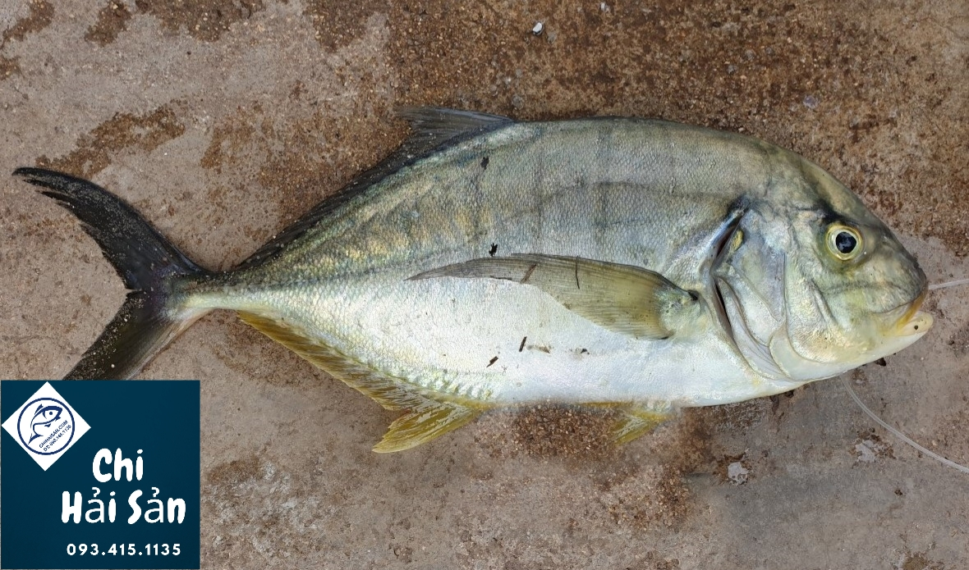
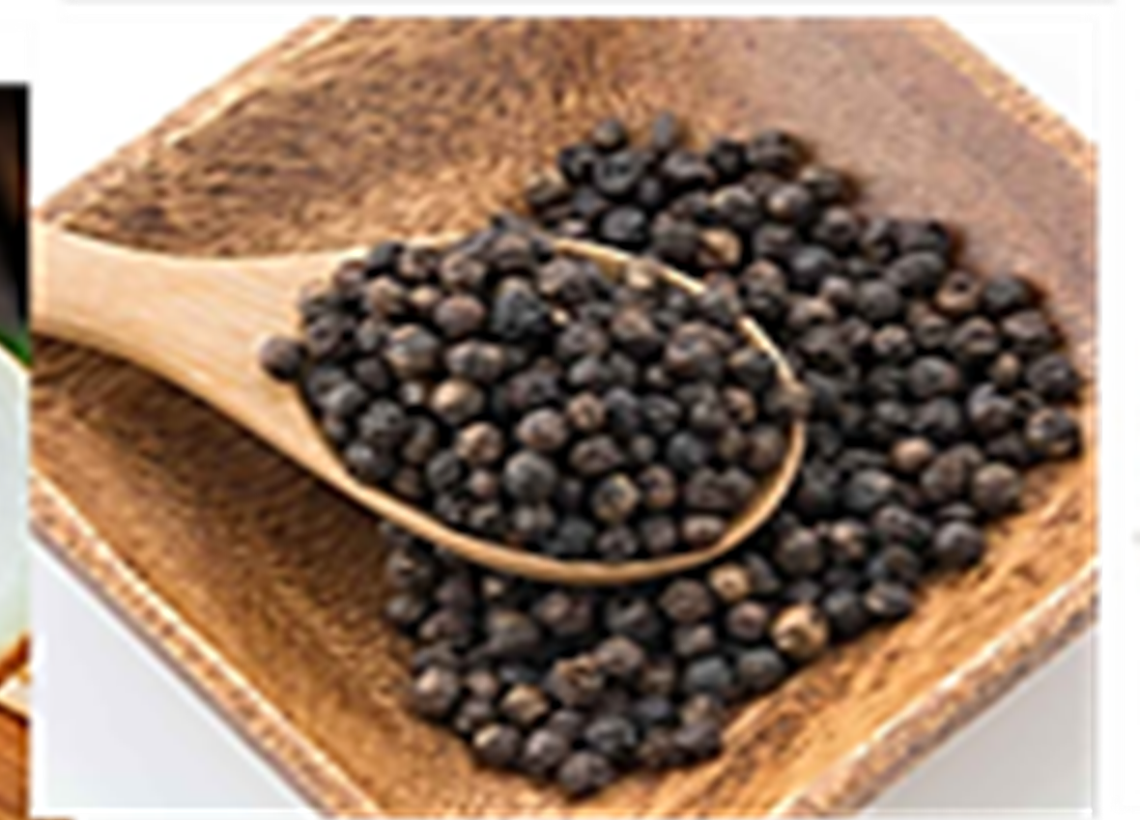
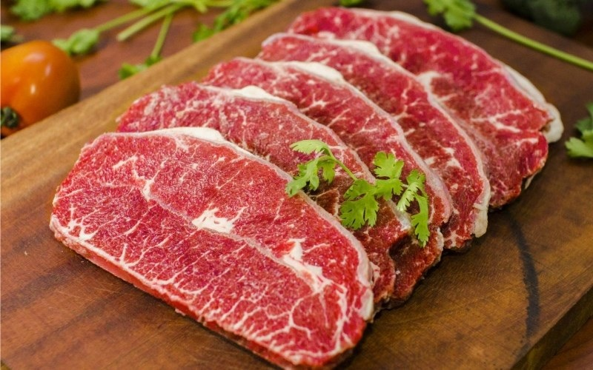
* Warm up:
Crossword puzzle
1
W | A | T | E | R
2
E | G | G | S
3
R | I | C | E
4
F | I | S | H
5
P | E | P | P | E | R
6
B | E | E | F
1. We often drink …………after meals.
2. To make omelette you need some ……….. .
3. ………is our main food everyday.
RECIPE:
Công thức

Slide 3
* Mini game
Guess: What can you make?
Look at the ingredients.
Write the food you can cook using the ingredients.
Show others your answers.

Slide 4


Unit
5
FOOD AND DRINK
Lesson 7: LOOKING BACK & PROJECT
Vocabulary review
Grammar review
Project: Eating habits around the world
HOBBIES

Slide 5
* VOCABULARY REVIEW
1
Add the words and phrases you have learnt in the correct columns. Compare with your partner's. Who has more words and phrases? Add any that you did not write.
Dishes | Ingredients | Units of measurement
pancakes | flour | gram (g)
Dishes | Ingredients | Units of measurement
pancakes beef noodles Rice Beefsteak Omelette Roasted chicken | flour Rice Rice noodle Beef Meat salt | Gram Litre Tablespool Teaspoon kilo

Slide 6
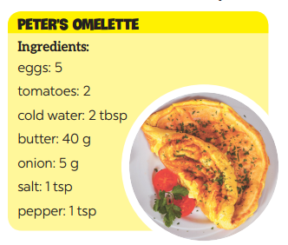
2
Read the recipe and write sentences as in the example.
* Suggested answers:
We need 5 eggs.
We need 2 tomatoes.
We need 2 tablespoons of cold water.
We need 40 grams of butter.
We need 5 grams of onion.
We need 1 teaspoon of salt.
We need a teaspoon of pepper.
Ingredients
eggs: 5
tomatoes: 2
cold water: 2 tbsp
butter: 40 g
onion: 5 g
salt: 1 tsp
pepper: 1 tsp

Slide 7
* GRAMMAR REVIEW
3
Complete the sentences. Write some, any, much, or a lot of/ lots of.
1. I have to go to the market now. There isn't food _________ for our dinner.
2. Would you like _________ sugar for your coffee?
3. There are ______________ trees in our village, so the air here is very fresh.
4. I'm very busy, I have ______________ things to do today.
5. We didn't have _________ beef left, so we had _________ fish for lunch.
any
some
a lot of/ lots of
a lot of/ lots of
any
some

Slide 8

4
Make questions with How many/ How much for the underlined words in the following sentences.
* Example: Minh has three apples.
→ How many apples does Minh have?
1. There are six bottles of juice in the fridge.
_________________________________________________ ?
2. I need some butter for my pancakes.
_________________________________________________ ?
3. We have only one bottle of fish sauce.
_________________________________________________ ?
4. We need ten chairs for the party.
_________________________________________________ ?
5. She put a lot of sugar in her lemonade.
_________________________________________________ ?
GAME

Slide 9
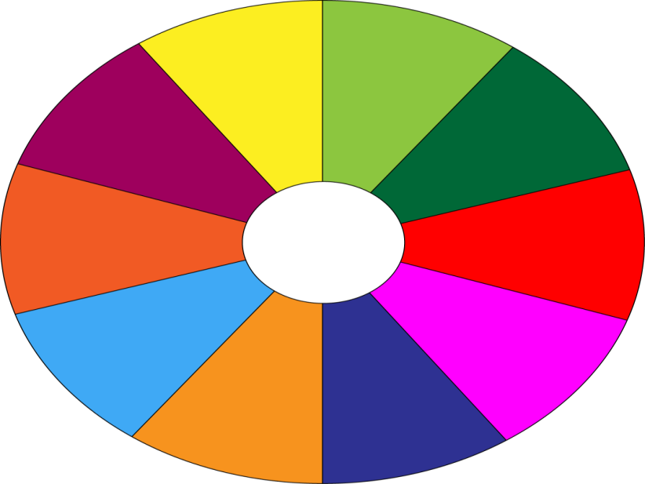
THE BIG WHEEL GAME
QUESTIONS
10
40
1
4
30
50
SPIN
2
5
20
10
3
6
-15
-20
05
60

Slide 10
4
Make questions with How many/ How much for the underlined words in the following sentences.
1. There are six bottles of juice in the fridge.
___________________________________________?
How many bottles of juice are there in the fridge?

Slide 11
4
Make questions with How many/ How much for the underlined words in the following sentences.
2. I need some butter for my pancakes.
___________________________________________?
How much butter do you need for your pancakes?

Slide 12
4
Make questions with How many/ How much for the underlined words in the following sentences.
3. We have only one bottle of fish sauce.
______________________________________________?
How many bottles of fish sauce do you/ we have?

Slide 13
4
Make questions with How many/ How much for the underlined words in the following sentences.
4. We need ten chairs for the party.
______________________________________________?
How many chairs do you/ we need (for the party)?

Slide 14
4
Make questions with How many/ How much for the underlined words in the following sentences.
5. She put a lot of sugar in her lemonade.
____________________________________________?
How much sugar did she put in her lemonade?

Slide 15
4
Make questions with How many/ How much for the underlined words in the following sentences.
6. Nam eats a banana every day.
____________________________________________?
How many bananas does Nam eat every day?

Slide 16
4
Make questions with How many/ How much for the underlined words in the following sentences.
1. There are six bottles of juice in the fridge.
_________________________________________________ ?
2. I need some butter for my pancakes.
_________________________________________________ ?
3. We have only one bottle of fish sauce.
_________________________________________________ ?
4. We need ten chairs for the party.
_________________________________________________ ?
5. She put a lot of sugar in her lemonade.
_________________________________________________ ?
How many bottles of juice are there in the fridge?
How much butter do you need for your pancakes?
How many bottles of fish sauce do you/ we have?
How many chairs do you/ we need (for the party)?
How much sugar did she put in her lemonade?

Slide 17
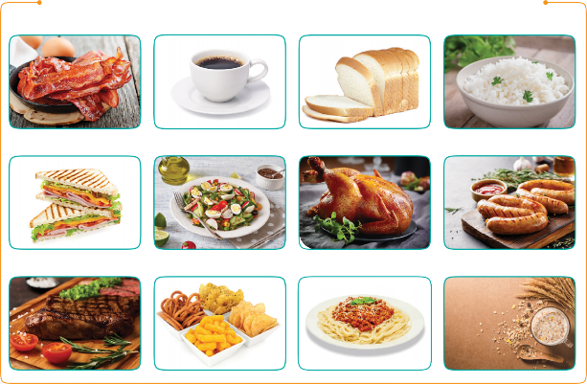
PROJECT
Eating habits around the world
1
Work in groups. Design a poster about eating habits in an area or a foreign country you know, including:
EATING HABITS AROUND THE WORLD
names of main meals and mealtimes
names of common food/ drink for each meal
pictures or photos to illustrate the meals

Slide 18

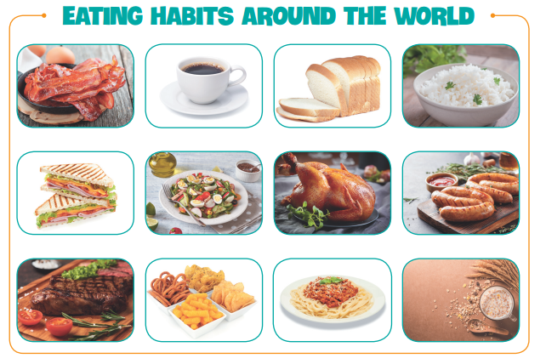
PROJECT
Eating habits around the world
2
Then organise an exhibition of all the posters in your class.
Present your poster to the class.

Slide 19
* CONSOLIDATION
In this lesson, we have learnt to:
Review the vocabulary and grammar of Unit 5
Apply what you have learnt into practice through the project
“EATING HABITS AROUND THE WORLD”

Slide 20
* Homework
Practise the exercises again.
Complete the project perfectly.
Prepare: Unit 6 (Getting started).

Slide 21

Goodbye.
See you again.

Slide 22




