Slide 1
Warm-up
CREATE SENTENCES

Slide 2
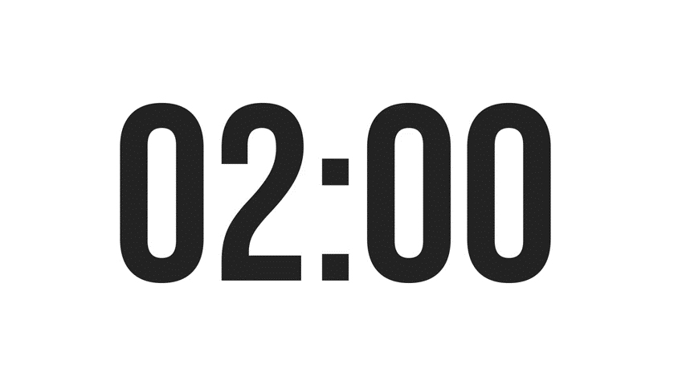
Match the phrases to create sentences
I
everyday.
juice.
I drink
I drink juice
science books.
drink.
I read

Slide 3
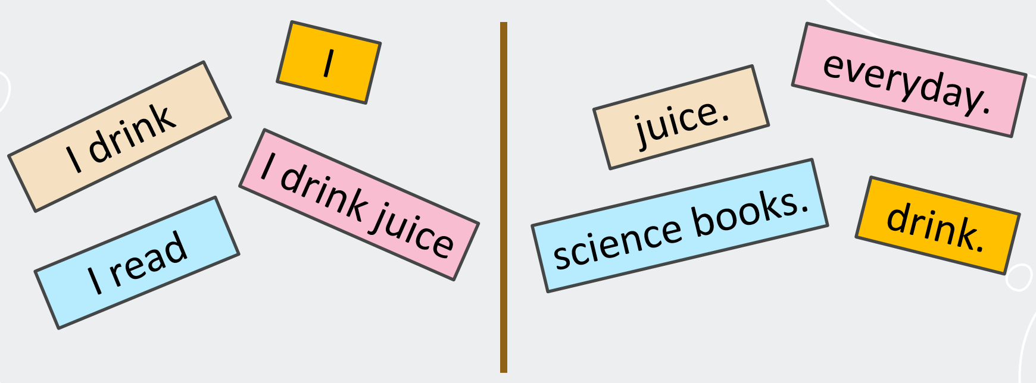
Check your answers
I
drink.
Simple sentences
I drink
juice.
I read
science books.
I drink juice
everyday.

Slide 4
7TH GRADE
UNIT 2:
HEALTHY LIVING
Lesson 3: A closer look 2

Slide 5
OBJECTIVES
By the end of the lesson, students will be able to:
know how to recognize and write simple sentences

Slide 6
3 BASIC TYPES OF SIMPLE SENTENCE
I
drink.
1. A subject and a verb.
subject
verb
2. A subject, a verb and an object
I
drink
juice.
subject
verb
object
3. A subject, a verb, an object and an adverb
I
drink
juice
everyday.
subject
verb
object
adverb

Slide 7
PRACTICE

Slide 8

Ex 1. Tick () the simple sentences. (P.21)
1. The Japanese eat a lot of tofu.
2. She drinks lemonade every morning.
3. I don’t eat fast food, and I don’t drink soft drinks.
4. I am fit.
5. I like fish, but my sister likes meat.
subject
verb
object
subject
verb
object
adverb
Subject + verb (to be) + adjective

Slide 9
Ex 2. Underline and write S (subject) and V (verb) in each simple sentence. (P.21)
1. Vegetarians eat a lot of vegetables and fruit.
2. Acne causes black and white pimples on the face.
3. On Saturdays, my brother often spends two hours exercising at the sports center.
4. My mother didn’t buy my favourite cheesecake.
5. We are not cleaning up our community library.
S
V
S
V
S
V
S
V
S
V

Slide 10
Ex 3. Rearrange the words and phrases to make simple sentences. (P.21)
soft drinks/ never/ my sister/ drinks/.
affects/ acne/ 80% of young people/.
has/ he/ for breakfast/ bread and eggs/.
don’t eat/ we/ much fast food/.
a lot of vitamins/ fruit and vegetables/ have/.
 My sister never drinks soft drinks.
Simple sentences:
S + V
S + V + O
S + V + O + Adv
 Acne affects 80% of young people.
 He has bread and eggs for breakfast.
 We don’t eat much fast food.
 Fruit and vegetables have a lot of vitamins.

Slide 11
Ex 3. Write complete sentences from the prompts. You may have to change the words given. (P.21)
tofu/ be/ healthy
many/ Vietnamese/ drink/ green tea.
she/ not/ use/ suncream.
father/ not/ exercise/ every morning.
most children/ have/ chapped lips and skin/ winter.

Slide 12
Ex 3. Write complete sentences from the prompts. You may have to change the words given. (P.21)
tofu/ be/ healthy
many/ Vietnamese/ drink/ green tea.
she/ not/ use/ suncream.
Present simple – to be
S + am/is/are + adj
 Tofu is healthy.
Present simple:
S + V(s/es)
(Many Vietnamese – plural noun)
 Many Vietnamese drink green tea.
Present simple – negative sentence
S + doesn’t / don’t V
 She doesn’t use suncream.

Slide 13
Ex 3. Write complete sentences from the prompts. You may have to change the words given. (P.21)
father/ not/ exercise/ every morning.
4. most children/ have/ chapped lips and skin/ winter.
Present simple
(negative sentence)
S + doesn’t / don’t V
 My father doesn’t exercise every morning.
Present simple:
S + V(s/es)
(Most children – plural noun)
 Most children have chapped lips and skin in winter.

Slide 14
Ex 5. Work in pairs. Discuss and write a simple sentence from the two given sentences (P.22)
Example: Many people are running. Many people are exercising.
 Many people are ___________________________.
running
exercising
running and exercising
We avoid sweetened food. We avoid soft drinks.
 We avoid _______________________________ .
2. My dad loves outdoor activities. I love outdoor activities.
 My ____________ love outdoor activities
3. You should wear a hat. You should wear suncream.
 You should wear ___________________________ .
4. My mother read the health tips. My mother downloaded the health tips.
 My mother ________________________________.

Slide 15
Ex 5. Work in pairs. Discuss and write a simple sentence from the two given sentences (P.22)
We avoid sweetened food. We avoid soft drinks.
We avoid ____________________________________ .
2. My dad loves outdoor activities. I love outdoor activities.
 My ___________________________ love outdoor activities
sweetened food
soft drinks
sweetened food and soft drinks
My dad
I
dad and I

Slide 16
Ex 5. Work in pairs. Discuss and write a simple sentence from the two given sentences (P.22)
3. You should wear a hat. You should wear suncream.
You should wear ___________________________ .
4. My mother read the health tips. My mother downloaded the health tips.
My mother ___________________________________________.
a hat
suncream
a hat and suncream
read the health tips
downloaded the health tips
read and downloaded the health tips

Slide 17
RECAP
01
How many types of simple sentence you have learnt?
3 types
02
What are they?
Subject + Verb
Subject + Verb + Object
Subject + Verb + Object + Adverb

Slide 18
THANKS!
Do you have any questions?

