Slide 1





















Unit 2
My school
Lesson 2 – Task 1,2,3
Notes:
Để nguyên trang bìa như này, chỉ thay đổi tên bài trong quá trình làm. Logo của sách Wonderful World

Slide 2







Warm up
Sing a song

Slide 3
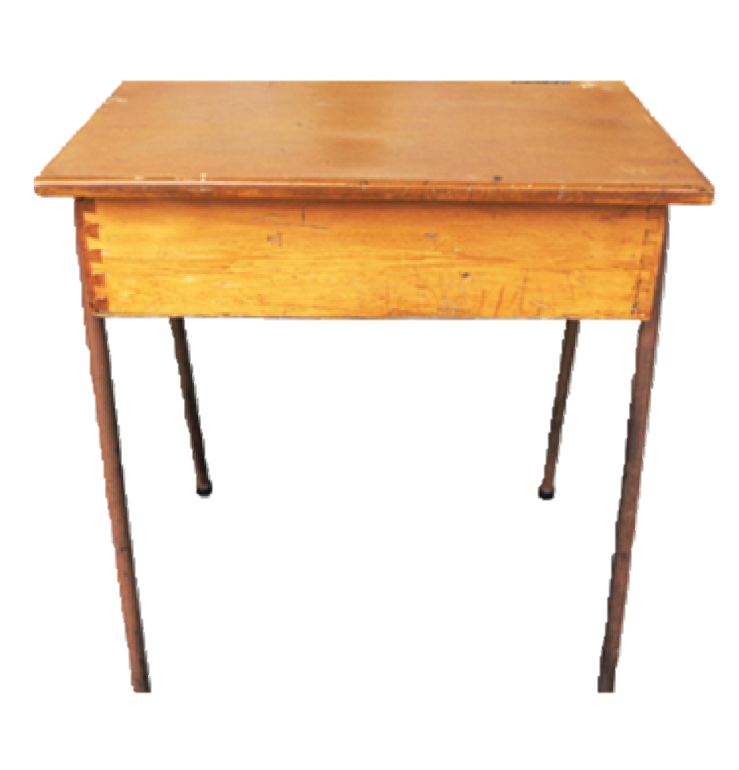
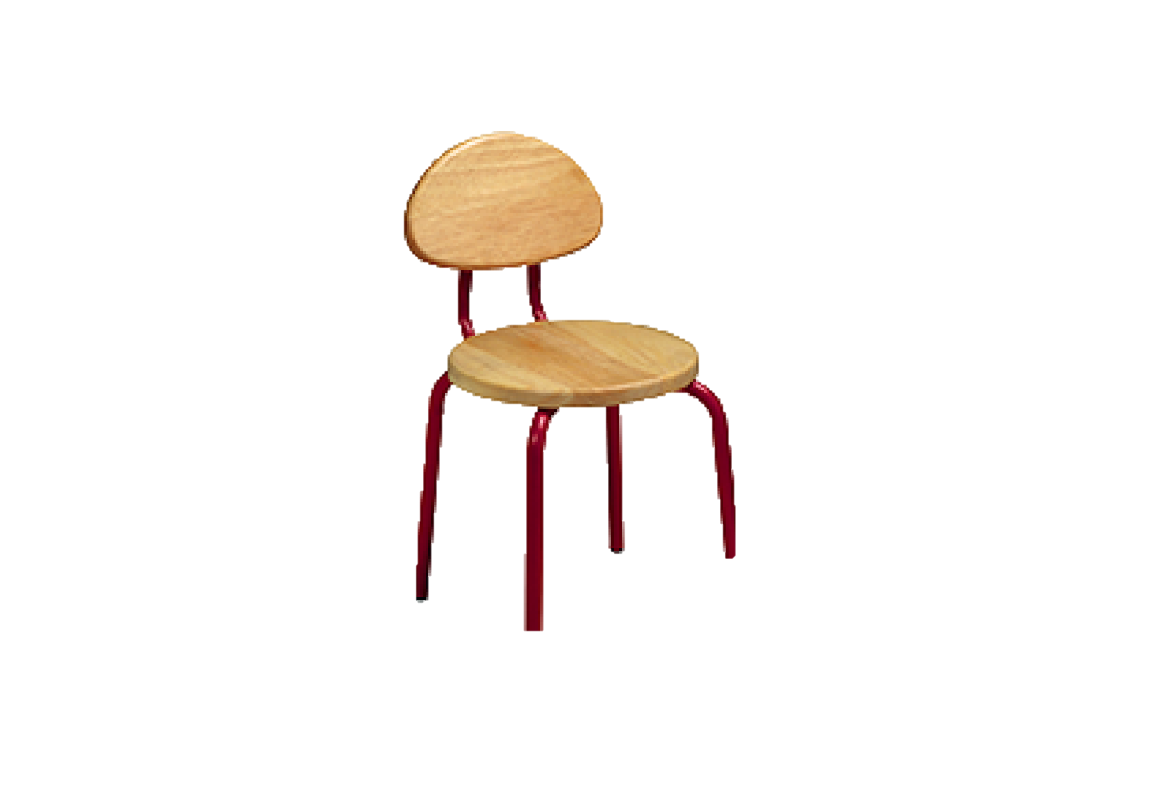
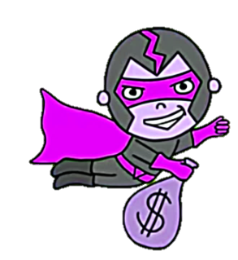

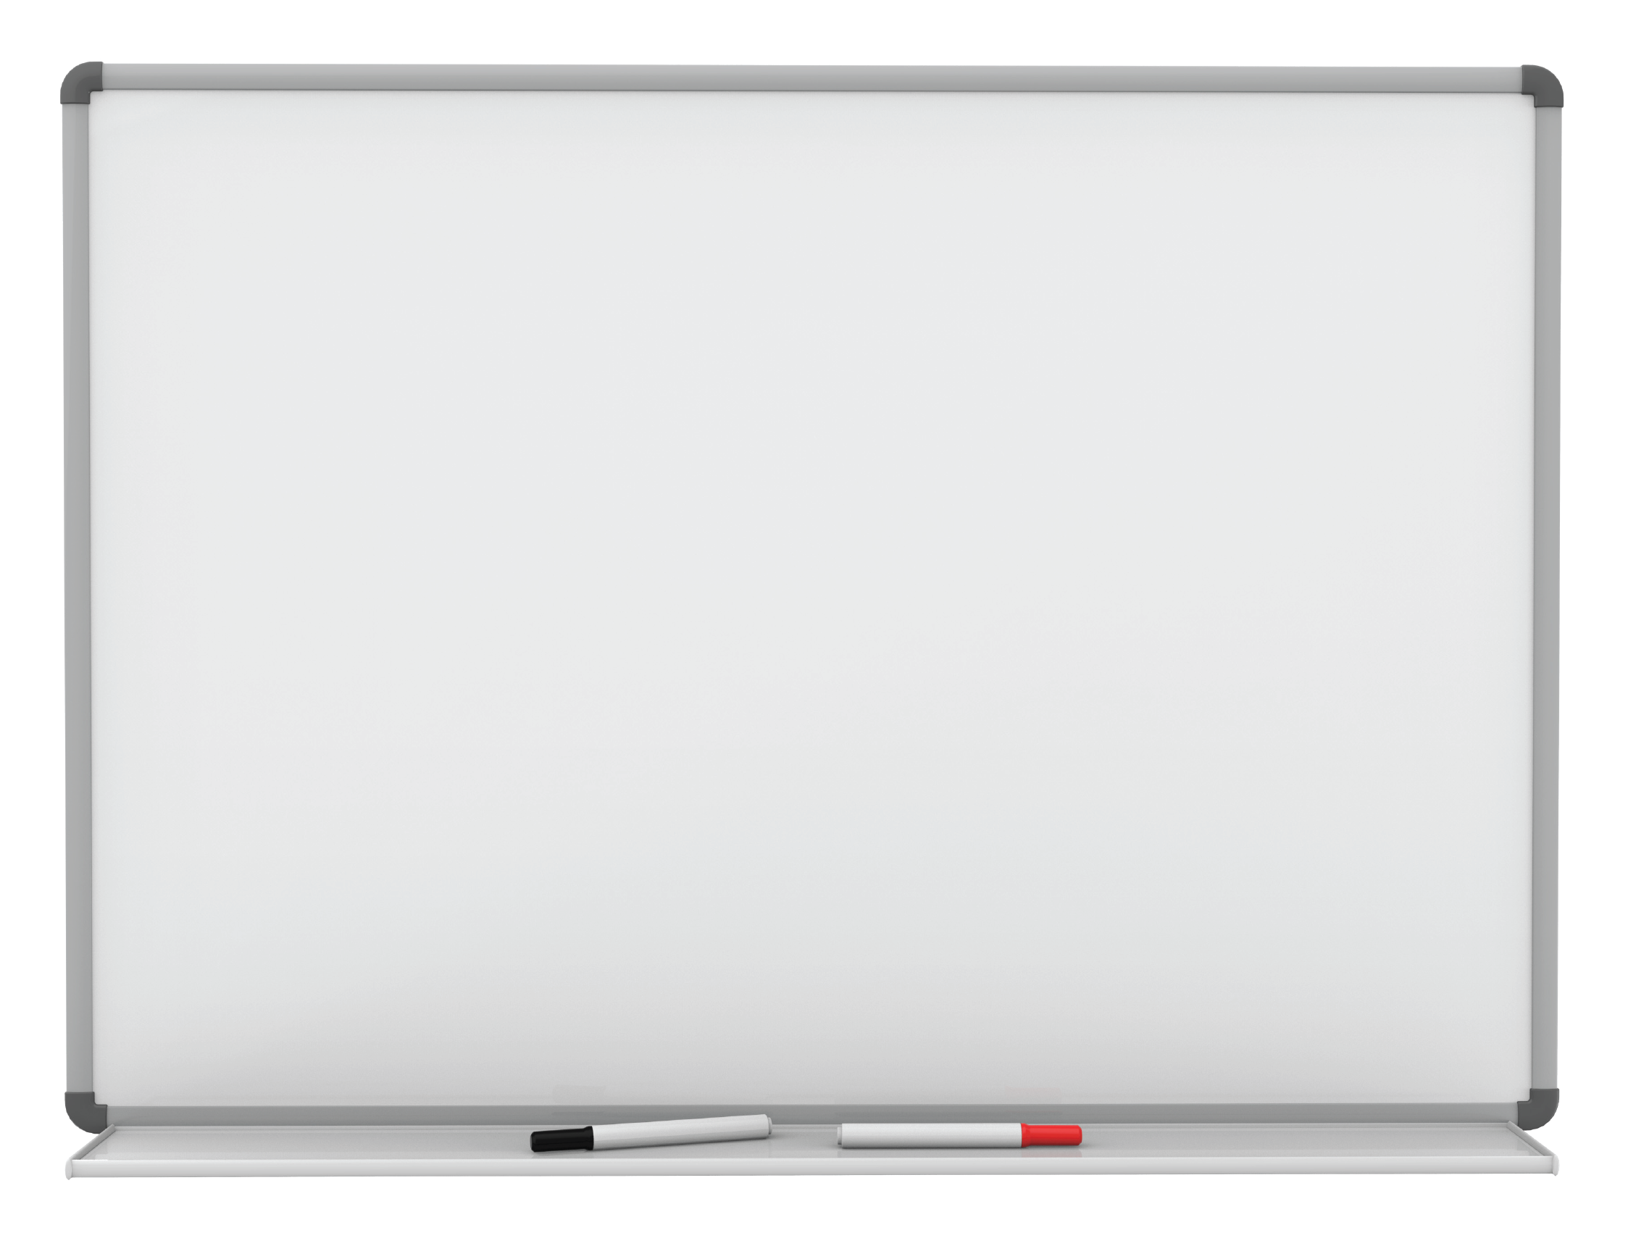

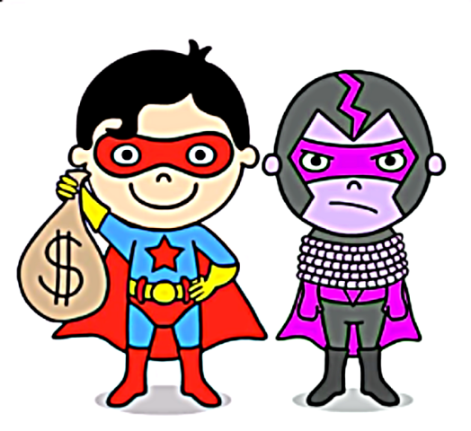

desk
chair
board
clock
Notes:
Click vào biểu tượng loa để nghe âm thanh
Sau khi hs luyện phát âm xong, click vào hình superman để hiện lên hình bắt tội phạm thành công

Slide 4

Practice
Task 2: Listen and tick

Slide 5
Read and guess
Look, It’s a family/ classroom.
It’s great/ funny.
The teacher is at the door/ board. It’s white/ black.
The students are at the desks/ windows. The chairs are brown/ orange.
Notes:
Pre- Listening

Slide 6
Listen and tick
Look, It’s a family/ a classroom. It’s great/ funny.
The teacher is at the door/ board. It’s white/ black.
The students are at the desks/ windows. The chairs are brown/ orange.
✓
✓
✓
✓
✓
✓

Slide 7
3 Look at the photo in 2.
Point and say
1 a classroom
2 a desk
3 a chair
4 a clock
It’s a classroom.
It’s great.

Slide 8

Production
Fill the blanks then talk

Slide 9
My classroom fact file fill the blanks then talk to partner
The classroom | great
The desks | brown
The chairs
The clocks
The girl
The boy
The teacher
The board
Others
Notes:
-Ask sts to look at the real classroom. Then make questions like:
What color is the chair? It’s brown
How is your teacher? She/He’s Great/ Funny
…………

Slide 10

Assessment
Choose the correct answer!

Slide 11
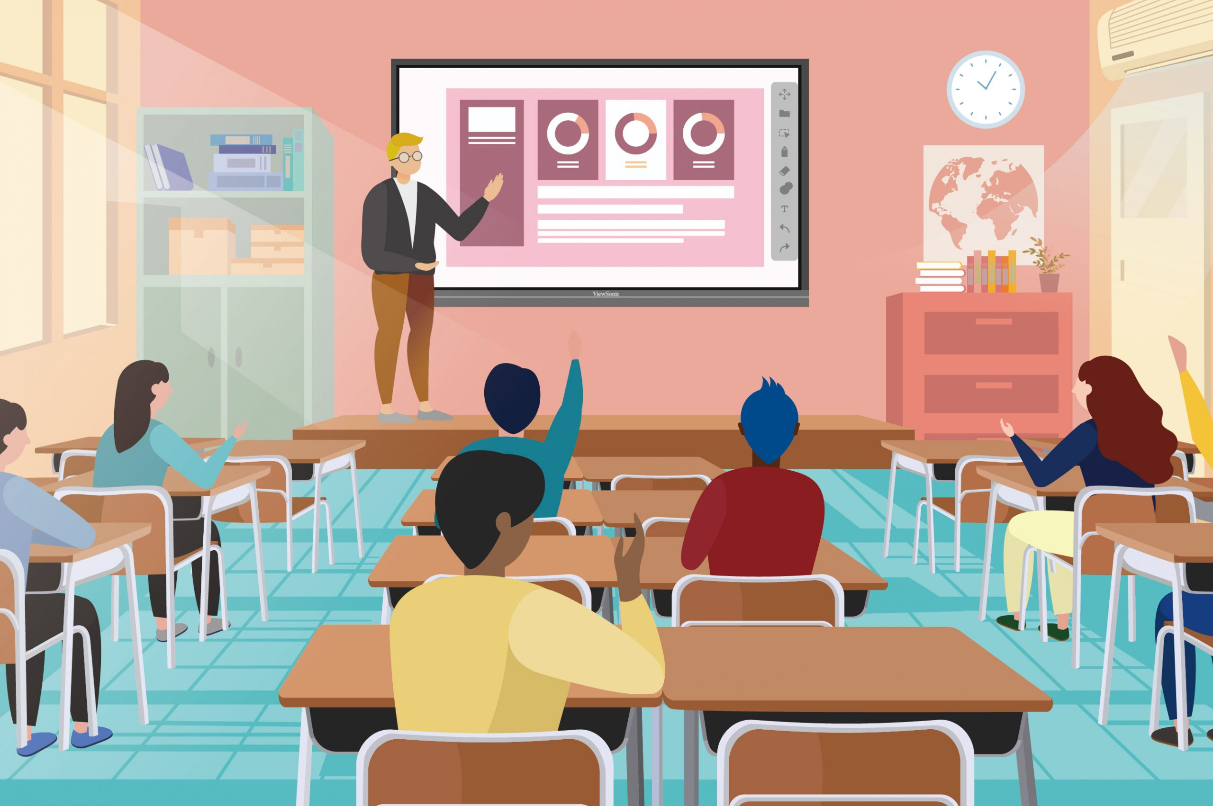
e
1.
2.
3.
4.
5.
6.
1. It’s a board.
f
f
2. It’s a clock.
e
3. It’s a chair.
a
d
4. It’s a desk.
b
c
5. He’s a teacher.
a
6. She’s a student.
c
b
d
Notes:
THIẾT KẾ HOẠT ĐỘNG TƯƠNG TÁC CHO 6 CÂU NÀY.

Slide 12




Good bye.
See you again!

