Slide 1








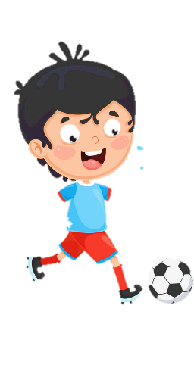
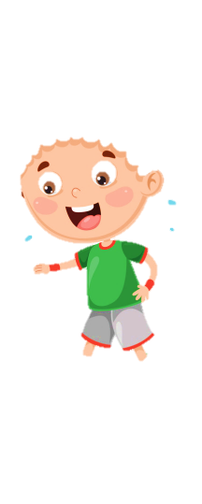





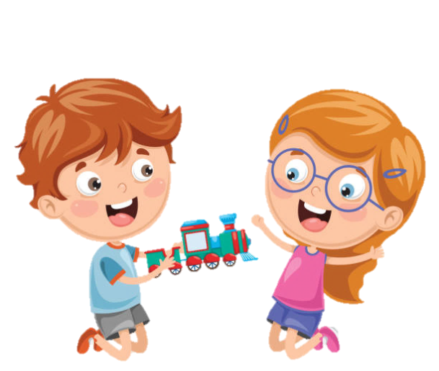





Notes:
Để nguyên trang bìa như này, chỉ thay đổi tên bài trong quá trình làm. Logo của sách Wonderful World

Slide 2
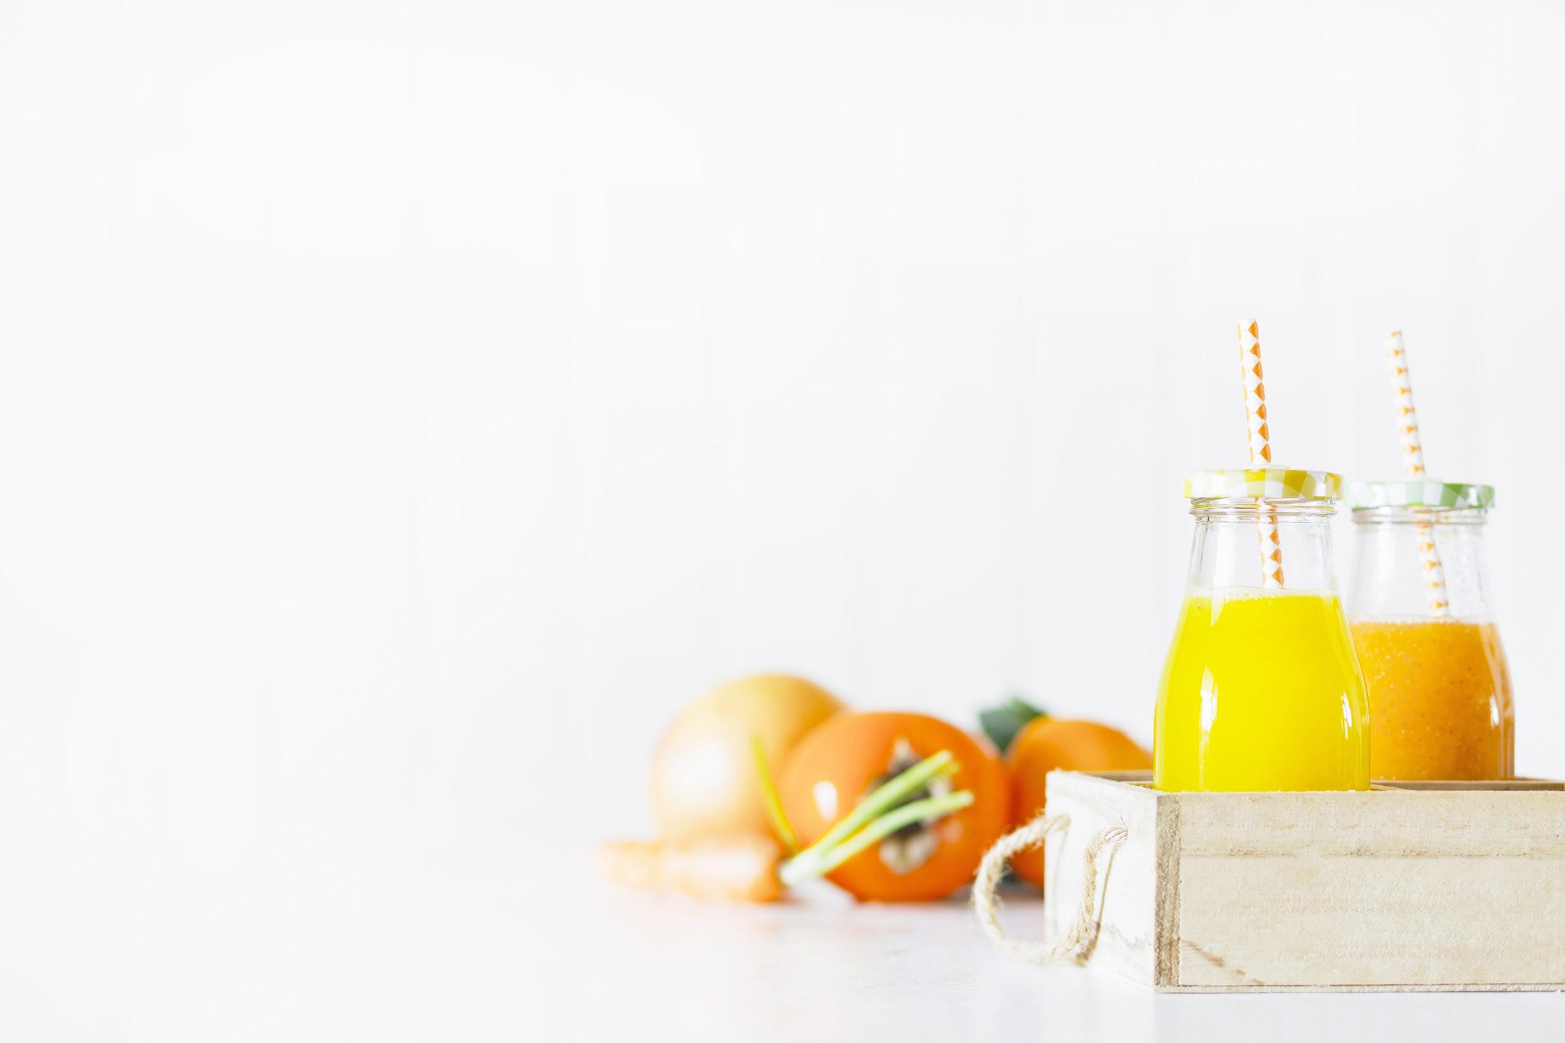

Unit 4:
Food and drinks
Lesson 1 – Task 4, 5, 6

Slide 3


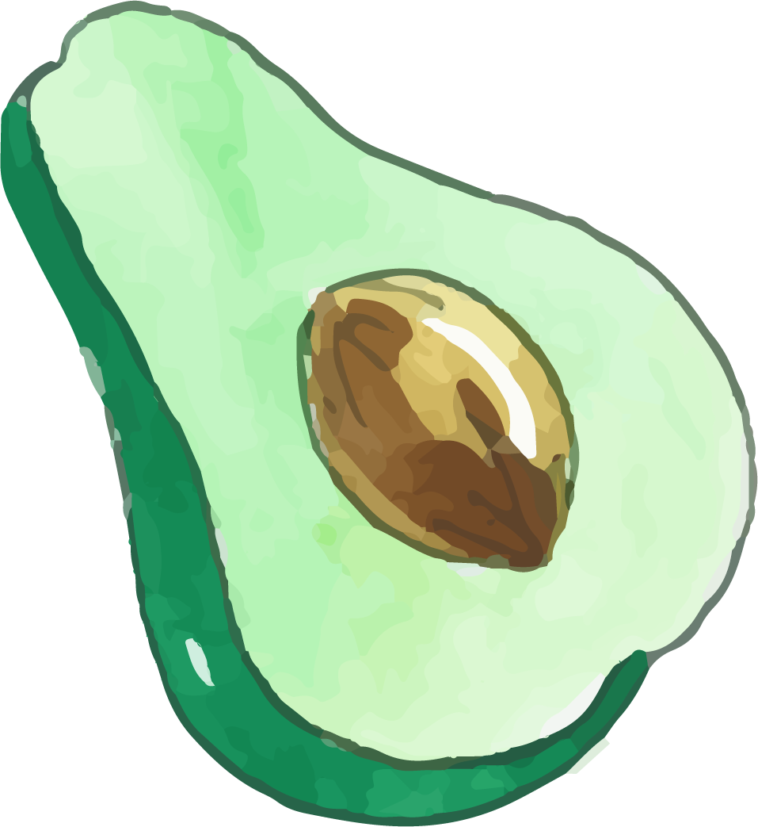
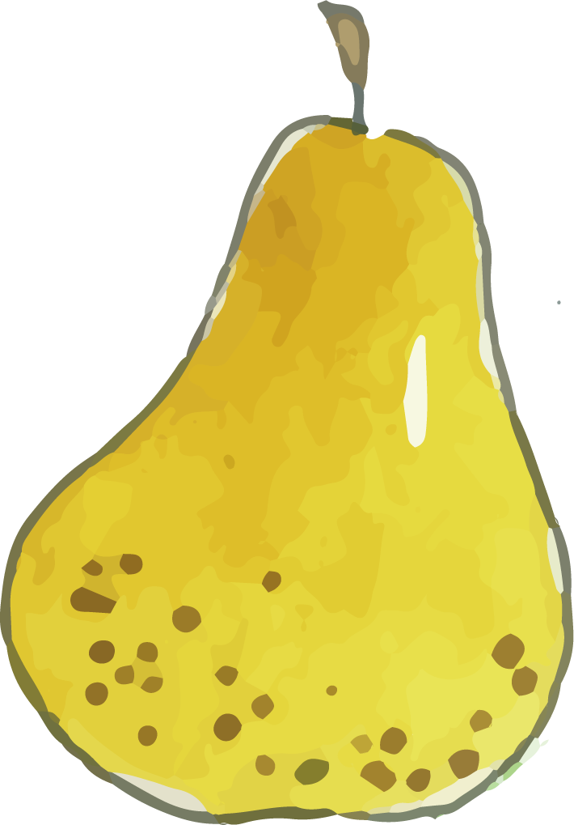


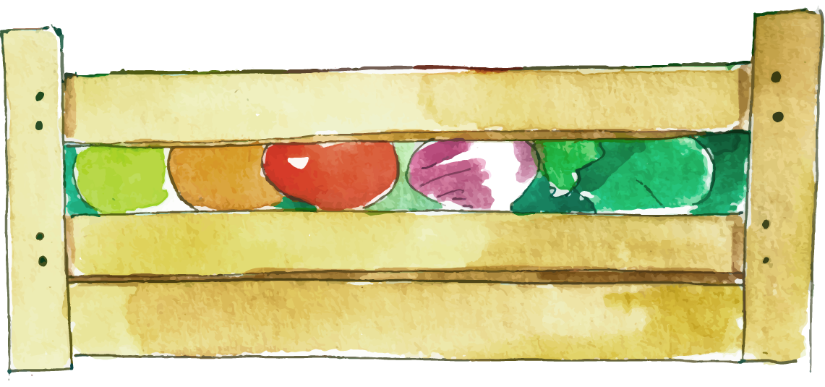

1 WARM UP
SPELLING BEE GAME.

Slide 4














SPELLING BEE GAME
5
Notes:
Bấm vào số để chọn câu hỏi
Bấm vào hũ để mở sao
Bấm vào Exit để thoát game

Slide 5
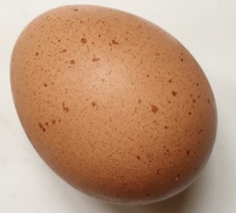


SPELLING BEE GAME
E-G-G
Time
over
02
04
03
05
01
12
28
27
24
19
08
09
26
14
15
23
13
21
10
20
06
07
22
17
25
18
11
30
16
29
START
Notes:
Bấm vào start để chạy đồng hồ
Bấm vào back để quay lại trang chủ

Slide 6
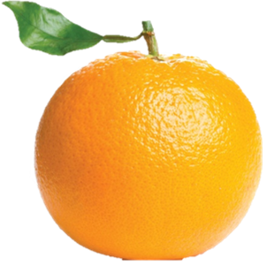
SPELLING BEE GAME
O-R-A-N-G-E
Time
over
02
04
03
05
01
12
28
27
24
19
08
09
26
14
15
23
13
21
10
20
06
07
22
17
25
18
11
30
16
29
START
Notes:
Bấm vào start để chạy đồng hồ
Bấm vào back để quay lại trang chủ

Slide 7
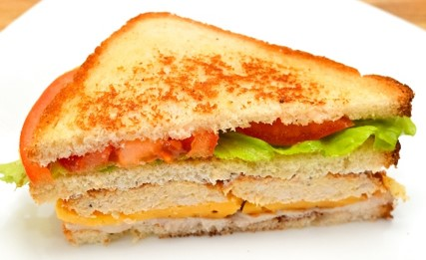
SPELLING BEE GAME
S-A-N-D-W-I-C-H
Time
over
02
04
03
05
01
12
28
27
24
19
08
09
26
14
15
23
13
21
10
20
06
07
22
17
25
18
11
30
16
29
START
Notes:
Bấm vào start để chạy đồng hồ
Bấm vào back để quay lại trang chủ

Slide 8
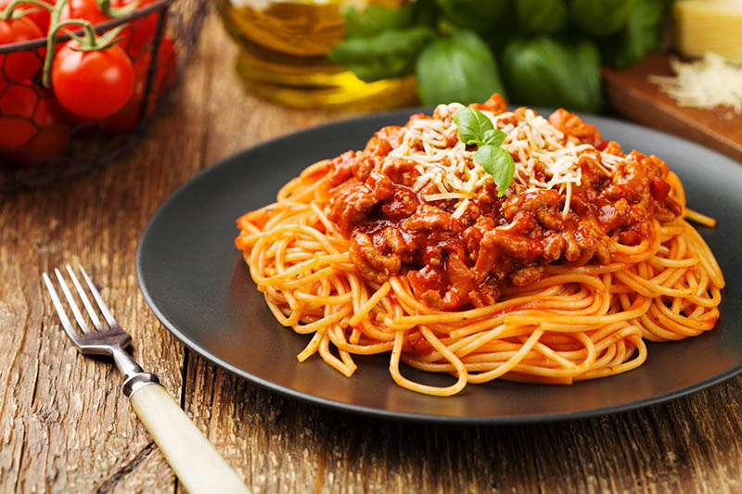
SPELLING BEE GAME
S-P-A-G-H-E-T-T-I
Time
over
02
04
03
05
01
12
28
27
24
19
08
09
26
14
15
23
13
21
10
20
06
07
22
17
25
18
11
30
16
29
START
Notes:
Bấm vào start để chạy đồng hồ
Bấm vào back để quay lại trangchủ

Slide 9
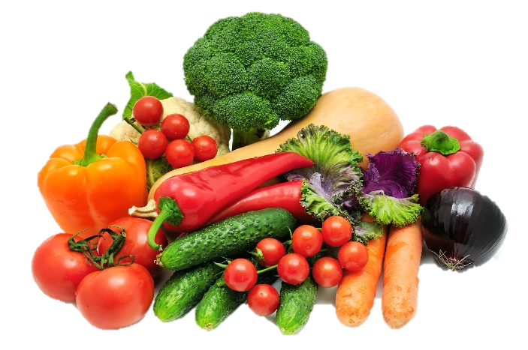
SPELLING BEE GAME
V-E-G-E-T-A-B-L-E-S
Time
over
02
04
03
05
01
12
28
27
24
19
08
09
26
14
15
23
13
21
10
20
06
07
22
17
25
18
11
30
16
29
START
Notes:
Bấm vào start để chạy đồng hồ
Bấm vào back để quay lại trang chủ

Slide 10


2 PRESENTATION
Task 4 Listen and repeat.

Slide 11
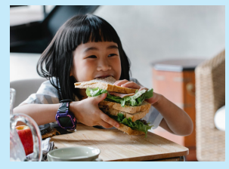
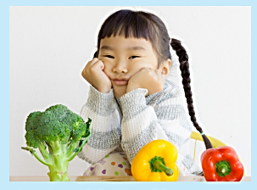
Listen and repeat.
1 Would you like a sandwich?
- Yes, please.
2 Would you like some vegetables?
-No, thanks.
Notes:
Bấm vào loa để nghe cả bài
Bấm vào câu để nghe từng câu

Slide 12
Let’s check!
Would you
like
a sandwich.
Yes, please!

Slide 13
Let’s check!
Would you
like
some vegetables.
No, Thanks!

Slide 14

3 PRACTICE
Task 5 Look and say.

Slide 15


Look and say.
❎
✅
2 an orange
1 some spaghetti
✅
❎
3 a sandwich
4 some vegetables

Slide 16
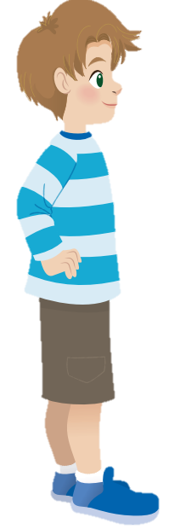
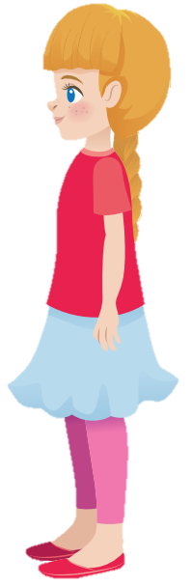
Look and say.
Would you like some spaghetti?
No, thanks
❎

Slide 17
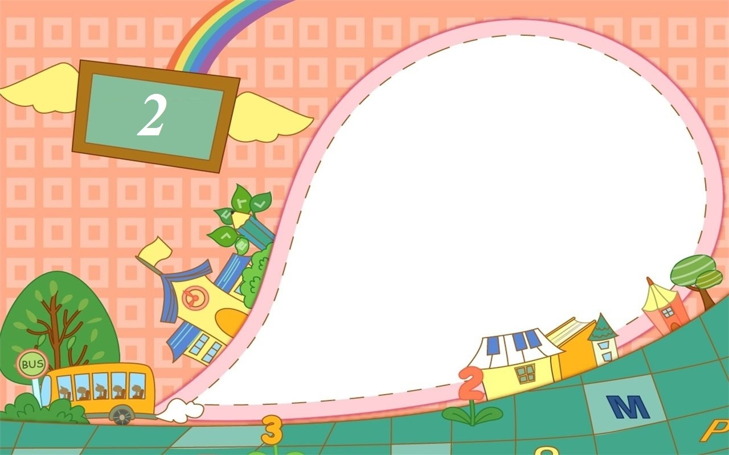
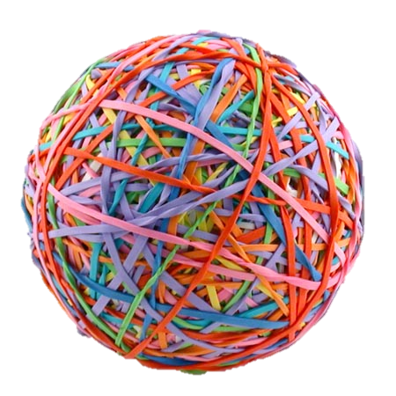
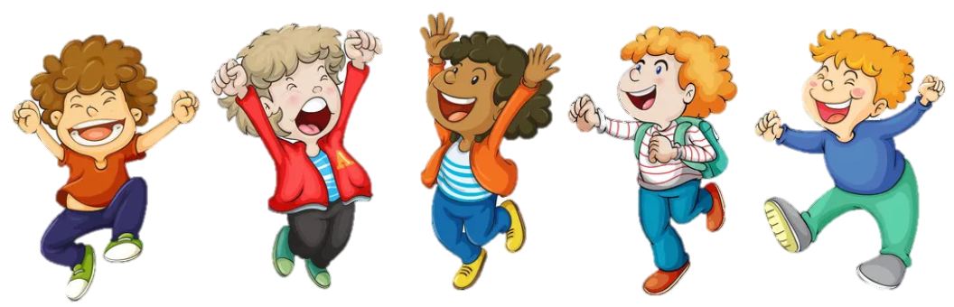
PASS THE BALL GAME
Notes:
Pass the ball. When the music stops – whoever has the ball must answer the question

Slide 18


Pass the BALL!

Slide 19
Yes, please.
Would you like an orange ?
✅

Slide 20
Pass the BALL!

Slide 21
Would you like some spaghetti?
❎
No, thanks.

Slide 22
Pass the BALL!

Slide 23
Would you like a sandwich?
✅
Yes, please.

Slide 24
Pass the BALL!

Slide 25
Yes, please.
Would you like an orange ?
✅

Slide 26
Pass the BALL!

Slide 27
Would you like some vegetables?
❎
No, thanks.

Slide 28
Pass the BALL!

Slide 29
Would you like a sandwich?
✅
Yes, please.

Slide 30
Pass the BALL!

Slide 31
Would you like some spaghetti?
❎
No, thanks.

Slide 32
Pass the BALL!

Slide 33
Would you like some vegetables?
❎
No, thanks.

Slide 34
Pass the BALL!

Slide 35
Would you like some spaghetti?
❎
No, thanks.

Slide 36
Pass the BALL!

Slide 37
Yes, please.
Would you like an orange ?
✅

Slide 38
Pass the BALL!

Slide 39
Would you like some vegetables?
❎
No, thanks.

Slide 40
Pass the BALL!

Slide 41
Would you like a sandwich?
✅
Yes, please.

Slide 42
Stop!

Slide 43
4 PRODUCTION
Task 6 Role play

Slide 44
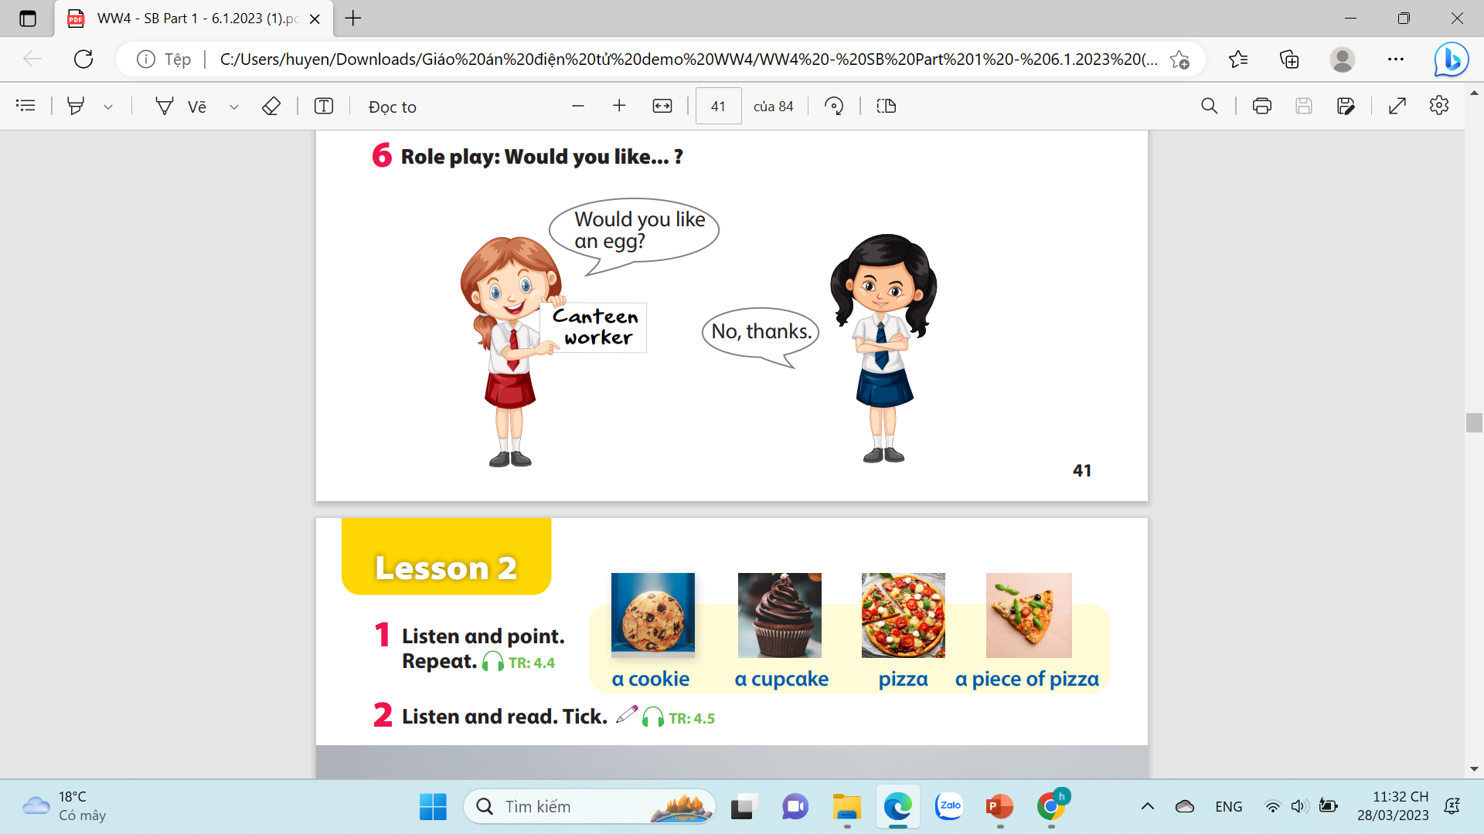
Role play : Would you like…?

Slide 45
5 ASSESSMENT
1. Would you like an orange? (✓)
→ Yes, please.
2. Would you like some juice? (✗)
→ No, thanks.
3. Would you like some biscuits? (✗)
→ No, thanks.
4. Would you like a sandwich? (✓)
→ Yes, please.

Slide 46


6.WRAP UP
1- Would you like ______?
-Yes, please.
2- Would you like some_______ ?
-No, thanks

Slide 47




Thank you & goodbye!

