Slide 1








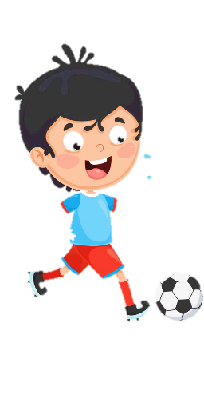
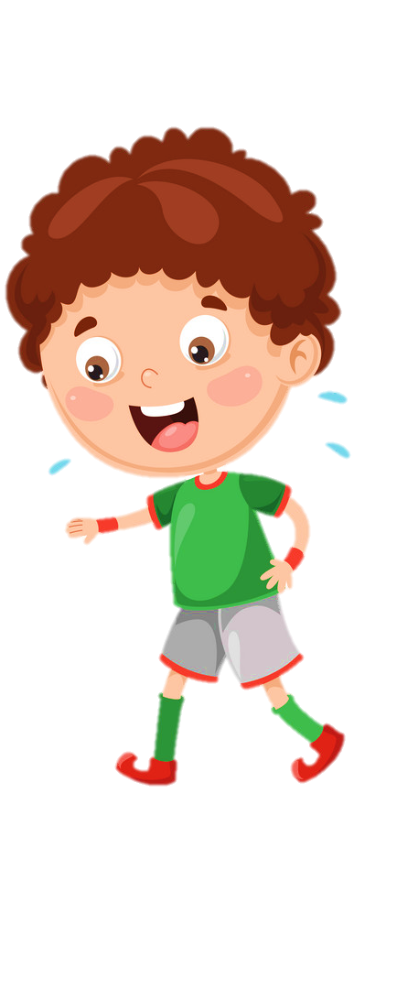

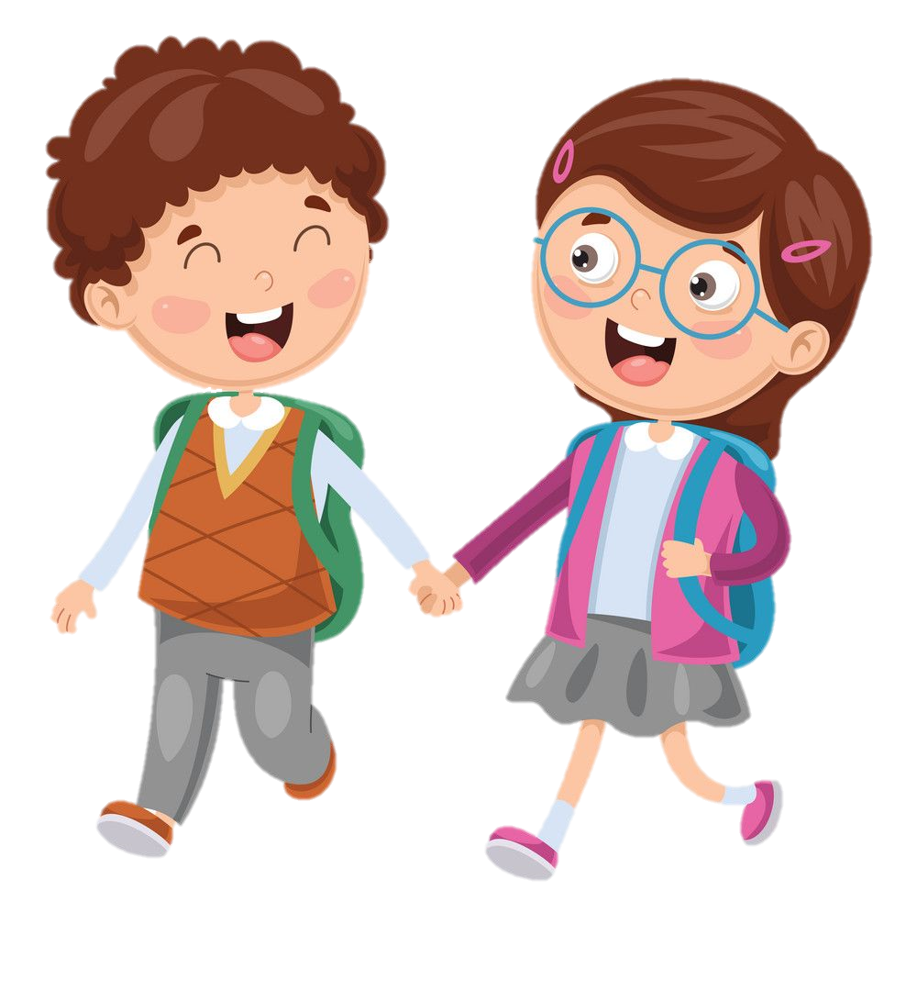



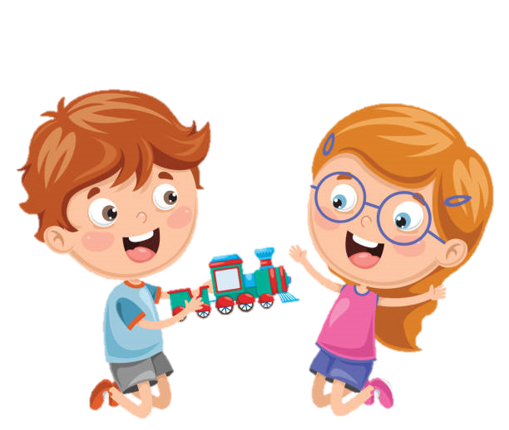





Notes:
Để nguyên trang bìa như này, chỉ thay đổi tên bài trong quá trình làm. Logo của sách Wonderful World

Slide 2
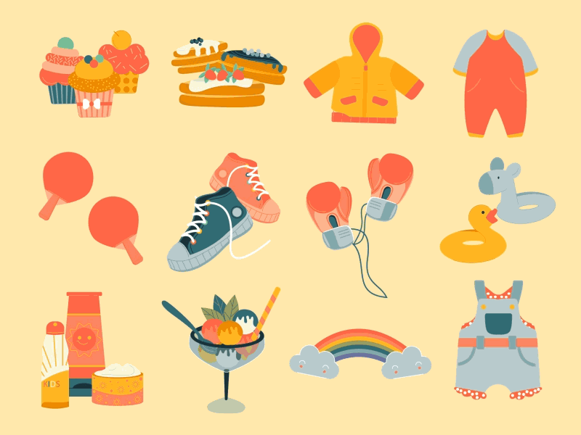

Unit 5
My Clothes
LESSON 2: task 1,2,3

Slide 3
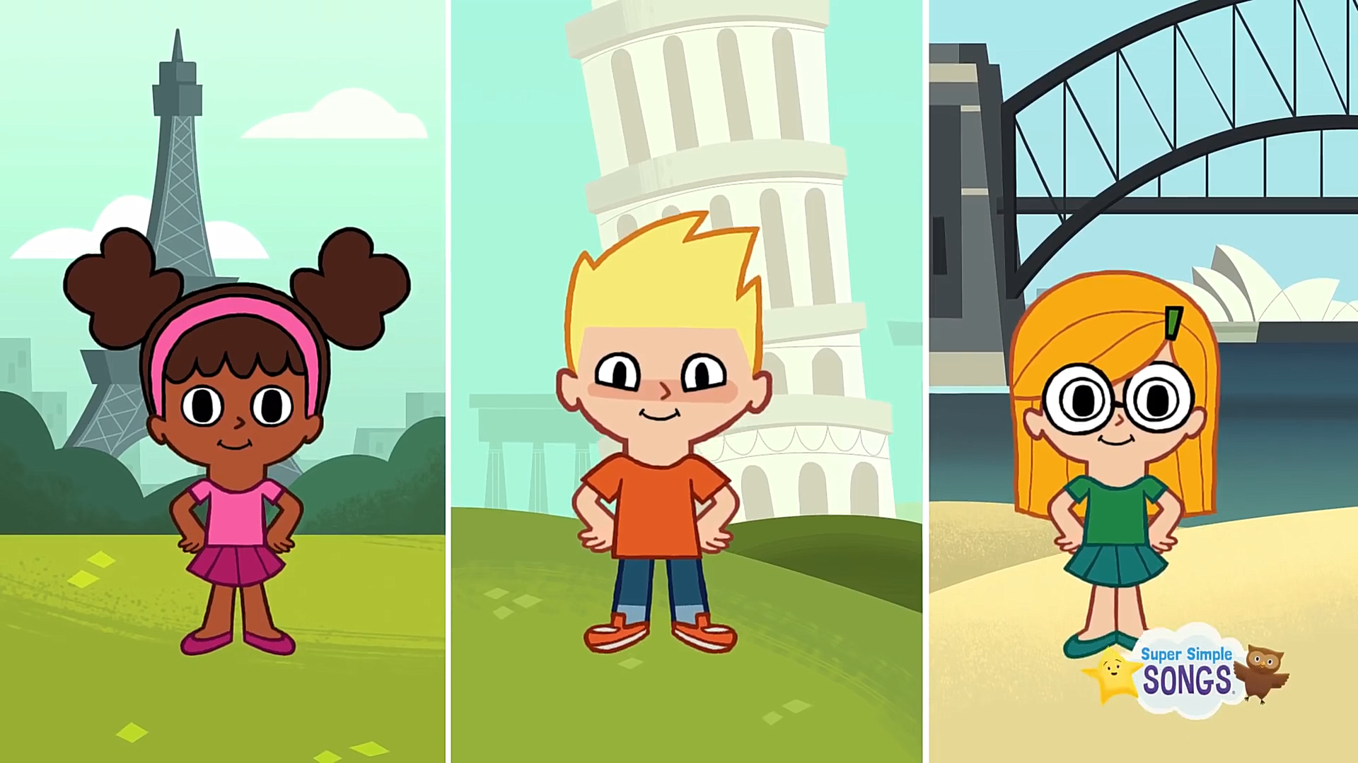

Hello everyone!
1 WARM UP

Slide 4


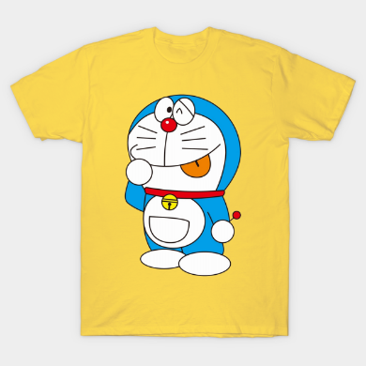
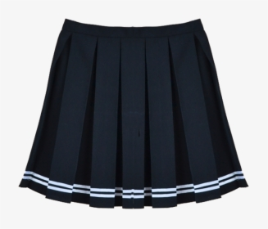
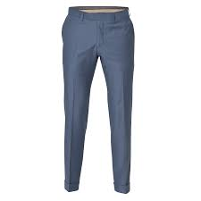
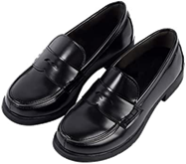
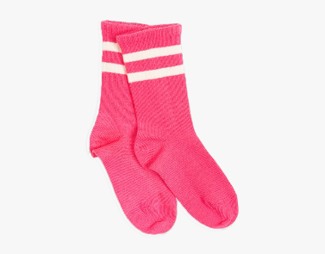
Gametime!
1
T
s
2
-
k
s
i
3
s
h
r
h
i
4
r
o
u
5
s
e
r
s
T
e
o
t
s
c
k
s

Slide 5


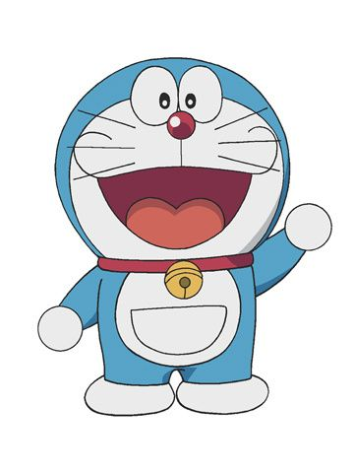
Hi! I’m Doraemon. I’m in Japan.
This is my magic bag.
What’s in my bag?
Notes:
THIẾT KẾ HOẠT ĐỘNG TƯƠNG TÁC CHO CÁC SLIDE TỪ 6 ĐẾN 10. MỖI CÂU KÈM THEO HÌNH ẢNH MINH HOẠ. HS TRẢ LỜI TỰ LUẬN

Slide 6

What’s in my bag?
boots

Slide 7
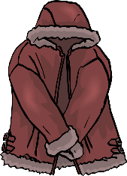
What’s in my bag?
coat

Slide 8
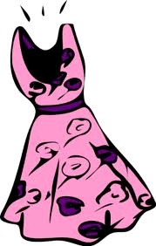
What’s in my bag?
dress

Slide 9
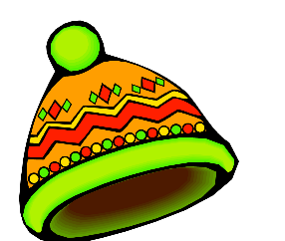
What’s in my bag?
hat

Slide 10
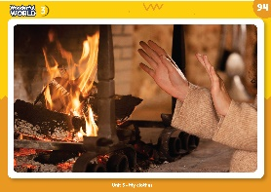
What’s in my bag?
warm

Slide 11
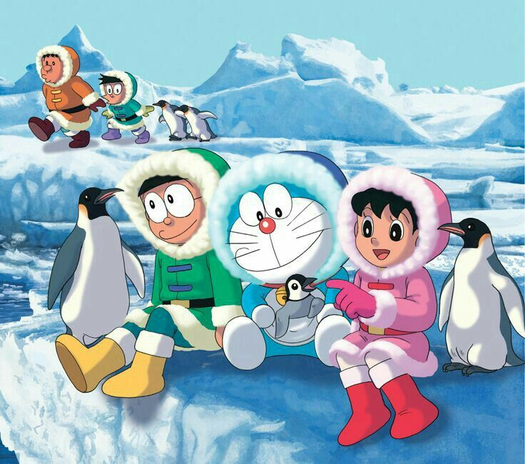

Slide 12
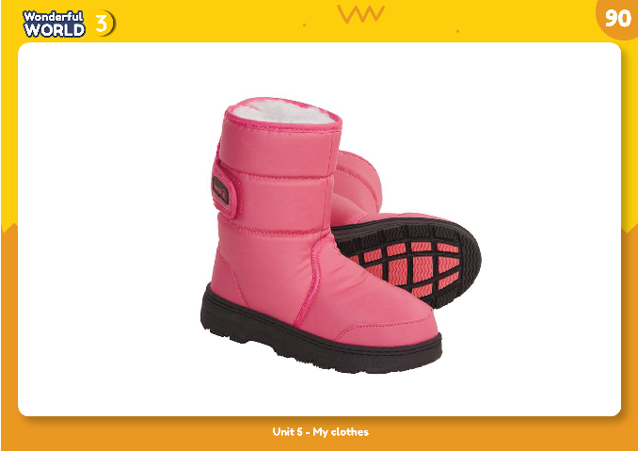
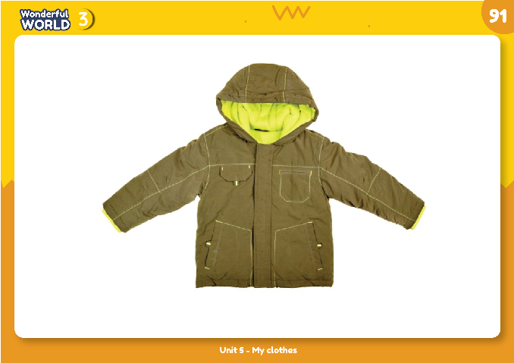
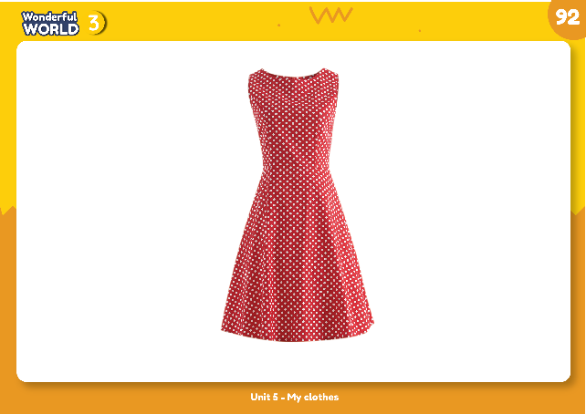
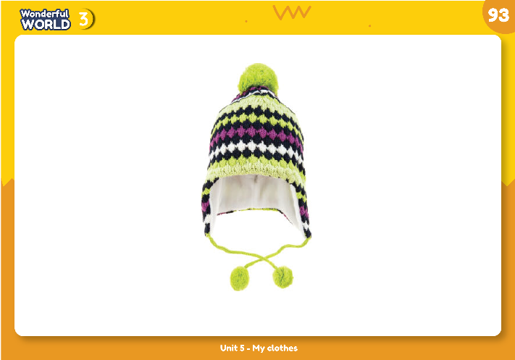
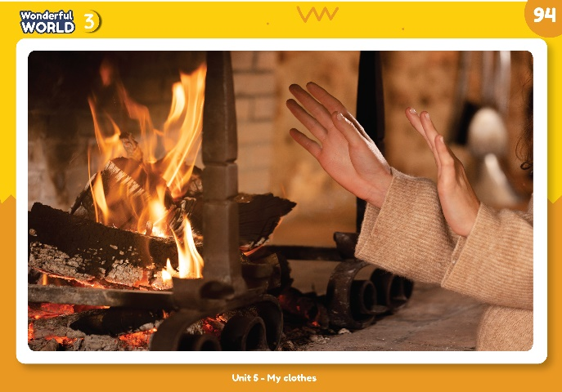

1. Listen and point. Repeat.
2 PRESENTATION
NEW WORDS

Slide 13

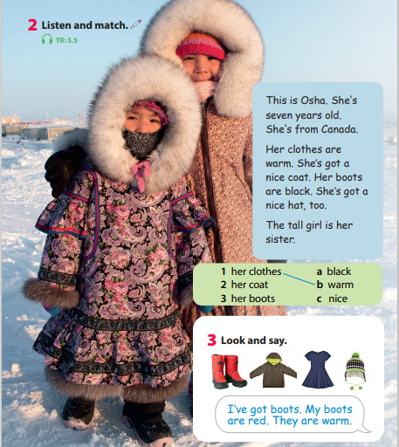
3 PRACTICE

Slide 15











Game time:
Who’s faster?
1. I’ve got ________. My _________ are _______ . They are warm.
2. I’ve got ________. My _________ are _______ .
3. I’ve got ________. My _________ are _______ . They are warm.
4. I’ve got ________. My _________ are _______ .
5. I’ve got ________. My _________ are _______ . They are warm.

Slide 16













4 PRODUCTION
Draw your warm clothes.
I’ve got ___.
My ___ is/are ___.
It’s ____./ They are___.

Slide 17

worksheet

Slide 18

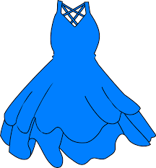
5 ASSESSMENT
Choose the correct answer
1. I have got ______. They are red.
A. dress B. boots C. T-shirt
2. There isn’t a _______ in my uniform.
A. coat B. trousers C. hat
3. This is my favourite ______. It’s blue.
A. coat B. boots C. dress
*Write
4. Her coat is very w _ _ _
5. My mother has got long _ o _ts.
a
r
m
b
o
Notes:
TƯƠNG TÁC:
THIẾT KẾ HOẠT ĐỘNG TƯƠNG TÁC CHO 5 CÂU NÀY. VỚI CÂU 1,2,3 CÓ KÈM HÌNH ẢNH MINH HOẠ

Slide 19


Goodbye~!

