Slide 1

Duc Giang Primary School
WELCOME ALL THE TEACHERS
TO CLASS 3A6
Unit 3: School - Lesson 1.1

Slide 2

LET’S SING school things song.mp4
Notes:
Put three or four FLASHCARDS (family members) on the board and tell your child to look at them. Ask them to close their eyes and take one card away. When your child opens their eyes, ask them to guess what is missing.

Slide 3

Unit 3: School
Lesson 1.1
Page 38

Slide 4
Lesson Outline
Vocabulary
Structure
Consolidation
Wrap-up

Slide 5
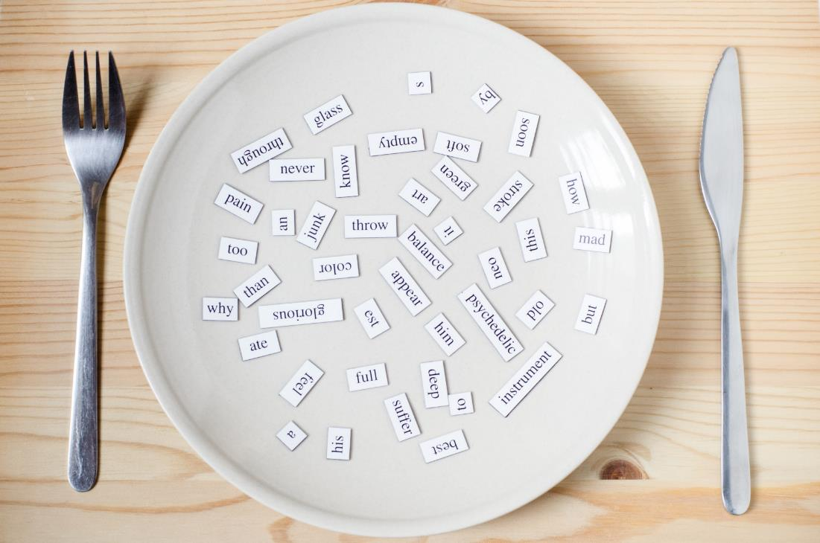
New words

Slide 6
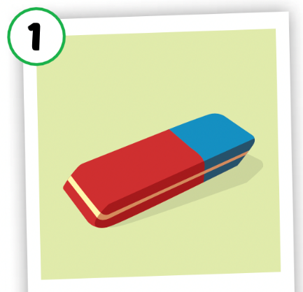

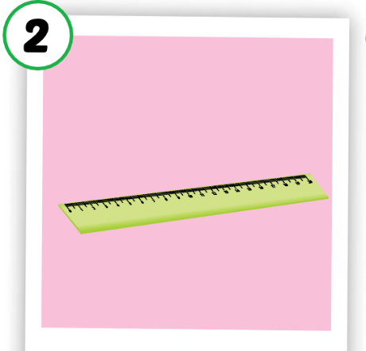
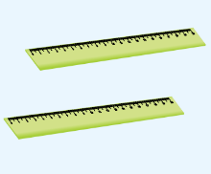
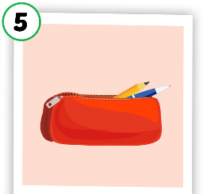




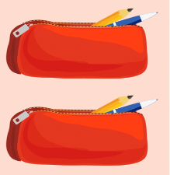
I. New words
eraser
erasers
ruler
rulers
pencil case
pen
pens
notebook
notebooks
pencil cases
Notes:
GV lưu ý dạng số nhiều của các từ vừa học

Slide 7
singular nouns
plural nouns
eraser
erasers
ruler
rulers
pencil
pencils
notebook
notebooks
pencil case
pencil cases

Slide 8

Let’s play

Slide 9
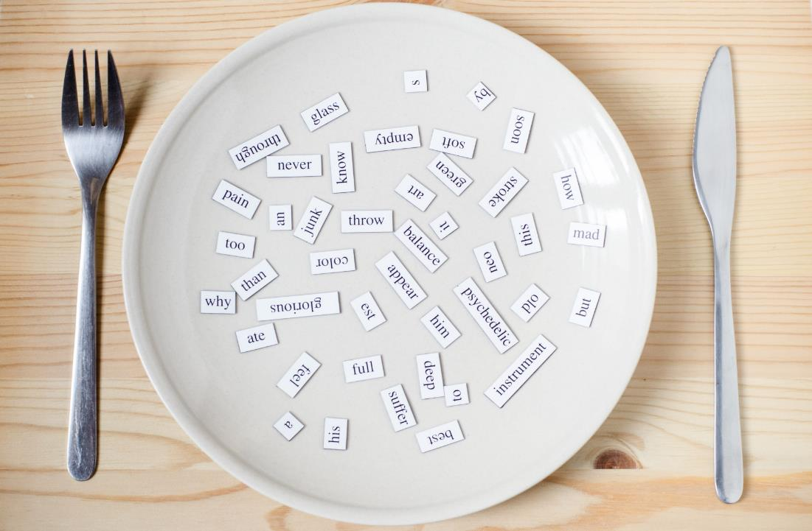
Structures

Slide 10




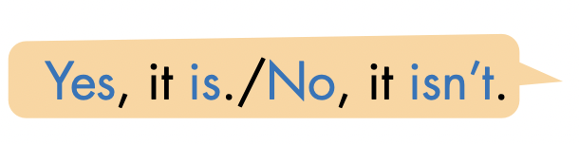



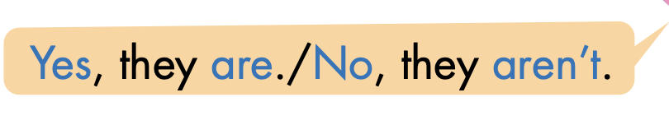
Click here to hear the sound.

Slide 11
Practice

Slide 12






Is this your .................? Yes, it is. / No, it isn’t.
Are these your ......................? Yes, they are. / No, they aren’t.
Let’s practice
➀✓
➁ ✗
➂✓
➃✗
➄✓
➅✗

Slide 13

Production

Slide 14


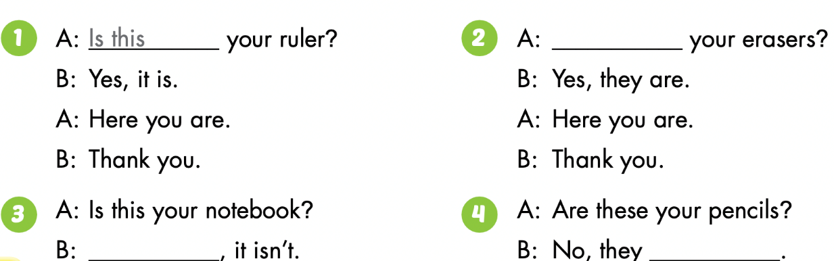

Slide 15
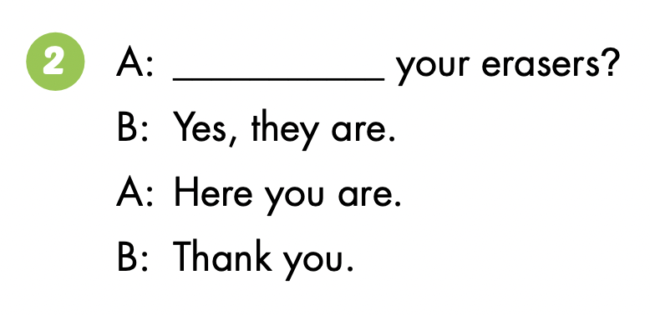
Are these

Slide 16

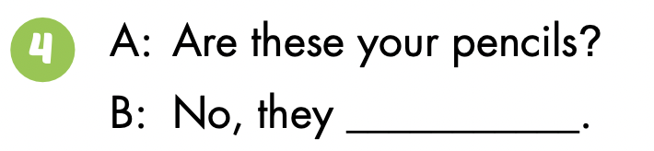
No
aren’t

Slide 17

CONSOLIDATION

Slide 18

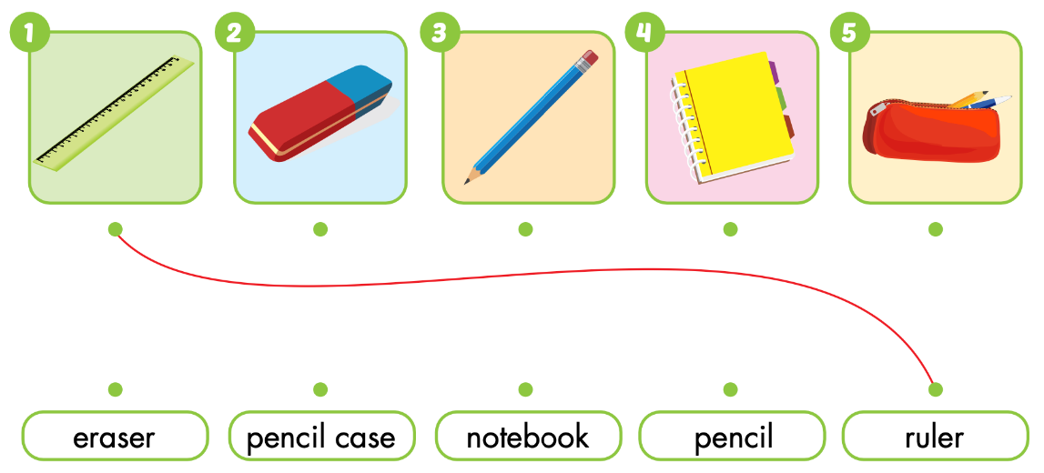
Extra Practice
WB p. 28

Slide 19

WRAP-UP

Slide 20
Lesson 3
Today’s lesson
Vocabularies
eraser, ruler, pencil, notebook, pencil case
Structures/ Sentence patterns
Is this your eraser?
- Yes, it is./No, it isn’t.
Are these your notebooks?
- Yes, they are./No, they aren't.

Slide 21
Lesson 3
Homework
Learn by hearts vocabularies, the structures and make sentences using them.
Do the exercises on page 28 WB
Prepare the next lesson (page 39 SB)
Play the consolidation games in Tiếng Anh 3 i-Learn Smart Start DHA App on www.eduhome.com.vn

Slide 22

Have a nice day!

