Slide 1
Unit 9
What did you see
at the zoo?
Lesson 1

Slide 2
VOCABULARY

Slide 3
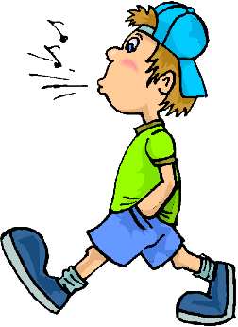
A. Vocabulary
Động từ
(V)
roar
move
walk
see
eat
/rɔːr/
/muːv/
/wɔːk/
/siː/
/iːt/
Gầm
Di chuyển
Đi bộ
Nhìn
Ăn
roared
moved
walked
saw
ate
Động từ ở
Quá khứ
(Ved/V2)
/rɔːrd/
/muːvd/
/wɔːkt/
/sɔː/
/eɪt/
Đã gầm
Đã d.chuyển
Đã đi bộ
Đã nhìn
Đã ăn

Slide 4
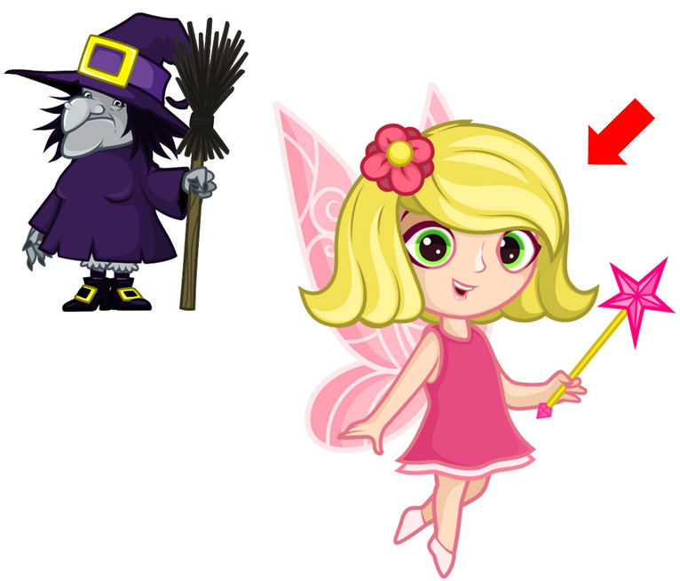
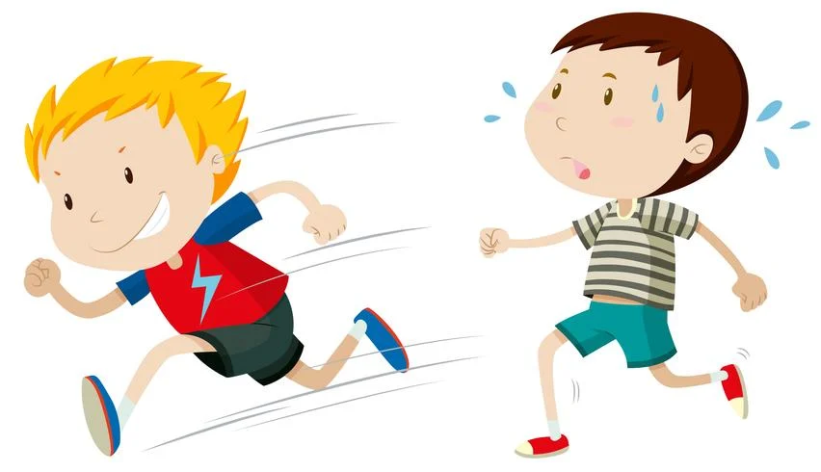
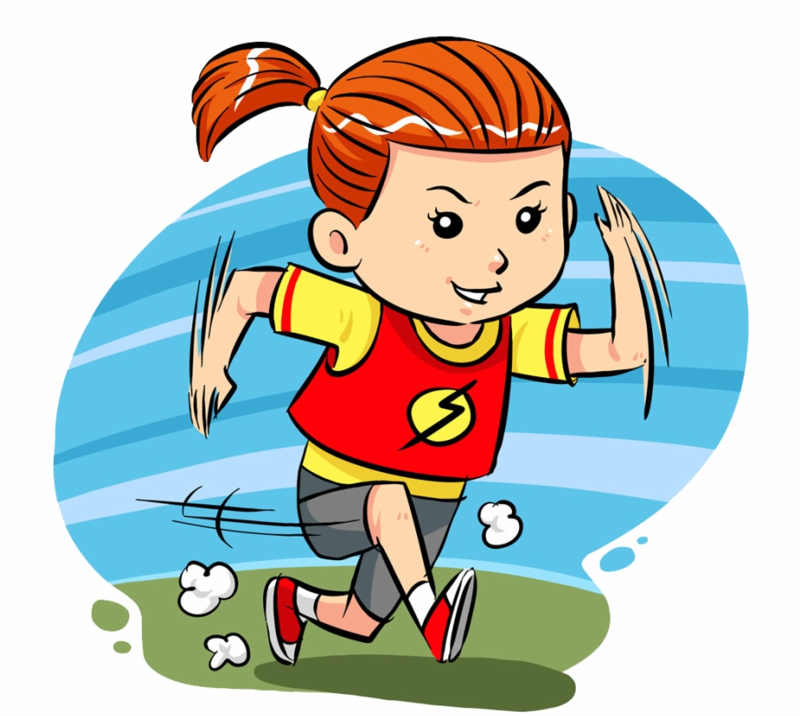
A. Vocabulary
Trạng từ
(adv)
Yên
tĩnh
Ầm ĩ,
to
Đẹp
Đứng sau V
Bổ nghĩa cho V
quietly
loudly
beautifully
/ɡəˈrɪlə/
/ˈelɪfənt/
/ˈlaɪən/
Ồn
ào
Chậm
Nhanh
Nhanh
slowly
fast
quickly
noisily
/ˈpaɪθɑːn/
/ˈpærət/
/ˈtaɪɡər/
/ˈmʌŋki/

Slide 5
GRAMMAR

Slide 6
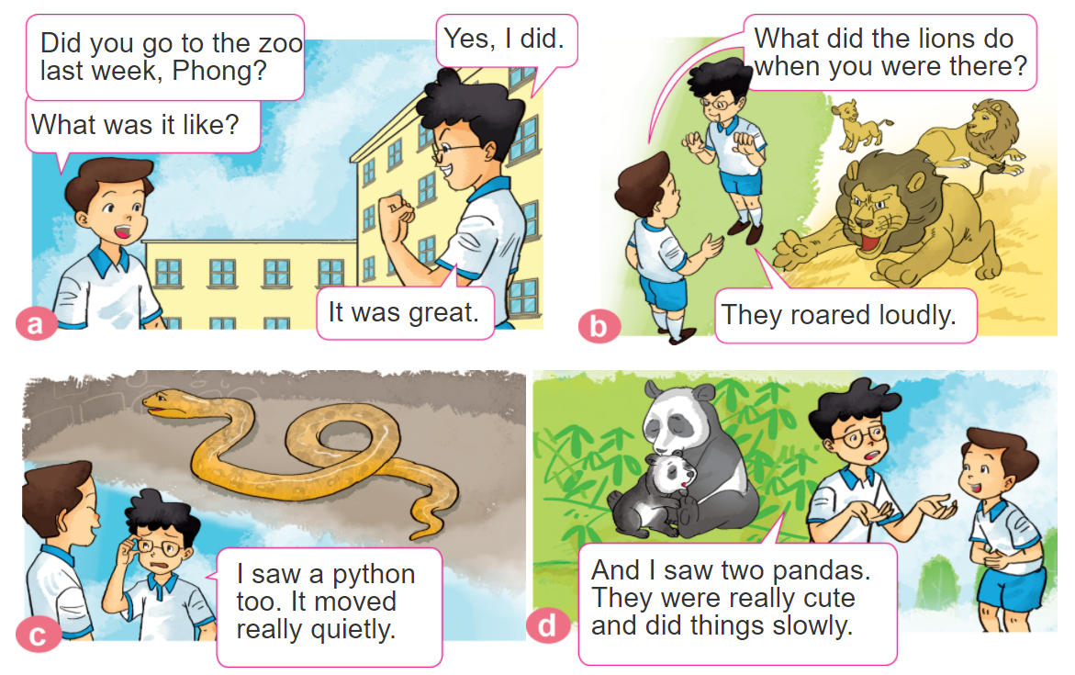
1. Look, listen and repeat.

Slide 7
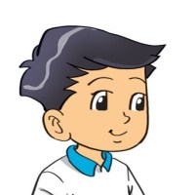
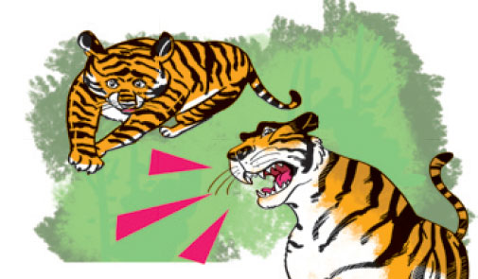
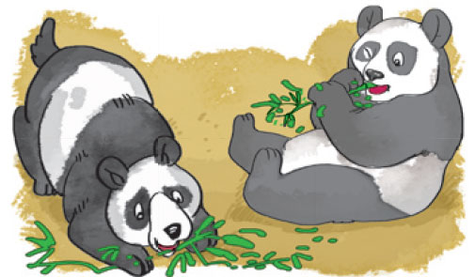
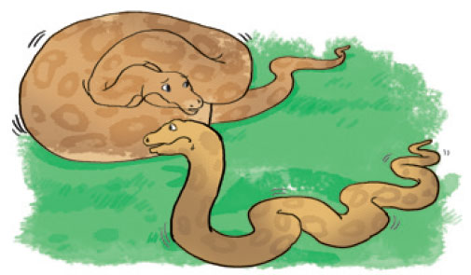
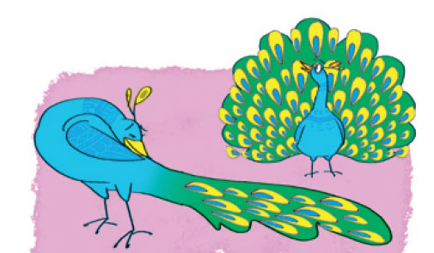
2. Point and say
What did the ______ do when you were there?
They _________.
tigers
roared loudly
pandas
ate slowly
pythons
moved quietly
peacocks
moved beautifully

Slide 8
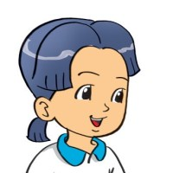
B. Grammar
Hỏi và đáp về con vật yêu thích:
(Con vật mà bạn yêu thích ở sở thú là gì?)
What are your favourite animals at the zoo?
They're ____________.
+ tên các con vật
(Chúng là ____________)
Hỏi và đáp các con vật đã làm gì?
What did the ________ do
when you were there?
They _________________.
+ hoạt động chúng đã làm
(Các con _____ đã làm gì
khi bạn ở đó.)

Slide 9
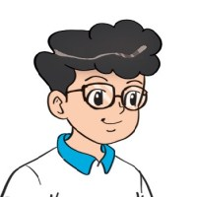
3. Let’s talk
What are your favourite animals at the zoo?
They're ________.
What did the ________ do when you were there?
They ______.

Slide 10
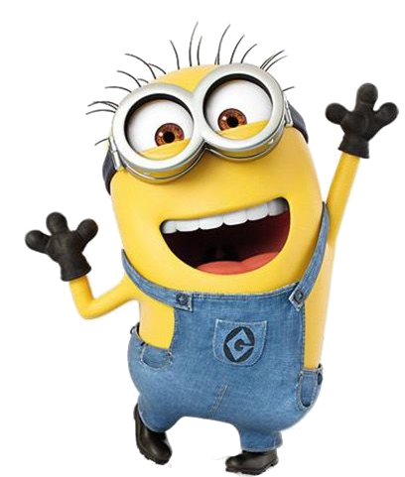
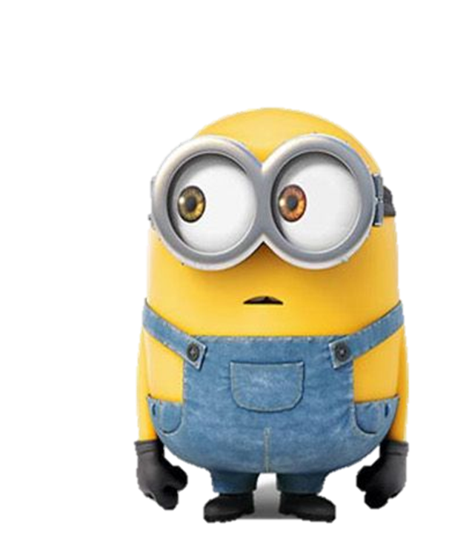
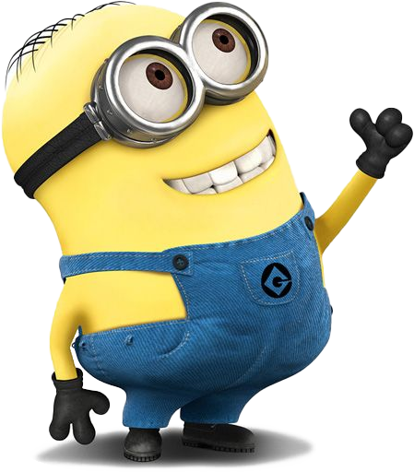

Slide 11
What did the pythons do
when you were there?
They moved quietly.
They move quietly.

Slide 12
What did the tigers do
when you were there?
They roared loudly.
They roared loud.

Slide 13
________________
when you were there?
What did the tigers do
What do the tigers do

Slide 14
What did the peacocks do
when you _____ there?
was
were

Slide 15
The monkeys _______ fast
when I was there.
move
moved

Slide 17
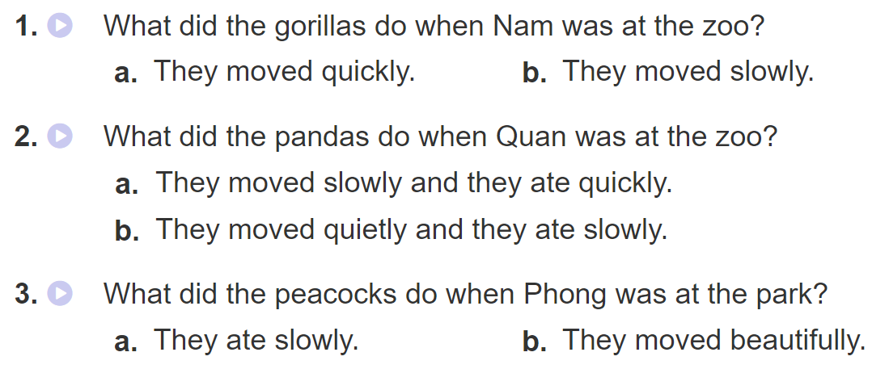
4. Listen and circle a or b.

Slide 18
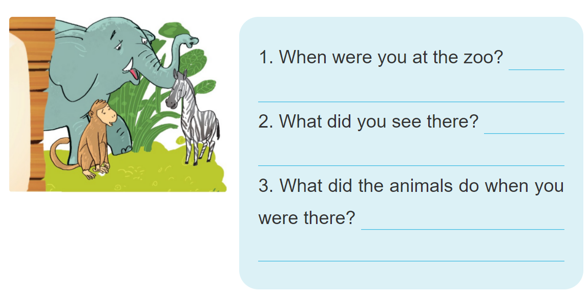
5. Write about your visit to the zoo.

Slide 19
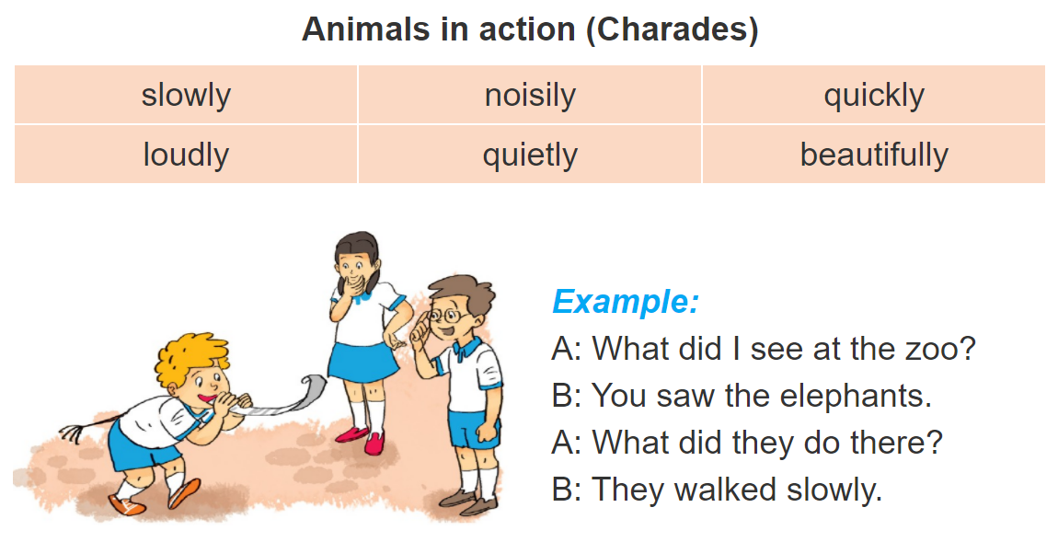
6. Let’s play

