Slide 1

Unit 4: HOME
Lesson 3.1
Page 58

Slide 2
Lesson Outline
Warm-up
Vocabulary
Structure
Consolidation
Wrap-up

Slide 3
Objectives
By the end of this lesson, students will be able to ask where things are.
Vocabulary: mirror, picture, sofa, table, box, house.
Structure: Is the picture in the living room? Yes, it is.
Is the cat in the house? No, it isn’t.

Slide 4

Structure

Slide 5
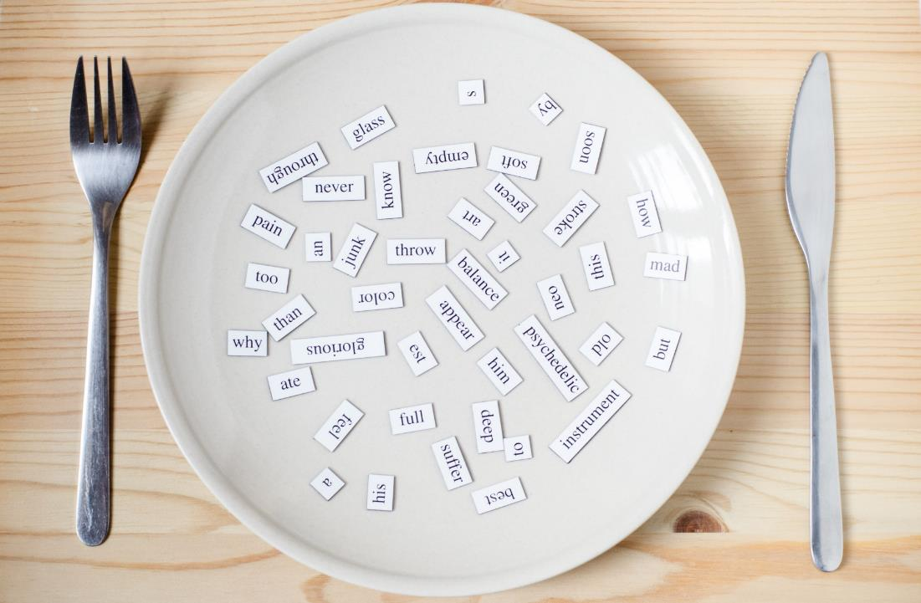
Structures
Is the picture in the living room?
Yes, it is.
Is the cat in the house?
No, it isn’t.

Slide 6



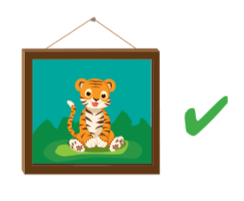
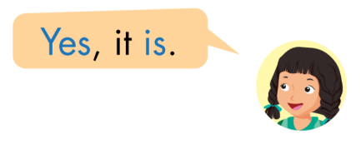

Slide 7

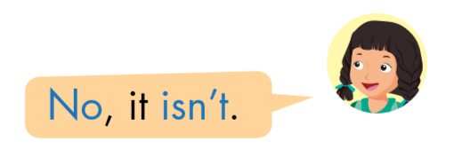
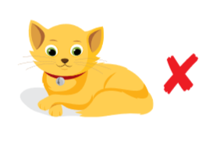

Slide 8

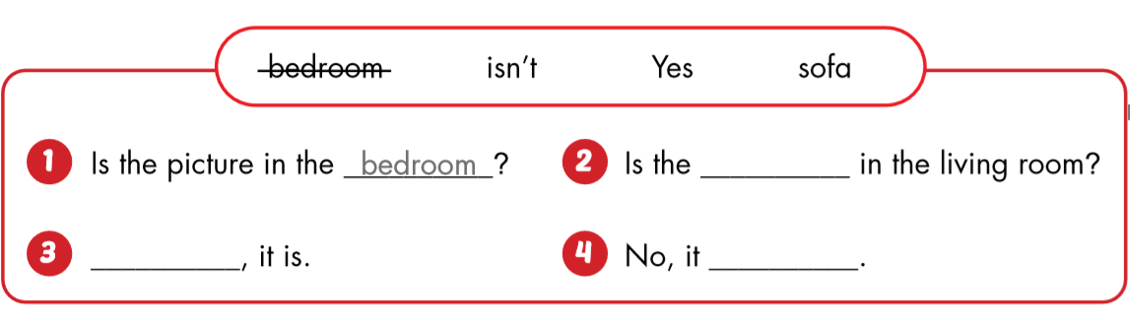
bedroom?
sofa
Yes
isn’t.

Slide 9

Have a nice day!

