Slide 1
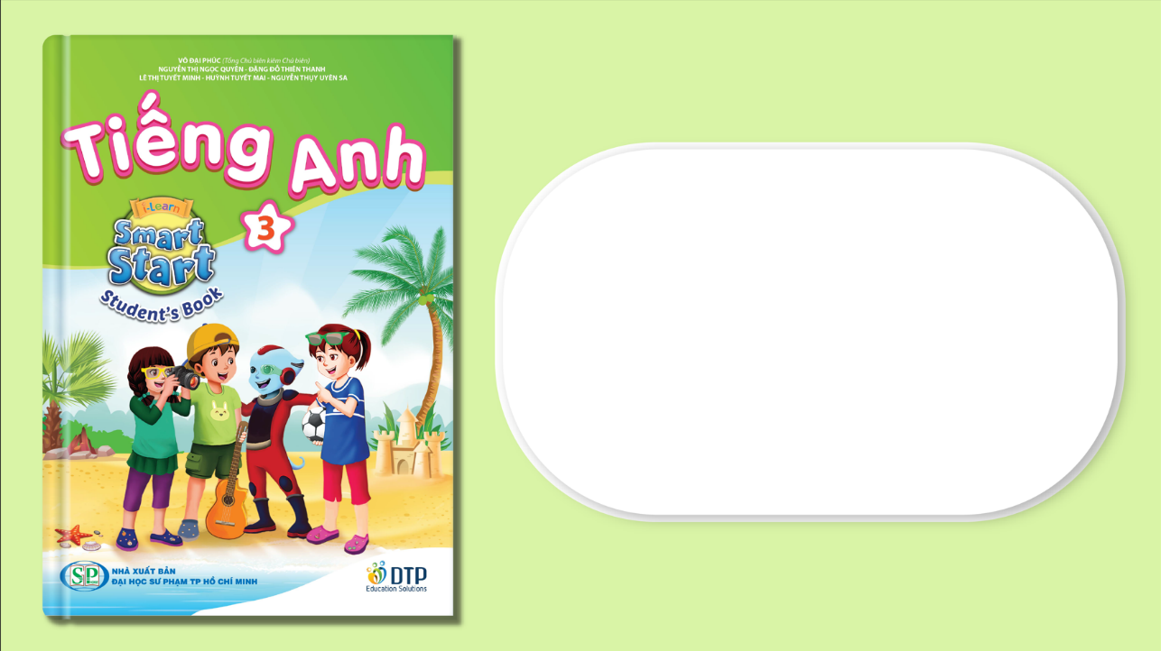
Unit 8: Food
Lesson 4.1
Page 119

Slide 2
Lesson Outline
Warm-up
Vocabulary
Structure
Consolidation
Wrap-up

Slide 3
Objectives
By the end of this lesson, students will be able to…
Vocabulary: learn and practice knife, spoon, chopsticks, fork, noodles
Structure: learn and practice
We eat ____with a ____.
We often eat ____.
My favorite food is ____.

Slide 4

Practice

Slide 5


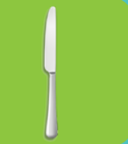

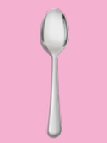
Sound here
Listen and choose the correct picture
Notes:
Click vào hình headphone để nghe âm thanh. click vào câu trả lời đúng để thấy hiệu ứng

Slide 6
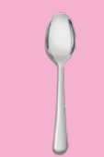
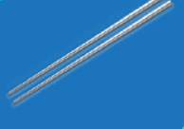
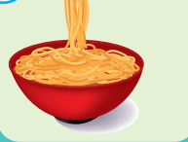
Listen and choose the correct picture

Slide 7


Listen and choose the correct picture

Slide 8


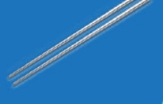
Listen and choose the correct picture

Slide 9
Listen and choose the correct picture

Slide 10
Listen and choose the correct answer
A. spoon
B. chopsticks
C. fork
D. noodles
Notes:
Click vào câu trả lời sai> sẽ bay đi mất
Câu trả lời đúng: có tiếng vỗ tay

Slide 11
Listen and choose the correct answer
A. spoon
C. chopsticks
B. fork
D. noodles

Slide 12
Listen and choose the correct answer
A. spoon
B. knife
C. fork
D. noodles

Slide 13
Listen and choose the correct answer
A. spoon
B. knife
C. fork
D. noodles
Notes:
Click on the picture to hear the sound
Click on incorrect answer-> disappear
Click on correct answer->applause sound

Slide 14
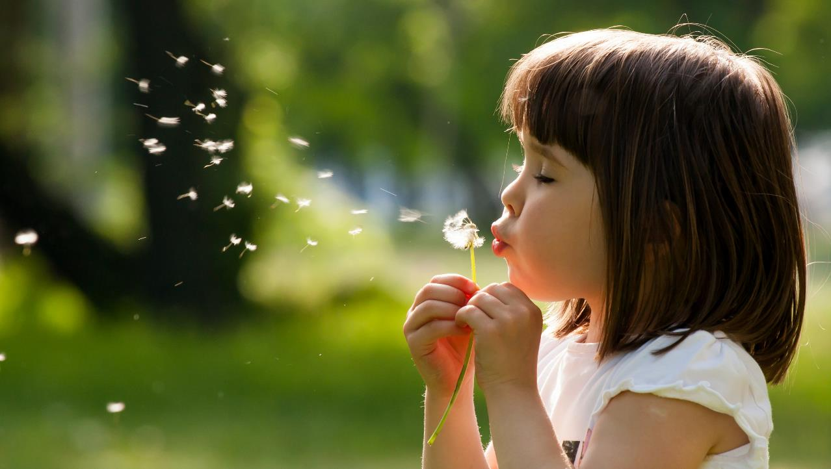
Enjoy your day!

