Slide 1

Unit 8: Food
Lesson 4.1
Page 119

Slide 2
Lesson Outline
Warm-up
Vocabulary
Structure
Consolidation
Wrap-up

Slide 3
Objectives
By the end of this lesson, students will be able to…
Vocabulary: learn and practice knife, spoon, chopsticks, fork, noodles
Structure: learn and practice
We eat ____with a ____.
We often eat ____.
My favorite food is ____.

Slide 4

WARM UP

Slide 5
Vocabulary
How to play?
- T will call out the words
- Cross off ONE square that has the word
- If you get the pattern, say BINGGO, you win!
BINGGO

Slide 6
Word list to choose
apple banana carrot some
cupcake donut onion any
tomato potato lime like
egg fries pizza please
cake chicken ice cream fish

Slide 7

Fill in this BINGO card with vocabulary from the list in slide 6

Slide 8
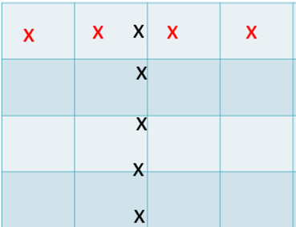
Any Straight Line Pattern like this

Slide 9

Enjoy your day!

