Slide 1

Unit 1: My Friends
Lesson 2
Page 15

Slide 2

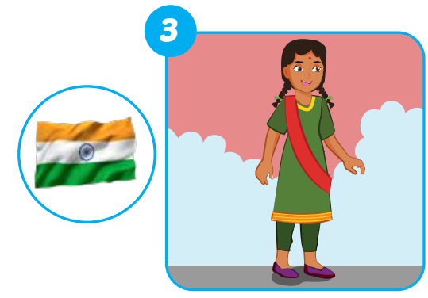
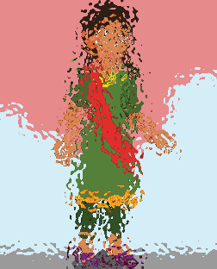


E
Point, ask and answer.
Where’s she from?
She’s from India.
Notes:
Instructions:
Ask “ Is it a girl or a boy?”
If it’s a boy, Students say: a boy -> teacher open the boy’s picture and get students to say: “Where’s he from?” -> let students guess where the person is from.
If it’s a girl, Students say: a girl -> teacher open the girl’s picture and get students to say: “Where’s she from?”-> let students guess where the person is from.
Teacher open the picture of the flag and check students’ answer.
Get all students to practice asking and answering the question.

Slide 3
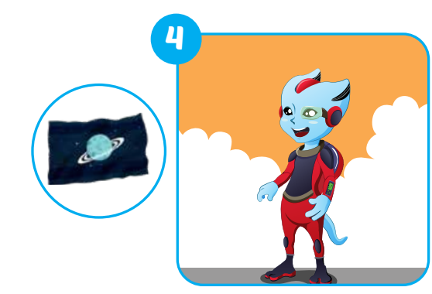


E
Point, ask and answer.
Where’s he from?
He’s from Alpha.
Notes:
Instructions:
Ask “ Is it a girl or a boy?”
If it’s a boy, Students say: a boy -> teacher open the boy’s picture and get students to say: “Where’s he from?” -> let students guess where the person is from.
If it’s a girl, Students say: a girl -> teacher open the girl’s picture and get students to say: “Where’s she from?”-> let students guess where the person is from.
Teacher open the picture of the flag and check students’ answer.
Get all students to practice asking and answering the question.

Slide 4
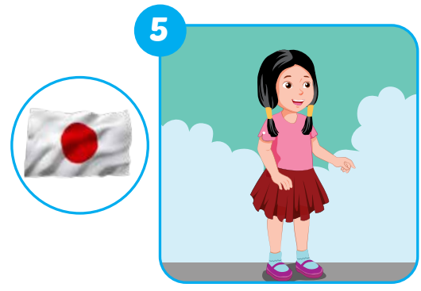


E
Point, ask and answer.
Where’s she from?
She’s from Japan.
Notes:
Instructions:
Ask “ Is it a girl or a boy?”
If it’s a boy, Students say: a boy -> teacher open the boy’s picture and get students to say: “Where’s he from?” -> let students guess where the person is from.
If it’s a girl, Students say: a girl -> teacher open the girl’s picture and get students to say: “Where’s she from?”-> let students guess where the person is from.
Teacher open the picture of the flag and check students’ answer.
Get all students to practice asking and answering the question.

Slide 5
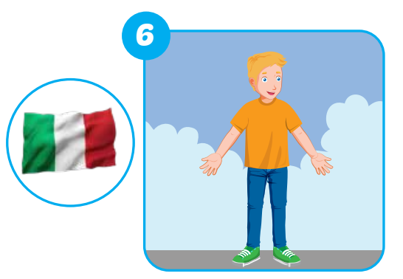
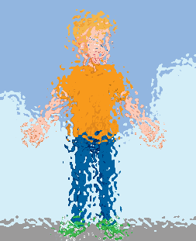

E
Point, ask and answer.
Where’s he from?
He’s from Italy.
Notes:
Instructions:
Ask “ Is it a girl or a boy?”
If it’s a boy, Students say: a boy -> teacher open the boy’s picture and get students to say: “Where’s he from?” -> let students guess where the person is from.
If it’s a girl, Students say: a girl -> teacher open the girl’s picture and get students to say: “Where’s she from?”-> let students guess where the person is from.
Teacher open the picture of the flag and check students’ answer.
Get all students to practice asking and answering the question.

Slide 6

E
Point, ask and answer.
Where are you from?
I’m from Vietnam.
Notes:
This is the extra question from this part.
They can choose to be in any country as they want. It doesn’t have to be in Vietnam.

Slide 7
Today’s lesson
Vocabulary
The USA
The UK
Italy
India
Japan
Alpha
Structures/ Sentence patterns
Where are you from?
I’m from…
Where’s she from?
She’s from….
Where’s he from?
He’s from…..

