Slide 1

Unit 5: Sports and hobbies
Lesson 3.3
Page 76

Slide 2
BROKEN WORDS
BROKEN WORDS

Slide 3

ska
go
ing
gh
te
rd
boa
set
Click on the piece.

Slide 4
BROKEN WORDS
go skateboarding

Slide 5
ly
swi
ing
mm
go
rd
wa
set

Slide 6
BROKEN WORDS
go swimming

Slide 7
go
re
ing
th
wa
si
tch
TV

Slide 8
BROKEN WORDS
watch TV

Slide 9
ty
wh
ou
u
go
rd
w
t

Slide 10
BROKEN WORDS
Go out

Slide 11

It’s time to learn …

Slide 12

Speaking

Slide 13

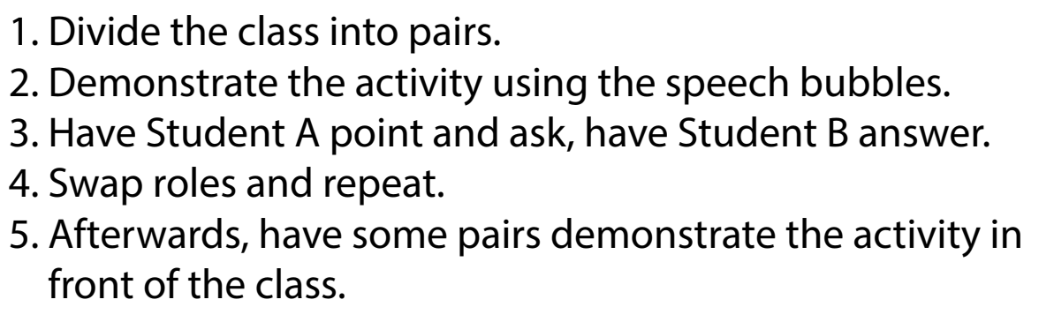

Slide 14

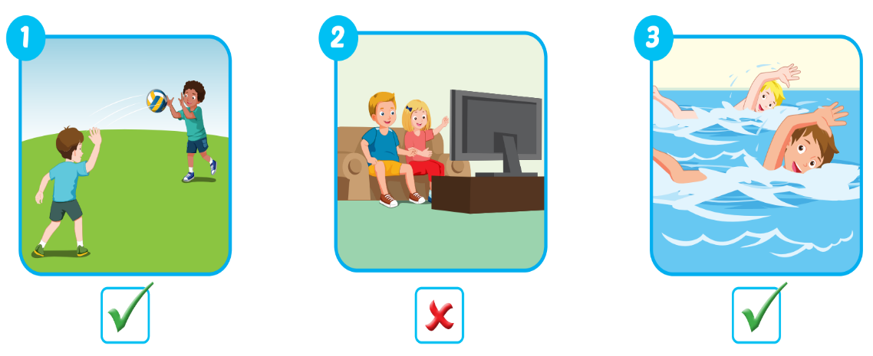
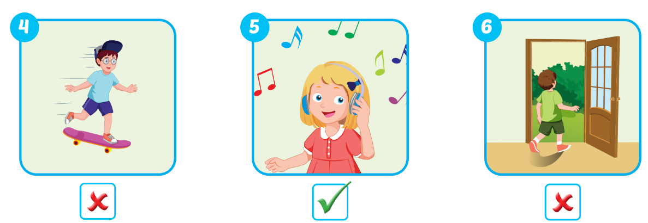

Slide 15

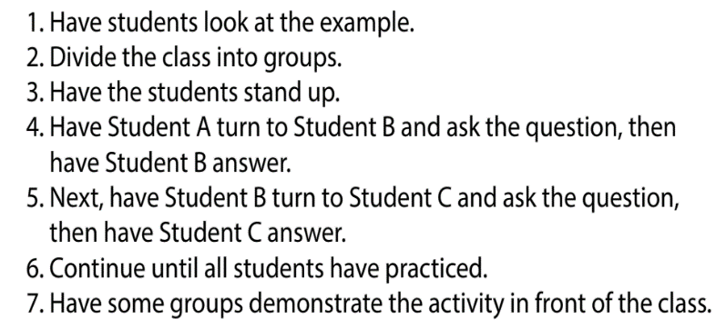

Slide 16
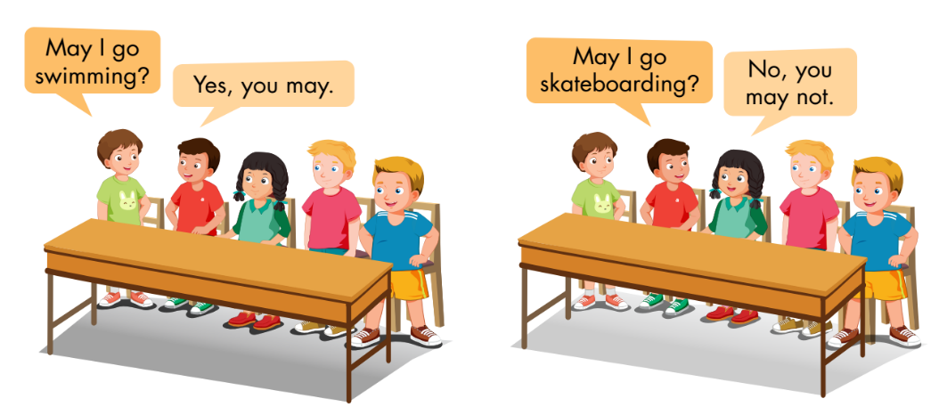

Slide 17

1. Divide the class into two teams.
2. Show a flashcard to the class and say "yes" or "no."
3. Have Team A ask the question and Team B answer.
4. Swap roles and repeat.

Slide 18
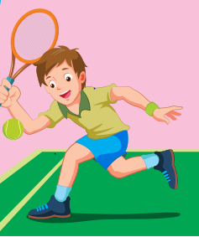
Team A:
May I play tennis?
❌
No, you may not.
Team B:

Slide 19

❌

Slide 20
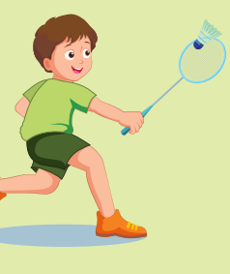
✓

Slide 21
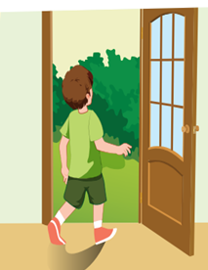
❌

Slide 22
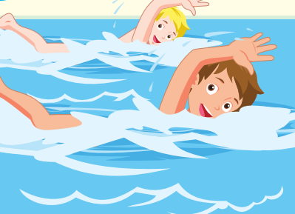
✓

Slide 23



