Slide 1

Unit 8: Food
Lesson 2.3
Page 115

Slide 2


What’s in the box?
I am red.
Tomato!
I have six letters.
t_ma_ _

Slide 3

What’s in the box?
_im_
I am green.
Lime!
I have four letters.

Slide 4
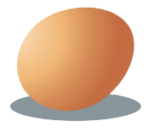
What’s in the box?
I have three letters.
I am brown.
Egg!
_ _ g

Slide 5
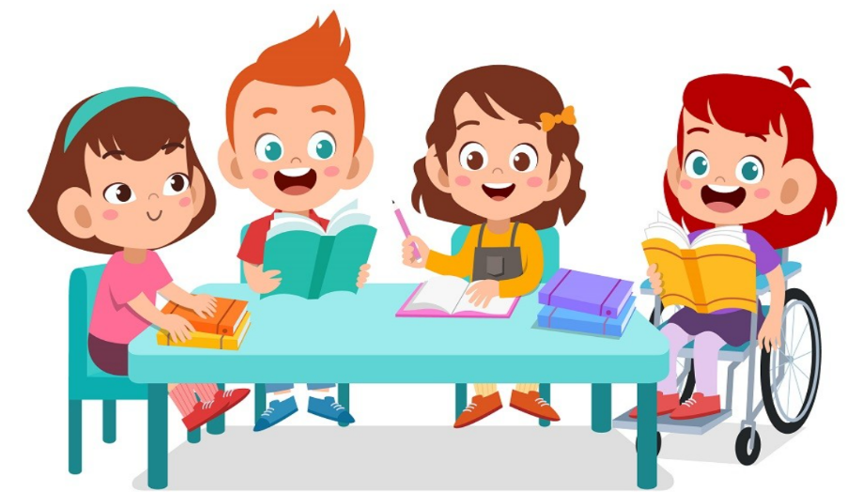
It’s time to learn …

Slide 6

Look and write
Pre-Speaking
______ _______ _______ limes?
Are there any limes?
Notes:
Click textbox: pre-speaking to hear the sound

Slide 7
Pre-Speaking
Look and write
______ , _______ are .
Yes, there are.
Notes:
Cắt: Would you like some pizza (lấy của lesson trước)

Slide 8

Pre-Speaking
Look and write
______ _______ an onion?
Is there an onion?
Notes:
Cắt: Would you like some fries (lấy của lesson trước)

Slide 9
Look and write
Pre-Speaking
______, _______ isn’t.
No, there isn’t.
Notes:
Cắt: Would you like some pizza (lấy của lesson trước)

Slide 10
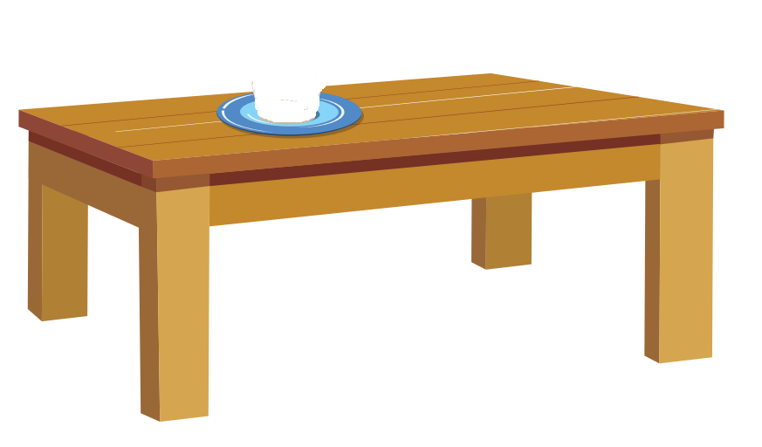



Look and answer.
Is there a tomato?
Yes, there is.

Slide 11
Look and answer.
Are there any potatoes on the table?
- No, there aren’t.

Slide 12
Look and answer.
Are there any limes on the table?
- Yes, there are.

Slide 13
Look and answer.
Is there an egg on the table?
- No, there isn’t.

Slide 14

Practice

Slide 15
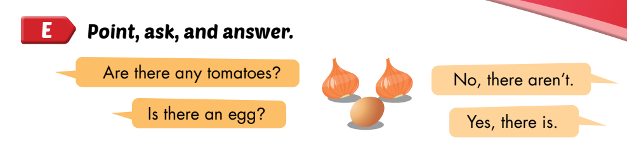
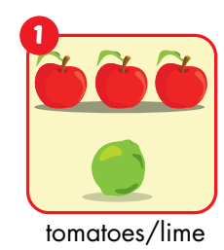

Slide 16

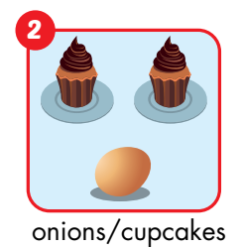
Are there any onions?
No, there aren’t.
Are there any cupcakes?
Yes, there are.

Slide 17
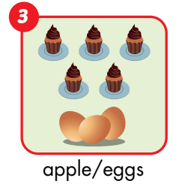
Is there an apple?
No, there isn’t.
Are there any eggs?
Yes, there are.

Slide 18
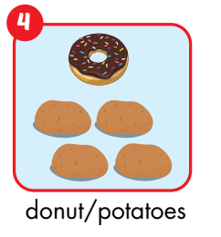
Is there a donut?
Yes, there is.
Are there any potatoes?
Yes, there are.

Slide 19
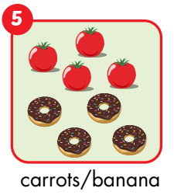
Are there any carrots?
No, there aren’t.
Is there a banana?
No, there isn’t.

Slide 20
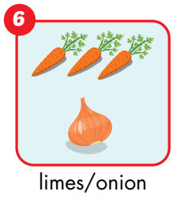
Are there any limes?
No, there aren’t.
Is there an onion?
Yes, there is.

Slide 21
Post speaking
Guess the food by asking questions.
One student will stand in front of the class. The teacher gives the student a picture of food. The other students will ask the questions to guess the food in the picture.

Slide 22
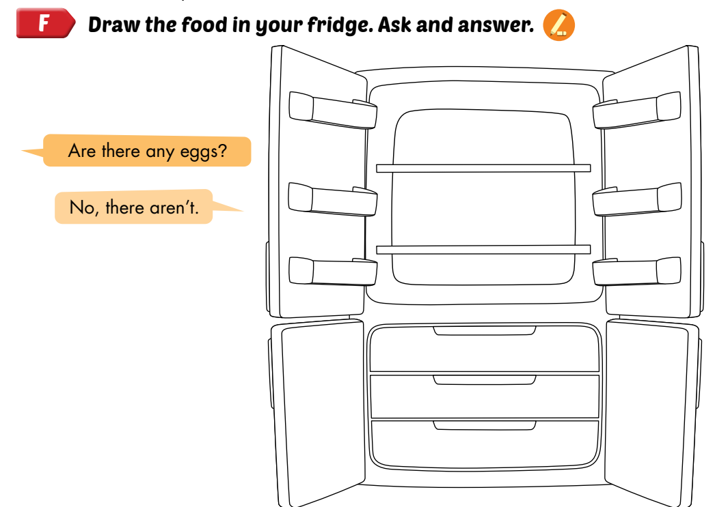
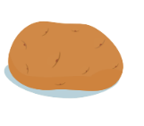



Slide 23
Memory game
Notes:
First, students have 30 seconds to remember as many pictures as they can from the screen. After 30 seconds, all of the pictures disappear. SS will write down as many items as they can remember using There is and There are, e.g. Finally, students read the sentences to share them with classmates.

