Slide 1
Unit 3
Where did you go
on holiday?
Lesson 2

Slide 2
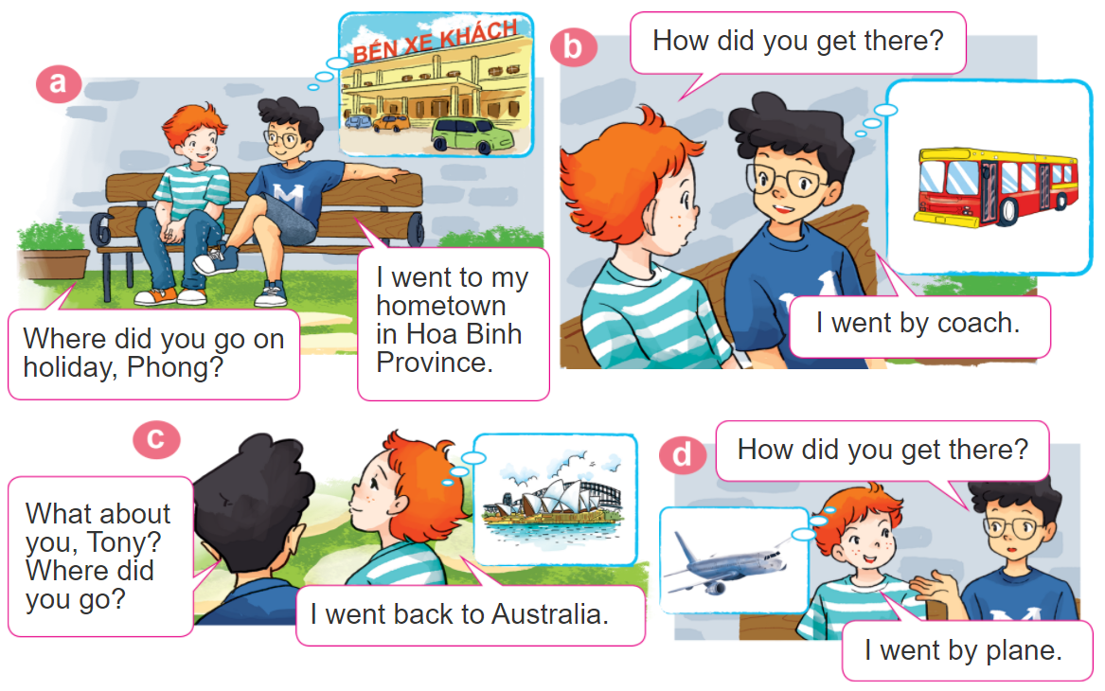
1. Look, listen and repeat

Slide 3
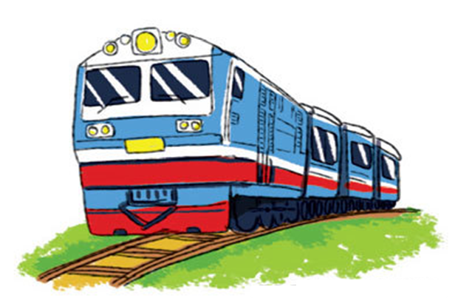
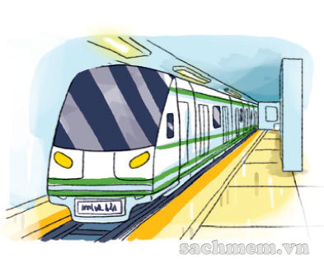
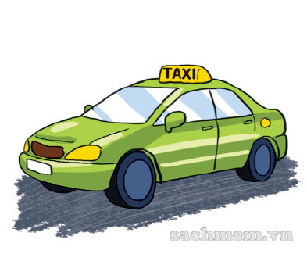
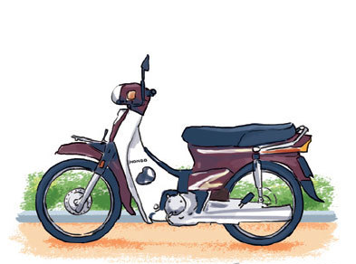
2. Point and say
How did you get there?
I went by____________.
train
underground
motorbike
taxi

Slide 4
Grammar
Hỏi và đáp bạn đã đi bằng phương tiện gì?
How did you get _______?
+ place
(Bạn đã đến ____ bằng gì?)
I went by ___________.
+ phương tiện
(Tớ đã đi bằng _____)

Slide 5
3. Let’s talk.
Where were you
on holiday?
I were ________.
I went to ________.
Where did you go?
I went by ________.
How did you get there?

Slide 6
How did you get there?
50
10
20
30
10
20
30
40
I went by motorbike.
Xem đáp án
Spin
Notes:
Ms Huyền Phạm - 0936.082.789 – YOUTUBE: MsPham. Facebook: Dạy và học cùng công nghệ.

Slide 7
5.
Write about your last holiday.
1. Where did you go last holiday?
2. How did you get there?
3. What did you do there?
4. Did you enjoy the trip?

Slide 8
6. Let’s sing.

