Slide 1
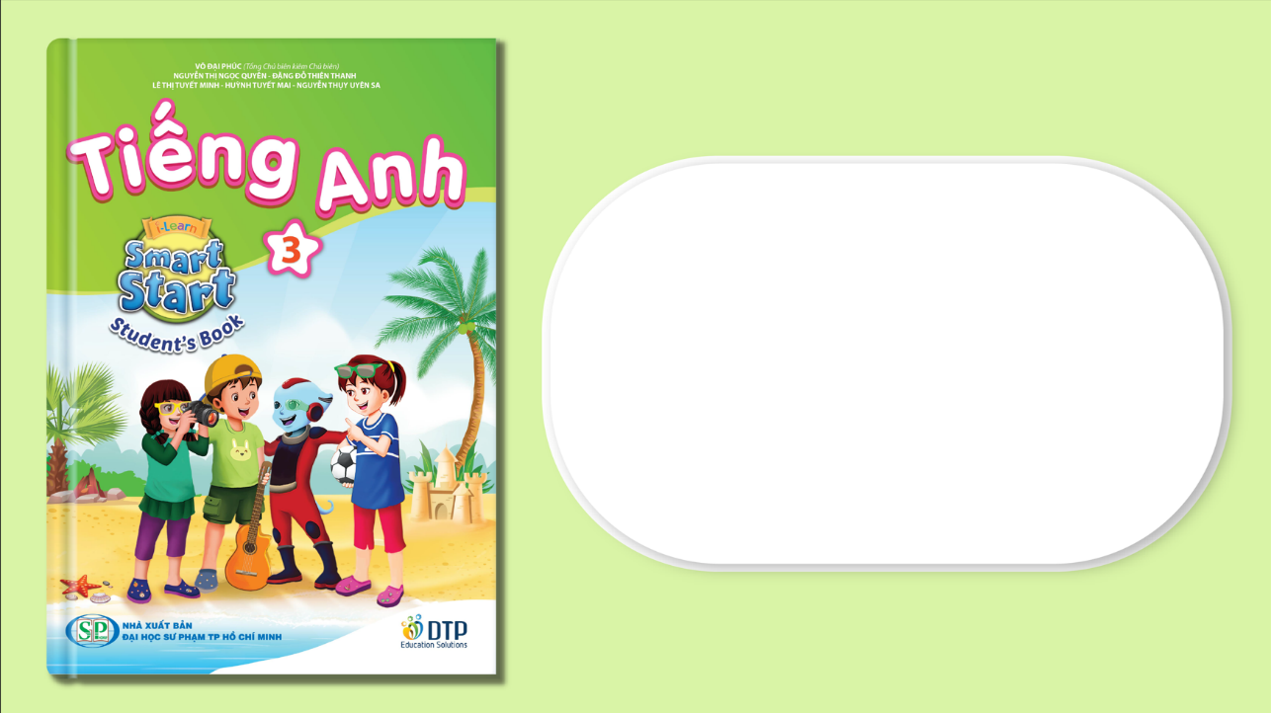
Unit 3: School
Lesson 4.3
Page 49

Slide 2
Lesson Outline
Warm-up
Reading
Writing
Consolidation
Wrap-up

Slide 3
Objectives
By the end of this lesson, students will be able to understand a paragraph and write about their favorite color.
Vocabulary: green, orange, pink, purple, gray, favorite
Structure: What's your favorite color?
- My favorite color is orange.
I can make orange with yellow and red.

Slide 4

WARM UP

Slide 5

Let’s play!
Touch
Have students run around the classroom touching things in the color that the teacher shouts out: "Touch something green".

Slide 6

It’s time to learn …

Slide 7
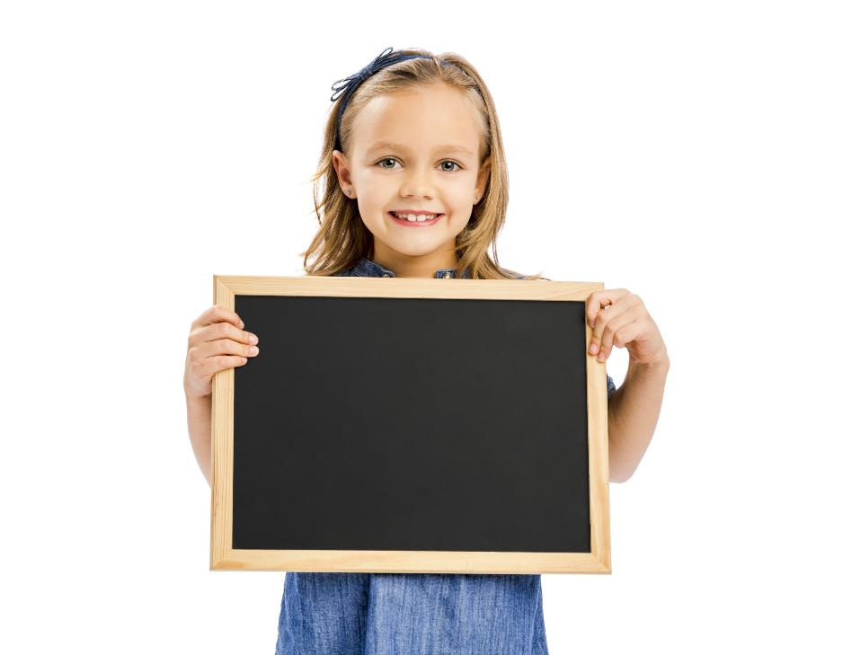
Reading

Slide 8

Have students read the text individually.
Read the text as a whole class.
Demonstrate the activity using the example.

Slide 9
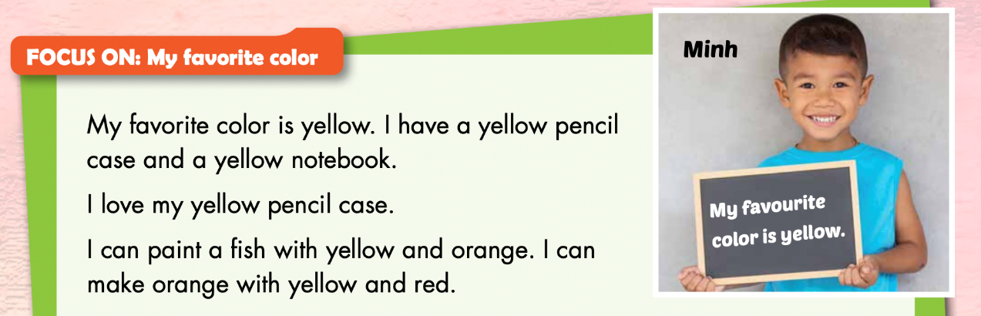
1 Minh has a blue notebook. True / False

Slide 10
2 Minh can paint a fish. True / False

Slide 11
3 Minh can make yellow with orange and red. True / False

Slide 12

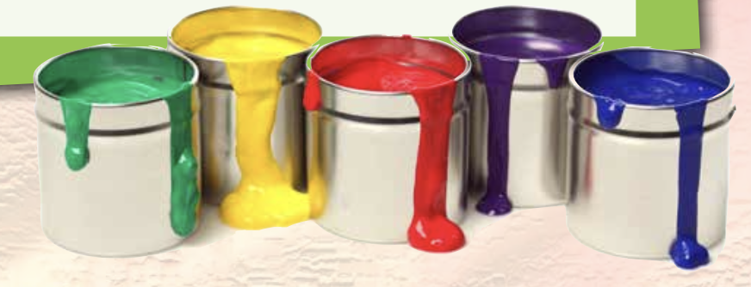

Slide 13
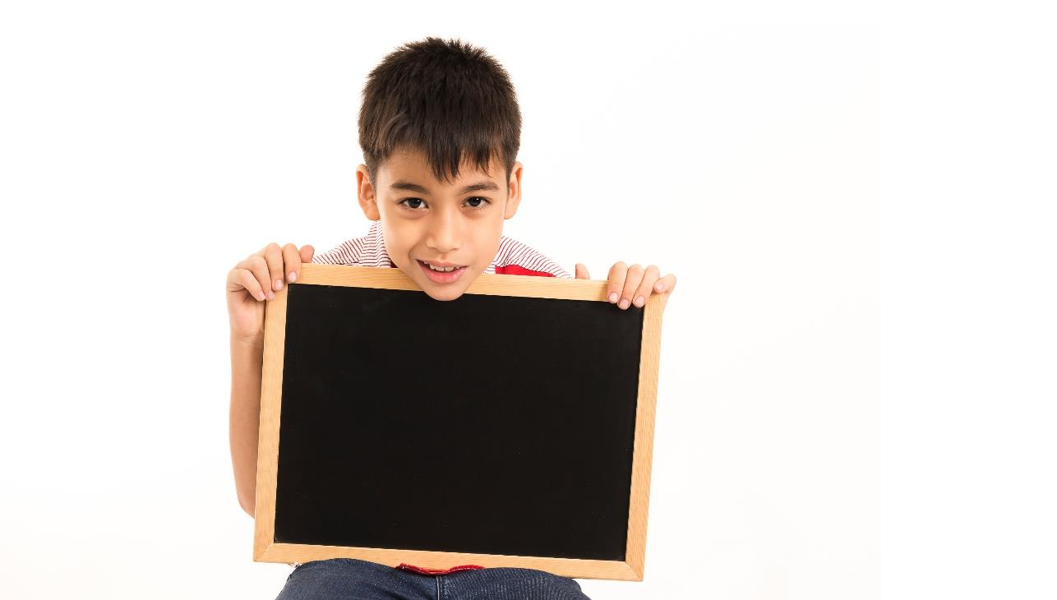
Writing

Slide 14
Have students read the text in Part E again.
Have students fill in the blanks about their favorite color.

Slide 15
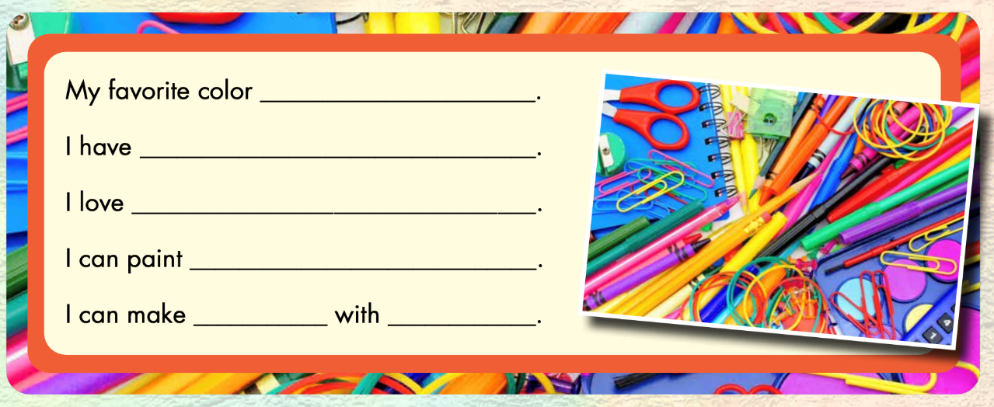
Example:
red
a red pencil
my red pencil
a pencil case
pink
red and white

