Slide 1
Unit 1: My friends
Lesson 1.3
Page 12

Slide 2
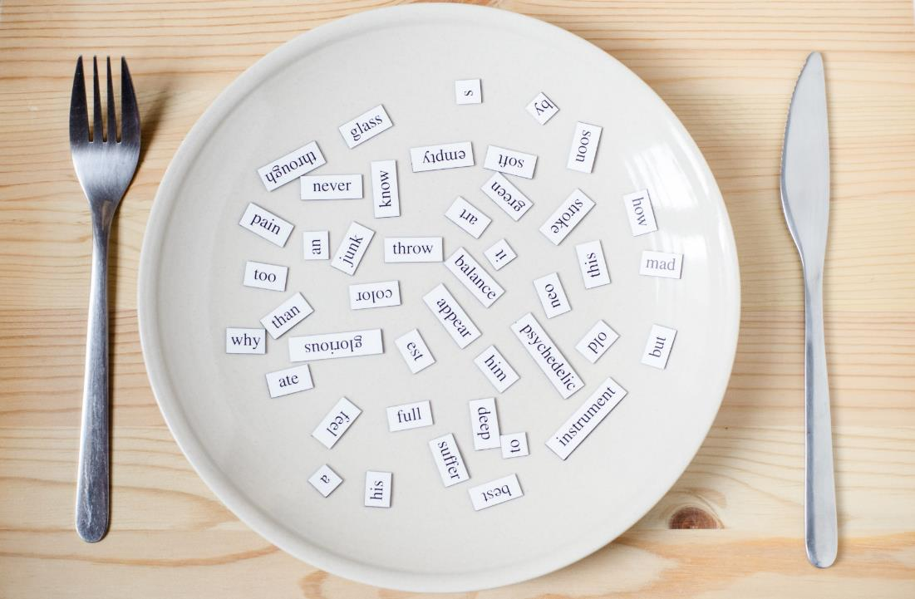
Speaking

Slide 3
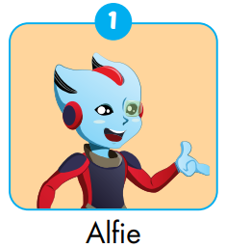
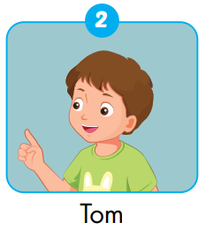
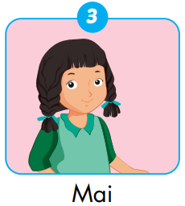
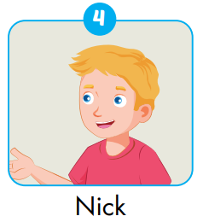
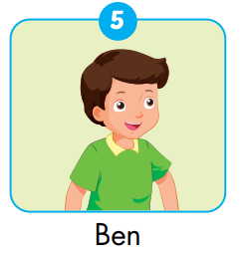
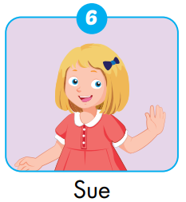

Slide 4
How can you spell “Alfie”?
A-L-F-I-E.
30
20
40
10
ESTHER
50
80
ELLY
NOOB
KELVIN
ROSE
LISA
SARAH
TINA
ANNA
ROSY
SLENDERMAN
HUGO
JENNIE
NACY
MARIO
LUCY
IRONMAN
MARIA
PATT
LOUIS
60
70
SPIN

Slide 5
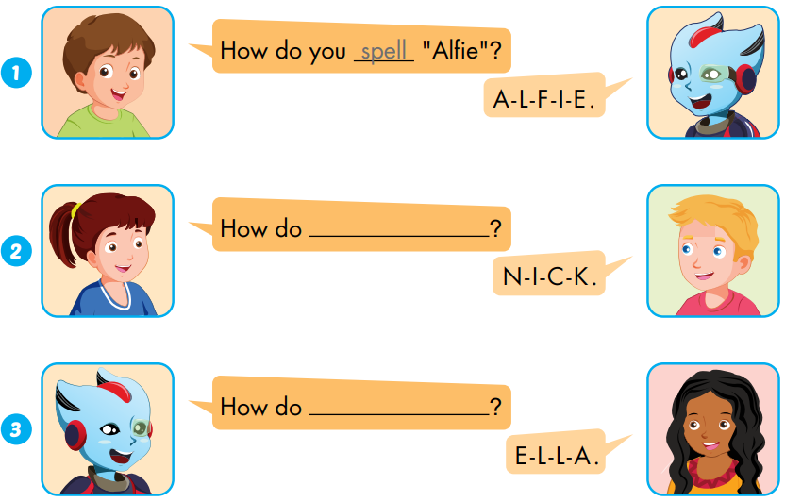
Extra 1 – WB P.9
...
spell
...
spell “Nick”
spell “Ella”
...

Slide 6
Act1.
NOOB
ALEX
ANNA
DYLAN
SIMON
Wheel of points
My friend’s name is Alfie.
It’s A-L-F-I-E.
SHARI
SARAH
ESTHER
IRON MAN
ROSE
ANNA
ELLY
PETER
KELVIN

Slide 7
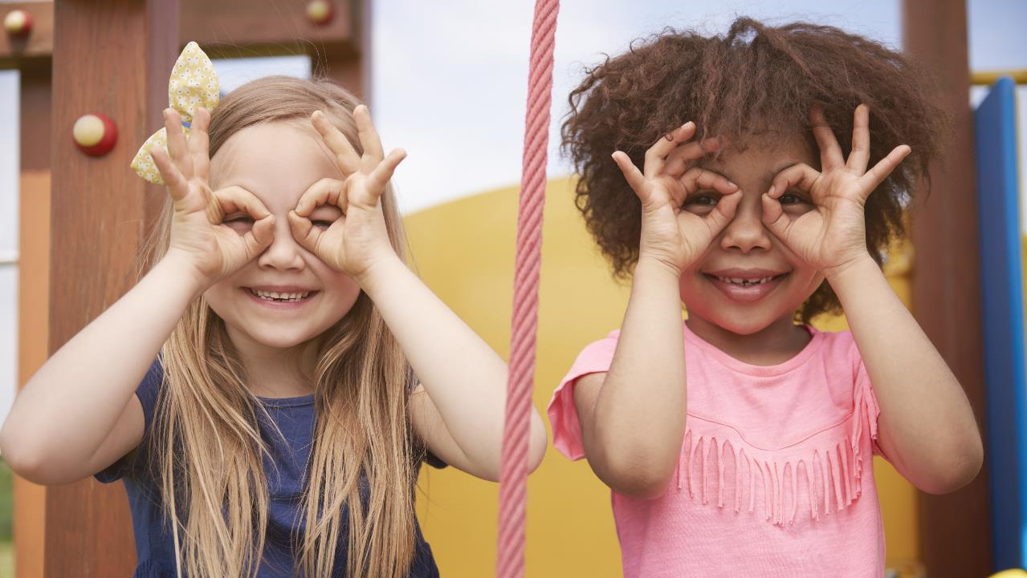
Enjoy your day!

