Slide 1

Unit 3: School
Lesson 4.1
Page 47

Slide 2
Lesson Outline
Warm-up
Vocabulary
Structure
Consolidation
Wrap-up

Slide 3
Objectives
By the end of this lesson, students will be able to ask what people's favorite color is and know how to answer it. They also learn how to express how they can make a certain color.
Vocabulary: green, orange, pink, purple, gray, favorite
Structure: What's your favorite color?
- My favorite color is orange.
I can make orange with yellow and red.

Slide 4

WARM UP

Slide 5
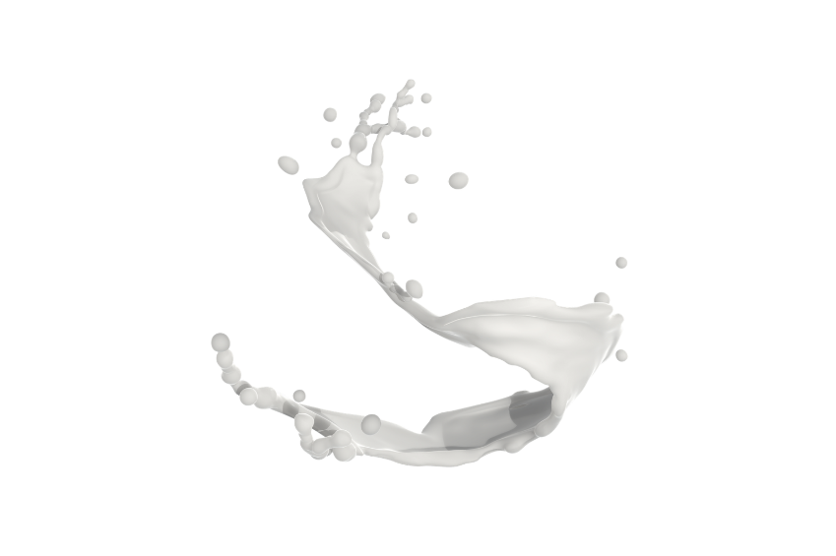
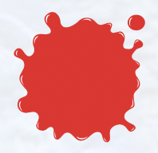
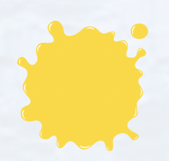

What color is it?

Slide 6

It’s time to learn …

Slide 7
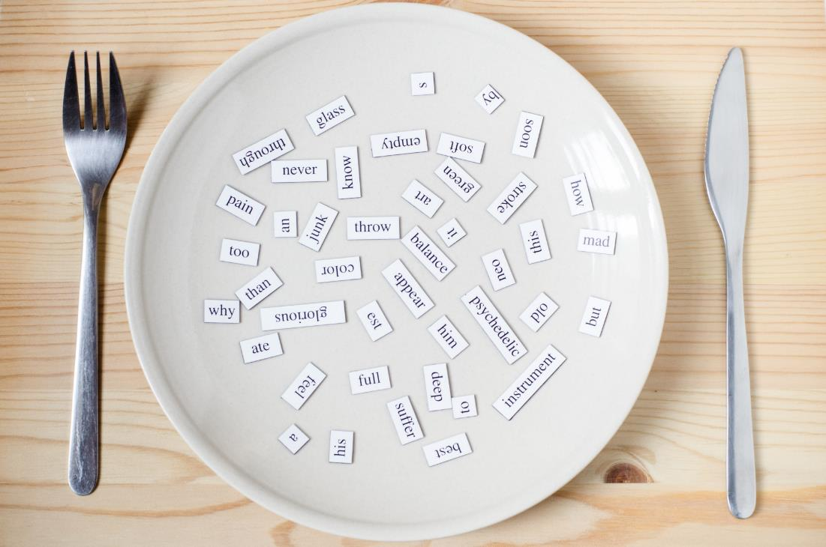
New words
green,
orange,
pink,
purple,
gray,
favorite

Slide 8

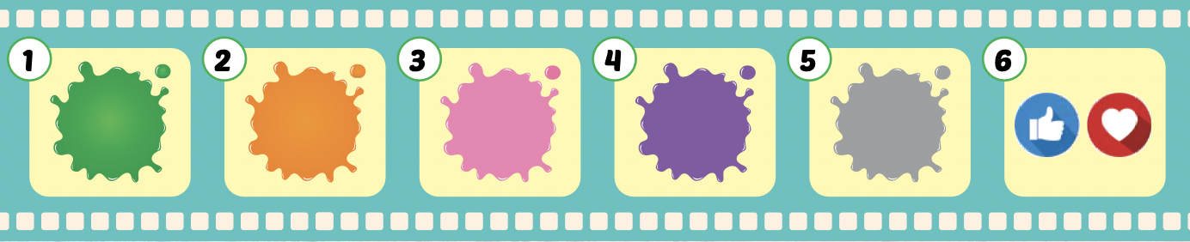
Listen and point.
Click the icon to hear the sound.

Slide 9
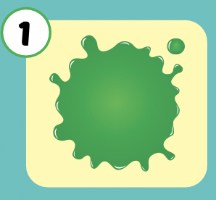
Listen and repeat.
Click each picture to hear the sound.
green
/ɡriːn/
màu xanh lá

Slide 10
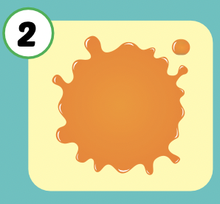
Listen and repeat.
Click each picture to hear the sound.
orange
/ˈɔːrɪndʒ/
màu cam

Slide 11
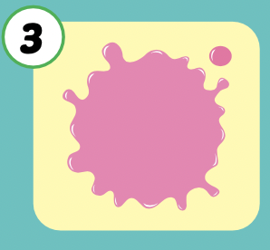
Listen and repeat.
Click each picture to hear the sound.
pink
/pɪŋk/
màu hồng

Slide 12
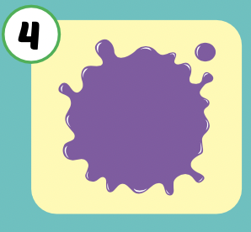
Listen and repeat.
Click each picture to hear the sound.
purple
/ˈpɜːrpl/
màu tím

Slide 13
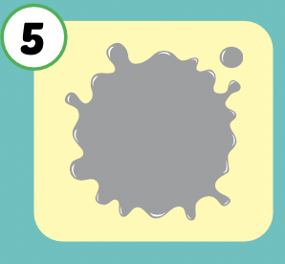
Listen and repeat.
Click each picture to hear the sound.
gray
/ɡreɪ/
màu xám

Slide 14
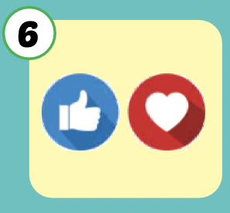
Listen and repeat.
Click each picture to hear the sound.
favorite
/ˈfeɪvərɪt/
yêu thích

Slide 15

