Slide 1

Unit 5: Sports and hobbies
Lesson 3.1
Page 74

Slide 2
Lesson Outline
Warm-up
Vocabulary
Structure
Consolidation
Wrap-up

Slide 3
Objectives
By the end of this lesson, students will be able to ask for permission, using ……….
Vocabulary: watch TV, go skateboarding, go out, go swimming
Structure: May I watch TV?
- Yes, you may./ No, you may not.

Slide 4

WARM UP

Slide 5
CROSSWORD
1
H | I | T | T | I | N | G
2
V | O | L | L | E | Y | B | A | L | L
3
B | A | D | M | I | N | T | O | N
4
B | A | S | K | E | T | B | A | L | L
5
K | I | C | K | I | N | G
6
T | E | N | N | I | S
7
S | O | C | C | E | R
KEYWORD
Click on the crossword to show the answer.
END

Slide 6
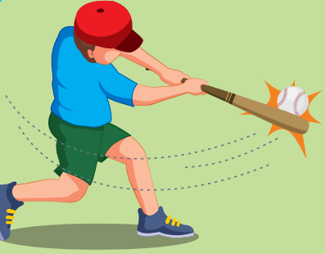
Back

Slide 7
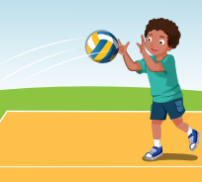
Back

Slide 8

Back

Slide 9

Back

Slide 10
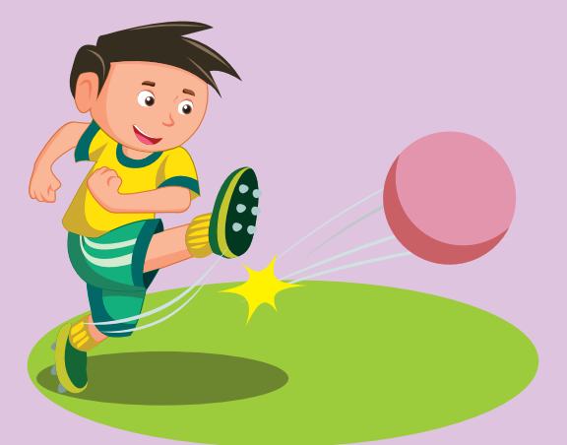
Back

Slide 11
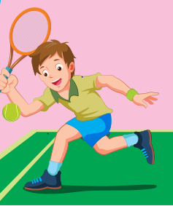
Back

Slide 12

Back

Slide 13

It’s time to learn …

Slide 14
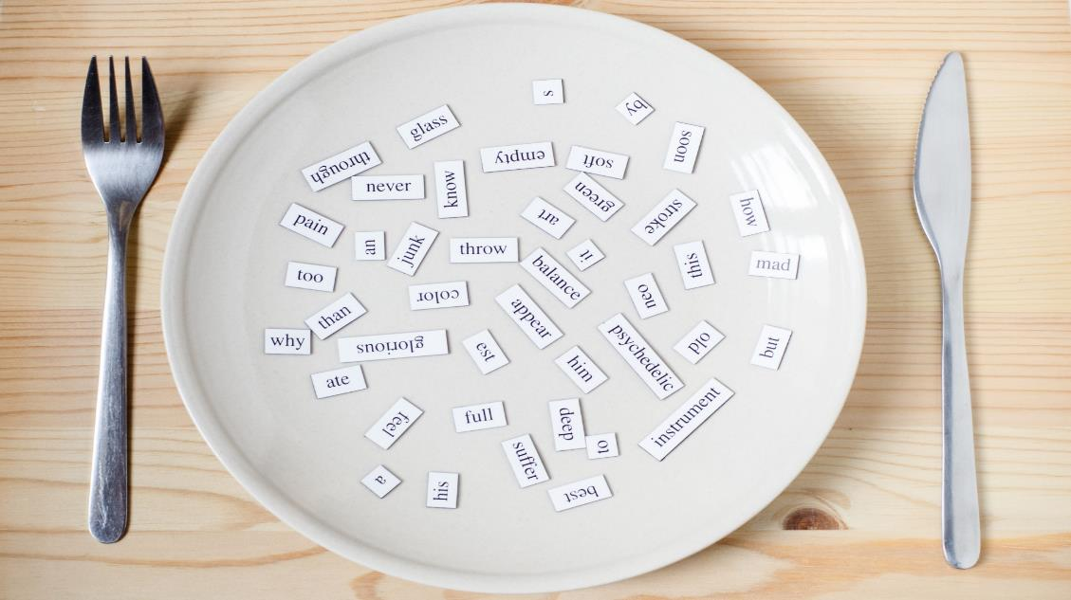
New words
watch TV
go skateboarding
go out
go swimming

Slide 15

Presentation

