Slide 1

Unit 1: My Friends
Lesson 3
Page 17

Slide 2
Lesson Outline
Warm-up
Phonics
Structure
Consolidation
Wrap-up

Slide 3
Objectives
By the end of this lesson, students will be able to improve their listening skills and ask what their friends like doing.
Vocabulary: dancing, singing, drawing, reading, painting
Structure: Do your friends like dancing?
Yes, they do./No, they don't.

Slide 4

WARM UP

Slide 5
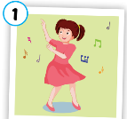
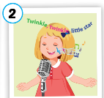
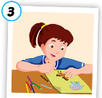

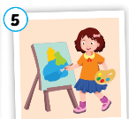
Lucky numbers!
A
1
2
3
4
5
$20
$30
$50
$30
$20
B
1
2
3
4
5
$30
$20
$30
$0
$50
C
1
2
3
4
5
$50
-$30
$20
-$10
$20
Notes:
Students say : 1A, 1B or 1C to open a picture.
After the picture is shown, ask students to say it and make sentences with “ Do your friends like…?” and answer.
Click the pictures to show the money behind.

Slide 6

It’s time to learn …

Slide 7
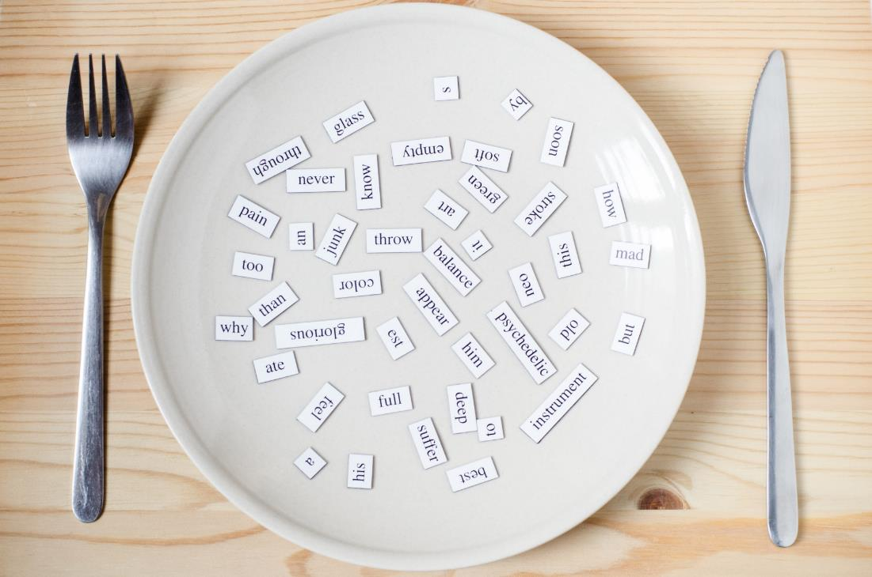
Phonics
/ŋ/ sound
singing
drawing
painting
reading
dancing

Slide 8

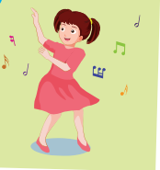





C
1. Listen and repeat.
singing
dancing
Notes:
Click the speakers to listen.
Click the light bulb to show the words.
Get student to pay attention to highlighted “ing” which is /ŋ/ sound . Pronounce it correctly.

Slide 9











C
2. Listen and chant.
/ŋ/, /ŋ, /ŋ/,
/ŋ/, /ŋ, /ŋ/
singing, dancing,
/ŋ/, /ŋ, /ŋ/.
(x2)
Notes:
Click the mic to listen.
Get student to listen and repeat carefully.
Click to show the lyrics.

Slide 10

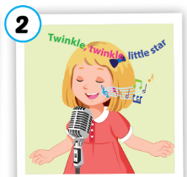



Activity 1
Look, complete and say.
danc___
sing___
draw___
read___
paint___
ing
ing
ing
ing
ing

Slide 11
Activity 2
Listen and repeat. Then draw lines.
1
singing
2
dancing
3
drawing
reading
4
painting
5
Notes:
Click the hearts to listen. Ask students to read along.
Click the hearts again to show answers.

Slide 12
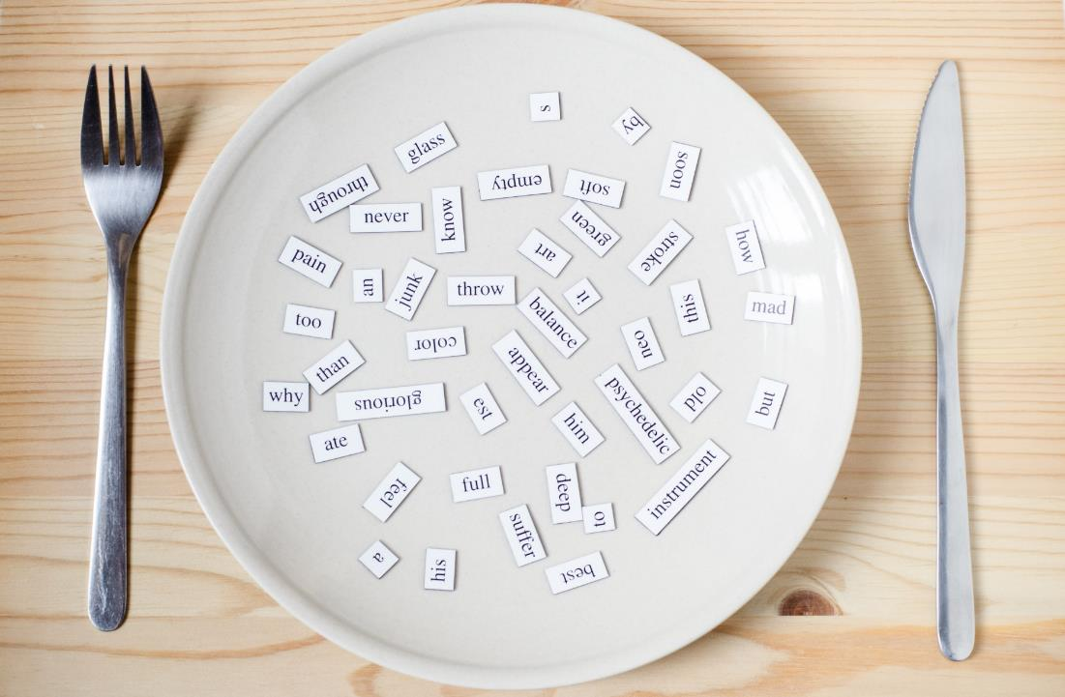
Listening
Do your friends like dancing?
Yes, they do.
Do your friends like singing?
No, they don’t.

Slide 13
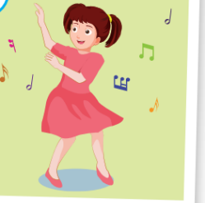
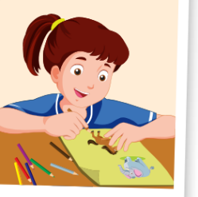
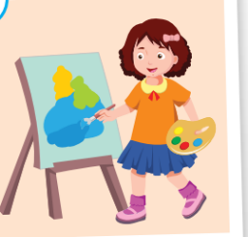
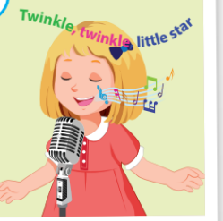

Activity 1
Can you catch it?
1
2
3
Do your friends like……………?
4
5
Yes, they do./ No, they don’t.
Notes:
Click the stars to show pictures quickly. Get students to pay attention and fill in the blank to ask question about the picture.

Slide 14

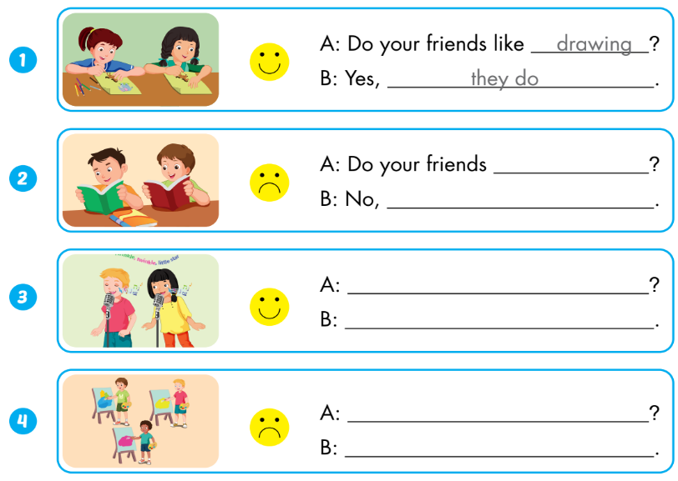
Extra Activity
WB p.13
like reading
they don’t
Do your friends like singing
Yes, they do.
Do your friends like painting
No, they don’t

Slide 15
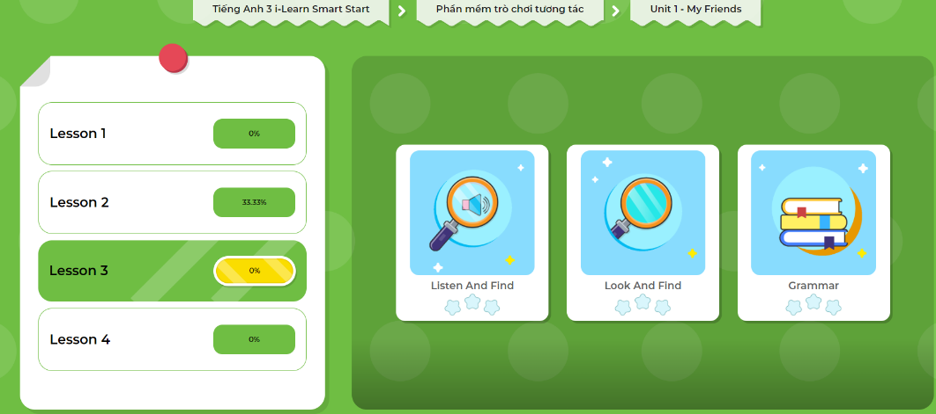
Extra- DHA app.
Click here to play the games

