Slide 1








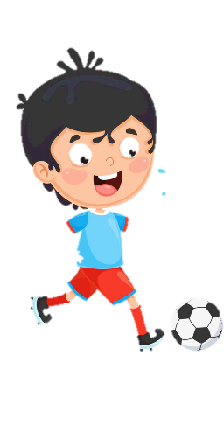
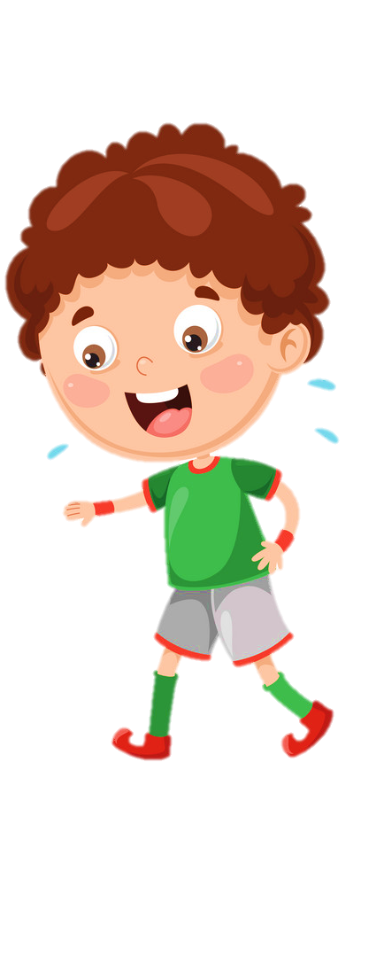





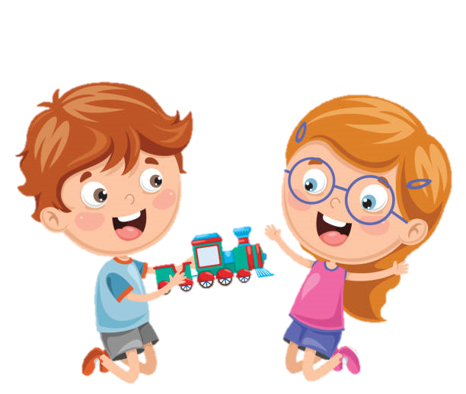





Notes:
Để nguyên trang bìa như này, chỉ thay đổi tên bài trong quá trình làm. Logo của sách Wonderful World

Slide 2






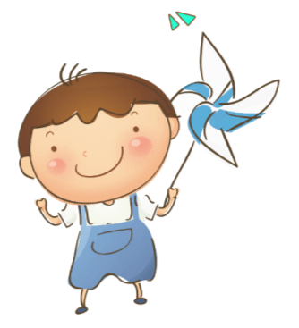
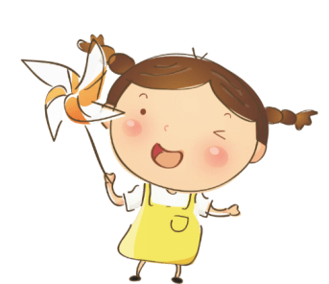

Slide 3


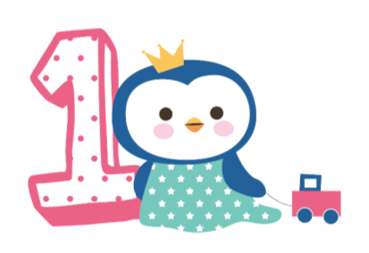
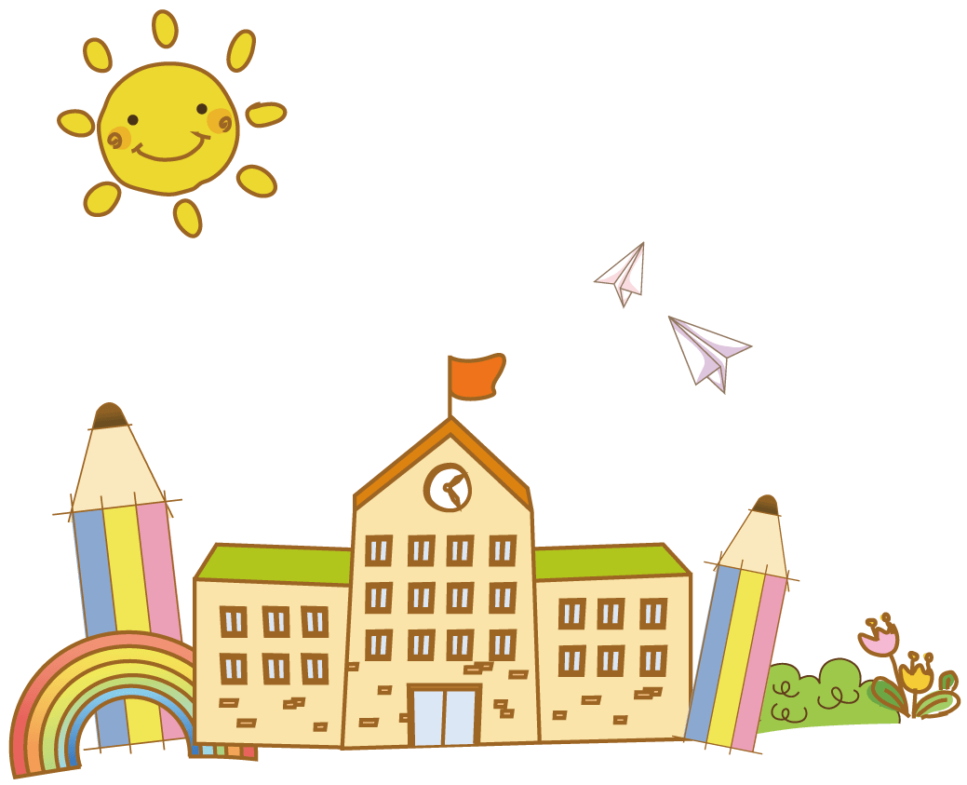

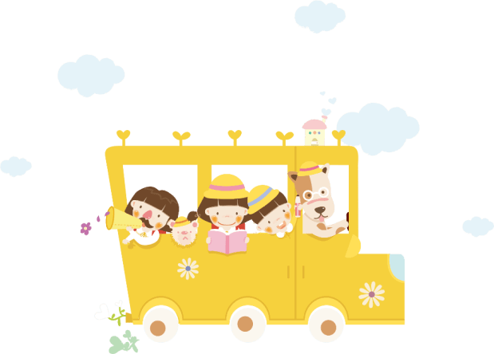
Warm up!

Slide 4




Movement Game: Hip hip hooray
Hands up!
Hands down!
Hip hip hooray
Go to Wonderful World!
Notes:
+ Hands up: raise 2 hands up
+ Hands down: Put to hands down
+ Hip hip hooray (2 times): smack 2 hands on hips then put hands to mouth when saying hooray (2 times)
+ Go to Wonderful World: join 2 hands and make waves then raise both hands up and wave.

Slide 5
Review:
Let’s chant!
Notes:
Review: Let’s chant!
- Say the chant and do the action.
Hi, I’m Ana. (wave hand, put hand in front of chess)
Hello, I’m Tom. (wave hand, put hand in front of chess)
Nice to meet you. (Shake hands)
Nice to meet you, too. (Shake hands back)

Slide 6
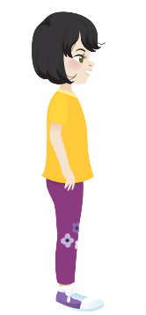

Hi, I’m Ana.
Hello, I’m Tomas.
Nice to meet you.
Nice to meet you, too.
Notes:
Review: Let’s chant!
- Say the chant and do the action.
Hi, I’m Ana. (wave hand, put hand in front of chess)
Hello, I’m Tom. (wave hand, put hand in front of chess)
Nice to meet you. (Shake hands)
Nice to meet you, too. (Shake hands back)
Say the chant individually.
A pair come to the board and do the action.
Lead in:
Ask 2 sts come to the board and say the chant. Then lead to the lesson with sentences:
Hi, ______ How are you?
I’m ______, thank you.

Slide 7

Presentation
Task 4: Listen and repeat.

Slide 8
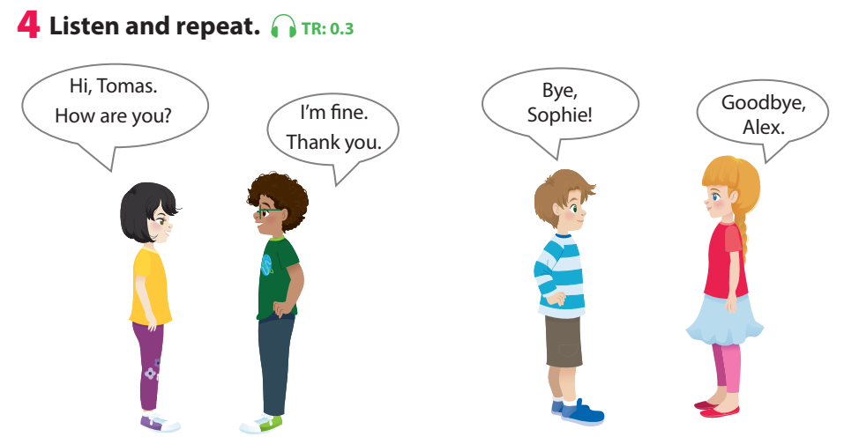
Notes:
Use flashcards to introduce the vocabulary and structure of lesson.
Say the words/sentences for sts to repeat in chorus.
Put the flashcards in different places around the room.
Say a word/sentence for sts to repeat then point.

Slide 9

Notes:
Play the track 0.3, ask students to listen and repeat in chorus, group.

Slide 10

Practice
Task 5: Say
Notes:
Task 5: Say
- Ask sts how many friends can they see and their names.
- Have sts look at the bubbles and ask them to complete (spoken).
- Have sts practice the dialogues in chorus, group, pairs.
- Go over the activity. Ask children to say sentences about different pictures in their classroom, pointing to them.
Game: Chinese whisper!
- Let sts stand in lines of 5-6. Say a sentence for them to whisper one by one, from the top the back. The last one will say out loud the sentence.

Slide 11
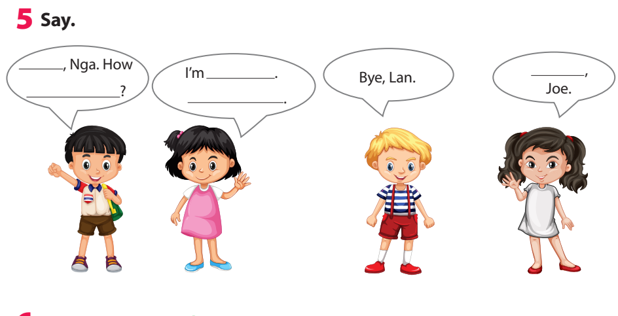
Thank you
Hi
are you
fine
Goodbye
Notes:
Task 5: Say
- Ask sts how many friends can they see and their names.
- Have sts look at the bubbles and ask them to complete (spoken).

Slide 12
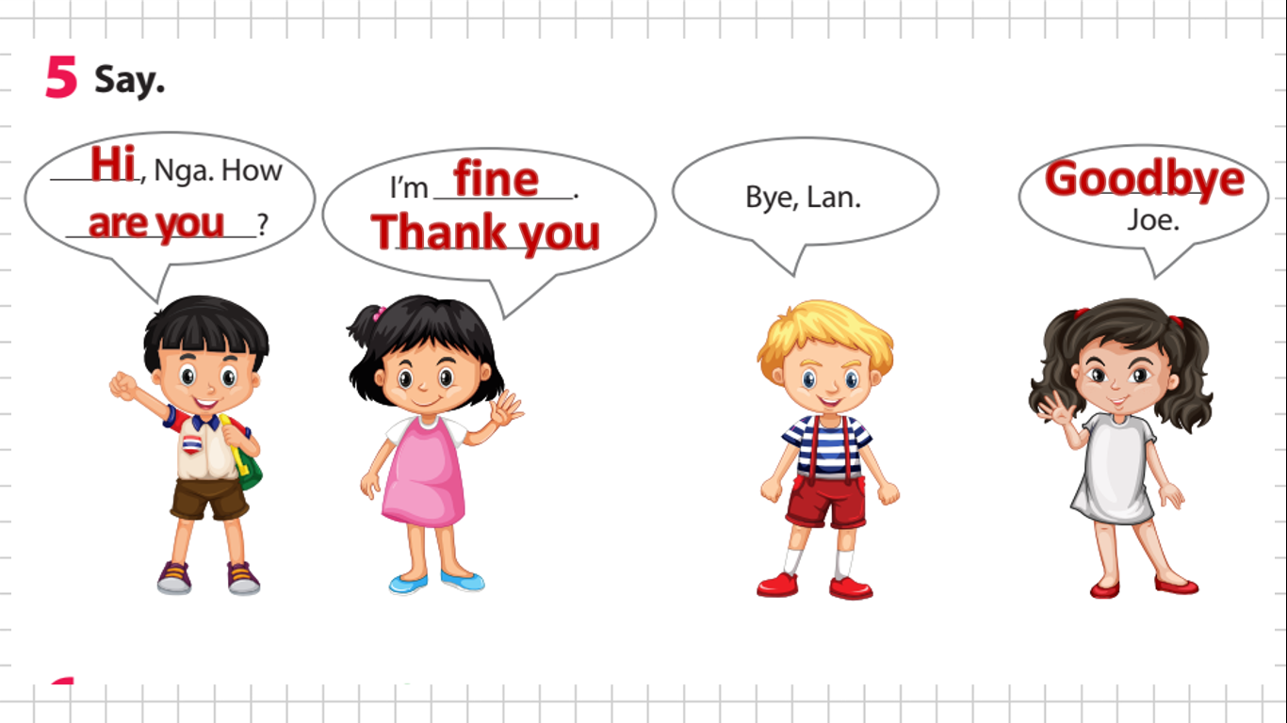
Notes:
- Have sts practice the dialogues in chorus, group, pairs.
- Go over the activity. Ask children to say sentences about different pictures in their classroom, pointing to them.

Slide 13

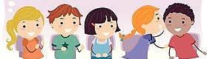
Game: whispering
Hi, Nga. How are you?
Notes:
Game: Chinese whisper!
- Let sts stand in lines of 5-6. Say a sentence for them to whisper one by one, from the top the back. The last one will say out loud the sentence.

Slide 14
Game: whispering
I’m fine. Thank you.
Notes:
Game: Chinese whisper!
- Let sts stand in lines of 5-6. Say a sentence for them to whisper one by one, from the top the back. The last one will say out loud the sentence.

Slide 15
Game: whispering
Bye, Lan.
Notes:
Game: Chinese whisper!
- Let sts stand in lines of 5-6. Say a sentence for them to whisper one by one, from the top the back. The last one will say out loud the sentence.

Slide 16
Game: whispering
Goodbye, Joe.
Notes:
Game: Chinese whisper!
- Let sts stand in lines of 5-6. Say a sentence for them to whisper one by one, from the top the back. The last one will say out loud the sentence.

Slide 17
Practice
Task 6: Listen and sing.
Notes:
Task 6: Listen and sing.
-Ask children to look at the picture. Point to the book and ask What’s this? Ask children to predict what the song is about (Good bye friends).
-Play the song all the way through once for children to listen; then play it again as they follow the words in their books.
-Play it again, stopping after each line for children to repeat.
-Play the recording for children to sing along.

Slide 18
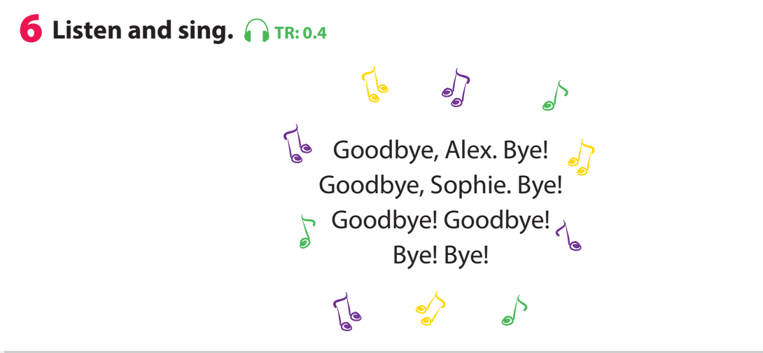

Slide 19
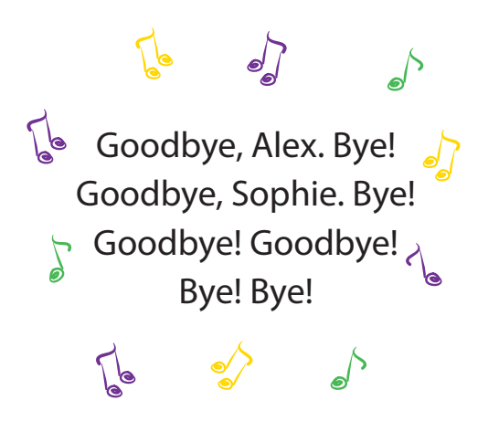
Notes:
Task 6: Listen and sing.
-Ask children to look at the picture. Point to the book and ask What’s this? Ask children to predict what the song is about (Good bye friends).
-Play the song all the way through once for children to listen; then play it again as they follow the words in their books.
-Play it again, stopping after each line for children to repeat.
-Play the recording for children to sing along.

Slide 20
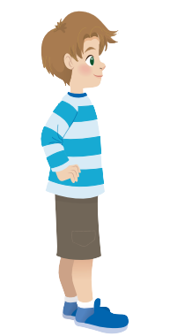

Notes:
Game: Sing, stand up, sit down!
-Give 2 students word cards for 2 children Alex, Sophia.
- Play the song. Each time children hear their word, they quickly stand up and sit down.

Slide 21
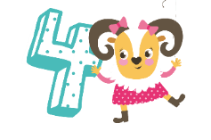
Production
Role play
Notes:
Game: Role play
Situation 1:
A new member of an English club come to the club. Practice the greeting and goodbye.

Slide 22

Hi, I’m Sophia. Nice to meet you.
Hi, I’m Anna. Nice to meet you.
English club
Notes:
Game: Role play
Situation 1:
A new member of an English club come to the club. Practice the greeting and goodbye.

Slide 23
English club
Notes:
Practice the greeting and goodbye.
Ask some sts to come to the front to role play for the class.

Slide 24

Hi, I’m Alex. Nice to meet you.
Hi, I’m Tomas. Nice to meet you, too.
Notes:
Situation 2:
2 new classmates meet at the school the first time. Practice the greeting and goodbye.
Ask some sts to come to the front to role play for the class.

Slide 25
Notes:
Practice the greeting and goodbye.
Ask some sts to come to the front to role play for the class.

Slide 26
Goodbye, Tomas.
Bye, Alex.
Notes:
Situation 2:
2 new classmates meet at the school the first time. Practice the greeting and goodbye.
Ask some sts to come to the front to role play for the class.

Slide 27
Notes:
Situation 2:
2 new classmates meet at the school the first time. Practice the greeting and goodbye.
Ask some sts to come to the front to role play for the class.

Slide 28
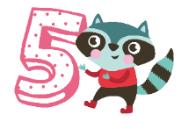
Assessment
Say and respond!
Notes:
THIẾT KẾ HOẠT ĐỘNG TƯƠNG TÁC CHO 3 CÂU HỎI Ở SLIDE 32 (ĐÁP ÁN Ở SLIDE 33)

Slide 29
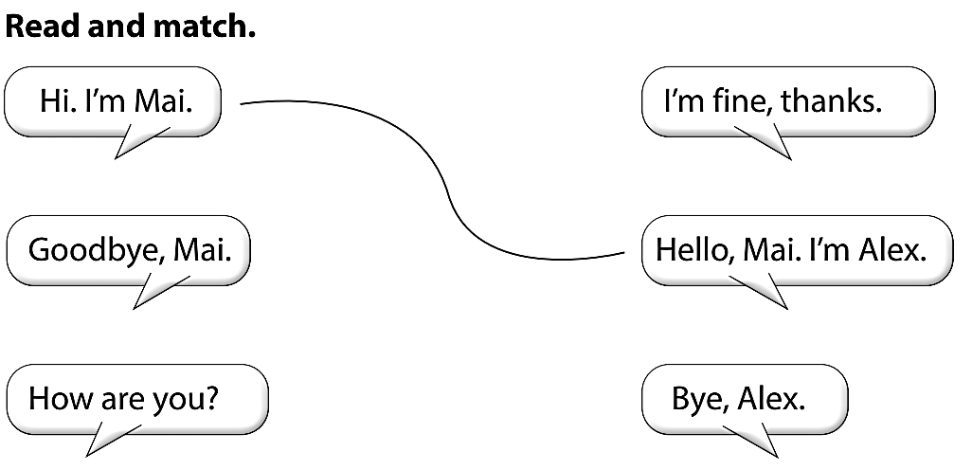

Slide 30


Let’s check!

Slide 31
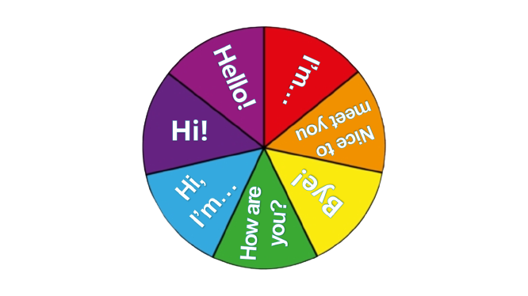
Spin, say
and do action!
spin

Slide 32
Spin, say
and do action!
spin

Slide 33
Spin, say
and do action!
spin

Slide 34
Spin, say
and do action!
spin

Slide 35
Spin, say
and do action!
spin

Slide 36
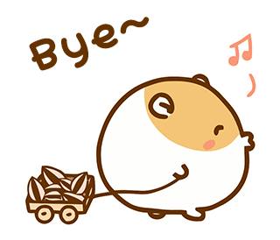
Goodbye!

