Slide 1

Unit 2: Family
Lesson 2.3
Page 29

Slide 2
Lesson Outline
Warm-up
Practice
Speaking
Consolidation
Wrap-up

Slide 3
Objectives
By the end of this lesson, students will be able to ask who someone is confidently.
Vocabulary:
grandfather, grandmother, uncle, aunt, cousin
Structures:
Who’s he?/ He’s my grandfather.
What’s his name?/ His name’s Dan.

Slide 4

WARM UP

Slide 5
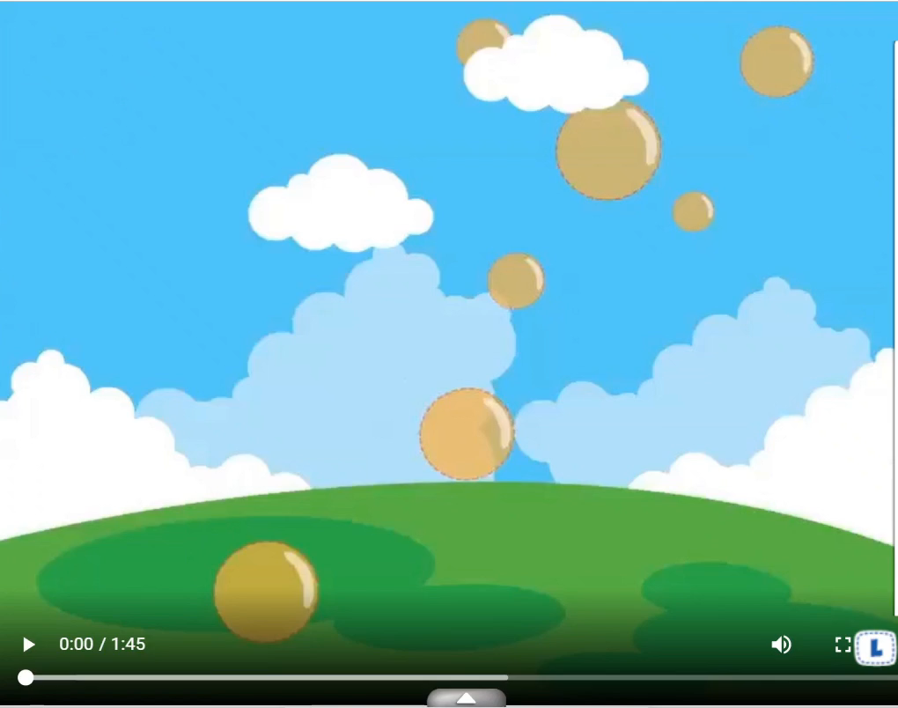

Slide 6






Memory Game
1
2
3
4
5
6
sister
uncle
7
8
9
grandfather
10
11
12
cousin
aunt
grandmother
Notes:
Divide the class into teams.
Ask each team to take turns choosing 2 numbers.
Get them a point if the picture matches with the word.
Click on the red circles to hide the picture and word if they don’t match.
Give a chance to another group.

Slide 7

It’s time to learn …

Slide 8

Practice

Slide 9
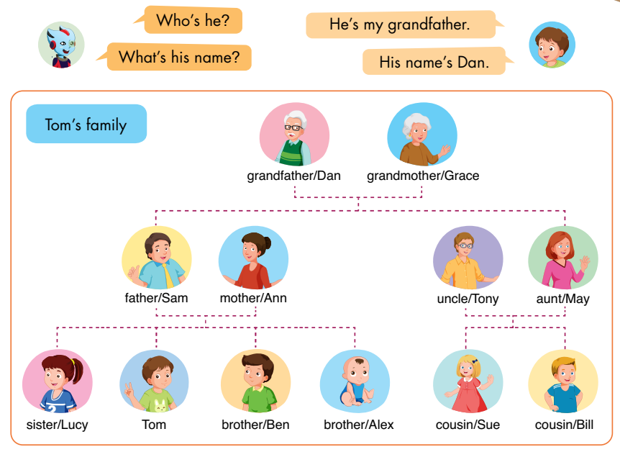
E
Point, ask, and answer.
Notes:
Have the class look at the picture.
Ask them to name the family members and spell the names in the pictures.
E. Point, ask, and answer.
Divide the class into two pairs.
Demonstrate the activity using the speech bubbles.
Have the student A point to a person in the picture, have the student B introduce.
Swap roles and repeat.
Afterwards, have some pairs demonstrate the activity in front of the class.

Slide 10

Speaking

Slide 11
E
2. Role-play.
Example:
Tina: This is my brother, Ben.
Mark: Hello, Ben. I’m Mark.
Ben: Hello, Mark.
Notes:
2. Role-play.
Divide the class into groups of three.
Demonstrate the activity using the example.
Ask them to role-play the activity.
Swap roles and repeat.
Afterwards, have some pairs demonstrate the activity in front of the class.

Slide 12
Practice

Slide 13
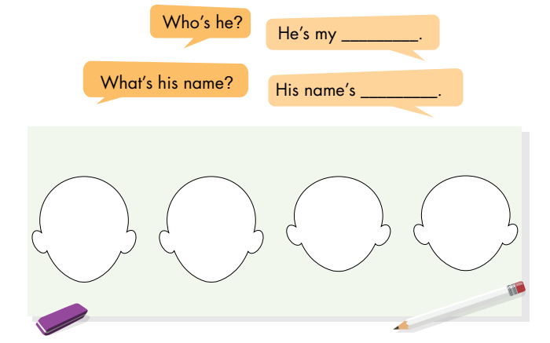
F
Draw your family. Ask and answer.
Notes:
F. Draw your family. Ask and answer.
Have the students draw the faces of their family members.
Divide the class into two pairs.
Have the students look at their drawings, then ask and answer.
Swap roles and repeat.
Afterwards, have some pairs demonstrate the activity in front of the class.

Slide 14
Speaking

Slide 15
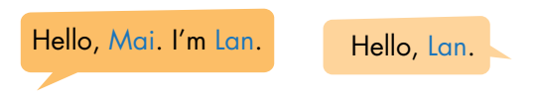
F
2. Role-play.
Example:
Lily: This is my sister, Mary.
Sam: Hello, Mary. I’m Sam.
Mary: Hello, Sam.
Notes:
2. Role-play.
Divide the class into groups of three.
Demonstrate the activity using the example.
Ask them to role-play the activity.
Swap roles and repeat.
Afterwards, have some pairs demonstrate the activity in front of the class.

Slide 16

CONSOLIDATION

Slide 17
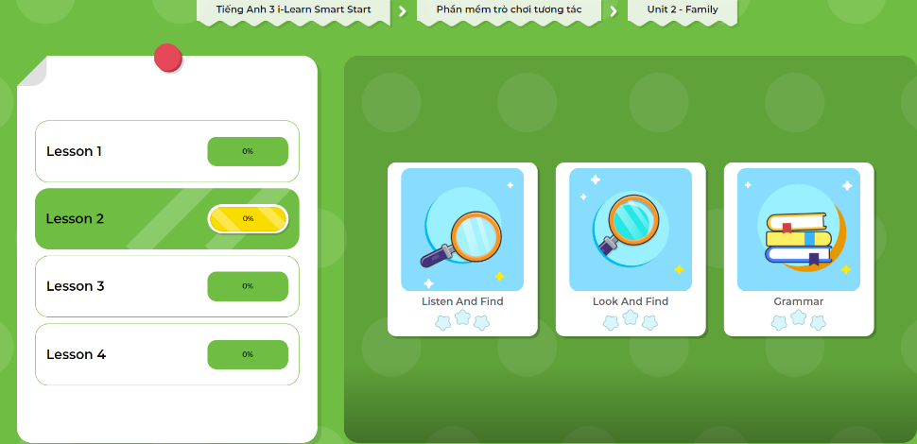
LET’S PLAY!
Click here to play the games!

Slide 18

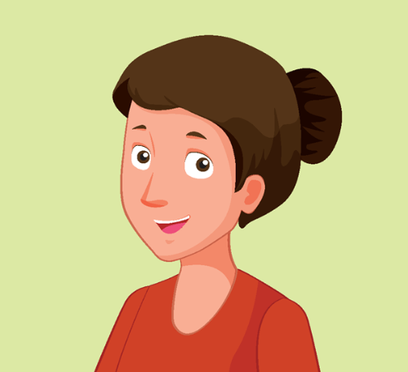
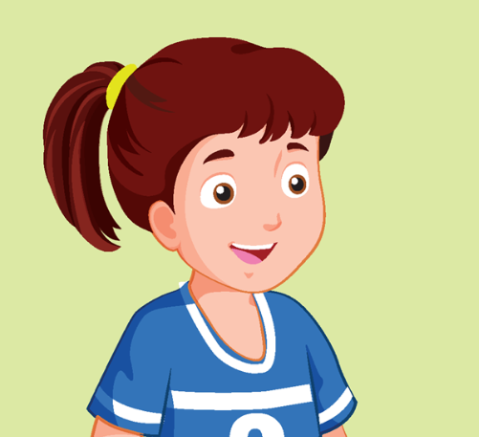
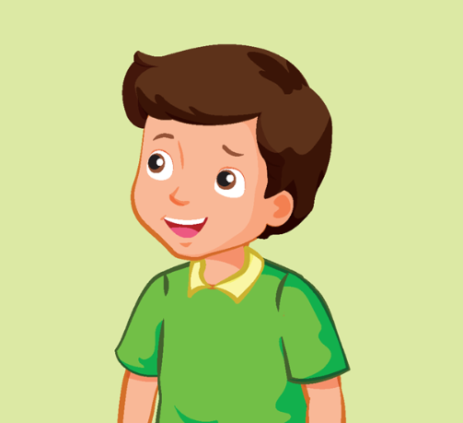
Look and say.
This is my… .
Notes:
Look and say.
Demonstrate the activity in front of the class.
Ask the class to look at the flashcards.
Have them use the structure: “This is my… .” to introduce family members.
Help them with their pronunciation and grammar (if any).

Slide 19

WRAP-UP

Slide 20
Today’s lesson
Vocabularies
grandfather grandmother
uncle
aunt
cousin
Structures/ Sentence patterns
Who’s he?
He’s my grandfather.
What’s his name?
His name’s Dan.

Slide 21
Homework
Practice the vocabularies and structures; and make sentences using them.
Do the exercises in Tiếng Anh 3 i-Learn Smart Start Notebook on page 17.
Prepare the next lesson: Unit 2 – Lesson 3 – Page 30.
Play the consolidation games in Tiếng Anh 3 i-Learn Smart Start DHA App on www.eduhome.com.vn

Slide 22
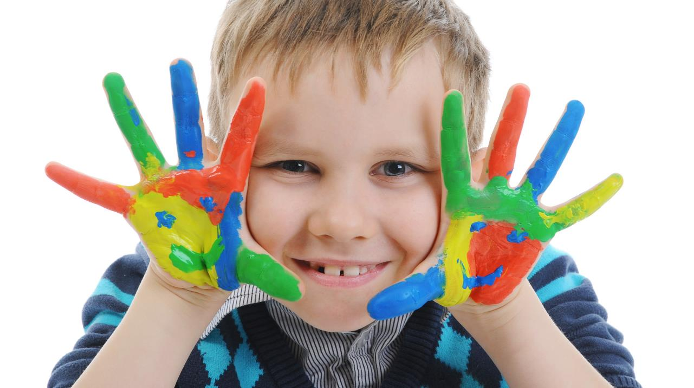
Enjoy your day!

