Slide 1

Unit 8: FOOD
Lesson 2.2
Page 114

Slide 2
Lesson Outline
Warm-up
Listening
Consolidation
Wrap-up

Slide 3
Objectives
By the end of this lesson, students will be able to…
Phonics: Pronounce /z/ correctly.
Structure: Review:
Are there any…? - Yes, there are (some…)/ No, there aren’t.
Is there…? - Yes, there is (a/an…)/No, there isn’t.
Listen: Listen to friends talking about food in the kitchen
Practice: Practice the conversations with friends.

Slide 4

WARM UP

Slide 5

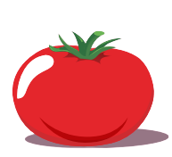

What is behind the question marks?
t
o
m
a
t
o

Slide 6
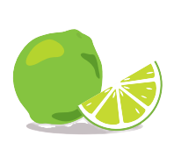
l
i
m
e

Slide 7
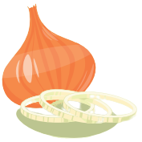
o
n
i
o
n

Slide 8
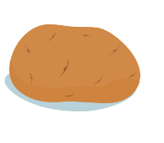
p
o
t
a
t
o

Slide 9

It’s time to learn …

Slide 10
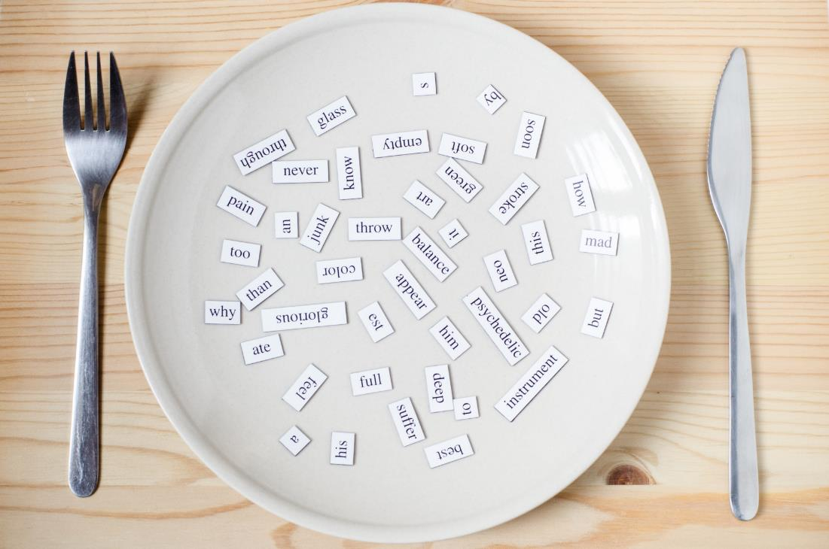
Phonics
/z/

Slide 11
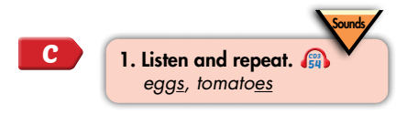

Notes:
Click vô hình để nghe

Slide 12
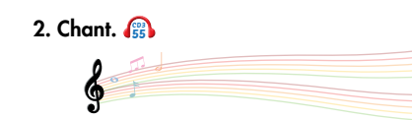
/z/, /z/, /z/,
/z/, /z/, /z/,
eggs, tomatoes,
/z/, /z/, /z/.
(x2)
Click here to play the audio
Notes:
Click vô hình để nghe

Slide 13

Listening

Slide 14
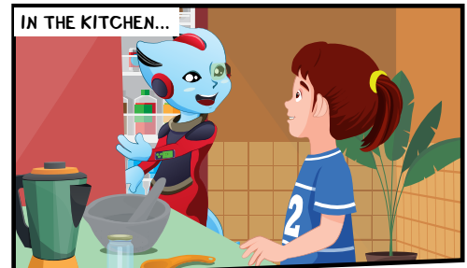
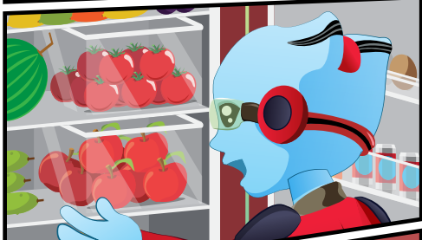
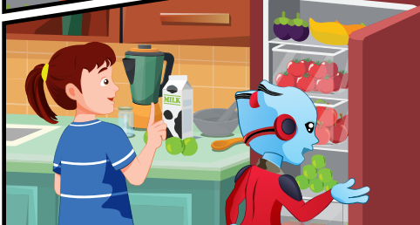
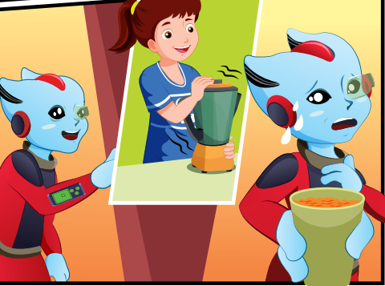
BEFORE LISTENING
LOOK

Slide 15


BEFORE LISTENING
What food can you see in the fridge?
limes
eggs
potato
apples
tomatoes
banana
onion
apple

Slide 16
BEFORE LISTENING
What is on the counter?
Some limes and milk

Slide 17
BEFORE LISTENING
What is Alfie holding?
A cup of smoothie

Slide 18

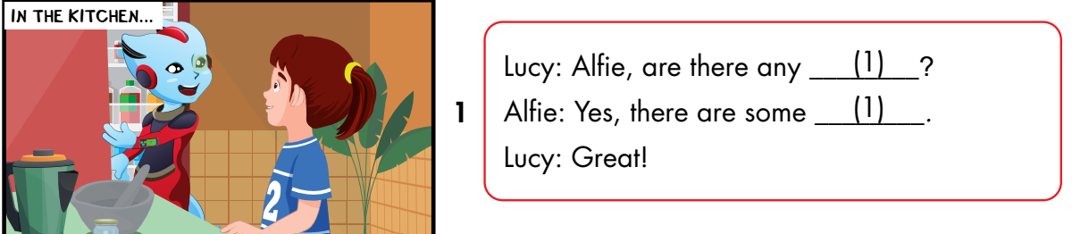
Notes:
Click vô chữ listen để nghe

Slide 19
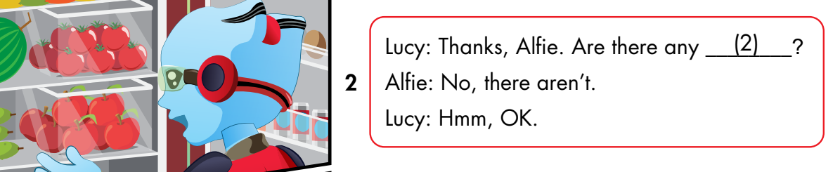

Slide 20
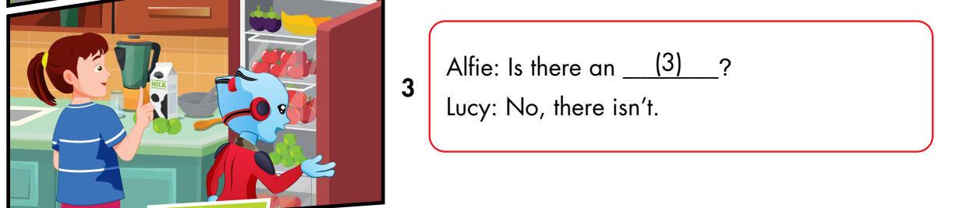

Slide 21
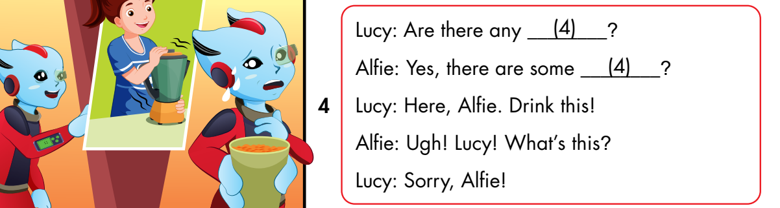

Slide 22

Notes:
Cho nghe vi du truoc

Slide 23
(2)

Slide 24
(3)

Slide 25
(4)

Slide 26

More practice

Slide 27
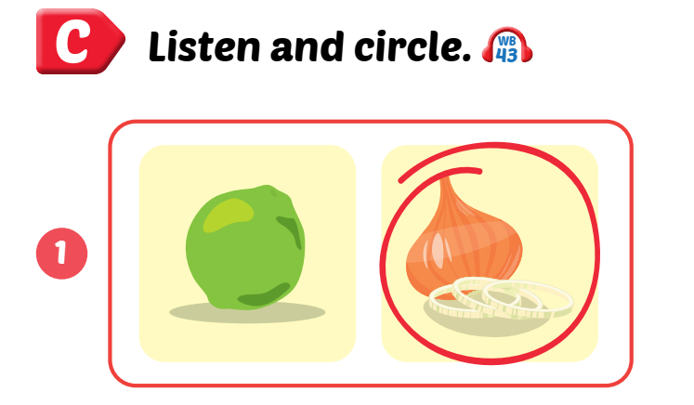
Wordbook, p.81

Slide 28

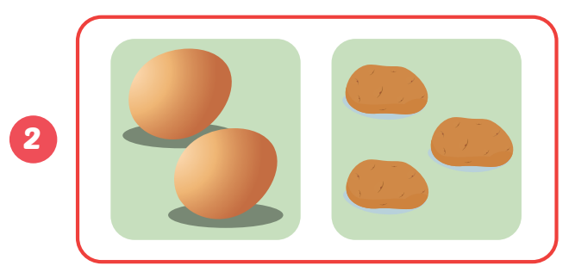
Wordbook, p.81

Slide 29
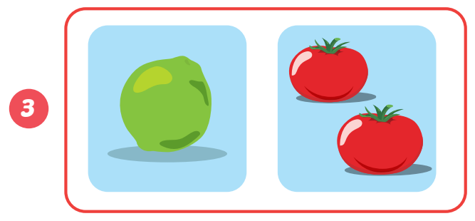
Wordbook, p.81

Slide 30
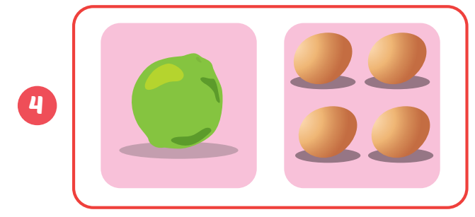
Wordbook, p.81

Slide 31

AFTER LISTENING
Let’s speak

Slide 32


Look and ask
Are there
__________ any limes?
__________________ .
Click here to open the cupboard
No, there aren’t.

Slide 33
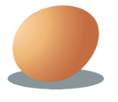
Look and ask
Is there
__________ a potato?
________________ .
Click here to open the cupboard
No, there isn’t.

Slide 34
Look and ask
Are there
__________ any eggs?
________________ .
Click here to open the cupboard
Yes, there are.

Slide 35

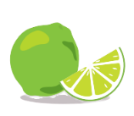
Look and ask
Are there
__________ any potatoes?
__________________
Click here to open the cupboard
Yes, there are.

Slide 36



Slide 37
Lucy: Alfie, are there any tomatoes?
Alfie: Yes, there are some tomatoes.
Lucy: Great!
Notes:
GV chia lớp 2 nhóm, thực hành nói, sau đó gọi vào cặp lên nói to trước lớp

Slide 38
Lucy: Thanks, Alfie. Are there any bananas?
Alfie: No, there aren’t.
Lucy: Hmm, OK
Notes:
GV chia lớp 2 nhóm, thực hành nói, sau đó gọi vào cặp lên nói to trước lớp

Slide 39
Alfie: Is there an onion?
Lucy: No, there isn’t.
Notes:
GV chia lớp 2 nhóm, thực hành nói, sau đó gọi vào cặp lên nói to trước lớp

Slide 40
Lucy: Are there any eggs?
Alfie: Yes, there are some eggs?
Lucy: Here, Alfie. Drink this!
Alfie: Ugh! Lucy! What’s this?
Lucy: Sorry, Alfie!
Notes:
GV chia lớp 2 nhóm, thực hành nói, sau đó gọi vào cặp lên nói to trước lớp

Slide 41

CONSOLIDATION

Slide 42
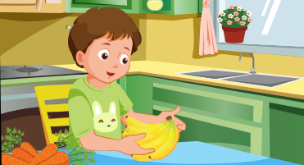
Draw the food in the kitchen in your house and talk with your classmate.

Slide 43
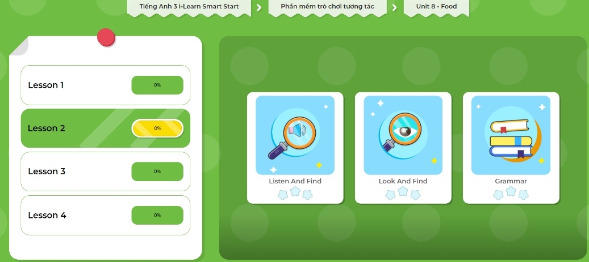
Extra Practice
DHA App
LET’S PLAY!
Click here to play the games

Slide 44

WRAP-UP

Slide 45
Today’s lesson
Sentence patterns
Are there any…? - Yes, there are (some…)/ No, there aren’t.
Is there…? - Yes, there is (a/an…)/No, there isn’t.
Phonics:
/z/
Listening
Listen to friends talking about food in the kitchen.

Slide 46
Homework
Practice the vocabularies and structure; and make sentences using them.
Do the exercises in Tiếng Anh 3 i-Learn Smart Start WB (page 81)
Prepare the next lesson (page 115 SB)
Play the consolidation games in Tiếng Anh 3 i-Learn Smart Start DHA App on www.eduhome.com.vn

Slide 47
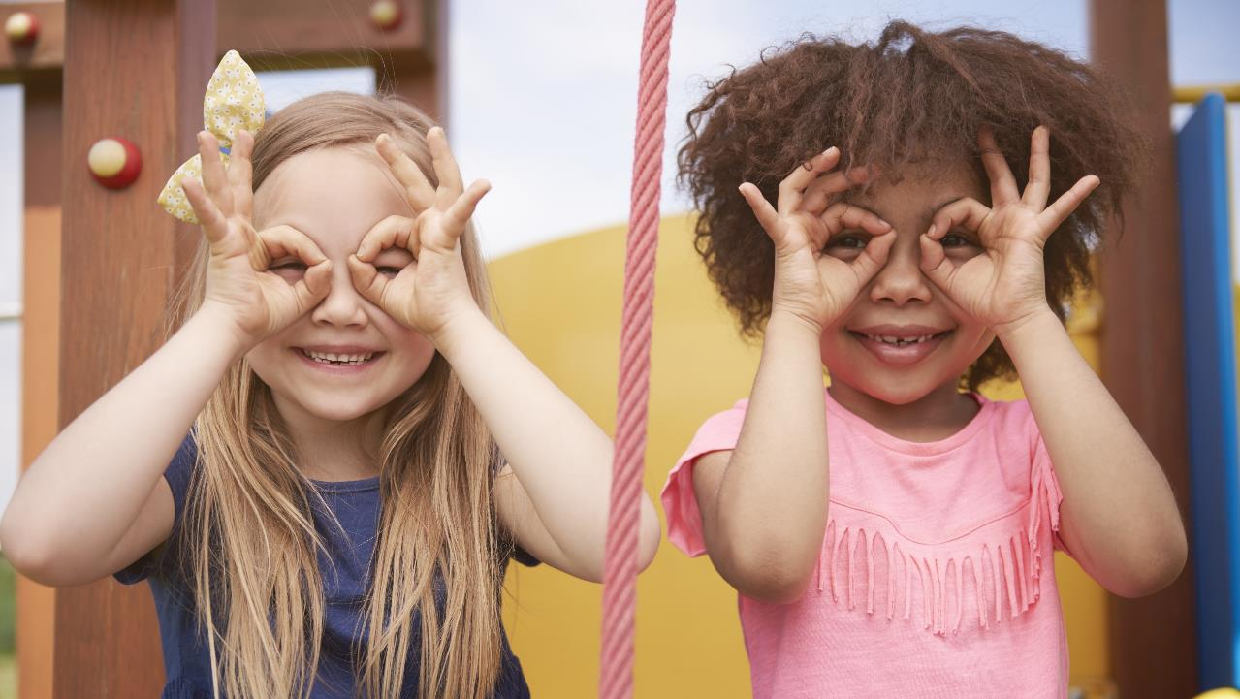
Enjoy your day!

