Slide 1
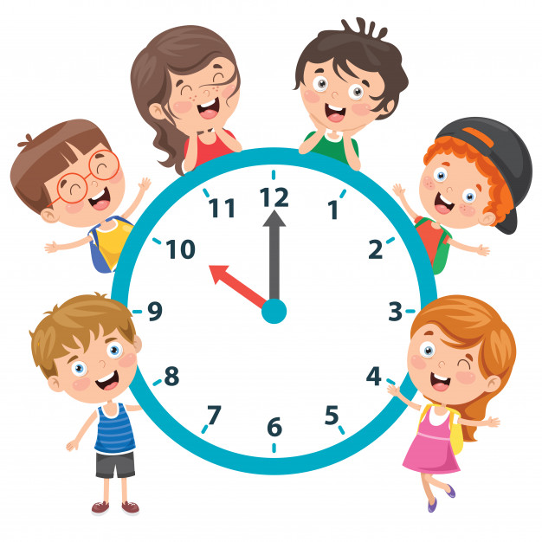
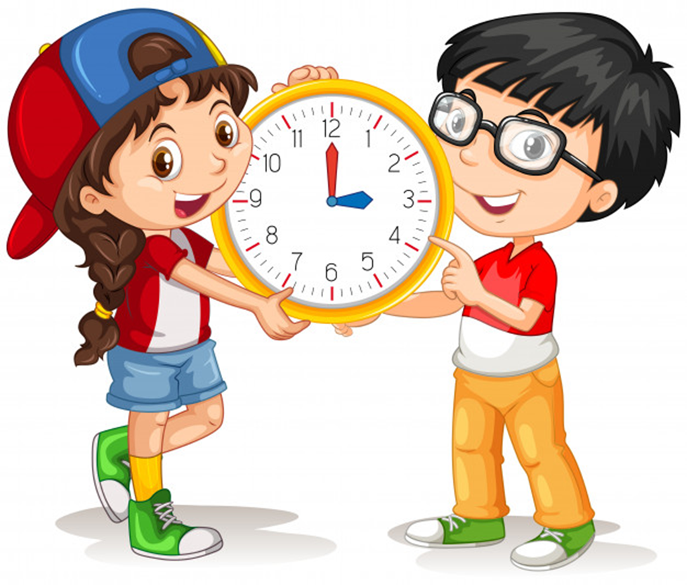
Unit 11
What time is it?
Lesson 2

Slide 2
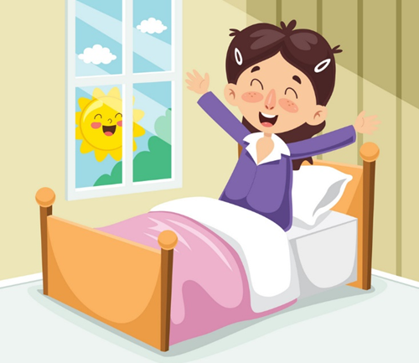
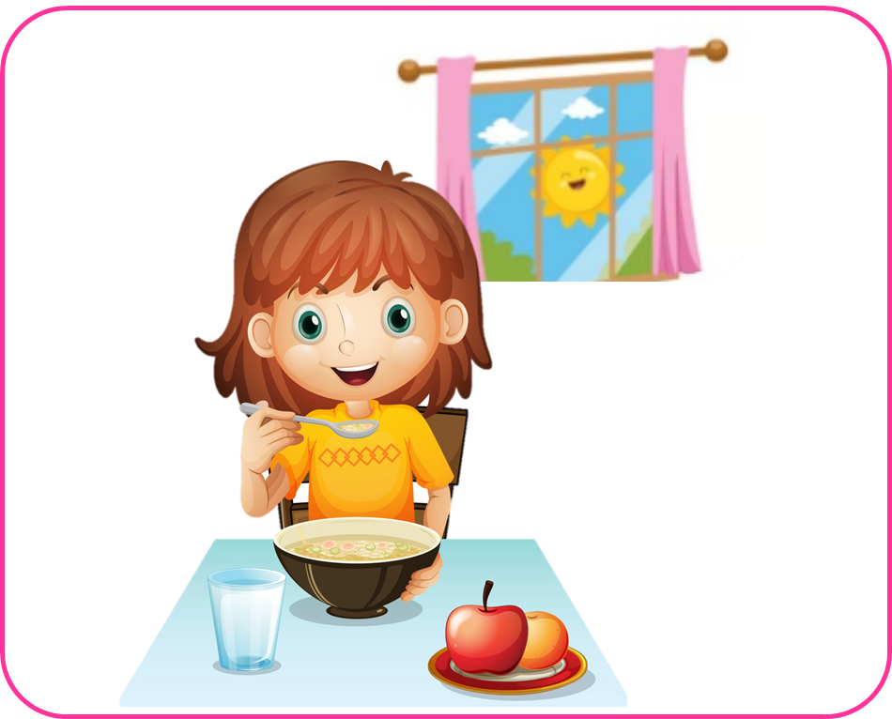
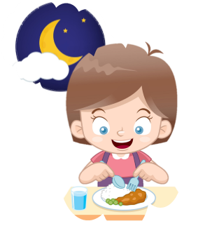
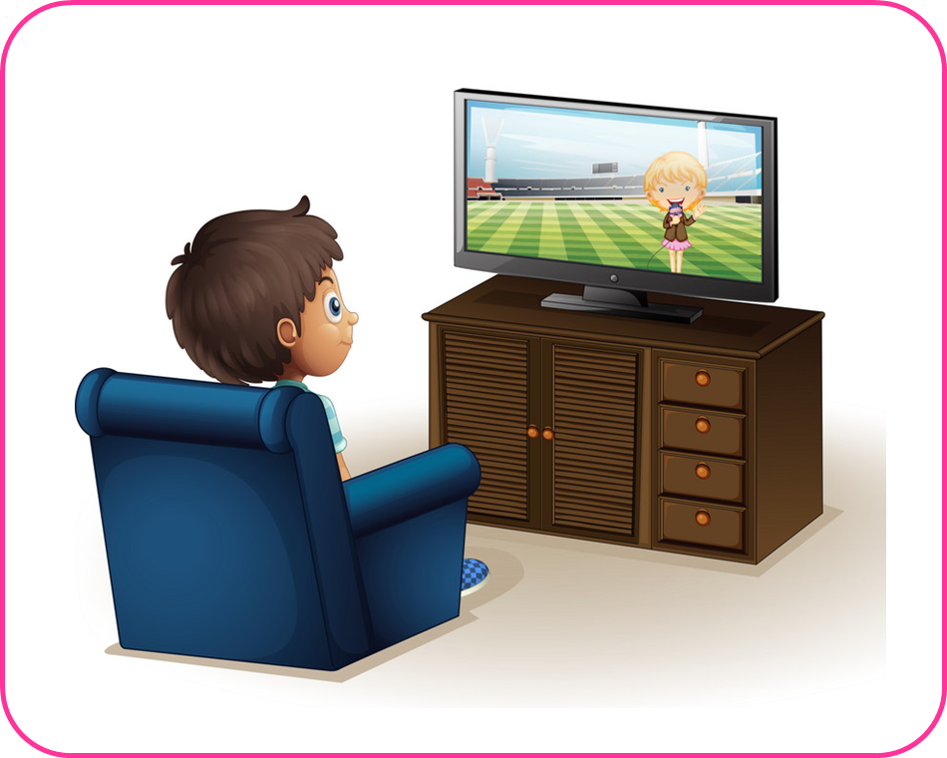
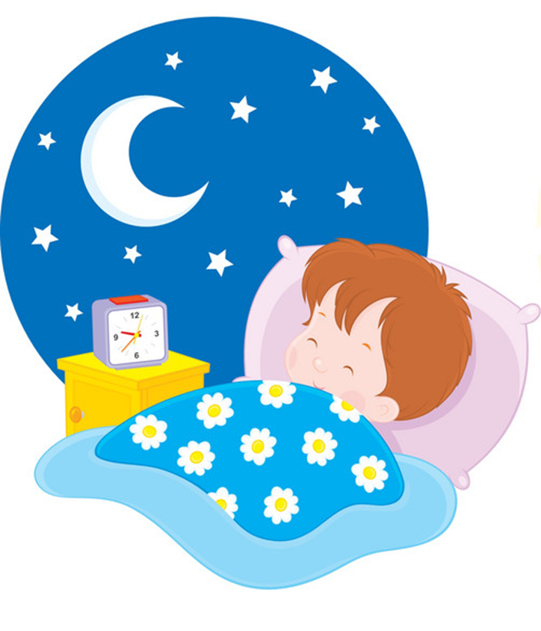
Vocabulary
get up
have breakfast
go to school
have dinner
watch TV
go to bed

Slide 3
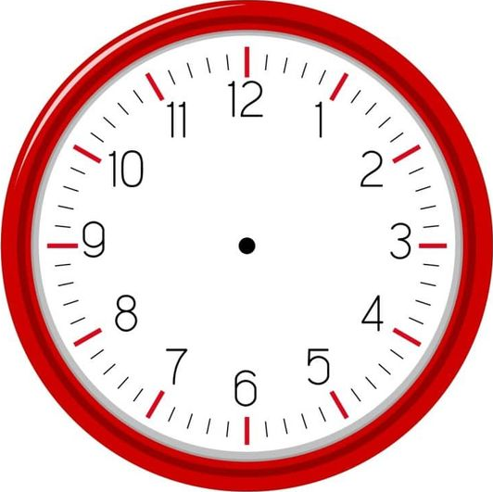
Model sentence
What time do you _____?
I _______ at + (giờ).
go to bed
get up
watch TV
have breakfast
have dinner
go to school

Slide 4
Extra sentence
What time does he/she _____?
He/she _______ at + (giờ).
goes to bed
gets up
watches TV
has breakfast
has dinner
goes to school

Slide 5
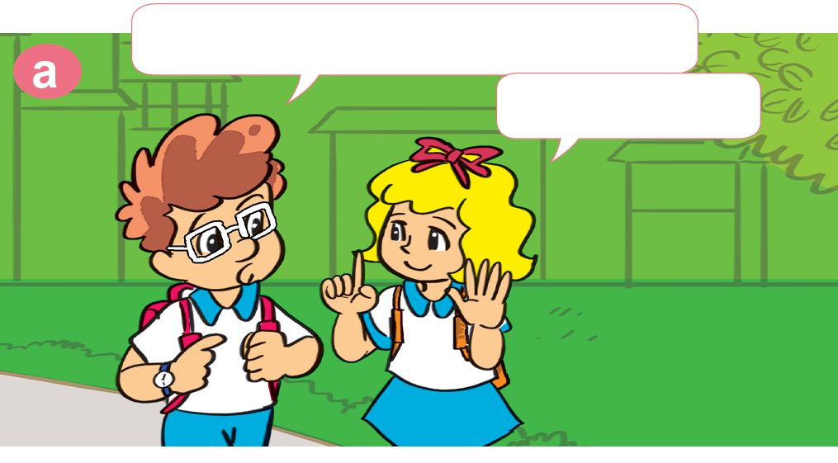
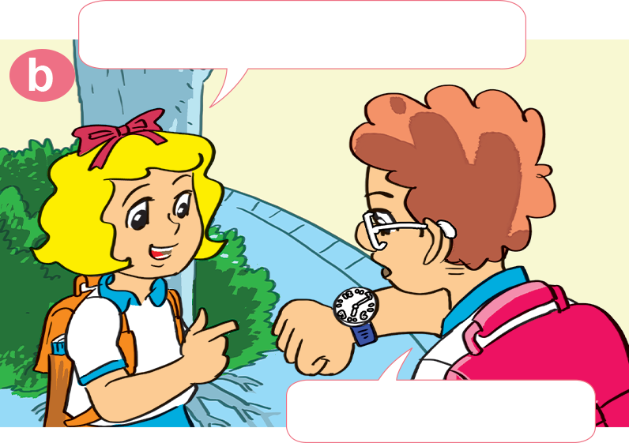
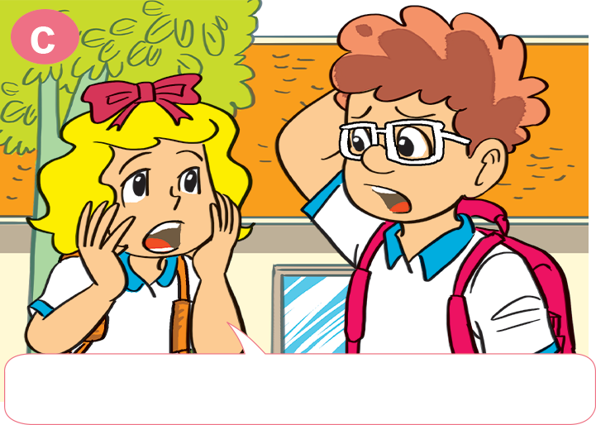
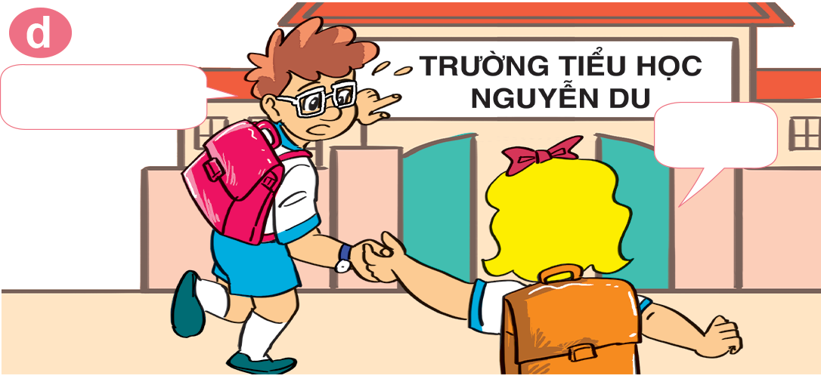
1. Look, listen and repeat.
What time do you get up?
What time is it now?
Six o'clock.
Seven fifteen.
Let's run.
Yes!
Oh no! We're late for school.

Slide 6
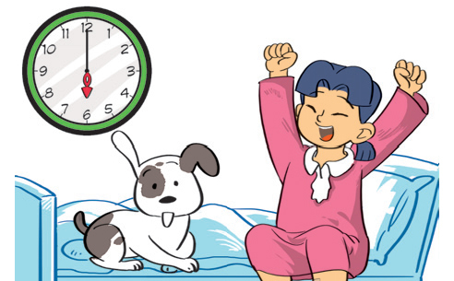
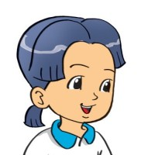
2. Point and say.
get up
What time do you _____________?
get up
six o’clock
I __________ at ____________.

Slide 7
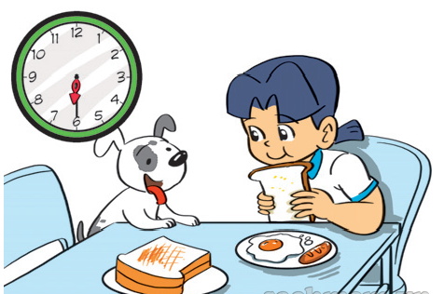
2. Point and say.
What time do you ________________?
have breakfast
I _______________ at ____________.
have breakfast
six thirty

Slide 8
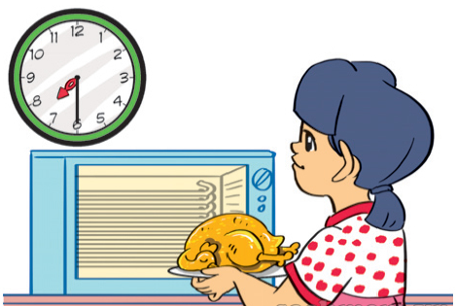
2. Point and say.
have dinner
What time do you _____________?
have dinner
I _____________ at ____________.
seven thirty

Slide 9
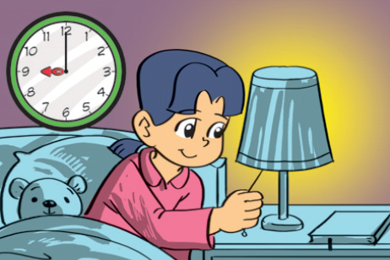
2. Point and say.
go to bed
What time do you _____________?
go to bed
I ____________ at ____________.
nine o’clock

Slide 10
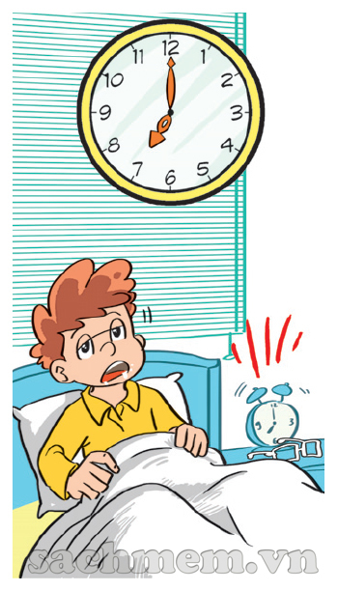
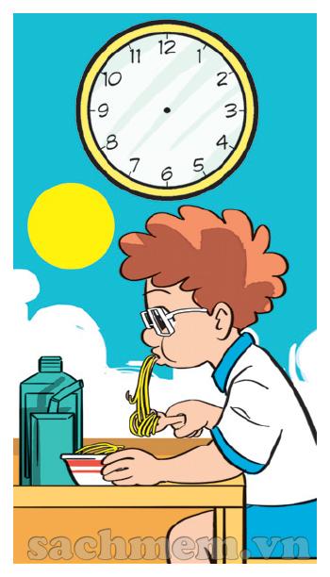
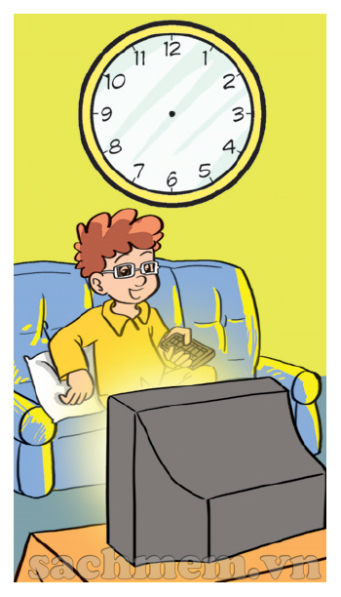
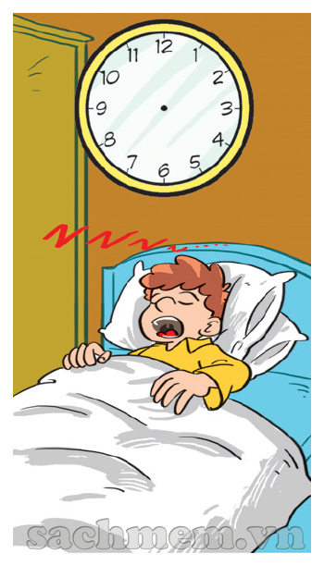
4. Listen and draw the time.
1
2
3
4
5
7:00
7:30
8:15
8:00
9:00

Slide 11
5. Draw and write the time.
1. What time do you get up?
I get up at _________.
2. What time do you go to school?
____________________.
3. What time do you have dinner?
____________________.
4. What time do you go to bed?
____________________.

