Slide 1
Unit 5: Sports and hobbies
Lesson 1.1
Page 68

Slide 2
Objectives
By the end of this lesson, students will be able to…
Vocabulary: badminton, tennis, volleyball, basketball, soccer
Structure: Can you play soccer?
- Yes, I can./No, I can't.

Slide 3
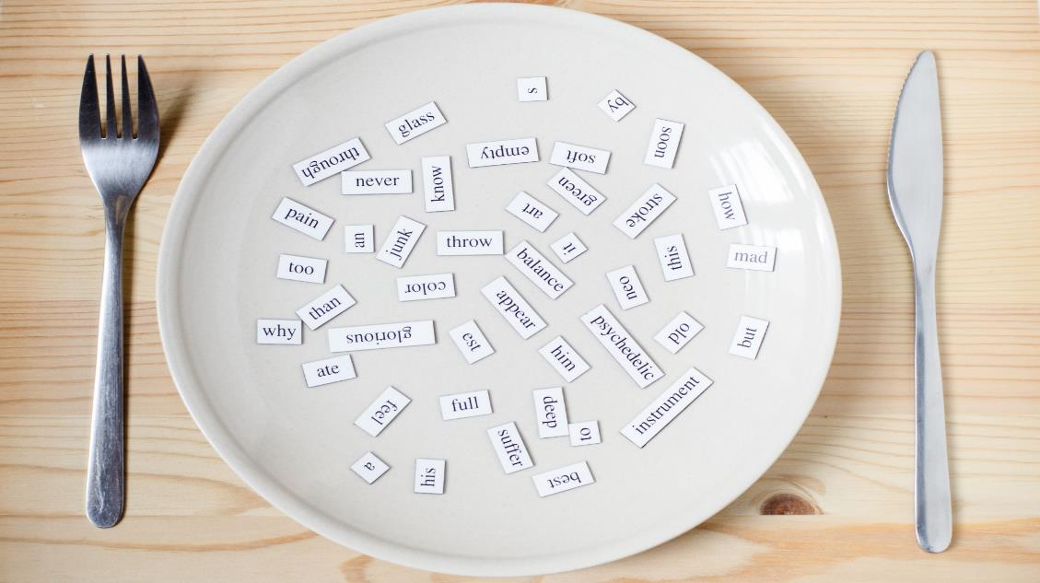
New words
badminton
tennis
volleyball
basketball
soccer

Slide 4
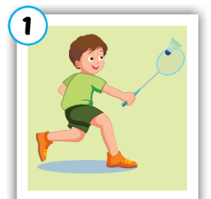
Click on each word to hear the sound.
badminton
/ˈbædmɪntən/
cầu lông

Slide 5
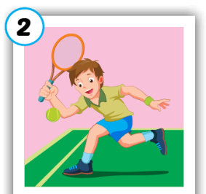
Click on each word to hear the sound.
tennis
/ˈtenɪs/
quần vợt

Slide 6
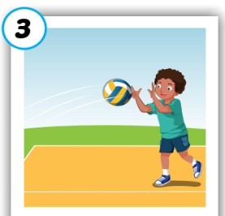
Click on each word to hear the sound.
volleyball
/ˈvɑːlibɑːl/
bóng chuyền

Slide 7
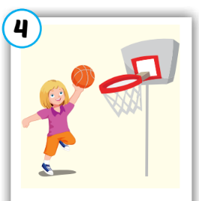
Click on each word to hear the sound.
basketball
/ˈbæskɪtbɑːl/
bóng rổ

Slide 8
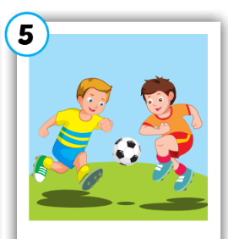
Click on each word to hear the sound.
soccer
/ˈsɑːkər/
bóng đá

Slide 9
Click on each word to hear the sound.
badminton
tennis
volleyball
basketball
soccer
/ˈbædmɪntən/
cầu lông
/ˈtenɪs/
quần vợt
/ˈvɑːlibɑːl/
bóng chuyền
/ˈbæskɪtbɑːl/
bóng rổ
/ˈsɑːkər/
bóng đá

Slide 10
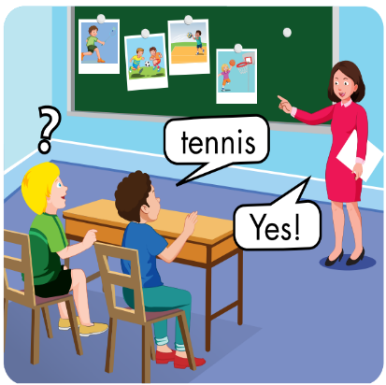

Slide 12
badminton
/ˈbædmɪntən/
cầu lông

Slide 14
volleyball
/ˈvɑːlibɑːl/
bóng chuyền

Slide 16
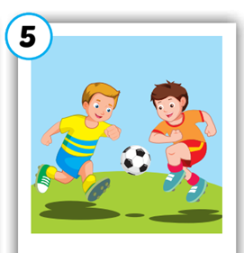

Slide 17
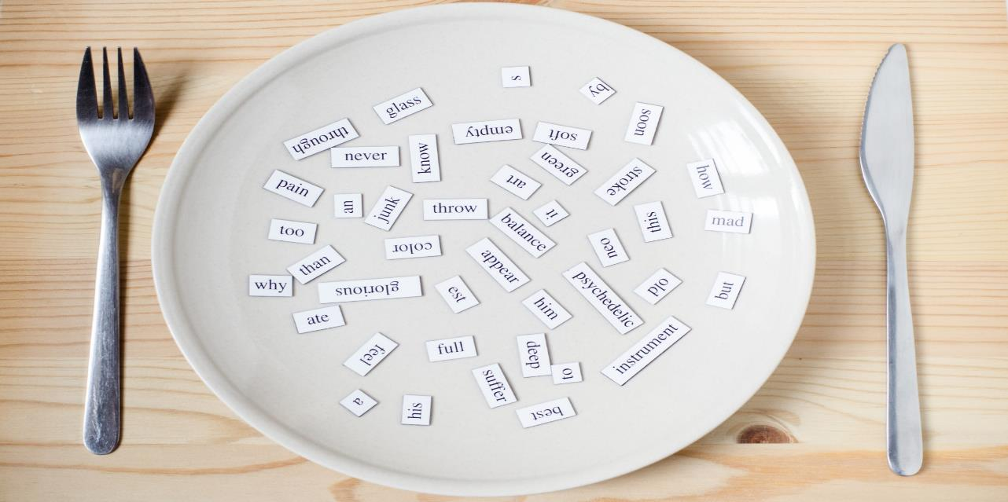
Structures
Can you play soccer?
-Yes, I can./No, I can't.

Slide 18
Today’s lesson
Vocabulary
badminton
tennis
volleyball
basketball
soccer
Structures/ Sentence patterns
Can you play soccer?
- Yes, I can./No, I can't.

Slide 19
Lesson 3
Homework
Do the exercises in Tiếng Anh 3 i-Learn Smart Start Notebook (page 34)
Prepare the next lesson (page 69)

Slide 20
Have a nice day!

