Slide 1
Unit 4: HOME
Lesson 4.3
Page 63

Slide 2
Objectives
By the end of this lesson, students will be able to read a text about one’s home and write a short paragraph about their home.
Vocabulary:
Revision (words about colors and things in a house).
Structure: - I have a desk in my bedroom. - I love my bedroom. It is pink.
It has a picture in it.

Slide 3
WARM UP

Slide 4
Reading

Slide 10
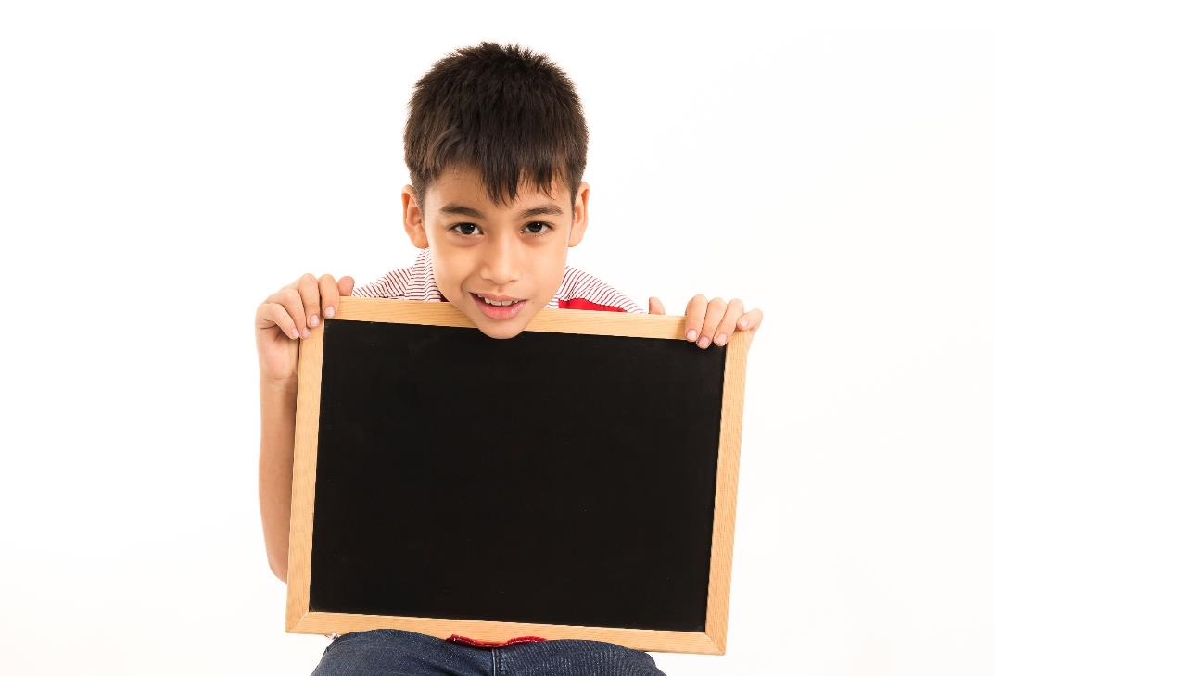
Writing

Slide 11
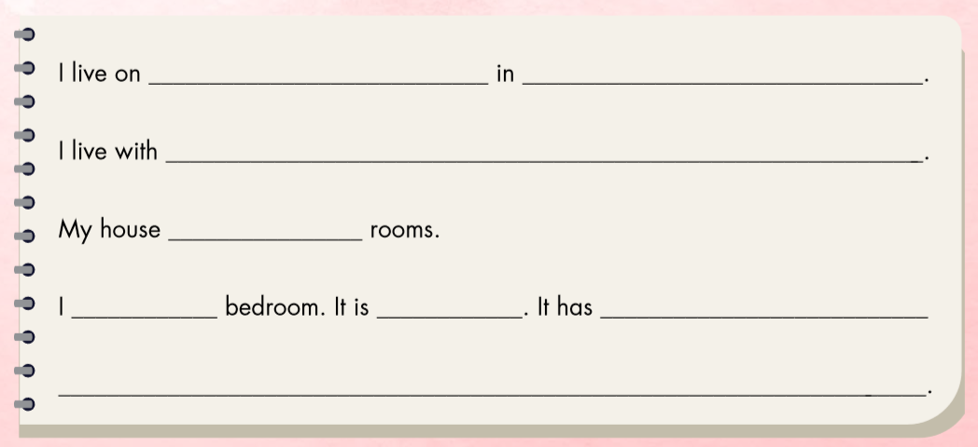

Slide 12
Dương Tự Minh Street
Thái Nguyên
my mother and father.
has six
love my
blue
a bed, a desk, and a closet.

Slide 13
Workbook
p. 43

Slide 14
E. Write about your home. Write 10–20 words.

Slide 15
CONSOLIDATION

Slide 16
WRAP-UP

Slide 17
Homework
Review the vocabularies and sentence patterns. Make sentences using them.
Do the exercises on page 45 (WB)
Prepare the next lesson (page 64 SB)
Play the consolidation games in Tiếng Anh 3 i-Learn Smart Start DHA App on www.eduhome.com.vn
Do the exercises in Tiếng Anh 3 i-Learn Smart Start Notebook on page 31.

Slide 18
Enjoy your day!

Slide 19
Have a nice day!

