Slide 1
Unit 13: Would you like some milk?
Lesson 2 (page 20+21)

Slide 2
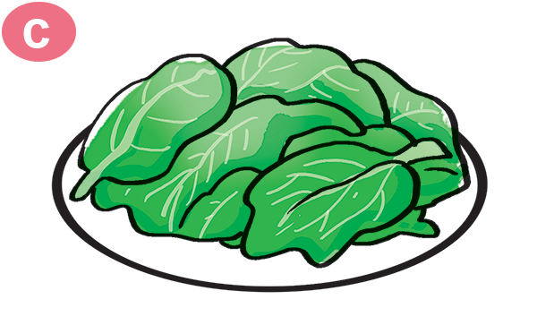
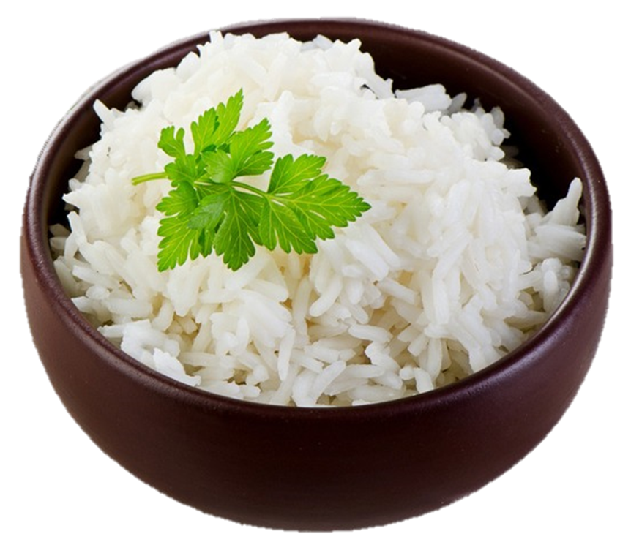
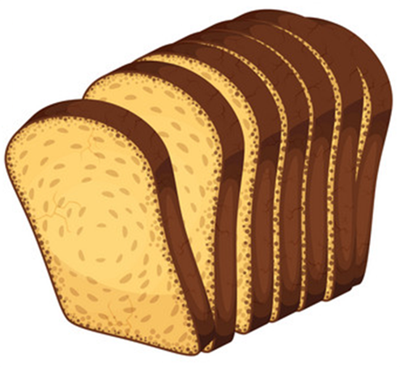
Vocabulary
lemonade
nước chanh
vegetable
rau củ
rice
cơm
bread
bánh mỳ

Slide 3
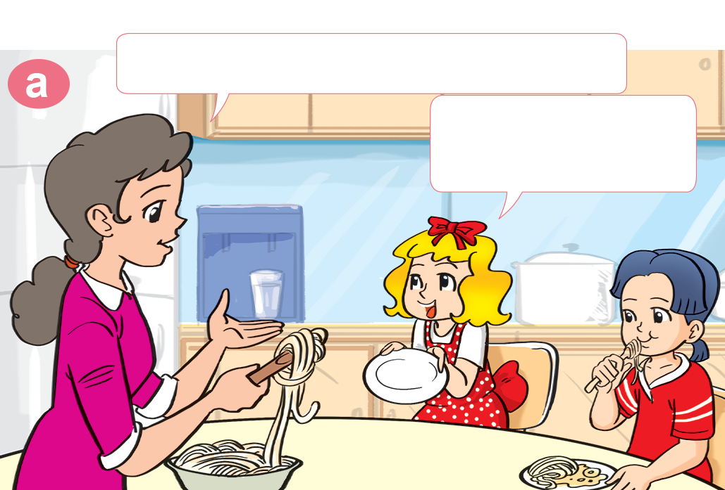
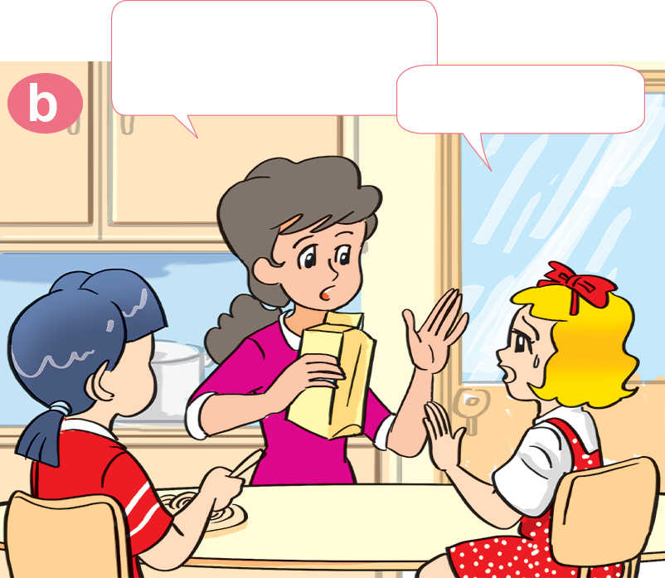
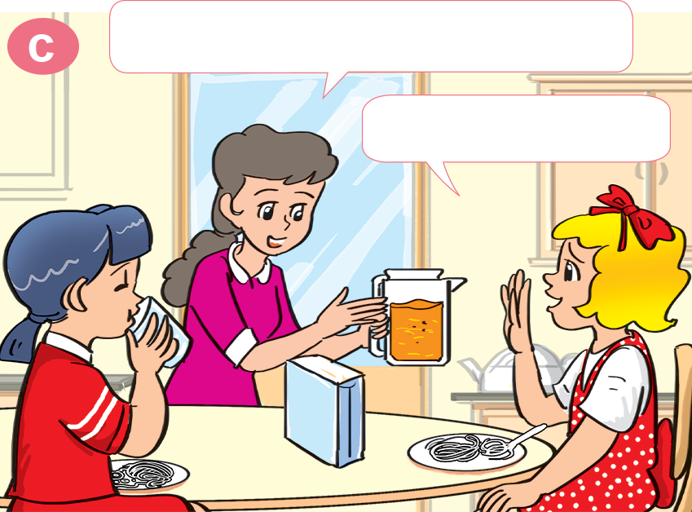
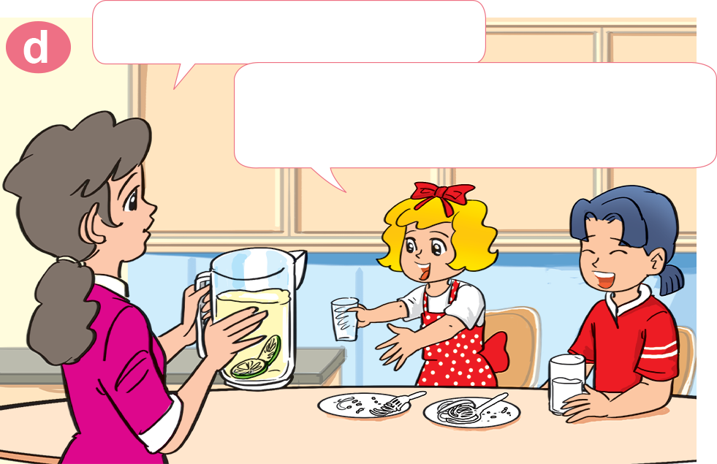
1. Look, listen and repeat.
Would you like some milk?
Would you like some noodles?
No, thanks.
Yes, please. I love noodles.
What about orange juice?
How about lemonade?
Lemonade! Yes, please!
That's my favourite drink.
No, thank you.

Slide 4
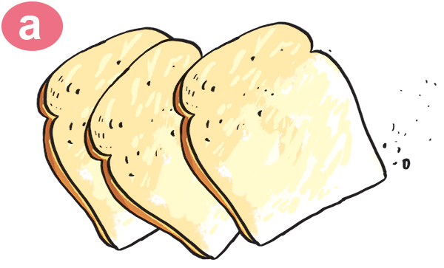
2. Point and say.
bread
Would you like some _________?
Yes, please.

Slide 5
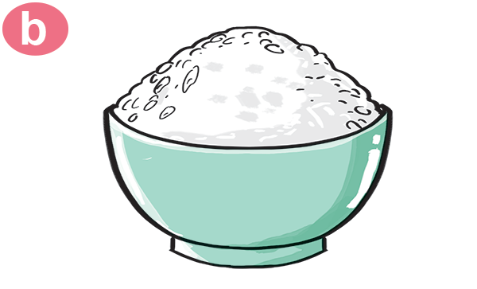
2. Point and say.
rice
Would you like some _________?
Yes, please.

Slide 6
2. Point and say.
Would you like some _________?
vegetable
No, thanks.

Slide 7
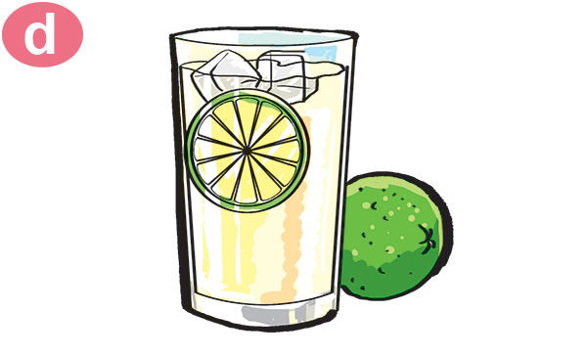
2. Point and say.
Would you like some _________?
lemonade
No, thanks.

Slide 8
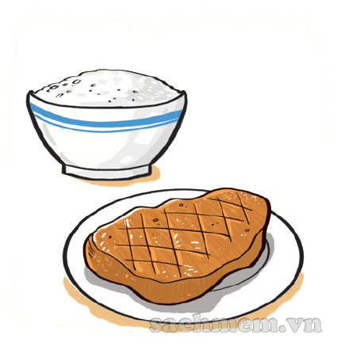
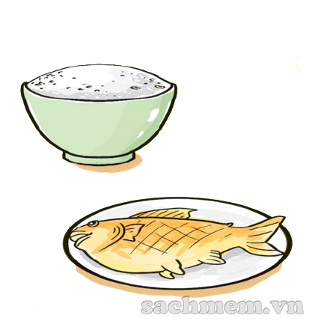
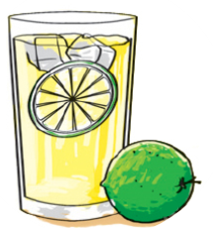
3. Listen and number.
a
3
b
1
c
2
d
4
1
2
3
4

