Slide 1
Unit 15: What would you like to be in the future?
Period 50_Lesson 2 (page 32+33)

Slide 2
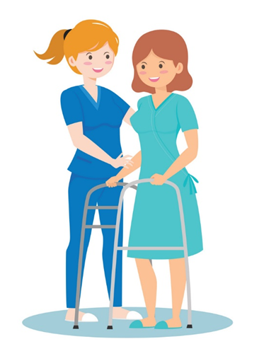
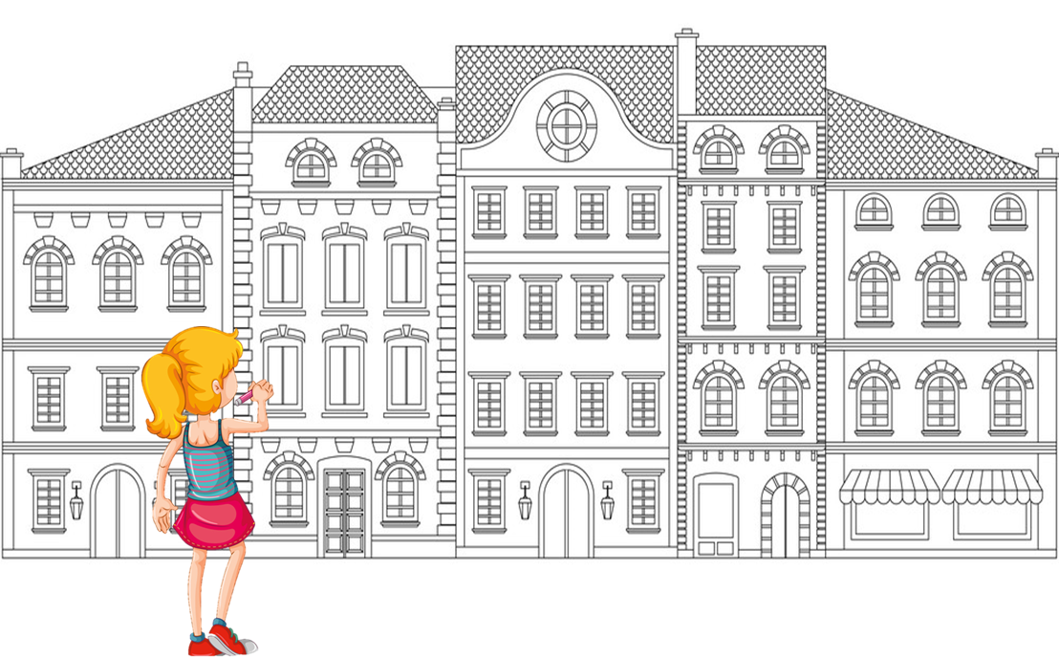
Vocabulary
look after patients
(chăm sóc nhưng bệnh nhân)
write stories for children
1
(viết truyện cho trẻ em)
2
fly a plane
(lái máy bay)
design buildings
3
(thiết kế các tòa nhà)
4

Slide 3
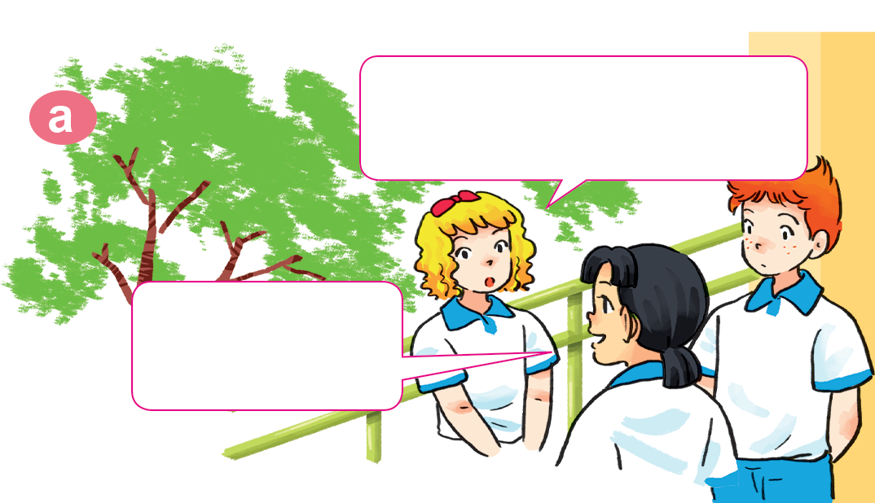
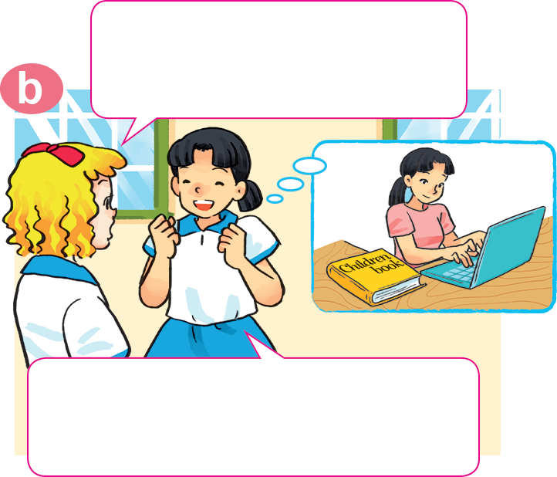
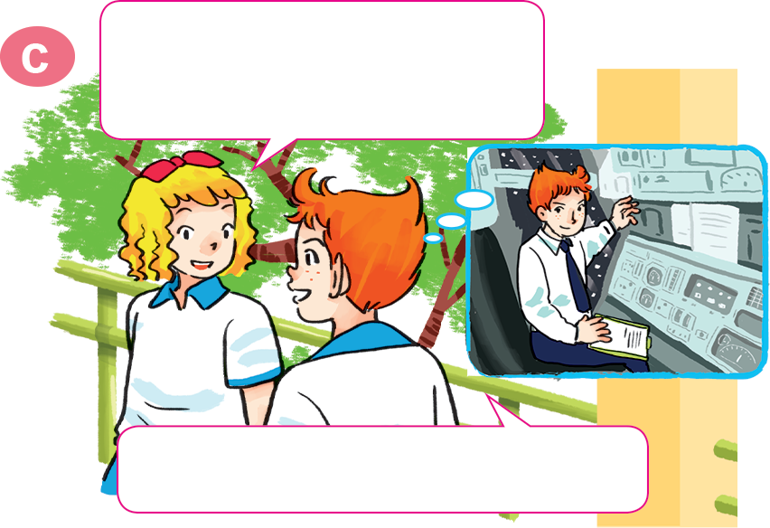
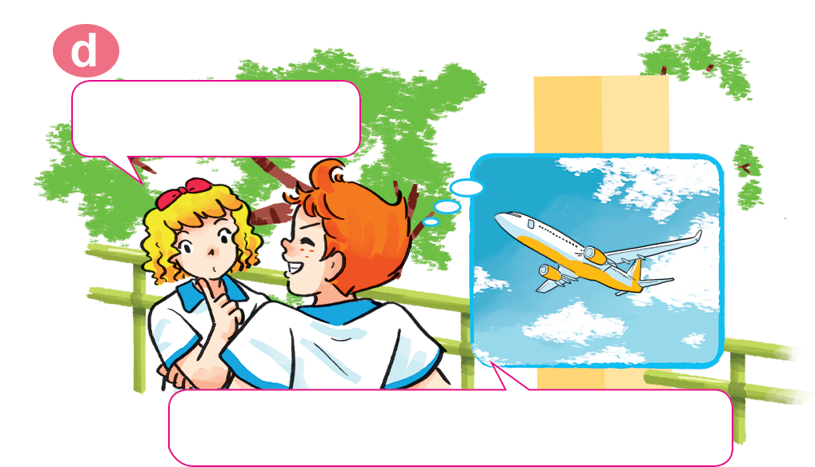
1. Look, listen and repeat.
Why would you like to be a writer?
What would you like to be in the future, Mai?
I'd like to be a writer.
Because I'd like to write stories for children.
Would you like to be a writer too, Tony?
A pilot? Why?
No. I'd like to be a pilot.
Because I'd like to fly a plane.

Slide 4
Model sentences
Why would you like to be _________?
Because I'd like to _____________.
look after patients
design buildings
write stories for children
fly a plane

Slide 5
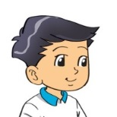
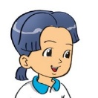
2. Point and say.
a nurse
Why would you like to be _________?
Because I'd like to ________________.
look after patients
A

Slide 6
2. Point and say.
a writer
Why would you like to be _________?
write stories for children
Because I'd like to _____________________.
B

Slide 7
2. Point and say.
a pilot
Why would you like to be _________?
Because I'd like to ________________.
fly a plane
C

Slide 8
2. Point and say.
Why would you like to be ___________?
an architect
Because I'd like to ________________.
design buildings
D

Slide 9
4. Listen and circle a, b or c.
1. Trung would like to be ___________.
a. an engineer b. an artist c. an architect
2. Mai would like to be ___________.
a. a nurse b. a teacher c. a singer
3. Tony would like to ___________.
a. drive a car b. fly a plane c. work in a factory
4. Tom would like to ___________.
a. grow vegetables b. look after flowers c. work on a farm

Slide 10
5. Read and complete.
do nurse look after write hospital
A: What would you like to be in the future?
B: I'd like to be a (1) __________.
A: Why?
B: Because I'd like to (2) __________ patients.
A: Where would you like to work?
B: In a (3) __________ in the countryside.
A: What would you like to (4) _____ in your free time?
B: I'd like to (5) __________ comic stories.
nurse
look after
hospital
do
write

