Slide 1
UNIT 18
What's your
phone number?
Lesson1

Slide 2
VOCABULARY

Slide 3
Vocabulary
mobile phone
/ˌməʊbaɪl ˈfəʊn/
điện thoại di động

Slide 4
Vocabulary
phone number
/ˈfəʊn nʌmbər/
số điện thoại

Slide 5
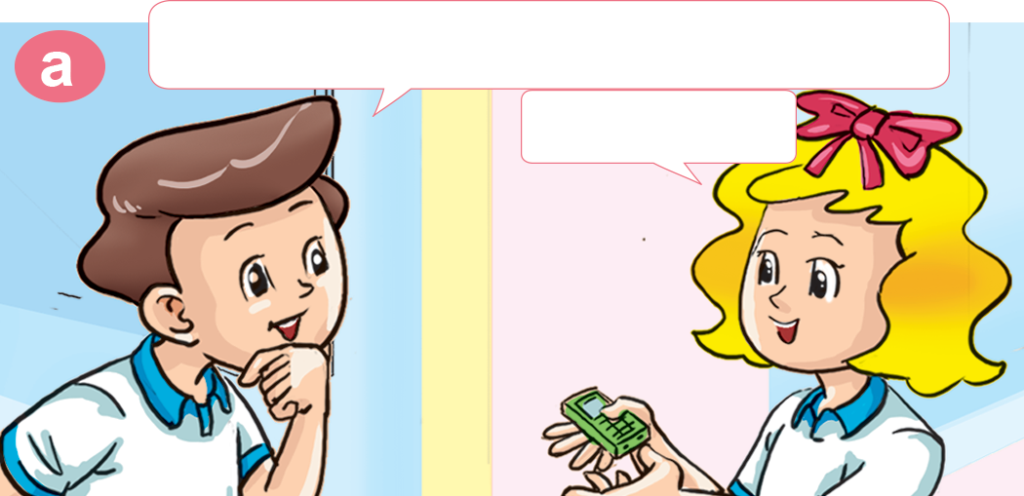
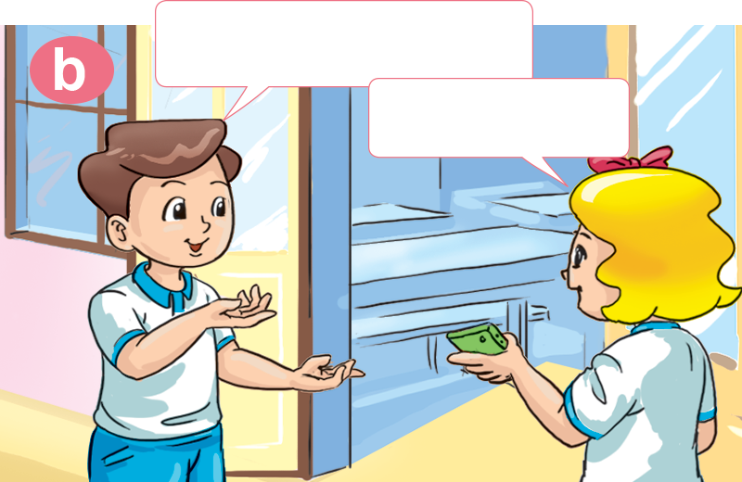
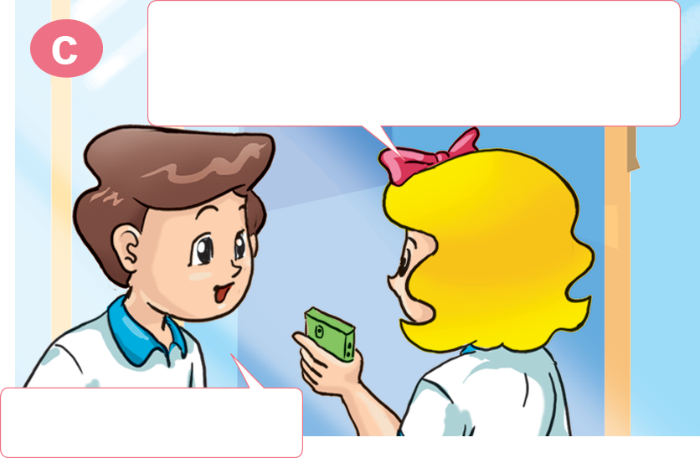
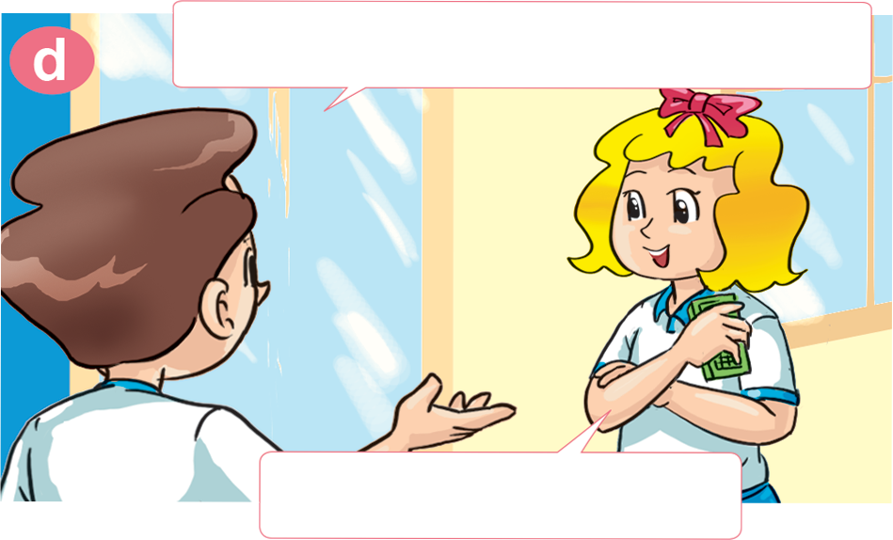
1. Look, listen and repeat.
Wow! You have a mobile phone.
It's very nice!
Yes, I do.
Yes, it is.
It's a birthday present from my father.
What's your phone number?
That's great!
It's 0912 158 657.

Slide 6
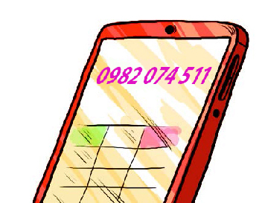
2. Point and say.
What's Lily's phone number?
It's ________________.
0982 074 511

Slide 7
2. Point and say.
What's John's phone number?
It's ________________.
0915 099 995

Slide 8
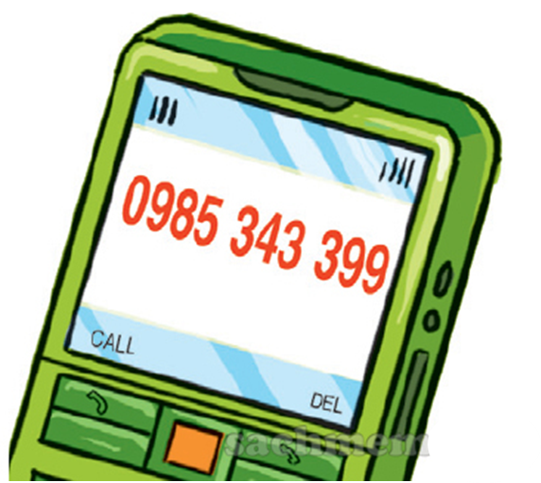
2. Point and say.
What's Saly's phone number?
It's ________________.
0985 343 399

Slide 9
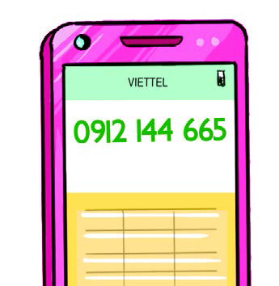
2. Point and say.
What's Sam's phone number?
It's ________________.
0912 144 665

Slide 10
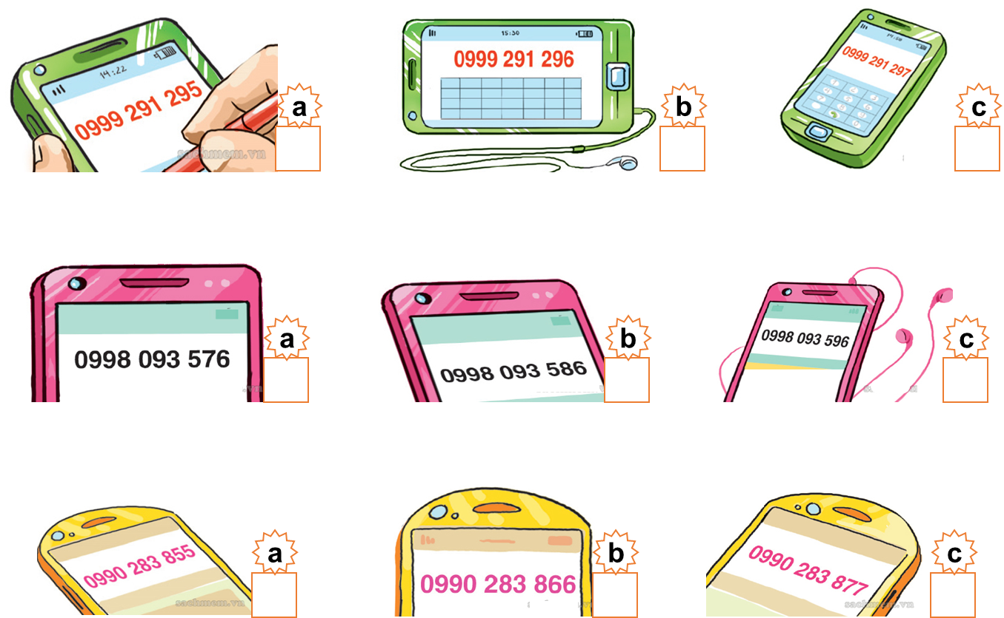
a
b
3. Listen and tick.
1. What's Tom's phone number?
2. What's Mai's phone number?
3. What's Mr Loc's phone number?

Slide 11
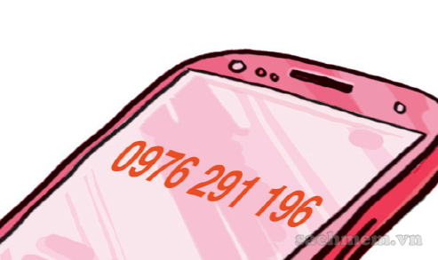
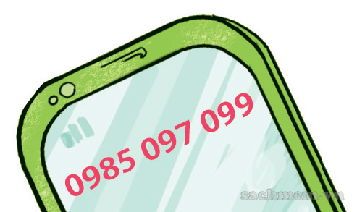
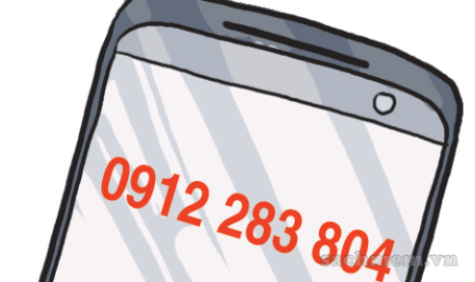
4. Look and write.
What's Joe's phone number?
What's Ann's phone number?
What's Ben's phone number?
It's oh-nine-seven-six, two-nine-one, one-nine-six.
It's oh-nine-eight-five, oh-nine-seven, oh-nine-nine.
It's oh-nine-one-two, two-eight-three, eight-oh-four.

Slide 12
5. Let's sing

Slide 13
5. Let's sing

