Slide 1

Unit 6: Clothes
Review& Practice 2
Page 95

Slide 2
Lesson Outline
Warm-up
Speaking
Consolidation
Wrap-up

Slide 3
Objectives
By the end of this lesson, students will be able to review talking about what clothes they want, talking about what they're wearing, and asking and answering about their clothes.
Vocabulary: review all vocabularies learnt in Unit 6.
Speaking: Practice asking and answering questions about clothes, about what they are wearing.

Slide 4

WARM UP

Slide 5
belt
thắt lưng
scarf
khăn choàng
shirt
áo sơ mi
skirt
váy
dress
đầm, áo đầm

Slide 6
jacket
áo khoác
boots
đôi ủng
jeans
quần jean
pajamas
quần áo ngủ
skiing
trượt tuyết

Slide 7
tie
cà vạt
polo shirt
áo thun có cổ
sneakers
giày thể thao
socks
đôi tất
pants
quần dài

Slide 8

It’s time to learn …

Slide 9

Speaking

Slide 10
PRE-SPEAKING
Rearrange these words to make a sentence.
do want what you ?
What do you want?

Slide 11
PRE-SPEAKING
Rearrange these words to make a sentence.
What you are wearing ?
What are you wearing?

Slide 12
PRE-SPEAKING
Rearrange these words to make a sentence.
those your Are jeans ?
Are those your jeans?

Slide 13
PRE-SPEAKING
Rearrange these words to make a sentence.
aren’t No, they
No, they aren’t.

Slide 14
PRE-SPEAKING
Rearrange these words to make a sentence.
want shorts I some
I want some shorts.

Slide 15
PRE-SPEAKING
Rearrange these words to make a sentence.
‘m a I T-shirt green wearing
I’m wearing a green T-shirt.

Slide 16

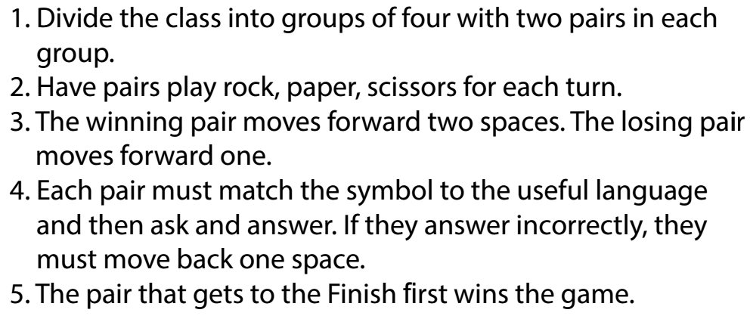
HOW TO PLAY?

Slide 17
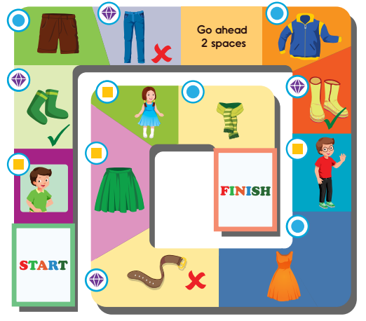



A: What are you wearing?
B: I’m wearing a green
T-shirt.
A: Are those your socks?
B: Yes, they are.
A: What do you want?
B: I want some shorts.

Slide 18
A: Are those your jeans?
B: No, they aren’t.

Slide 19
A: What do you want?
B: I want a jacket.
A: Are those your boots?
B: Yes, they are.
A: What are you wearing?
B: I’m wearing a red polo shirt and black jeans.

Slide 20
A: What do you want?
B: I want a dress.
A: Is that your belt?
B: No, it isn’t.
A: What are you wearing?
B: I’m wearing a green skirt.

Slide 21
A: What are you wearing?
B: I’m wearing a blue drees.
A: What do you want?
B: I want a scarf.

Slide 22



• I can talk about different clothes.
• I can say what clothes I want.
• I can say what clothes I’m wearing.

Slide 23

CONSOLIDATION

Slide 24
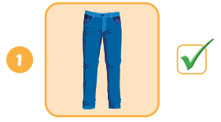
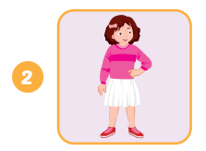
Look and write.
A: Are your ?
B: Yes, they are.
those
jeans
A: What’s she ?
B: She’s wearing a pink
and a white .
wearing
sweater
skirt

Slide 25
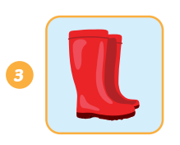
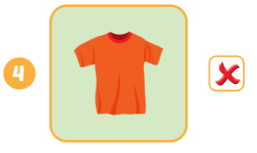
Look and write.
A: What want?
B: I want .
do you
some boots
A: your ?
B: .
Is that
T-shirt
No, it isn’t

Slide 26

WRAP-UP

Slide 27
Lesson 3
Today’s lesson
Vocabularies
Review all vocabularies learnt in Unit 6
Speaking
Practice asking and answering questions by clothes

Slide 28
Lesson 3
Homework
Review the vocabularies and structure; and make sentences using them.
Do the exercises in Tiếng Anh 3 i-Learn Smart Start WB (page 67).
Do the exercises in Tiếng Anh 3 i-Learn Smart Start Notebook (page 45).
Prepare the next lesson (page 96 SB).
Play games in Tiếng Anh 3 i-Learn Smart Start DHA App on www.eduhome.com.vn

Slide 29
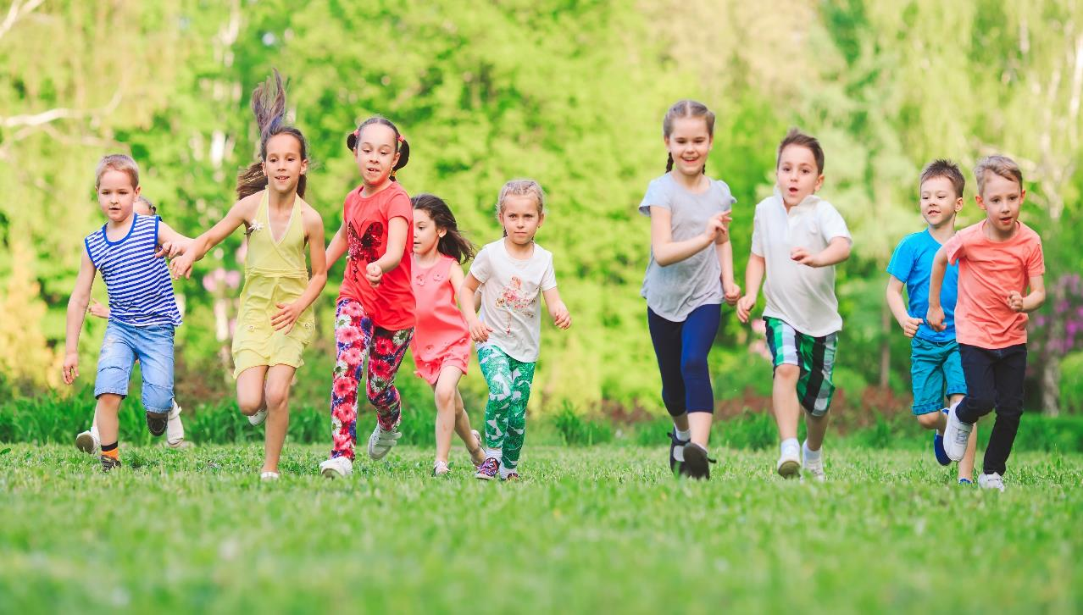
Have a nice day!

