Slide 1
Unit 8: What subjects do you have today?
Lesson 3
Teacher: Ngoc Khue

Slide 2
Objectives
- Use the words and phrases related to the School subjects.
- Pronounce the sounds of the letters “ct ” and “cts”.
Mục đích bài học:
Sử dụng các từ và cụm từ liên quan đến chủ đề các môn học ở trường học.
Phát âm chính xác 2 âm sau: “ct” và “cts”.

Slide 3
Table of contents
01
02
Warm Up
Phonics
03
04
Practice
Homelink

Slide 4
01. Warm Up

Slide 5
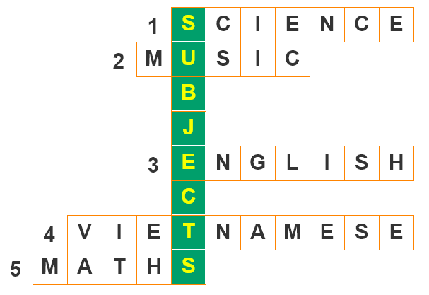
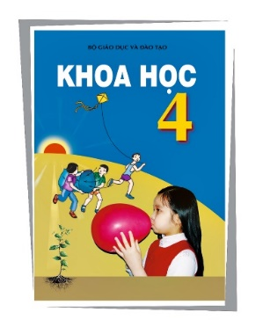
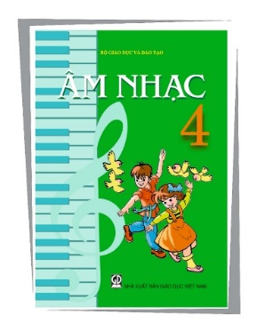
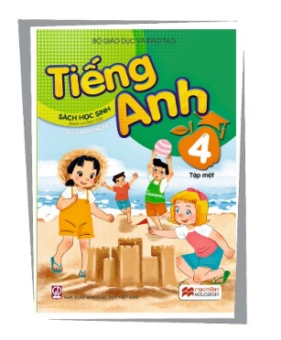
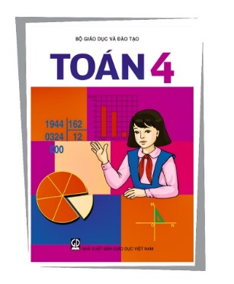
A. Let’s play
Write the names of the subjects.

Slide 6
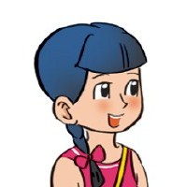
Structures:
Hỏi và trả lời khi nào bạn có môn này:
When do you have ____________?
I have it on _______.
+ môn học
+ thứ
(Khi nào bạn có môn__?)
(Tớ có vào thứ ______.)
Hỏi và trả lời ai dạy bạn môn học nào đó:
Who is your _________ teacher?
+ môn học
It’s Mr./Miss
__________.
+ tên giáo viên
(Ai là giáo viên môn ____?)
(Đó là thầy/cô ____)

Slide 7
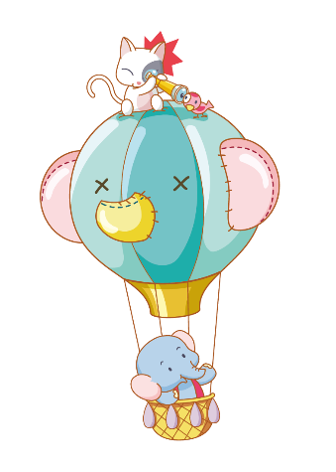
Let’s talk
What subjects do you
have today?
I have _________.
When do you have ________?
I have it on _____.
Who is your ______ teacher?
It’s ________.

Slide 8
02. Phonics

Slide 9
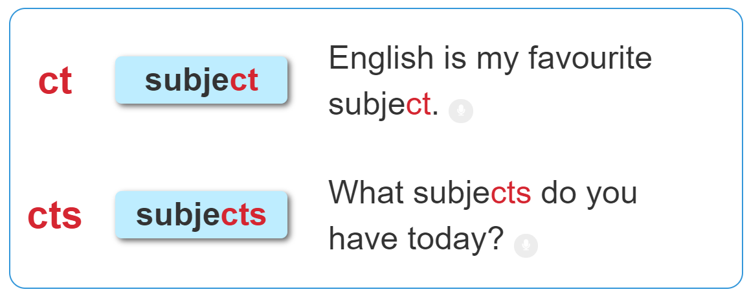
1. Listen and repeat.

Slide 10
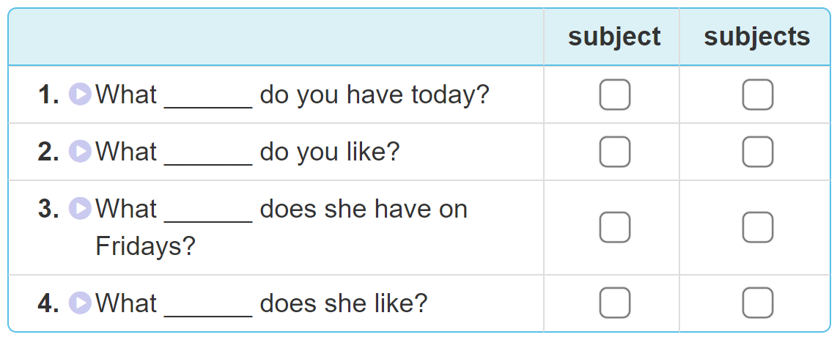
2. Listen and tick. Then write and say aloud

Slide 11
03. Practice

Slide 12
3. Let’s chant

Slide 13
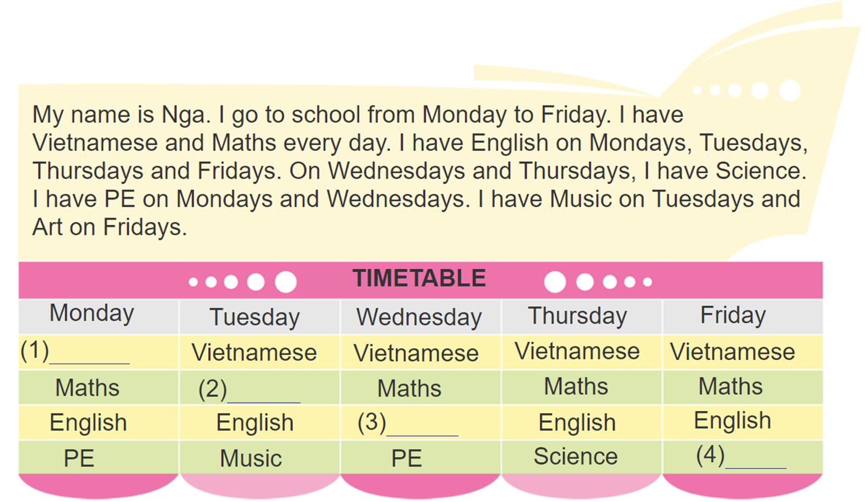
4. Read and complete
Vietnamese
Maths
Science
Art

Slide 14
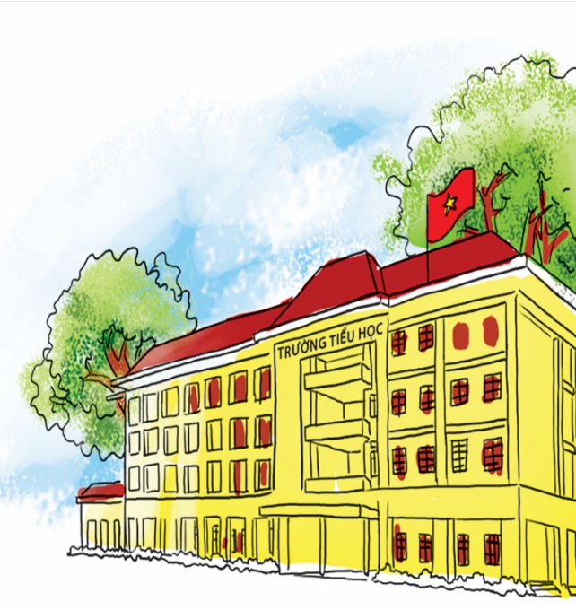
5. Write about you and your school subjects:
I am a pupil at ________________ Primary School.
I go to school from Monday to __________.
At school, I have Vietnamese, Maths, ____
_________.
I have English on____________.
My favourite subject is____________.
Thanh Am
Friday
English,
Music, Art, PE, IT and Science.
Mondays and Thursdays.
Music.

Slide 15
6. Let’s sing

Slide 16
04. Homelink

Slide 17
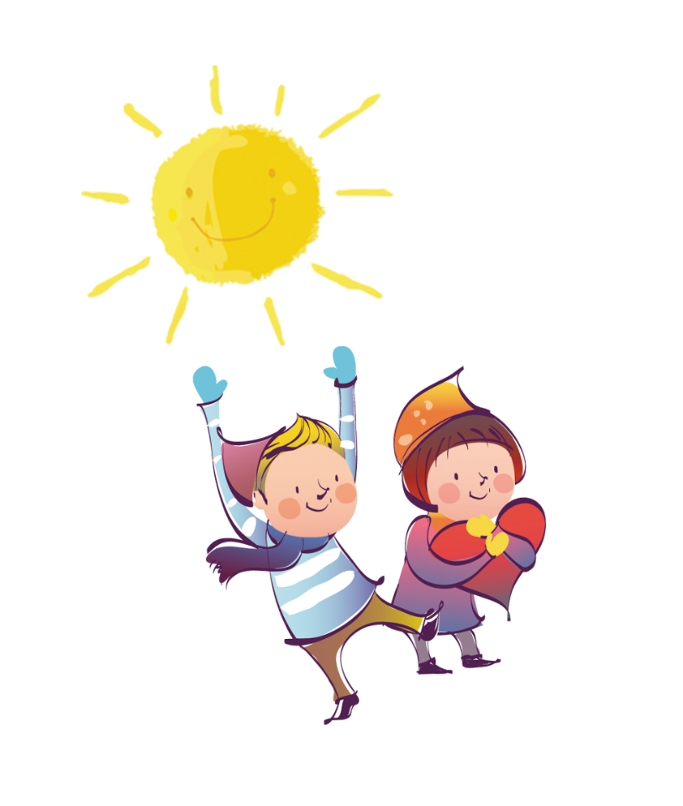
Thursday, December 1st 2022 Unit 8: What subjects do you have today? Lesson 3
1. Phonics:
ct | cts
subject | subjects
2. Homework:
Learn by heart the phonics.
Do WB (SBT): part A-1,2 (page 32)

Slide 18
Thanks

